Slide 1
ThingBook
WeChat successful because:
1. An integrated content platform for browsing
2. A content-driven platform for shopping
Problems
Solution
Key messages
Presentation: video, mobile, slide.
Notes:
With the thingBook we want to put the user in the center of :
“Quick and relevant information, Machines, and Manufacturers”
We want to
“Provide additional values to customers with our digital services”
“An easy way to implement a service chatbot, or easy access to our APIs”
“or product upgrades on the Bosch marketplace”
For the connected industry:
we can offer an unified Control of machines via unique user interface (chat-like)
We can offer a platform for the manufacturing staff to interact with their machines or colleagues

Slide 2






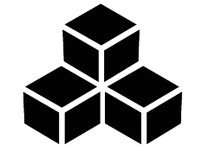

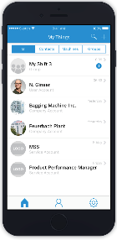

ThingBook
Machine/IoT Cloud
Machine
(digital twin)
Manufacturer
Marketplaces
API
Consumers
Manufacturing staff
Dealer and Service
Companies
Notes:
With the thingBook we want to put the user in the center of :
“Quick and relevant information, Machines, and Manufacturers”
We want to
“Provide additional values to customers with our digital services”
“An easy way to implement a service chatbot, or easy access to our APIs”
“or product upgrades on the Bosch marketplace”
For the connected industry:
we can offer an unified Control of machines via unique user interface (chat-like)
We can offer a platform for the manufacturing staff to interact with their machines or colleagues

Slide 3
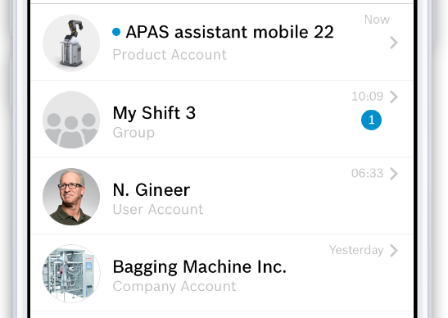
ThingBook
Account concept is comparable to other messaging apps (Whatsapp, WeChat):
Public accounts (e.g. Manufacturer / Service companies)
Product Account
Service Account
Company Account
User Account
Groups (Public & Private)
Notes:
Our account concept is similar to the leading messenger applications, we have two main types of accounts:
User Accounts
Public Accounts
Our Public accounts have three different sub-types:
Product, for the actual instances of „things“ or machines like the robot in the image.
Service Accounts, for dealer and service companies looking for a better communication mechanism.
Company, For manufacturers looking to promote families of products or a direct communication channel with customers.

Slide 4
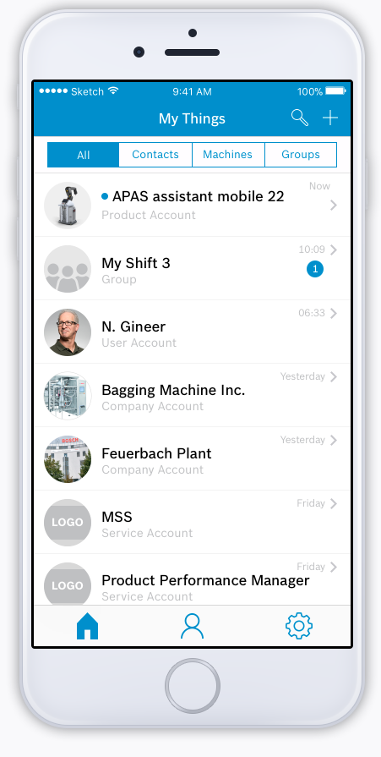
ThingBook Messenger
5
CI/DAD5 | 2018-01-15
© Robert Bosch GmbH 2018. All rights reserved, also regarding any disposal, exploitation, reproduction, editing, distribution, as well as in the event of applications for industrial property rights.
Notes:
The new version of the ThingBook is a messaging app, really bringing people, products and services together.
** CHANGE SLIDE **

Slide 5
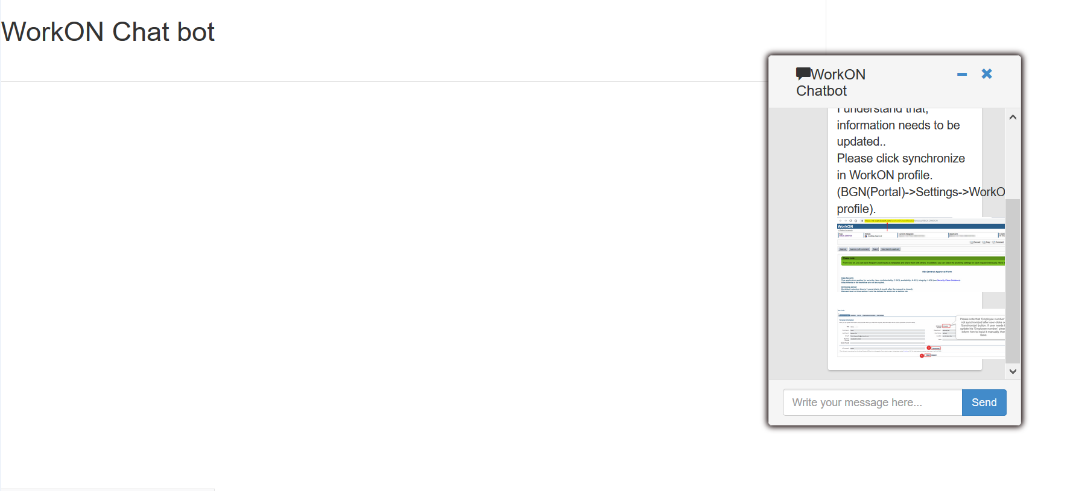
Help CI-Hotline handling the WorkON ticket
Improve the processing speed
FAQ:
Help to reduce effort for support team
Consulting user
Can embedded in Webapp
Can integrate with ThingBook by create a public account
6
Internal | CI/ACM-NC | 13.12.2017
© Robert Bosch GmbH 2017. All rights reserved, also regarding any disposal, exploitation, reproduction, editing, distribution, as well as in the event of applications for industrial property rights.

Slide 6
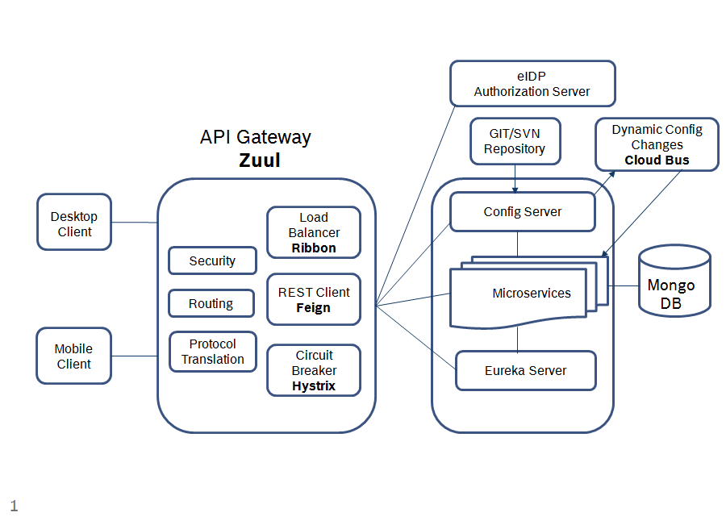
ThingBook Proposed Architect
Notes:
Salient Components of the architecture
The API Gateway is itself a Microservice which uses Netfix library, Zuul.
The API Gateway authenticates users by communicating with eIDP authorization service.
Using an API gateway has the following advantages:
Insulates the clients from how the application is partitioned into microservices
Insulates the clients from the problem of determining the locations of service instances
Provides the optimal API for each client
Reduces the number of requests/roundtrips. For example, the API gateway enables clients to retrieve data from multiple services with a single round-trip. Fewer requests also means less overhead and improves the user experience. An API gateway is essential for mobile applications.
Simplifies the client by moving logic for calling multiple services from the client to API gateway
Config Server also known as Spring Cloud Config which provides server and client-side support for externalized configuration in a distributed system. With the Config Server you have a central place to manage external properties for microservices across all environments.Miscoservices get their respective configuration details including Eureka server url from the config server.
Open points for discussion
Security
API Gateway microservice serves as single stop shop. It is proposed to have user authentication functionality in API Gateway microservice and other services are free from authentication but can use the JWT token for extracting user information for other purposes. However we need to decide if this is fine for not having authentication check in the individual services.
It is assumed that variation of mobile and desktop client in terms of requirements between is not significant. If the variation is significant, we can have 2 API Gateways. One for mobile client and the other for desktop client.
Dynamic configuration changes to services
If there is a need to make changes to configuration such as profile and database properties on the fly, we can use Spring Cloud Bus which serves as a AMQP broker.
Database
It is assumed to have a data store for each service unless otherwise specified.
MongoDB is proposed data store at the moment as it is flexible and suitable to embrace evolving requirements

Slide 7
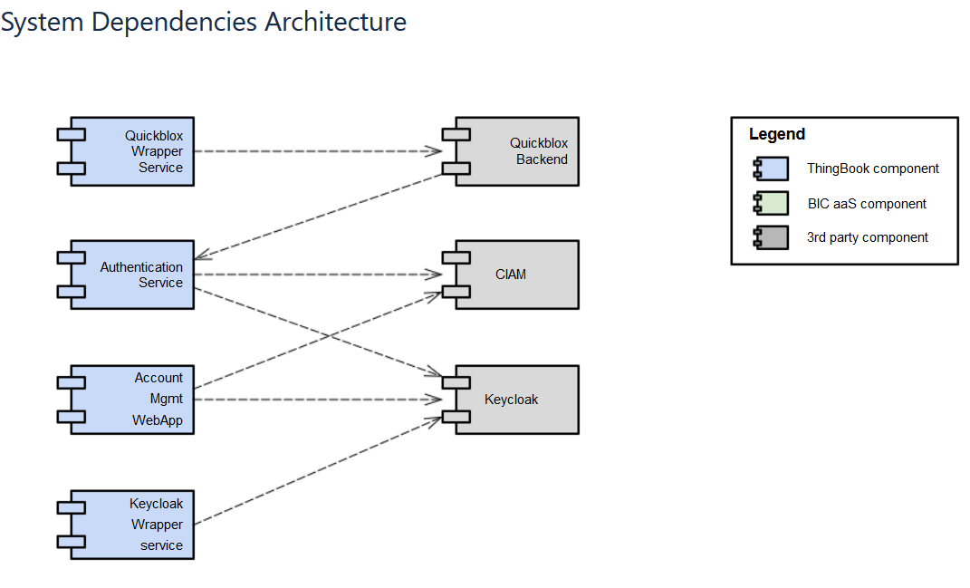
ThingBook Messenger Depolyment View
Notes:
Salient Components of the architecture
The API Gateway is itself a Microservice which uses Netfix library, Zuul.
The API Gateway authenticates users by communicating with eIDP authorization service.
Using an API gateway has the following advantages:
Insulates the clients from how the application is partitioned into microservices
Insulates the clients from the problem of determining the locations of service instances
Provides the optimal API for each client
Reduces the number of requests/roundtrips. For example, the API gateway enables clients to retrieve data from multiple services with a single round-trip. Fewer requests also means less overhead and improves the user experience. An API gateway is essential for mobile applications.
Simplifies the client by moving logic for calling multiple services from the client to API gateway
Config Server also known as Spring Cloud Config which provides server and client-side support for externalized configuration in a distributed system. With the Config Server you have a central place to manage external properties for microservices across all environments.Miscoservices get their respective configuration details including Eureka server url from the config server.
Open points for discussion
Security
API Gateway microservice serves as single stop shop. It is proposed to have user authentication functionality in API Gateway microservice and other services are free from authentication but can use the JWT token for extracting user information for other purposes. However we need to decide if this is fine for not having authentication check in the individual services.
It is assumed that variation of mobile and desktop client in terms of requirements between is not significant. If the variation is significant, we can have 2 API Gateways. One for mobile client and the other for desktop client.
Dynamic configuration changes to services
If there is a need to make changes to configuration such as profile and database properties on the fly, we can use Spring Cloud Bus which serves as a AMQP broker.
Database
It is assumed to have a data store for each service unless otherwise specified.
MongoDB is proposed data store at the moment as it is flexible and suitable to embrace evolving requirements

Slide 8
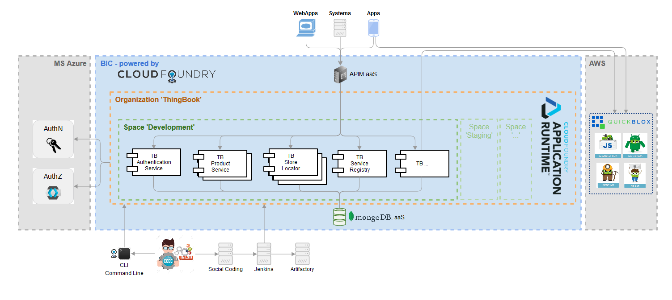
ThingBook MicroServices Deployment View

Slide 9
ThingBook Key messages
A mobile messenger app where users connect with their things, services, companies and peers.
The user is in the center of: “Quick and relevant information, Machines, and Manufacturers”
As a company you can use ThingBook to deliver dedicated digital services to their customers with a short time to market.
Offer a platform for the manufacturing staff to interact with their machines or colleagues
Offer an unified Control of machines via unique user interface (chat-like)

