Slide 1
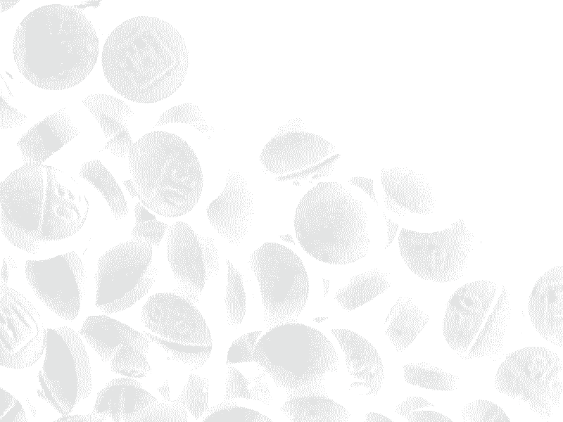
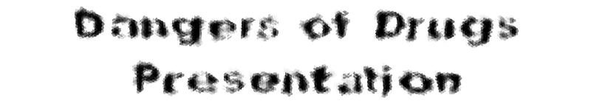

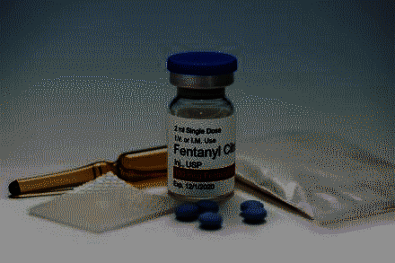

Members (solo project) : Varik Nguyen – PowerPoint, Research, VFX, …
Fonts used : Arial, Arial Black, Smash, DpQuake, SimSun, BankGothic
Background Image : Fentanyl in tablets form

Slide 2

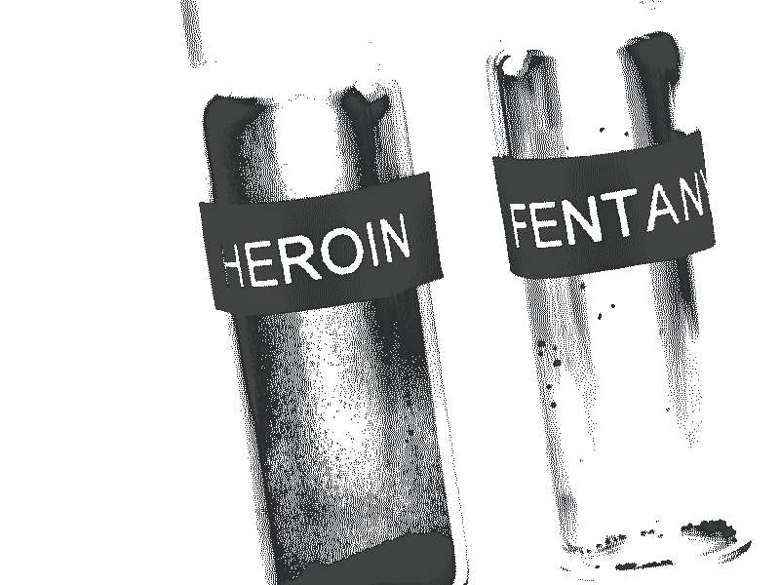

What is Fentanyl ?
Fentanyl is a powerful synthetic opioid that is similar to morphine but is 50 to 100 times more potent.[1] It has the ability to relief pain and is used to treat severe pain medically if the user is physically tolerant to opioids [2]
Fentanyl is available in form of tablets, injectable liquid, powder,... [2]
Misusing Fentanyl carries high risk of overdose and death [2] as 2 milligrams of fentanyl is considered a lethal dose [3]
[1] : https://nida.nih.gov/publications/drugfacts/fentanyl
[2] : https://drugfree.org/drugs/what-is-fentanyl/ [3] : texas.gov – “Fentanyl: One Pill Kills”
Background Image : Comparison of lethal dosages of Heroin and Fentanyl (Fentanyl is more deadly)

Slide 3
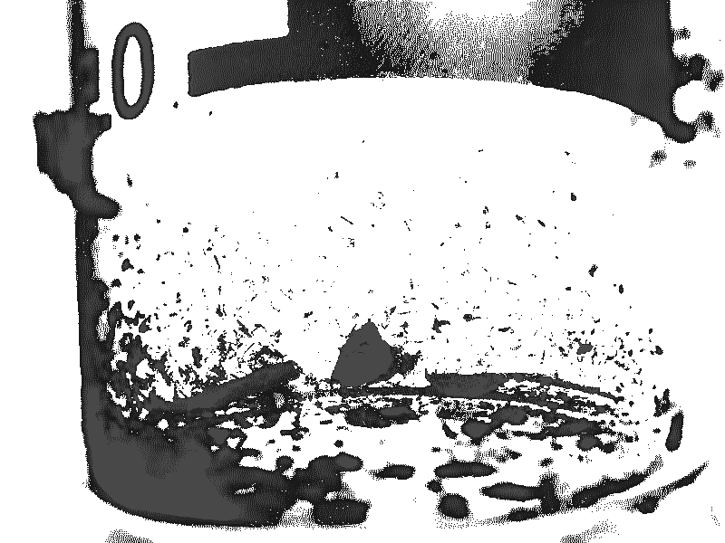

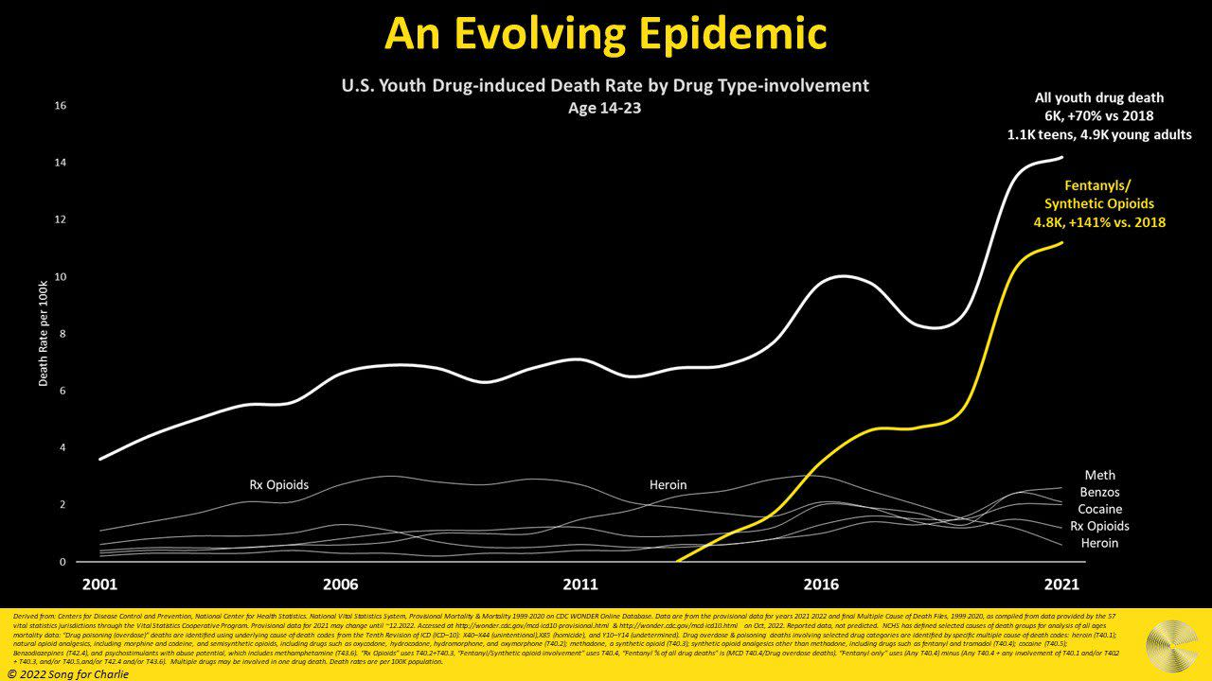
Why talking about Fentanyl ?
With illegal-manufactured Fentanyl being found in drugs like Heroin, Cocaine, Meth and fake pills [1], deaths by Fentanyl has been rapidly increasing as of lately :
As fatalities increase, the
epidemic has been made aware by ...
communities, organizations, schools,
etc... (as well as this presentation)
(Remember when a warning of Fentanyl is
displayed as a desktop background on school laptops
for a period of time ?)
Chart of drug-related deaths, deaths by opioids/fentanyl and others
[1] : texas.gov – “Fentanyl: One Pill Kills”
[image] : https://www.songforcharlie.org/page/current-data [3rd page]
Background Image : Lethal dose of Fentanyl shown in beaker (by drugfree.org)

Slide 4


How does Fentanyl changes one’s body ?
To relief pain, Fentanyl can cause muscle rigidity, tightening chest muscles which makes it harder to breathe. Other symptoms being dizziness, euphoria, nausea and respiratory depression which can cause low oxygen levels and is the most dangerous side-effect [1]
If overdosing on Fentanyl, it could affect the body by weakening the user’s breathing, reducing consciousness, choking, causing smaller pupils and discolored skin, ... [1]
>> More detailed effects>>
[1] : https://www.dallasnews.com/news/2023/09/03/visualizing-fentanyls-swift-dangerous-effects-on-the-brain-and-body/
Background Image : “The Faces of Fentanyl” exhibit of DEA, containing faces of people died by Fentanyl

Slide 5
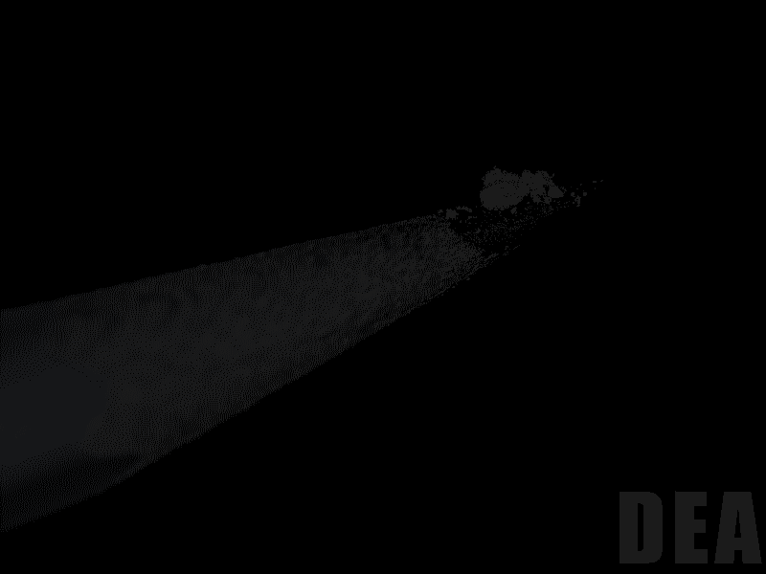
does Fentanyl changes one’s body
Effects of Fentanyl :
(1/2)
>> More effects >>
[citation] : https://www.amazon.com/Harmful-Effects-Fentenyl-Educational-Laminated/dp/B09TCBGHH4
Human model : System Shock 1 (1994)
Background Image : Lethal dosage of Fentanyl on pencil tip (image by DEA)

Slide 6
does Fentanyl changes one’s body
Effects of Fentanyl :
(2/2)
>> Next page (What can we do ?) >>
[citation] : https://www.amazon.com/Harmful-Effects-Fentenyl-Educational-Laminated/dp/B09TCBGHH4
Human model : System Shock 1 (1994)
Background Image : Lethal dosage of Fentanyl on pencil tip (image by DEA)

Slide 7
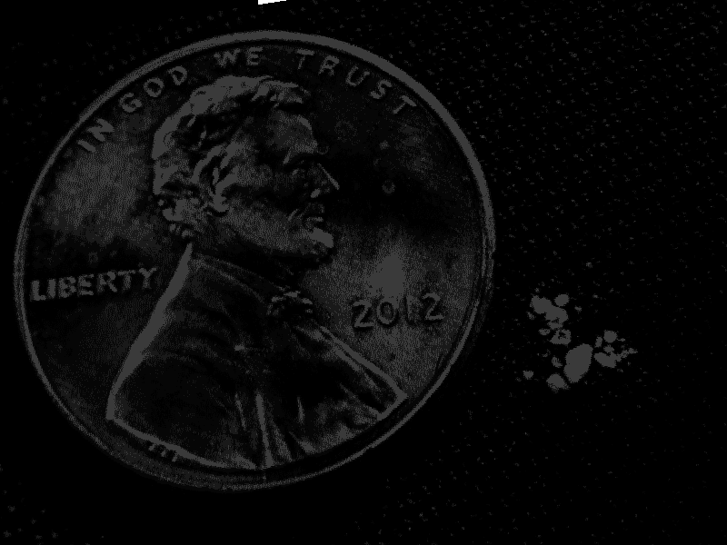
can we do
Protecting your loved ones
If you know/suspect is using/at risk of using Fentanyl, you can increase with these strategies :
→ Carry naloxone (opioid overdose reverse medicine) at all times in case of an accidental overdose (higher quantities might be necessary)
→ Test any illicit substances with Fentanyl test strips before using
→ Use clean, sterile needles to reduce disease transmission (HIV for example)
[from] : https://drugfree.org/drugs/what-is-fentanyl/
Background Image : Lethal dosage of Fentanyl (right) next to a U.S penny (left)

Slide 8

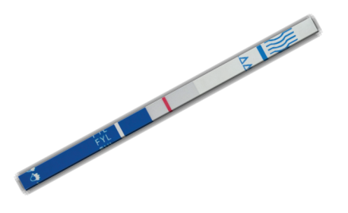
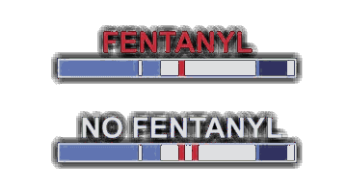
can we do
Test strip appearance
Fentanyl Test Strips
Many substances have Fentanyl in them (drugs, counterfeit pills). To avoid consuming substances with Fentanyl, test strips are made to detect its presence, here is how to use them :
→ Dissolve small amount the test substance (size of half grain of rice) into ½-2 tablespoons of water in dry container (bottle cap, cooker, ...)
→ Hold blue side and dip the white part into the water (don’t let water go past the blue line)
→ Wait 1-2 mins : If one line → Fentanyl is present
If two lines → Clear of Fentanyl
[from + more] : https://drugfree.org/fentanyl-test-strips/
https://mattersnetwork.org/supplies/
Background Image : Fentanyl test strips

Slide 9
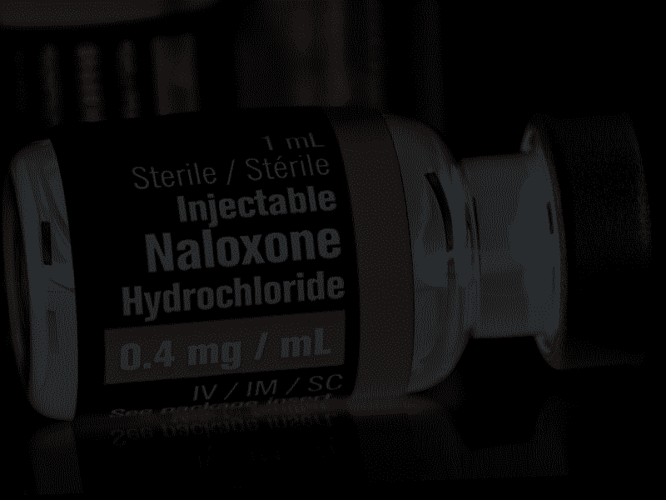
can we do
Learn more & Tell others
To assure more people are safe from Fentanyl poisoning/overdosing, people must be aware of it, its danger and what to do to be safe
To combat something dangerous that is also widespread, awareness and knowledge are the key. And it starts with you
▄▀ Learn more at sites like ▀▄
https://drugfree.org/fentanyl-poisoning/
https://mattersnetwork.org/supplies/#tab-1728674820151-9
https://nida.nih.gov/publications/drugfacts/fentanyl
https://www.songforcharlie.org/page/facts-about-fentanyl
>> END (music ahead!) >>
Background Image : Injectable Naloxone (opioid overdose reverse medicine)

Slide 10



the presentation ends here
thanks for watching
this project was made with the help of
microsoft powerpoint
paint.net
gnu image manipulation program
fruityloops studio
werkkzeug1
info are researched through
drugfree.org
mattersnetwork.org
nida.nih.gov
songforcharlie.org
dallasnews.com
credits music
wayfinder – ein.schlag (outro)
(farbrausch demo)
background artwork
original work on 3dsmax
have a good night

