Slide 1
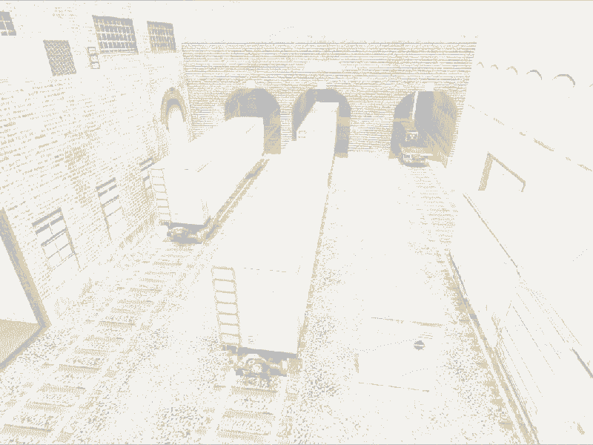

Notes:
more research sites :
https://issuu.com/education-mocanyc/docs/rr_guide_final_6.30.20_page_numbers/s/10763923#:~:text=This%20photo%20shows%20three%20Chinese,Archives%2C%20Fort%20Worth%2C%20Texas.

Slide 2
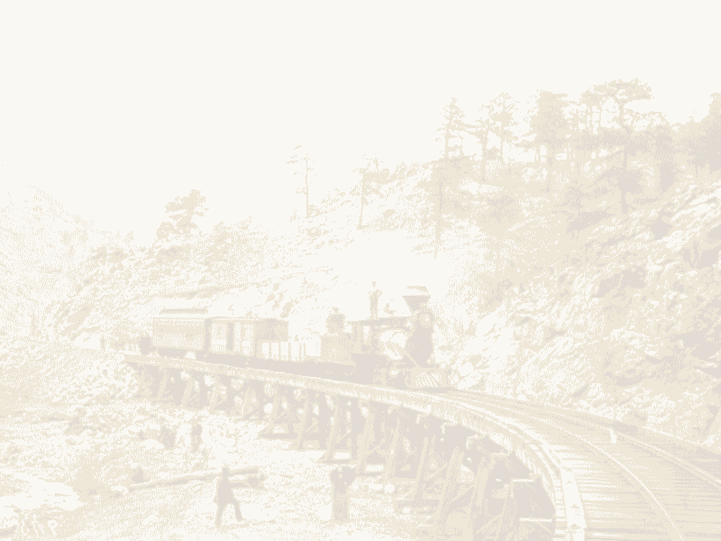
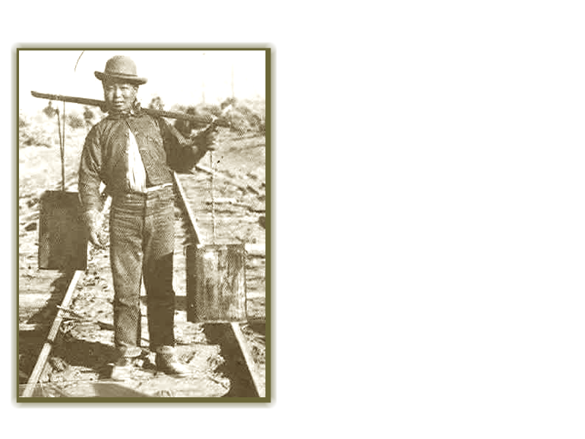
The Story of Zheng Qin
Zheng Qin is a Chinese worker who migrated to the US due to overpopulation and poverty [3]. Hearing the discovery of gold in California, he moved to the US to work for a higher wage in hopes of supporting his family like many other Chinese immigrants at the time.
Background : 1800’s railroads (https://thebouldermag.com/boulder-s-locomotive-love-affair)
Image : https://www.dol.gov/general/aboutdol/hallofhonor/2014_railroad
[1] : https://www.pbs.org/wgbh/americanexperience/features/tcrr-workers-central-union-pacific-railroad/

Slide 3
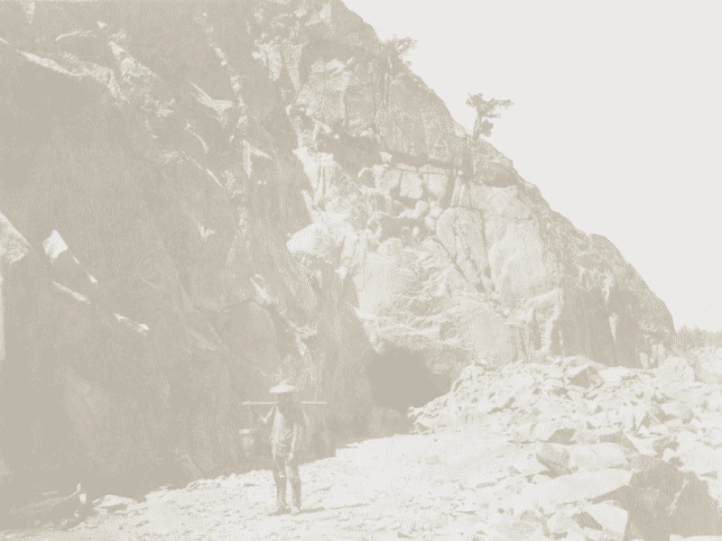
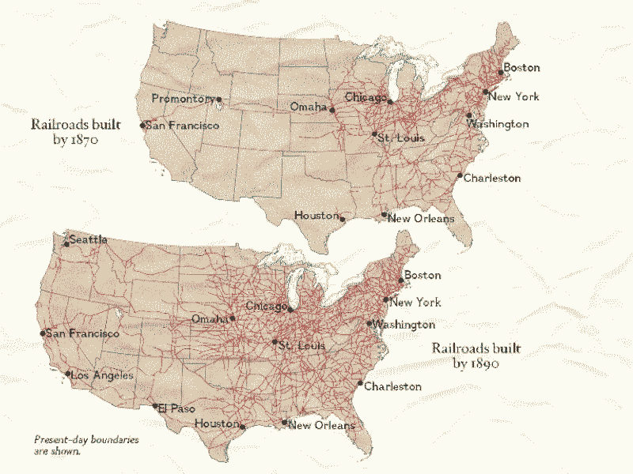
Working on Railroads
Working in the U.S., he along with many Chinese workers were given the task of building a transcontinental railroad, a railroad that passes through continents.
The task itself is not only tiresome but dangerous as well
Background : Chinese worker working on a tunnel railroad (issuu.com/education-mocanyc/docs/rr_guide_final_6.30.20_page_numbers/s/10763923)
Image : https://education.nationalgeographic.org/resource/tracking-growth-us/

