Slide 1
GPGPU Programming

Slide 2
Me
Danny George, member of the ESP team
My experience
  Fluid simulation modeling and visualization
  NOAA particle simulation prototype

Slide 3
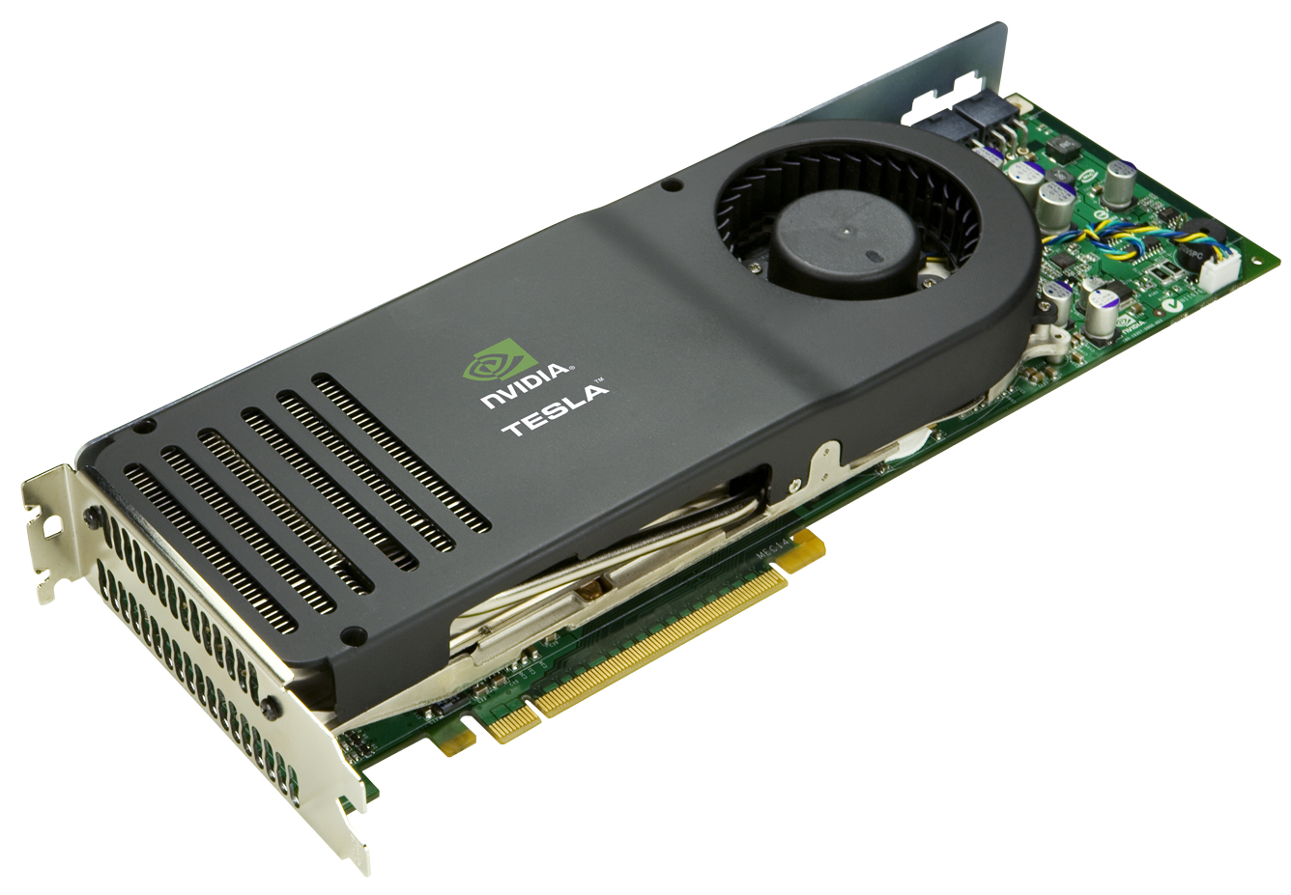
Some Background
What is GPGPU programming?
  General Purpose
  Graphics Processing Unit Programming
  Programs intended to use a graphics card to aid in computation

Slide 4
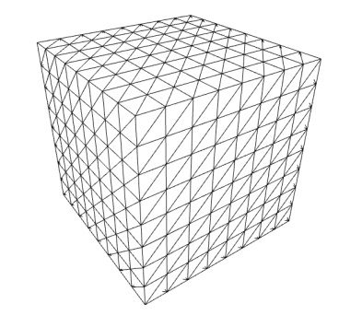

Some Background
100mph how it started
What's out there?
  CUDA – Compute Unified Device Architecture
  (Nvidia proprietary)
  OpenCL (Apple, AMD, IBM, Qualcomm, Intel, Nvidia)
My experience is with CUDA
Notes:
How it started
- Dedicated graphics cards for game performance
- Fragment shaders, ~4 instructions per pixel
- Highjacked shaders, fudged buffers
CUDA vs. OpenCL
CUDA runs on NVIDIA hardware, proprietary
OpenCL runs on CPU, GPU, DSP, FPGA
CUDA has market share
These are compiler extensions
My experience is ~2 years old, possibly newer/better ways of doing things

Slide 5
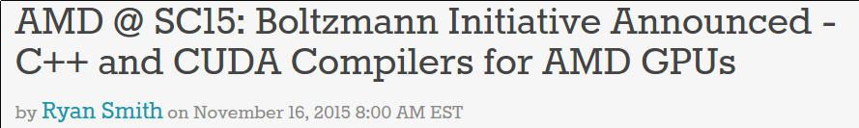
Hot off of the press
http://www.anandtech.com/show/9792/amd-sc15-boltzmann-initiative-announced-c-and-cuda-compilers-for-amd-gpus

Slide 6
Some Background
What is it used for?
  *Data Parallel* number crunching (SIMD like)
  Machine learning (matrix computations)
  Bitcoin mining (no longer profitable)
  Scientific computing
  Database research
Notes:
GPUs are very good at
floating point
double precision
integer ops
Not so great at very heavy data dependent branching

Slide 7
Parallelization Types
Data Parallelism
  The same instructions just different data (SIMD)
  Divide and conquer on an array.
Task Parallelism
  Multiple tasks doing different things
  1 thread hitting ws
  1 thread hitting db
  ...

Slide 8

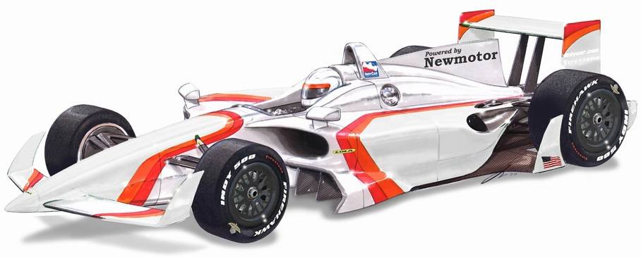
Why is it faster than a CPU?
CPU
GPU
Optimized for low latency
5 ALU per core
(or fewer)
Optimized for high throughput
100s of ALUs
Notes:
When moving across town, which would you rather use?
CPU very agile, great with branching
Clock speed differences
Memory architecture differences

Slide 9

Part 2 – The Code
WARNING: We are entering the land of raw memory management.
Notes:
Does anyone have questions regarding the how or why of GPGPU programming?

Slide 10
Parallel Programming Problem 1
Element wise sum of two vectors
You have two arrays/lists/vectors of numbers, sum them element wise into a result vector.
r[i] = x[i] + y[i]
Notes:
Before we tackle this...

Slide 11

Let's build a program map!
int main() {
// declare variables
// allocate memory
// initialize / fill memory
// perform computation
// do something with data
// cleanup
}
Notes:
This is our map through the forgotten lands – keep this handy
What's left to do in these forgotten lands? Unless you're lazy and you want the OS to always clean up after you.
Hopefully this flow is not new to anyone – apply it to a typical ETL
Think back to your C days – how do we allocate and clean up memory?

Slide 12
Vector Add (no GPU)
https://github.com/dangets/cwan-gpu-presentation/tree/master/code
Notes:
Walk through the main function
Go through the indexing logic of vector_add
Point out the loop of the vector_add

Slide 13
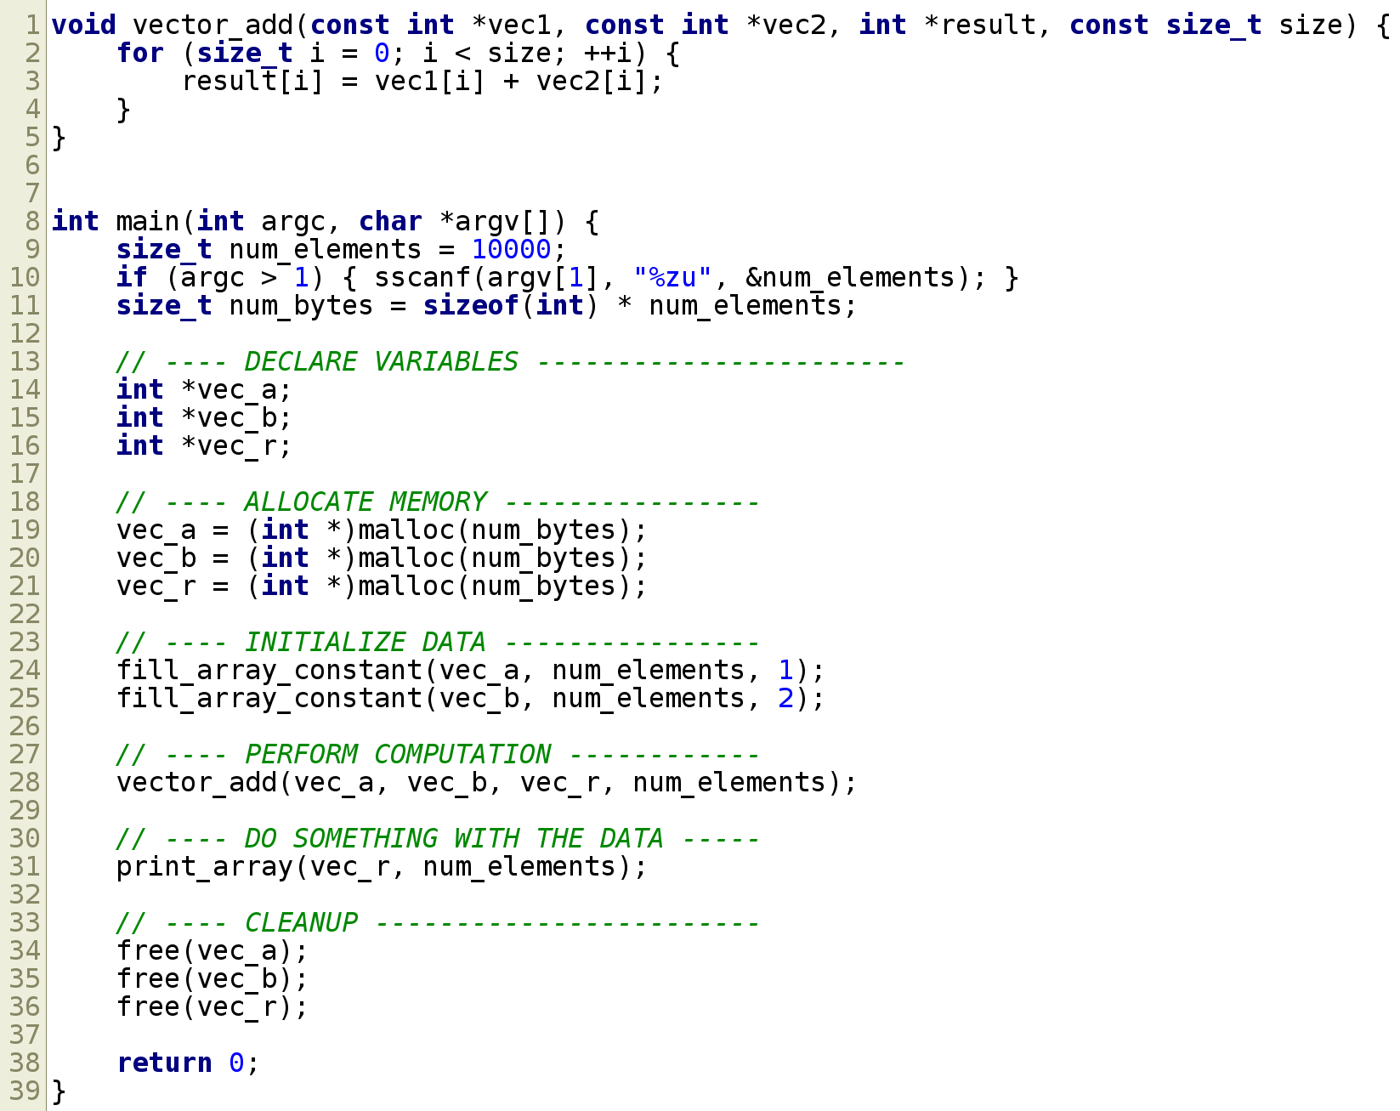
Vector Add (no GPU)
Notes:
Walk through the main function
Go through the indexing logic of vector_add
Point out the loop of the vector_add

Slide 14
Program Map with GPU
int main() {
// declare variables
// allocate memory on host
// initialize memory on host
// allocate memory on GPU
// copy data to GPU
// perform computation (on GPU)
// copy result back to host
// do something with data
// cleanup (on host and GPU)
}
Notes:
GPU memory is physically separate from host memory.

Slide 15
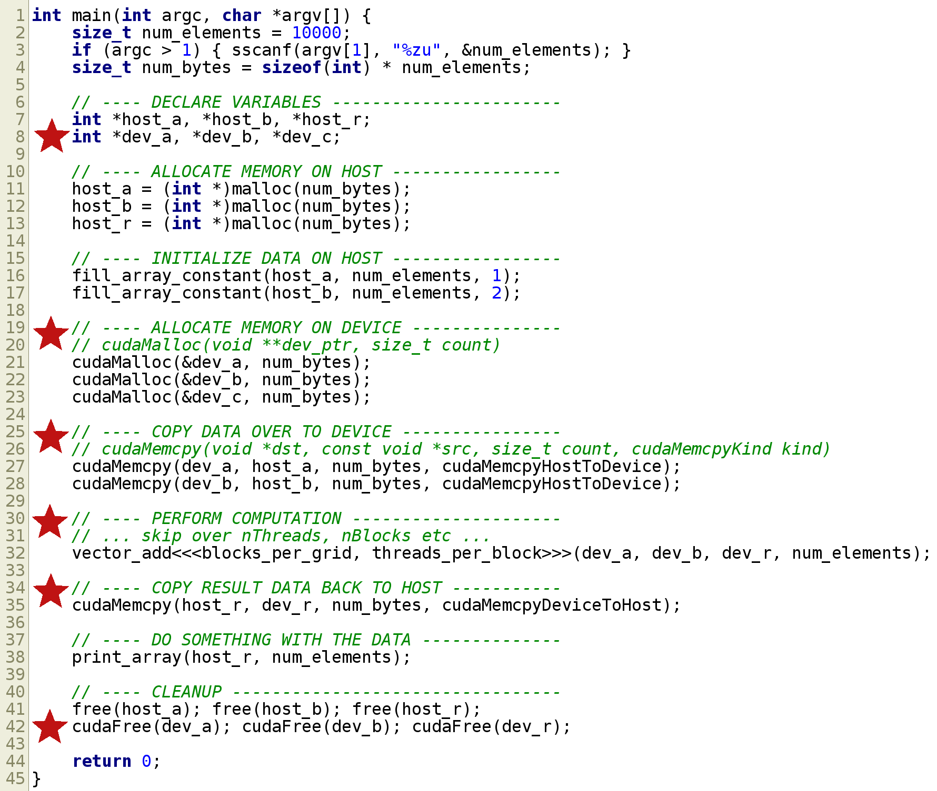
Notes:
The stars are the “new” GPU parts.
Skim over the kernel call – explain the basic parameters – specifiable thread block sizes.
Emphasize the extra cost of the memory copy to/from. If possible, keep the data on the GPU

Slide 16
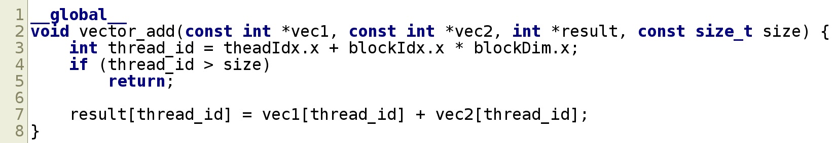
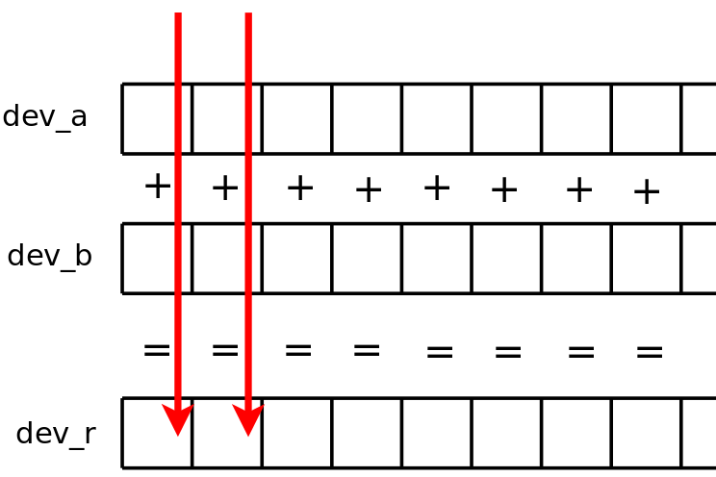
Notes:
This is called a 'kernel'
CUDA runtime scheduler takes care of thread creation and scheduling
This is called “at the same time” by 100s of threads

Slide 17

Take a breather
Notes:
Who wants to rewrite everything in C?
That wasn't too terrible, but complex for a “hello, world”
Lot of “trust me on this”
Granted a lot of that code is the necessary boilerplate and more code would focus on the actual computation
But before too long...

Slide 18

Let's upgrade to C++
Notes:
Who has used C++ since C++11?, C++14?
Let's take a detour through the futuristic world of C++

Slide 19
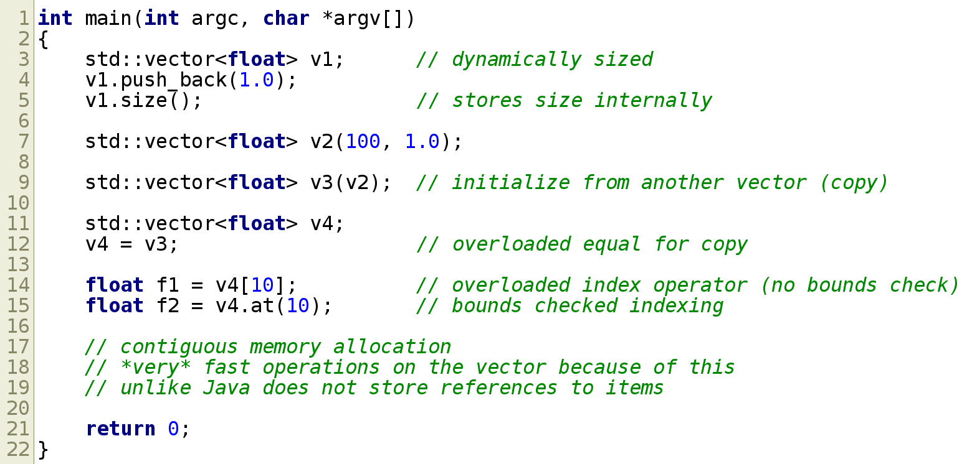
C++ vectors
Notes:
expand on std::vector
similar to ArrayList to the Java-ites
stores size internally
indexable like an array
resizes on demand
easily copy/assign between vectors

Slide 20
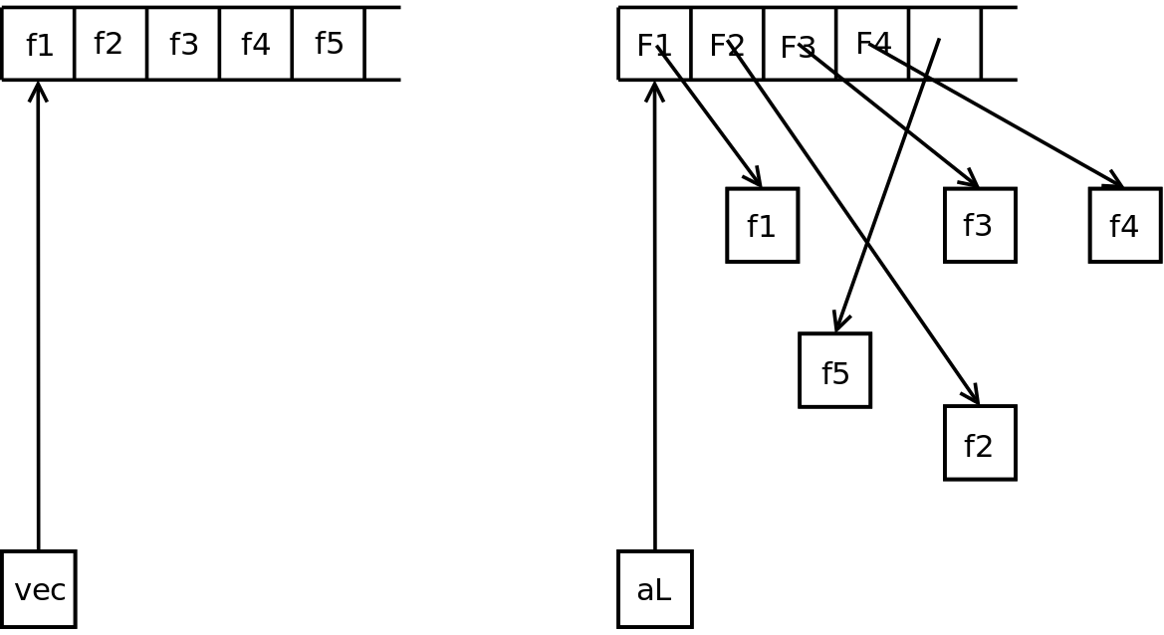
C++ Vectors vs. Java ArrayList
std::vector<float>
ArrayList<Float>

Slide 21
Parallel Programming Problem 2
Saxpy
You have a constant 'a', and two vectors 'x' and 'y'. The element wise result is a * x + y
r[i] = a * x[i] + y[i]
Notes:
Think of how you would do this in Java
ArrayList vs primitive array

Slide 22
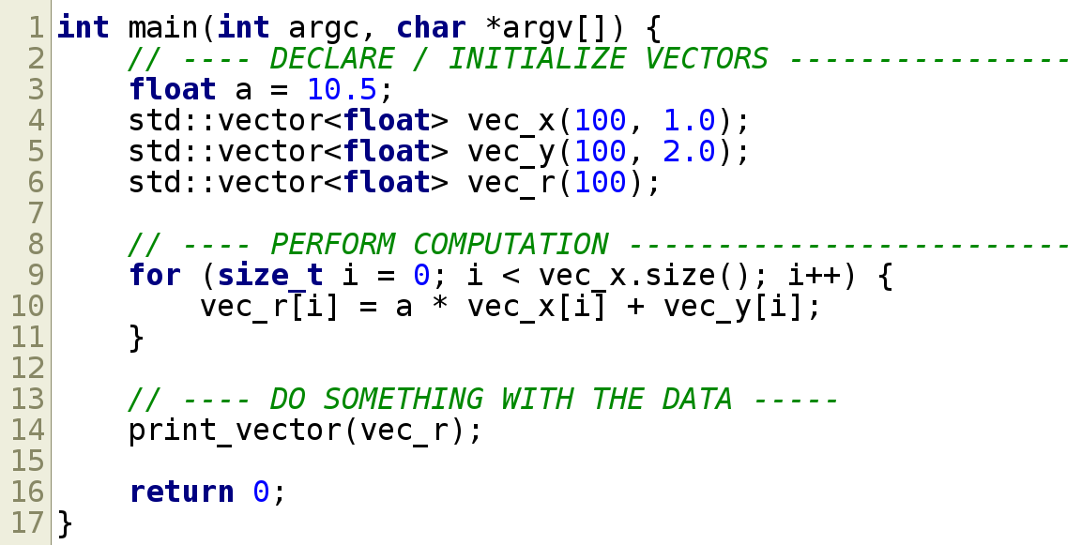
C++ saxpy (no GPU)
Notes:
Build up to “what did I miss?” in the code
*end of slide* auto cleans up after itself
In “modern” C++ you should avoid new/delete
this includes 'new'ing up an array

Slide 23
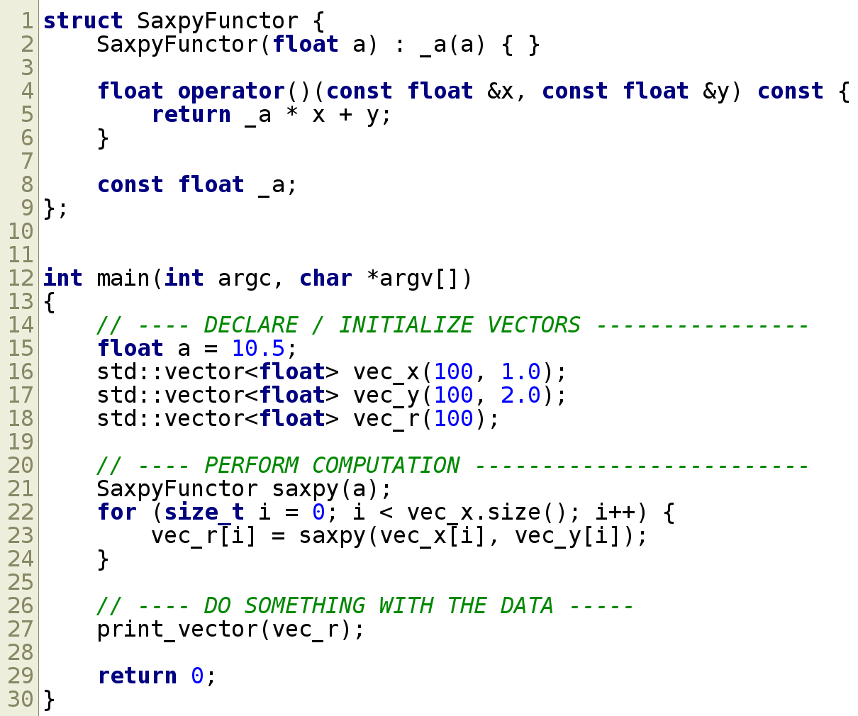
C++ saxpy pt. 2
Notes:
C++ allows operator overloading, even the function call operator. Go into detail.
What does this look like? What can capture local variable(s), act like a function, and be passed around like a variable? … sometimes written with arrow syntax?
Java8 users – what's the next step? where am I going with this? (lines 22 through 24)

Slide 24
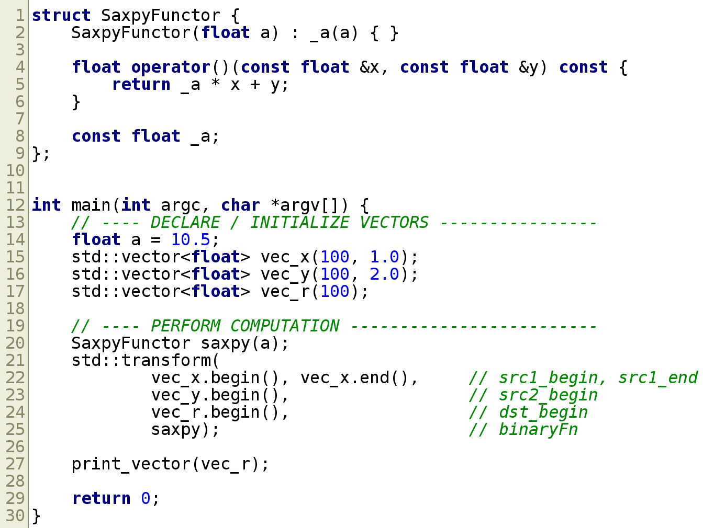
C++ saxpy pt. 3
Notes:
C++ STL has an 'algorithm' library. Existed before C++11, but has become much easier to use since then.
If you've heard of MapReduce, std::transform is the 'map' function
There are a ton of other common algorithms defined in that library reduce, count, find, …
What're some benefits of this transform function vs. an explicit for loop? (abstract away the 'how')

Slide 25
Let's get back to GPU programming

Slide 26
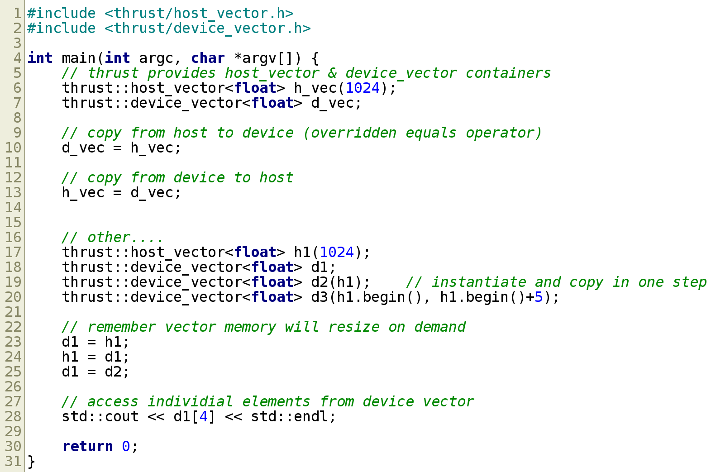
C : C++ :: CUDA : Thrust
Notes:
Go through each commented block, explaining what is going on.
Alright, now let's apply this to our problem.

Slide 27
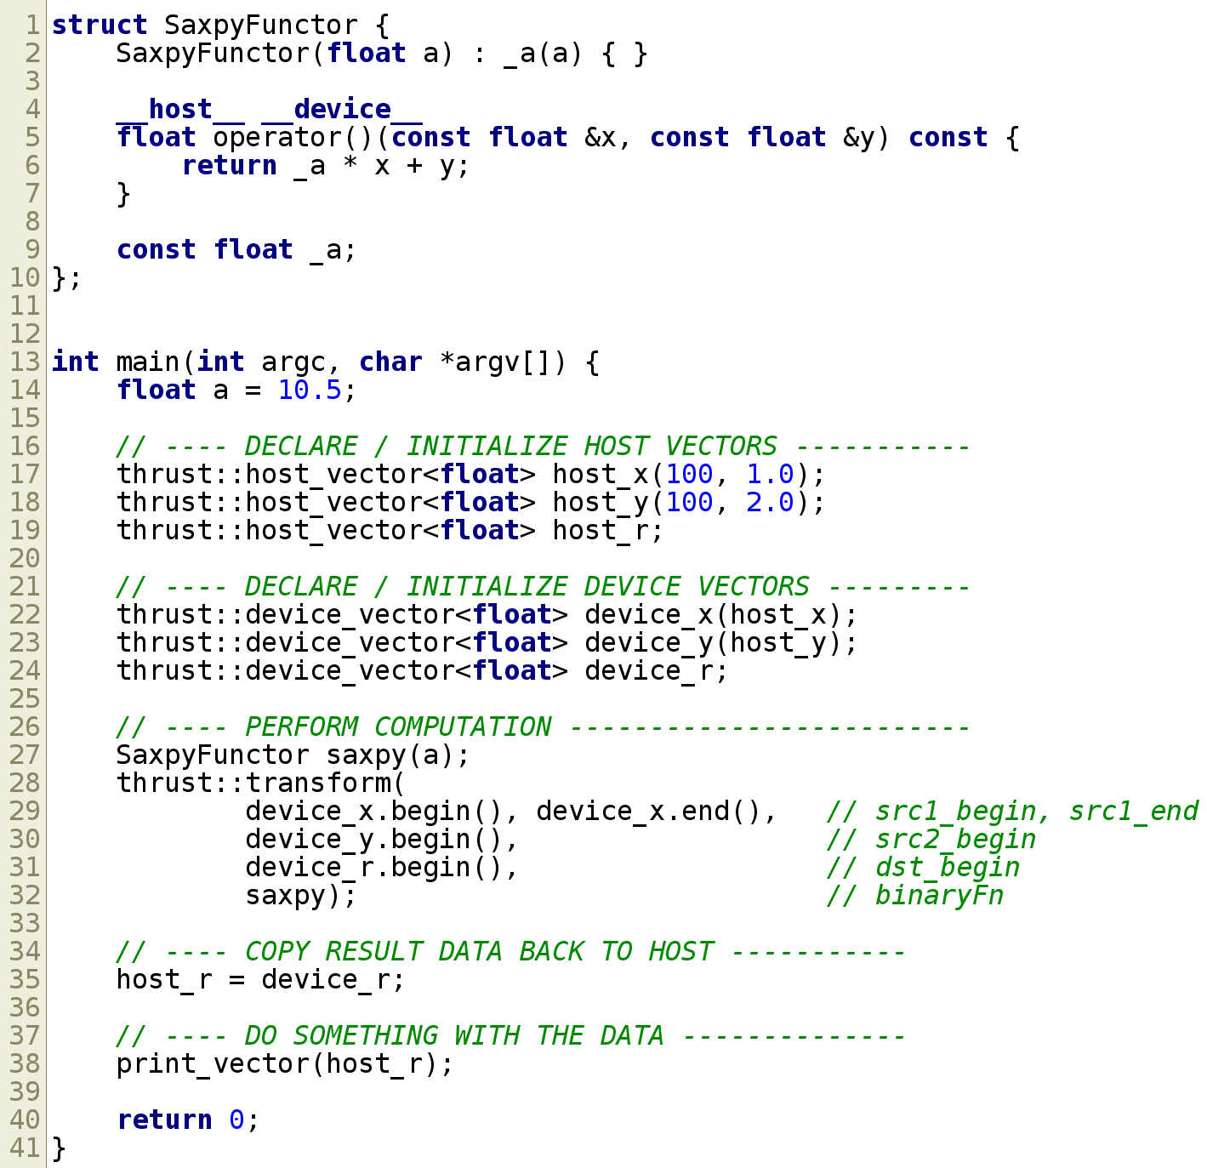
saxpy with CUDA Thrust
Notes:
Thrust also provides an 'algorithm' library designed after the STL one. Lot of the same functions, except optimized for GPU
You also don't have to worry about the number of threads spawned. (the triple chevrons in the earlier slide)

Slide 28

We made it

Slide 29

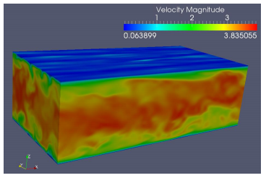
Other GPGPU Notables
Specialized memory regions
  e.g. 2D and 3D Texture Memory
  global, shared, registers, etc...
OpenGL interoperability
NVIDIA nsight
  Visual profiler and debugger

Slide 30
What else is out there
C/C++
  Thrust
  Boost.Compute
  (like Thrust, but for OpenCL)
  CUBLAS
  CUFFT
  OpenACC
  cuDNN
Java
  JCUDA
  aparapi
Python
  Numpy
  PyCUDA
  PyOpenCL
Haskell, Julia, Matlab, Fortran

Slide 31

Application to Clearwater
Why do we use Java?
  Expertise across company
  Great libraries, great tooling
  Don't have to worry about memory
BUT
If you really care about speed, MEMORY IS IMPORTANT
Notes:
Expertise – standardization, jump into others' code bases, bigger hiring pool, etc...
Libraries, tooling – tomcat, versionmanager, versiontracker
Memory – productivity, fewer memory leaks
Speed – if we truly care about performance down to the nitty gritty, you have to know memory usage.
CPU architecture, cache lines, prefetching, has a huge impact on code performance.
Instead of the attitude of just throw more RAM at it to be able to run.

Slide 32
Application to Clearwater
We would see a bigger benefit by going to C++
C++11,14 and on have radically simplified the language*
Better GPU migration plan anyway
Can be made possible by the ETL Dispatcher
JCUDA is more like the C style CUDA programming
Notes:
C++ OR some other lower-level system accessible language (Rust, Julia, D)
C++ still isn't pretty – requires much more discipline than Java, can still get really hairy.
This should *only* be for the compute intensive parts of the code. Benchmark first! Ahmdal is still omnipresent, overcome extra memory copy.
Would delay us buying and managing GPU nodes
I would love to work on this... if we do go this route
Disclaimer about personal lack of experience with calling C from Java, zero experience with Java & GPU

Slide 33
Resources
NVIDIA Fermi Architecture Overview
http://www.cc.gatech.edu/~vetter/keeneland/tutorial-2011-04-14/02-cuda-overview.pdf
Inside The Programming Evolution of GPU Computing
http://www.nextplatform.com/2015/10/28/inside-the-programming-evolution-of-gpu-computing/
From Java Code to Java Heap
https://www.youtube.com/watch?v=FLcXf9pO27w
Why you should avoid linked lists
https://www.youtube.com/watch?v=YQs6IC-vgmo
Modern C++: What you need to know (especially after 24:00)
https://channel9.msdn.com/Events/Build/2014/2-661
Machine Architecture: Things Your Programming Language Never Told You
https://www.youtube.com/watch?v=L7zSU9HI-6I
Stack Overflow – What is cache friendly code?
http://stackoverflow.com/questions/16699247/what-is-cache-friendly-code

