Slide 1
On Sampling from Massive Graph Streams
ONU STEFAN
GHERMAN DAN

Slide 2
Purpose of the article
Graph Priority Sampling provides a general way to weight edge sampling according to auxiliary and/or size variables so as to accomplish various estimation goals of graph properties.
In the context of subgraph counting, we show how edge sampling weights can be chosen so as to minimize the estimation variance of counts of specified sets of subgraphs.
In distinction with many prior graph sampling schemes, GPS separates the functions of edge sampling and subgraph estimation.

Slide 3


Frameworks
The article propose two estimation frameworks:
Post-Stream estimation, to allow GPS to construct a reference sample of edges to support retrospective graph queries.
In-Stream estimation, to allow GPS to obtain lower variance estimates by incrementally updating the subgraph count estimates during stream processing
The article is illustrate its results with applications to triangle and wedge counting.
triangle
wedges

Slide 4
Goal
The main goal of this paper is to propose some solutions that are able to predict graph information like (triangle and wedge counting ) with a sample from the huge graph . As an example :
GPS achieves high accuracy with < 1% error for triangle and wedge counting, while storing a small fraction of the graph with average update times of a few microseconds per edge. Notably, for a large Twitter graph with more than 260M edges, GPS accurately estimates triangle counts with < 1% error, while storing only 40K edges.

Slide 5



Algorithm and Intuition
The basic outline and intuition of the proposed framework comprises of two steps. In the first step, we select a small sample of edges
from the set of all edges arriving by time t, with m = |Kbt| is the reservoir capacity. The second step allows us to estimate the count of general subgraphs in G regardless of whether they were all sampled. We define the subset indicator of a subset of edges J ⊂ [|K|] by the function,
Thus, SJ,t = 1 if and only if all the edges in J have arrived by time t.

Slide 6
Concepts used by the algorithms
Min Heap
Reservoir Sampling
Martingale formula
Horvitz-Thompson estimator
Variance and Covariance estimators

Slide 7
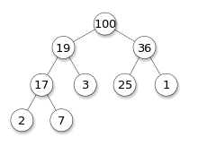
Heap (data structure)
In computer science, a heap is a specialized tree-based data structure which is essentially an almost complete tree that satisfies the heap property: in a max heap, for any given node C, if P is a parent node of C, then the key (the value) of P is greater than or equal to the key of C. In a min heap, the key of P is less than or equal to the key of C. The node at the "top" of the heap (with no parents) is called the root node.

Slide 8
Reservoir sampling
Reservoir sampling is a family of randomized algorithms for choosing a simple random sample, without replacement, of k items from a population of unknown size n in a single pass over the items. The size of the population n is not known to the algorithm and is typically too large for all n items to fit into main memory. The population is revealed to the algorithm over time, and the algorithm cannot look back at previous items. At any point, the current state of the algorithm must permit extraction of a simple random sample without replacement of size k over the part of the population seen so far.

Slide 9

Martingale
In probability theory, a martingale is a sequence of random variables (i.e., a stochastic process) for which, at a particular time, the conditional expectation of the next value in the sequence is equal to the present value, regardless of all prior values.
The concept of martingale in probability theory was introduced by Paul Lévy in 1934, though he did not name it. The term "martingale" was introduced later by Ville (1939), who also extended the definition to continuous martingales. Much of the original development of the theory was done by Joseph Leo Doob among others. Part of the motivation for that work was to show the impossibility of successful betting strategies in games of chance.
A basic definition of a discrete-time martingale is a discrete-time stochastic process (i.e., a sequence of random variables) X₁, X₂, X₃, ... that satisfies for any time n,
That is, the conditional expected value of the next observation, given all the past observations, is equal to the most recent observation.

Slide 10



Horvitz–Thompson estimator
In statistics, the Horvitz–Thompson estimator, named after Daniel G. Horvitz and Donovan J. Thompson, is a method for estimating the total and mean of a pseudo-population in a stratified sample. Inverse probability weighting is applied to account for different proportions of observations within strata in a target population. The Horvitz–Thompson estimator is frequently applied in survey analyses and can be used to account for missing data.
Formally, let
be an independent sample from n of N ≥ n distinct strata with a common mean μ. Suppose further that
is the inclusion probability that a randomly sampled individual in a superpopulation belongs to the ith stratum. The Horvitz–Thompson estimate of the total is given by:

Slide 11
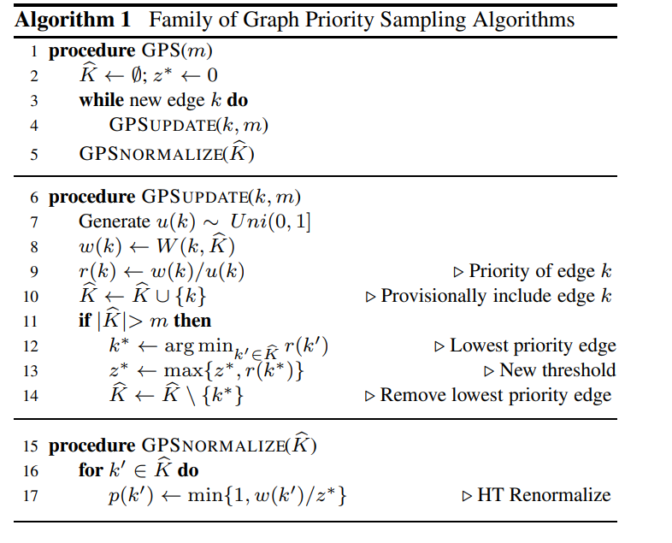
In statistics, the Horvitz–Thompson estimator, is a method for estimating the total and mean of a pseudo-population in a stratified sample.
Finally, at any time in the stream, we can call the procedure GPSNORMALIZE to obtain the edge sampling probabilities.

Slide 12
Variance
The variance is a measure of variability. It is calculated by taking the average of squared deviations from the mean.
Variance tells you the degree of spread in your data set. The more spread the data, the larger the variance is in relation to the mean.
The standard deviation is derived from variance and tells you, on average, how far each value lies from the mean. It’s the square root of variance.
Both measures reflect variability in a distribution, but their units differ:
Standard deviation is expressed in the same units as the original values (e.g., meters).
Variance is expressed in much larger units (e.g., meters squared)
Since the units of variance are much larger than those of a typical value of a data set, it’s harder to interpret the variance number intuitively. That’s why standard deviation is often preferred as a main measure of variability.

Slide 13
Covariance
In probability theory and statistics, covariance is a measure of the joint variability of two random variables. If the greater values of one variable mainly correspond with the greater values of the other variable, and the same holds for the lesser values (that is, the variables tend to show similar behavior), the covariance is positive. In the opposite case, when the greater values of one variable mainly correspond to the lesser values of the other, (that is, the variables tend to show opposite behavior), the covariance is negative. The sign of the covariance therefore shows the tendency in the linear relationship between the variables.
The magnitude of the covariance is not easy to interpret because it is not normalized and hence depends on the magnitudes of the variables. The normalized version of the covariance, the correlation coefficient, however, shows by its magnitude the strength of the linear relation.
A distinction must be made between (1) the covariance of two random variables, which is a population parameter that can be seen as a property of the joint probability distribution, and (2) the sample covariance, which in addition to serving as a descriptor of the sample, also serves as an estimated value of the population parameter.

Slide 14
Algorithm 2 Unbiased Estimation of Triangle & Wedge Counts
We start by calling Algorithm 1 to collect a weighted sample K of capacity m edges. For each edge k ∈ K, we use W(k, K) = 9 ∗ |△(k)|+1 where |△(k)| is the number of triangles completed by edge k and whose edges in K. Then, we call Algorithm 2 at any time t in the stream to obtain unbiased estimates of triangle/wedge counts, global clustering, and their unbiased variance.

Slide 15
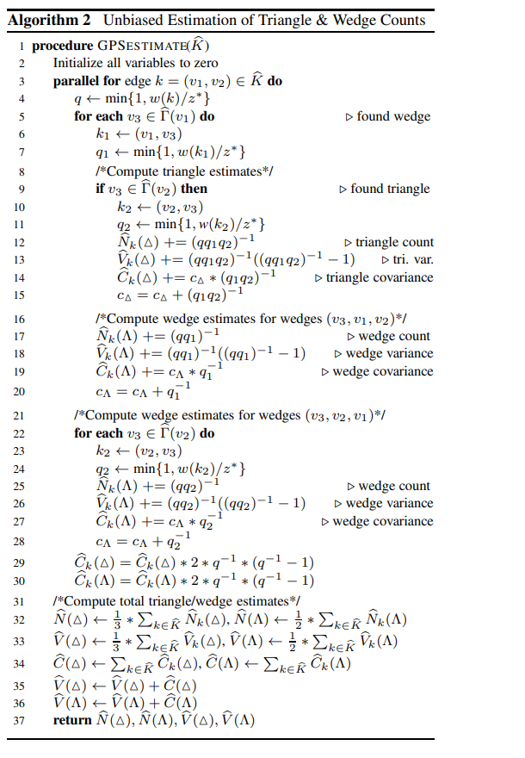

Slide 16

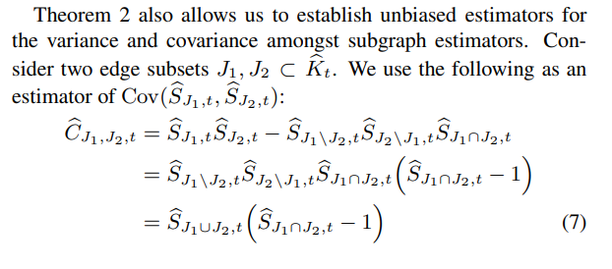

Slide 17
Algorithm 2 Unbiased Estimation of Triangle & Wedge Counts
Steps :
For each edge k = (v1, v2) ∈ Kb, Alg. 2 searches the neighborhood Γ(v1) of the node with minimum degree (i.e., deg(v1) ≤ deg(v2) for triangles (Line 5)
Lines 9–15 compute the estimates for each triangle (k1, k2, k) incident to edge k
Lines 17–20 compute the estimates for each wedge (k1, k) incident to edge k (and centered on node v1)
Then, Lines 25–28 compute the estimates for each wedge (k2, k) incident to edge k (and centered on node v2)
Finally, the individual edge estimators are summed in Lines 32–36, and returned in Line 37

Slide 18
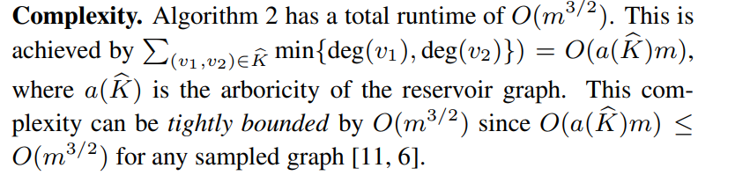
Complexity Algorithm 2

Slide 19
Algorithm 3 In-Stream Estimation of Triangle & Wedge Counts
We now describe a second estimation framework that we call In-Stream Estimation.
In this paradigm, we can take “snapshots” of specific sampled subgraphs at arbitrary times during the stream, and preserve them as unbiased estimators. These can be used or combined to form desired estimators.
These snapshots are not subject to further sampling; their estimates are not updated. However their original subgraphs remain in the graph sample and are subject to sampling in the normal way.
For example, each time a subgraph that matches a specified motif appears (e.g. a triangle or other clique) we take a snapshot of the subgraph estimator. If we only need to estimate the number of such subgraphs, it suffices to add the inverse probability of each matching subgraph to a counter

Slide 20
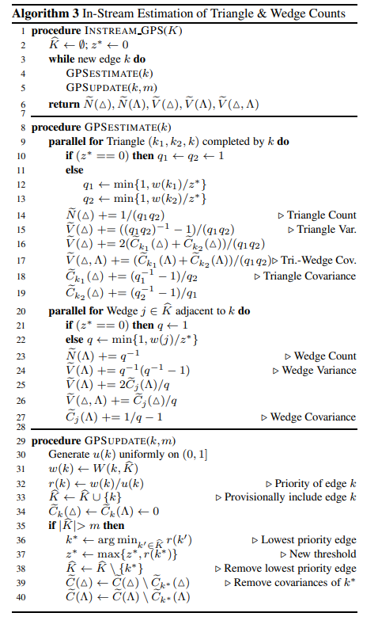

Slide 21
Algorithm 3 In-Stream Estimation of Triangle & Wedge Counts
When an edge k arrives, an update is performed for each triangle that k completes (line 9).
These updates can be performed in parallel because each such triangle must have distinct edges other than k. Triangle count Ne is updated with the current inverse probabilities of its first two edges k1 and k2 (line 14)
The variance Ve( I is updated first with the variance term for the current triangle (line 15) then secondly with its cumulative contributions Cbk1 ( and Cbk1 to the covariances with all previous triangles whose first two edges include k1 or k2 (line 16).
These cumulative terms are then updated by the current triangle (lines 18 and 19)
Wedge count variables are updated in a similar manner in lines 20–27
The edge-wedge covariance Ve(△, used for estimation of the global clustering coefficient α is updated using the cumulative triangle and wedge covariances in lines 17 and 26.

Slide 22
Experiments and results
The article have tested the performance of graph priority sampling on a large set of 50 graphs with hundreds of millions of nodes/edges, selected from a variety of domains and types, such as social, web, among others.
All graph data sets are available for download 1 [33, 34]. For all graph datasets, we consider an undirected, unweighted, simplified graph without self loops.
They generate the graph stream by randomly permuting the set of edges in each graph. For each graph, we perform ten different experiments with sample sizes in the range of 10K–1M edges.
They tested GPS as well as baseline methods using a single pass over the edge stream (such that each edge is processed once): both GPS post and in-stream estimation randomly select the same set of edges with the same random seeds. Thus, the two methods only differ in the estimation procedure.

Slide 23

Experiment steps for each dataset.
For each sample size m, Alg 1 collects an edge sample Kb ⊂
They use Alg 2 for post stream estimation, where the estimates are obtained only from the sample.
They use Alg 3 for in-stream estimation, where the estimates are updated incrementally in a single pass during the sampling process. Thus, both GPS post and in-stream estimation use the same sample
Given a sample Kb ⊂ K, we use the absolute relative error (ARE) |E[Xb] − X to measure the deviation between the expected value of the estimates and the actual statistics X. We use X to refer to triangle, wedge counts, or global clustering.
They e compute the 95% confidence bounds as

Slide 24
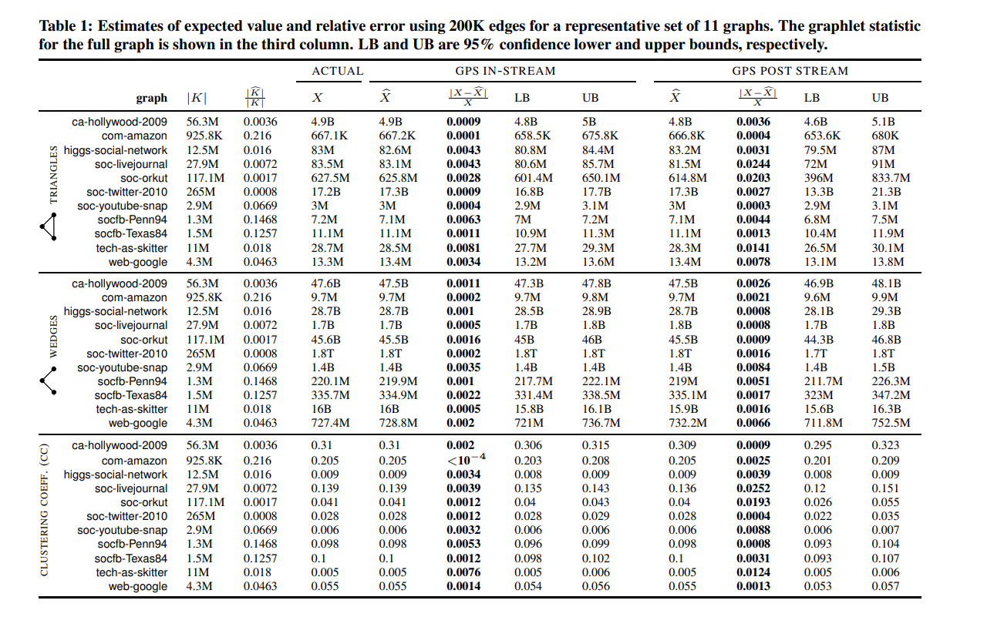
Results

Slide 25
Conclusion
In this paper, they presented graph priority sampling, a new framework for order-based reservoir sampling from massive graph streams.
GPS provides a general way to weight edge sampling according to auxiliary variables to estimate various graph properties. We showed how edge sampling weights can be chosen so as to minimize the estimation variance of counts of subgraphs, such as triangles and wedges. Unlike previous graph sampling algorithms, GPS differentiates between the functions of sampling and estimation. We proposed two estimation approaches
Post-stream estimation, to allow GPS to construct a reference sample of edges to support retrospective graph queries
In-stream estimation, to allow GPS to obtain lower variance estimates by incrementally updating the count estimates during stream processing.

Slide 26
Thank you

