Slide 1
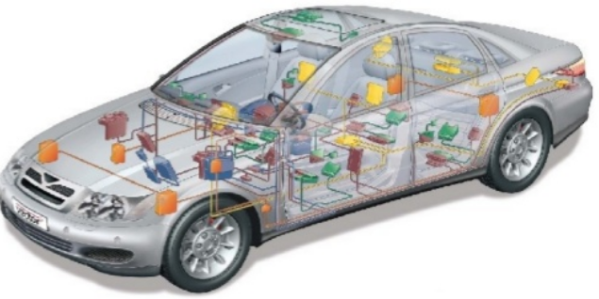
CAN - Physical Layer
^{9th} Oct 2017
DucTQ & DuongDH

Slide 2
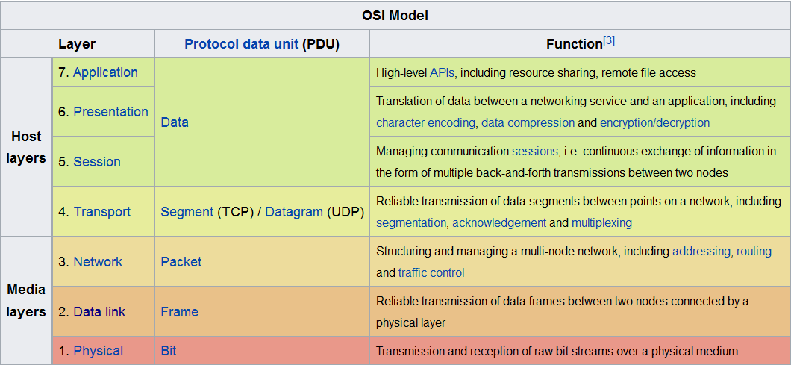
Content
Overview about OSI MODEL

Slide 3
CONTENT
Physical Layer

Slide 4
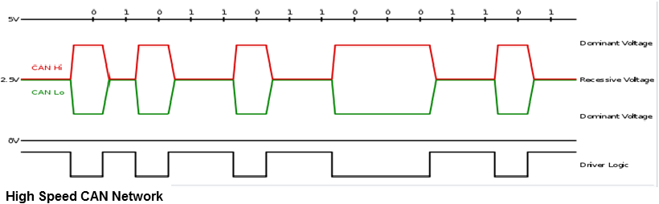
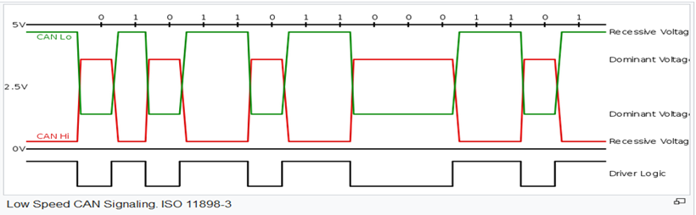
CONTENT
Notes:
CANH is greater than CANL about less than 0,5V => Recessive
CANH is greater than CANL about greater than 0,9V => Dominant

Slide 5
CONTENT
Method (lossless bitwise arbitration)
This arbitration method requires all nodes on the CAN network to be synchronized to sample every bit on the CAN network at the same time.
The CAN specifications use the terms "dominant" bits and "recessive" bits where dominant is a logical 0 and recessive is a logical 1.

Slide 6
CONTENT
II. DataLink Layer

Slide 7
CONTENT
1. Frames
Data Frame
Remote Frame
Error Frame
Overload Frame

Slide 8
CONTENT
Data Frame
The data frame is the only frame for actual data transmission. There are two message formats:
Base frame format: with 11 identifier bits
Extended frame format: with 29 identifier bits

Slide 9
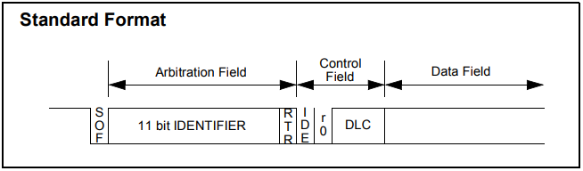
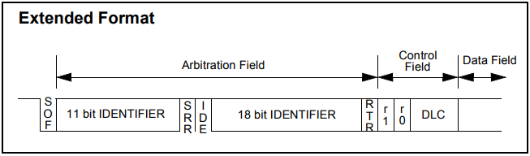
CONTENT

Slide 10
CONTENT
2. Remote Frame
This frame is transferred by a node to require an other node sending the data frame with same identifier with remote frame

Slide 11
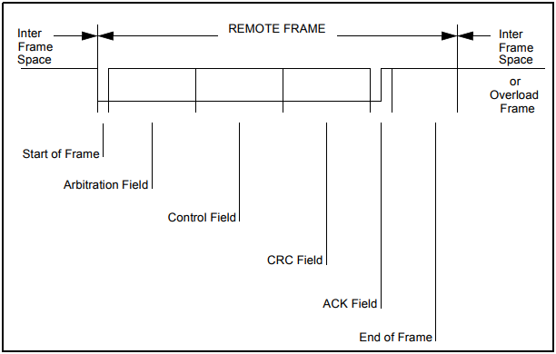
CONTENT
Remote Frame Format

Slide 12
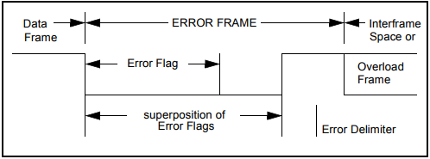
CONTENT
Error Frame Format

Slide 13
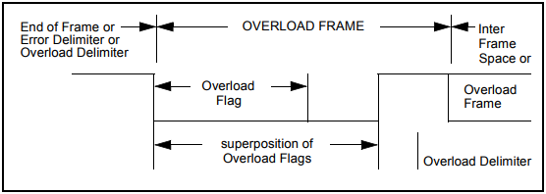
CONTENT
Overload Frame Format

Slide 14
CONTENT
? Confirm by interrupt ???
? Định dạng bản tin L-PDU giữa Physical và DataLink?
? Giống với các lớp trên? N-PDU?
? Can_Tp chuẩn hóa data ntnao?

Slide 15
CONTENT
2. Can Interface

Slide 16
CONTENT
Truyền, nhận L-PDU từ Can_driver
Truyền, nhận L-PDU lên Can_Tp

Slide 17
CONTENT
III. Network Layer

Slide 18
CONTENT
Truyền, nhận N-PDU từ Can_If

Slide 19
Q & A
Thank you for your attention!

