Slide 1
Smart Home Automation

Slide 2
TABLE OF CONTENTS
01
04
Understanding the Code
Aim of the Project
02
05
Components Used
Conclusion
03
Working of the Project

Slide 3
Aim of the Project
The goal of the project is create an Arduino based implementation of a Home Automation System where the basic functionalities could be met.
The basic functionalities include running a fan based on the temperature of the room, opening the door based on any motion detected and even turning on the lights on any motion detected.
The project will showcase the use of IoT in homes to create an efficient environment for staying at their homes.

Slide 4
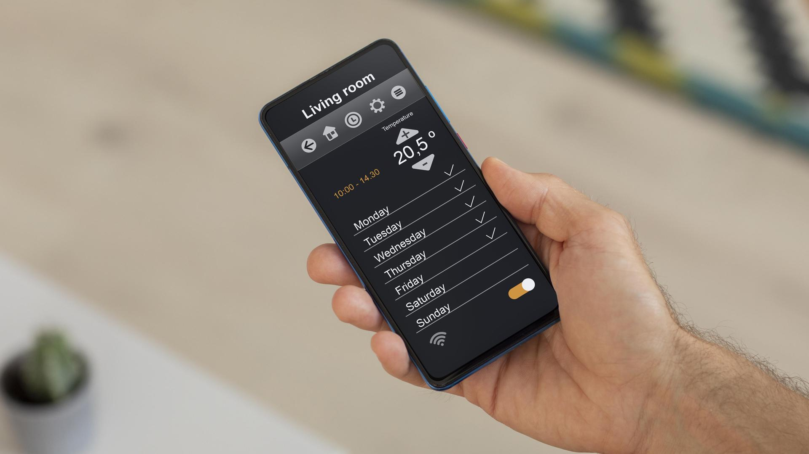
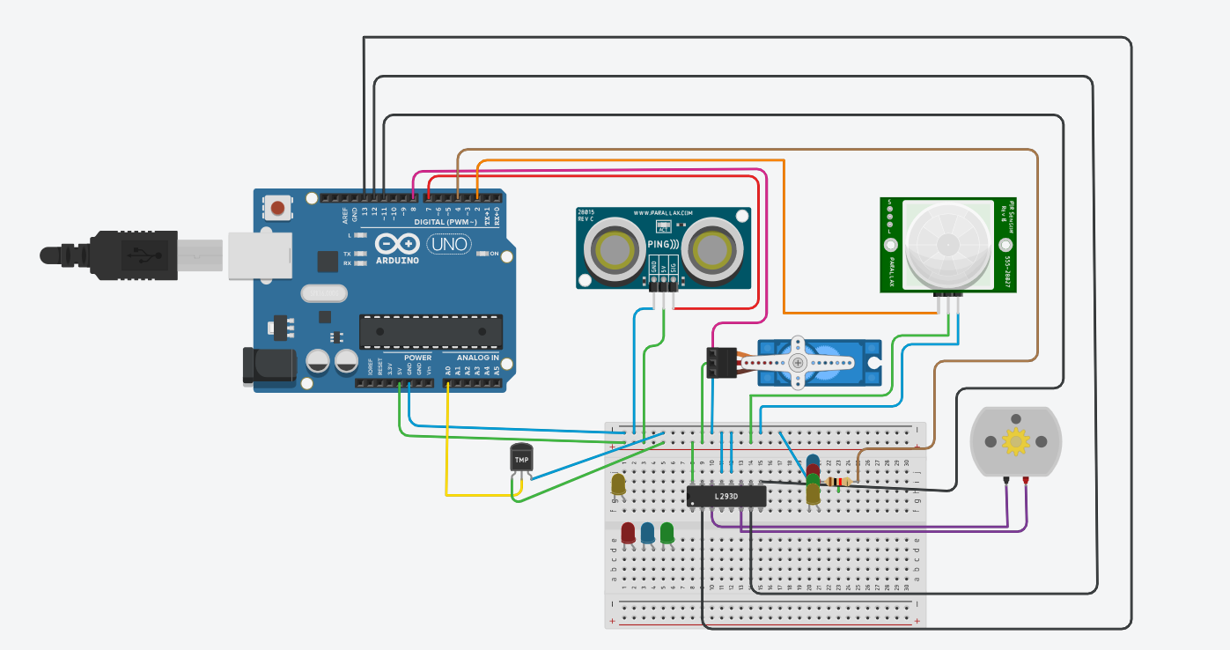
Arduino Project Components

Slide 5
Components
PIR Sensor
Ultrasonic Distance Sensor
Temperature Sensor
DC Motor
Micro Servo
H-bridge motor driver
LEDs

Slide 6
Working of the Project
The door will open If anyone comes near at the door within 40cm and door will be open for 2 seconds. Then it will check again if anyone is still within 40cm, if yes, then the door will still be open for 3 more seconds and if no, then the door will automatically be closed. (I used here Ultrasonic Sensor for measuring distance and Servo motor for opening the door )
If the room detects any movement, the light(LED) will automatically be lighting. If there is no movement in the rom, then the light will remain off. ( I used here PIR for detecting movement and LED for light )
It will detect room temperature and if that is greater than 20 degree Celsius then a fan will be running, otherwise, the fan will remain stopped. ( I used here temperature sensor LM35 for detecting temperature and a motor for running a fan )

Slide 7
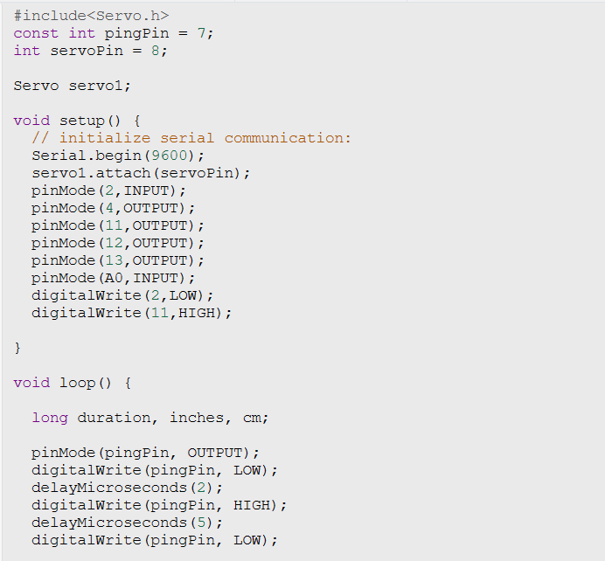
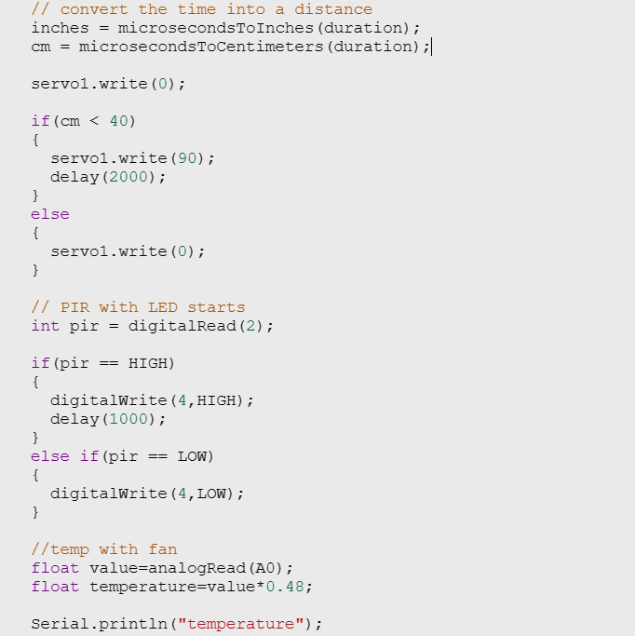
Understanding the Code

Slide 8
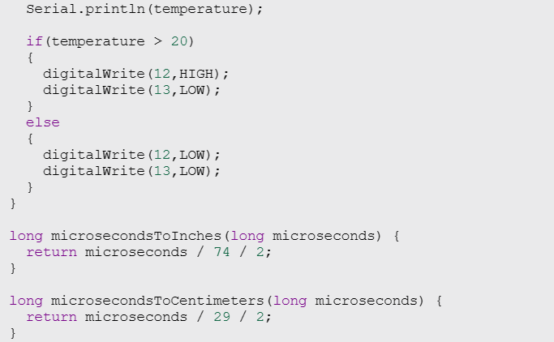
Understanding the Code

Slide 9
Conclusion
Ultimately, the integration of Arduino-based home automation systems into households contributes to improved quality of life by automating routine tasks, optimizing resource utilization and proving remote accessibility.

Slide 10
Thank You

