Slide 1

DAILY NEWS READER
Python Project Documentation
Submitted To: Prof. Abizer Sir
College: Sagar Institute of Science and Technology (SISTec - GN)
KUNAL DANGI
0187CS231101
0187CS231101

Slide 2
Project Overview & Key Features :-
Purpose: Fetch latest news articles from the internet using the GNews API
Key Functions: API integration using requests
  Convert JSON response into Python objects (Article class)
  Save news to TXT or JSON file
Core Concepts: Object Oriented Programming (classes, objects, methods)
  Exception Handling with custom exceptions
  File handling and formatted output
Use Case: Quickly download topic-wise news (Hindi / English) to read offline or keep as reference
0187CS231101

Slide 3
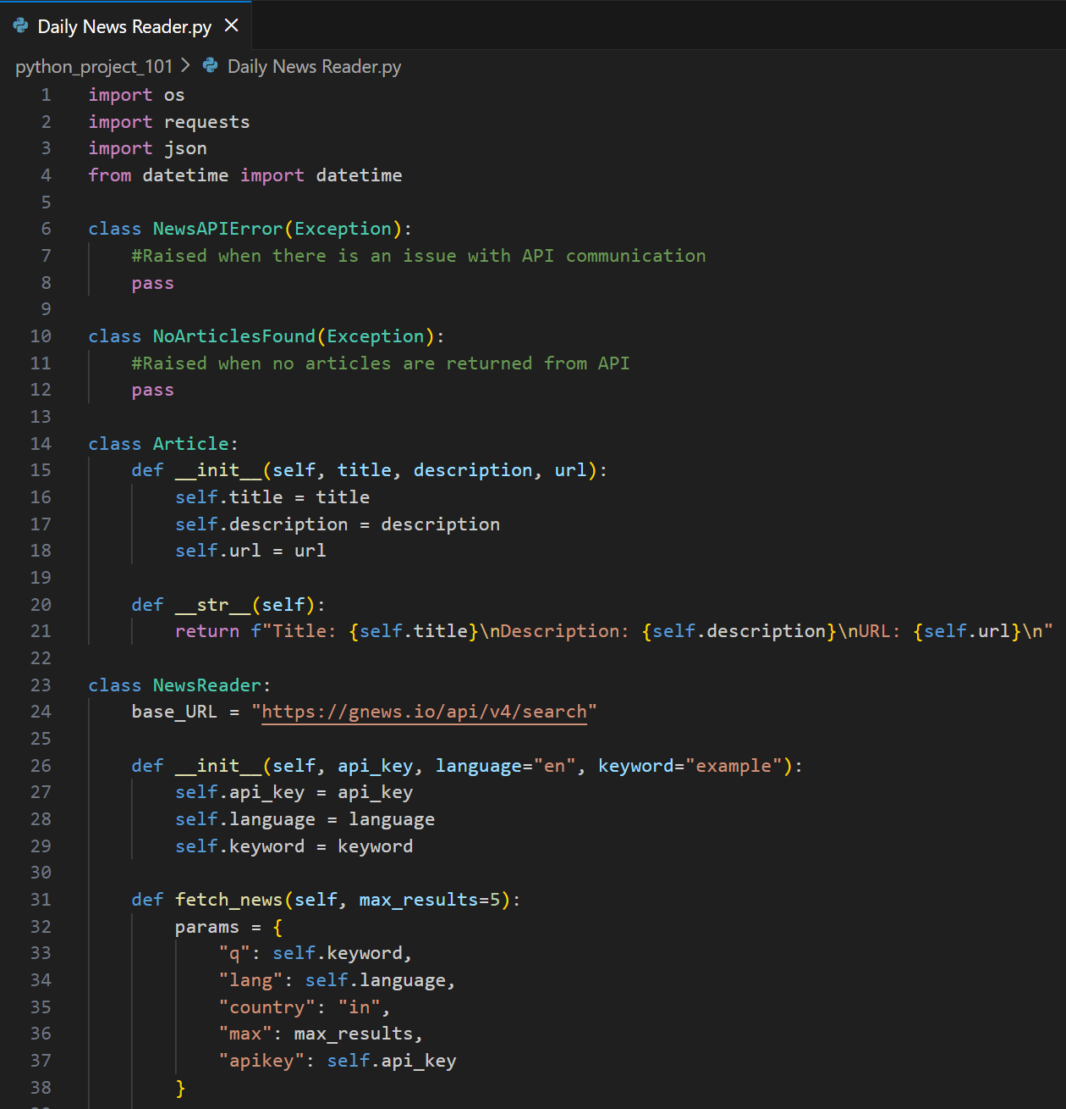
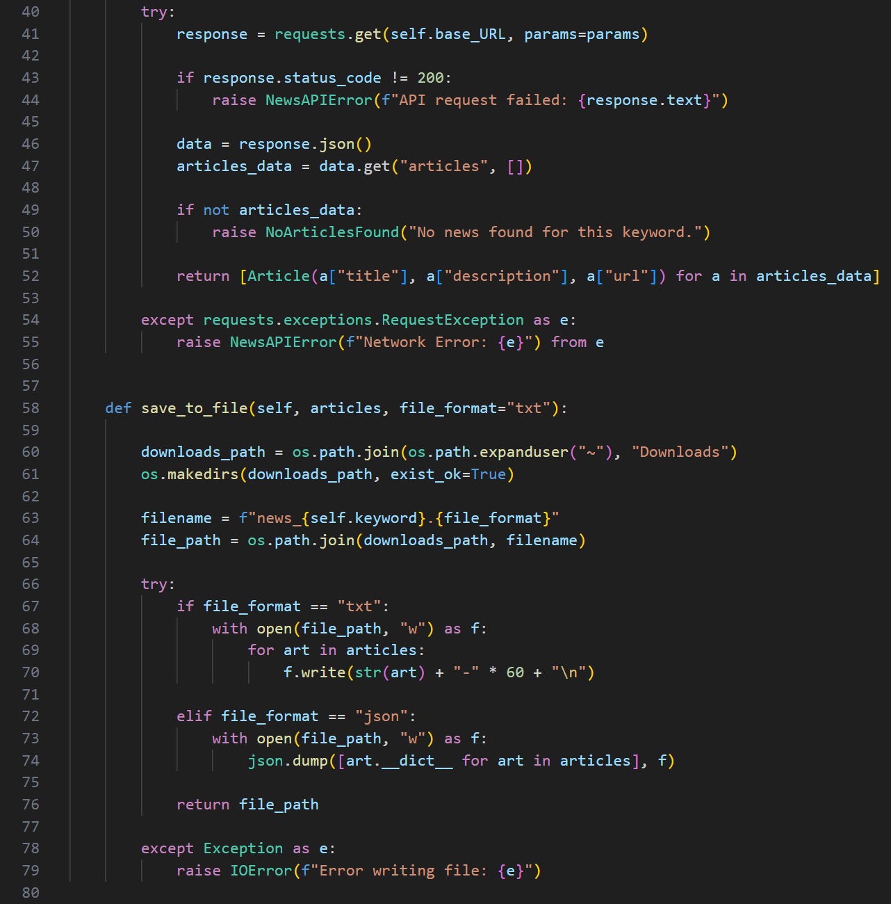
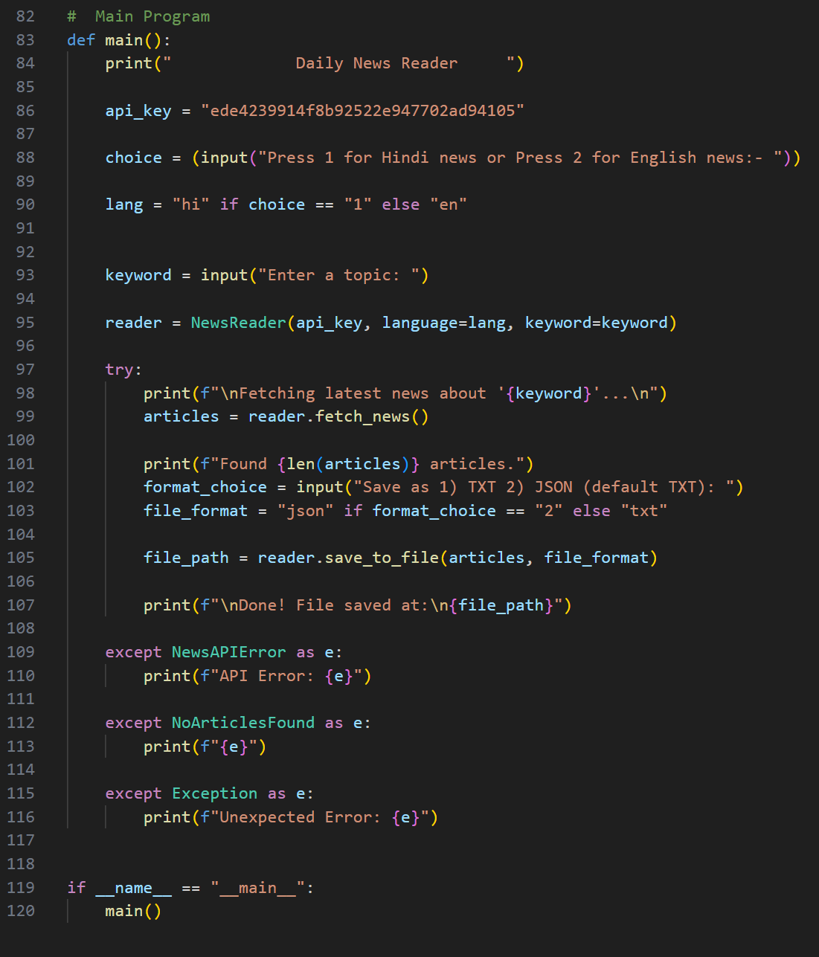
CODE :-
0187CS231101

Slide 4
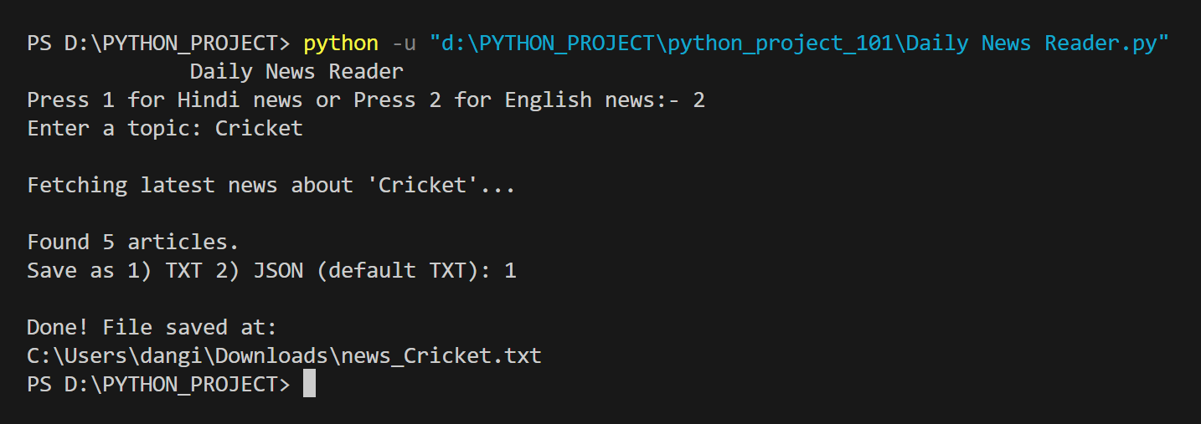
Code Execution Output :-
User chooses language → User enters topic → API fetches news → Program asks format (TXT/JSON) → File gets saved in Downloads → User reads the news
0187CS231101

Slide 5
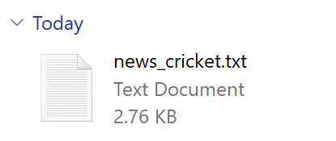
Download Process & Final Output :-
0187CS231101

Slide 6
THANK YOU !!

