Slide 1

Mini Project Presentation on QPGen: Artificial Intelligence -Powered Question Paper Generator for SIT Organization.
SIDDAGANGA INSTITUTE OF TECHNOLOGY, TUMKUR
Department of Infromation Science and Ingineering
Under the guidance of
Dr.Purohit Shrinivasacharya
Assoc. Professor
Dept. of ISE, SIT, Tumakuru
By
Keerthan S G : 1SI22IS041
Madan M : 1SI22IS048
Meghana V : 1SI22IS125
Vignesh H P : 1SI22IS123

Slide 2
Outline
Contents
Problem statement
Introduction
Objective
Literature Survey
Proposed Work
Block Diagram/System Architecture
Flow diagram/Algorithm/Methodology
Project Work Carried Out
Conclusion
References
Dept. of ISE, SIT, Tumkur

Slide 3
Problem Statement
Problem statement
Designing Exam Question Papers is time-consuming and complex, requiring a balance of subject coverage, difficulty, and question formats. Manual methods are inefficient and lack flexibility. An optimized solution is needed to automate customizable exam question paper generation, ensuring balanced content distribution while saving time and maintaining quality.
Dept. of ISE, SIT, Tumkur

Slide 4
INTRODUCTION
Introduction
CONTENT OVERVIEW:
This presentation introduces QPGen, an Artificial Intelligence-powered solution for automating question paper generation for SIT Organization.
It covers the project's motivation, the problems it addresses, the proposed system architecture, and key features that highlight its value.
The emphasis is on how QPGen can transform question paper preparation and enhance the educational process.
PURPOSE:
QPGen addresses the need for an automated solution to simplify and streamline the exam paper generation process.
It serves as a tool that ensures well-structured, diverse, and balanced question papers tailored to academic requirements.
QPGen has the potential to significantly reduce the workload for educators and administrative staff while maintaining high standards in exam question paper generation.
Dept. of ISE, SIT, Tumkur

Slide 5
INTRODUCTION
Introduction
OUTCOME:
The outcome of this presentation is a clear understanding of QPGen as an innovative Artificial Intelligence-powered solution for question paper generation.
It highlights the challenges faced in traditional question paper preparation and how QPGen effectively addresses these issues.
The presentation also emphasizes the benefits of implementing QPGen, such as reducing the workload for educators and improving the quality of exam papers. Ultimately, it aims to encourage support for advancing the project to its next phase of development.
Dept. of ISE, SIT, Tumkur

Slide 6
OBJECTIVES
Introduction: Objective
Customization and Flexibility: Allow educators to customize the exam question paper by selecting parameters such as subject, difficulty level, question format, and number of questions to meet specific requirements.
Automated Exam Question Paper Creation: Develop an Artificial Intelligence system that generates complete exam question papers with minimal human input, reducing the time and effort required for manual paper design.
Balanced and Intelligent Question Selection: Ensure the system intelligently selects a well-structured mix of questions, balancing difficulty and topic distribution, to create fair exams.
Dept. of ISE, SIT, Tumkur

Slide 7
LITERATURE SURVEY
Literature Survey
Objective and subjective question answering is an active research area in the field of natural language processing.A variety of approaches have been proposed to generate both types of questions using LLM models and NLP techniques.
A study by S. Chettukindi[1] proposed a neural network based approcah for generating multiple-choice questions.Their approach used a T5 tranformer model to generate the text. For our requirements this approach help us to generate quiz paper.
Another study by [2] uses the Langchain framework to generate question which are short answering. They have used Llama2 Large Language Model to generate questions. User will provide the data in the formatt of PDF, then the data will be splits into text chunks. These text chunks will be tokenised and Large Language Model will generate the Exam Question paper.
Dept. of ISE, SIT, Tumkur

Slide 8
LITERATURE SURVEY
Literature Survey
REF. | METHODOLOGY | MODEL | USAGE
[1] | AI-Powered Question Paper Generation With NLP: Streamlining Assessment In Education | NLP tokenisation, BERT Embedding | Adding POS to text chunks, Lemmatisation to reduce grammetical mistakes.
[2] | Simplifying Paragraph-Level Question Generation via Transformer Language Models | Lstm 6 layer neuralnetwork 2(encode,decode) Seq2seq | An overview of how to generate the neural network from given data and text chunking.
[3] | Question Generator and Text Summarizer Using NLP | Generate questions (mcq) and has option of text summary Natural Language Processing , Transformer T5, Key BERT, WordNet. | Generate Quiz questions using the model.
Dept. of ISE, SIT, Tumkur

Slide 9
LITERATURE SURVEY
Literature Survey
REF. | METHODOLOGY | MODEL | USAGE
[4] | Question Generation from PDF using LangChain | PYpdf, OpenAI LLM | Storing the data in the form of PDF and LLM model working.
[5] | An Effective Query System Using LLMs and LangChain | Langchain framework, OpenAI model. | Easier AI model usage from Langachain framework.
Dept. of ISE, SIT, Tumkur

Slide 10
LITERATURE SURVEY
Literature Survey
Merits:
Ease of Generation: Quickly creates question papers in a single format.
Simplicity: User-friendly interface for straightforward operation.
Digital Maintenance: Easy to manage and store digital formatted question papers.
Time Efficiency: Significantly reduces overall time spent on paper preparation.
Demerits:
Limited Selection Options: Users lack flexibility in choosing options.
No Integrated Platform: Absence of a unified platform for generating different formats of question papers.
Lack of Editing Options: Users cannot edit the generated question papers.
Feedback Absence: No mechanism for providing feedback on generated questions.
Dept. of ISE, SIT, Tumkur

Slide 11
PROPOSED WORK
Proposed work
Query Request to LLM Model
LLM Model Processing
User Interface
Selection
of Requirements
Data Processing
Revised Questions Update
Feedback
Editing Options
Generated Questions Display
Download
Dept. of ISE, SIT, Tumkur

Slide 12
Proposed Work :
PROPOSED WORK
User Interface: The user enters the website interface.
Selection of Requirements: The user selects the subject code, difficulty level, number of questions, number of modules, and question type.
Query Request to LLM Model: A request is sent to the trained LLM model. The model processes the requested subject code syllabus using auto-tokenization.
Data Processing:Steps include parts of speech tagging and lemmatization.
LLM Model Processing:The LLM model generates questions according to the given request.
Generated Questions Display:The generated questions are displayed to the user.
Editing Options:Users can make changes to the generated questions if needed.
Feedback:If the educator is not satisfied with any question, they can provide feedback. The feedback will be used to make modifications to the question based on the educator's suggestions.
Revised Questions Update:After the modifications, the question is updated according to the educator's feedback.
Download: The final exam question paper can be downloaded in PDF format.
Dept. of ISE, SIT, Tumkur

Slide 13
Working Model
Proposed Work: Working model
syllabus database
text chunks
embedding
text chunks
embedding
selecting parameters
text chunks
embedding
text chunks
embedding
user
exam question paper
LLM AI model
editing option
feedback
Dept. of ISE, SIT, Tumkur

Slide 14
Requirements to develop the project
Requirements to develop the project
Python: Primary programming language for backend development.
Flask: Lightweight web framework to create the backend API.
HTML, CSS, JavaScript: For building the user interface (frontend).
LLM-based AI Model: Llama2 is used for generating questions dynamically.
Langchain : framework used to handle LLM.
MySQL: Database includes the data(syllabus) which is required for generating the exam papers.
Dept. of ISE, SIT, Tumkur

Slide 15
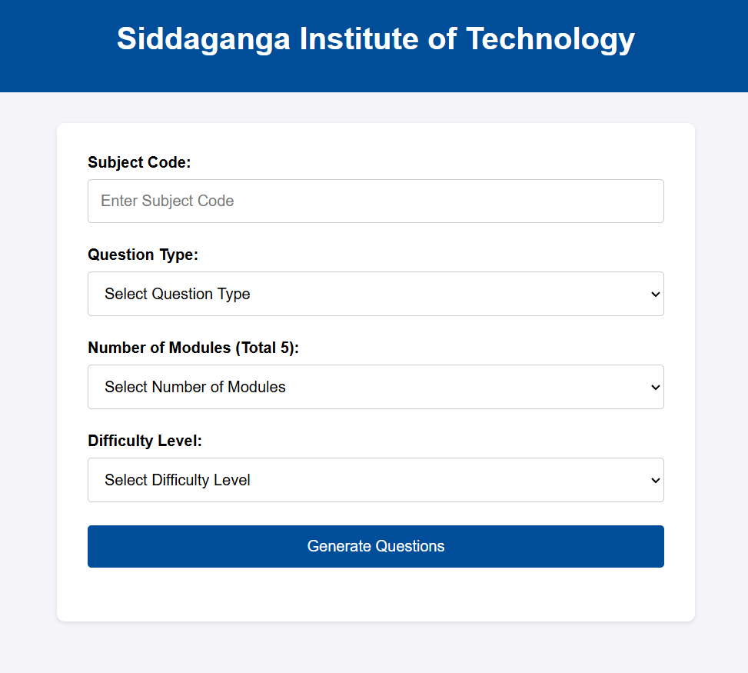
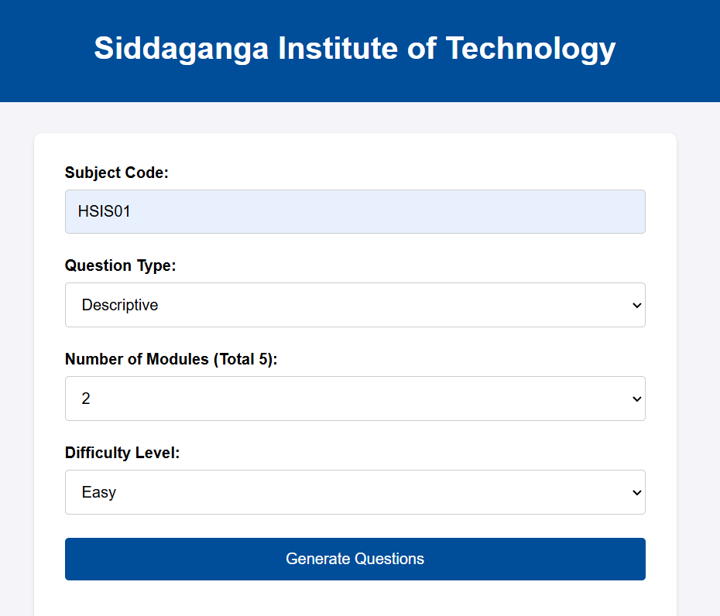
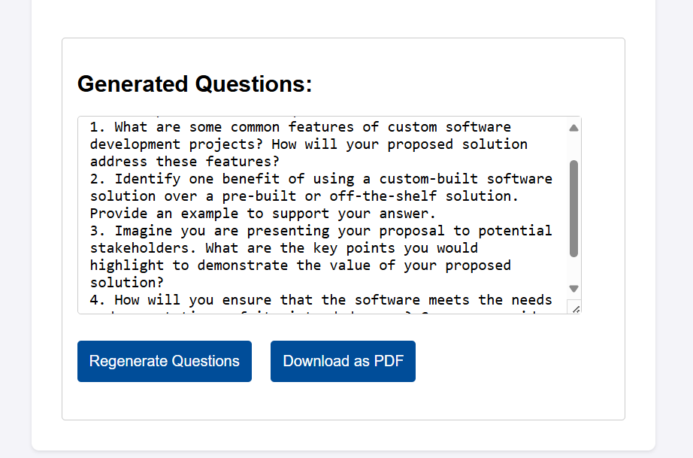
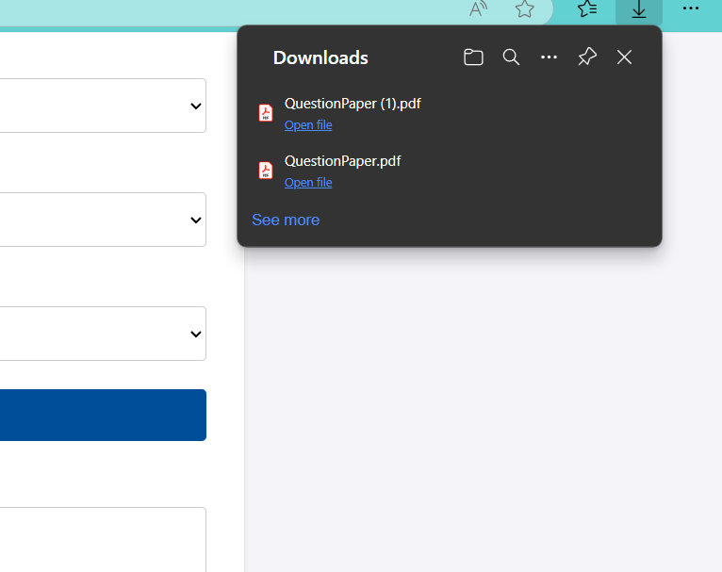
Demonstration of project work
Demonstration of project work
Dept. of ISE, SIT, Tumkur

Slide 16
APPLICATIONS
Applications
Educational institutions, including schools and colleges, can utilize the system to generate customized question papers that align with specific subjects and curricula.
Tutoring centers and online learning platforms can benefit from automated question paper generation tailored to their practice and assessment needs.
Researchers in educational fields can utilize QPGen to create standardized assessments for studies related to teaching methodologies, learning outcomes, or educational technology.
Dept. of ISE, SIT, Tumkur

Slide 17
CONCLUSION
Conclusion
In conclusion, QPGen represents a significant advancement in the automation of exam paper generation for SIT Organization. By leveraging Artificial Intelligence technology, this project addresses the inefficiencies of traditional methods, ensuring the creation of well-structured, diverse, and balanced question papers tailored to specific academic needs.
The expected outcome is a streamlined exam preparation process that reduces the workload for educators and administrative staff while maintaining high standards of quality.
As we move forward, we expect that QPGen will improve the exam preparation process and provide a foundation for future advancements in academic assessment.
As a result, teachers will save time and focus more on engaging with students. This tool can also be adopted by various educational institutions, promoting standardization and efficiency in exam preparation across subjects and grade levels.
Dept. of ISE, SIT, Tumkur

Slide 18
REFERENCES
References
[1] AI-Powered Question Paper Generation With NLP: Streamlining Assessment In Education" Dr. Deevi Hari Krishna, Mr. KANTHETI. RAJU MITHRA, Mr.JINKA BHANU PRAKASH,2023 IJCRT |Volume 11, Issue 12 December 2023 ISSN: 2320-2882.
[2]Simplifying Paragraph-level Question Generation via Transformer Language Models Luis Enrico Lopez, Diane Kathryn Cruz, Jan Christian Blaise Cruz, Charibeth Cheng | arXiv:2005.01107v4 [cs.CL] 13 Aug 2021.
[3] Question Generator and Text Summarizer Using NLP Sathwik Chettukindi¹, Uma Maheshwar Rao Dhinthakurthy, Chakrapani Seepathi', Dr. RRS. Ravi Kumar | Volume 11 Issue IV Apr 2023-Available at www.ijruset.com.
[4] Question Generation from PDF using LangChain Dinesh Madhav ,Urvashi Patel ,Sanskruti Nijai ,Komal Champanerkar |978-93-80544-51-9/24/©BVICAM, New Delhi, India
[5] An Effective Query System Using LLMs and LangChain , Jithendra Sai,Adith Sreeram a | Article in International Journal of Engineering Research and · July 2023.
[6] Automated Question Generator System Using NLP LIBRARIES Priti Gumaste¹, Shreya Joshi, Srushtee Khadpekar³, Shubhangi Mali , IRJET Volume: 07 Issue: 06 | June 2020 ,e-ISSN: 2395-0056
[7]Multi-purposed Question Answer Generator with Natural Language Processing ,Hiral Desai, Mohammed Firdos Alam Sheikh and Satyendra K. Sharma
Dept. of ISE, SIT, Tumkur

Slide 19
REFERENCES
References
[8] Automated Question Generator using NLP Tejas Chakankar¹, Tejas Shinkar², Shreyash Waghdhare', Srushti Waichal", Asst Prof. Mrs. M. M. Phadatare 1.2.3.4.5 Department of Computer Engineering AISSMS COE, Pune - SPPU | ISSN: 2321-9653, IC Value: 45.98, SJ Impact Factor: 7.538 Volume 11 Issue III Mar 2023
[9] Dynamic Question Answer Generator: An Enhanced Approach to Question Generation Rahul Bhatia, Vishakha Gautam, Yash Kumar, Ankush Garg |Volume: 3 | Issue: 4 | May-Jun 2019 e-ISSN: 2456-6470
[10] A question-answering framework for automated abstract screening using large language models Opeoluwa Akinseloyin, Msc, Xiaorui Jiang, PhD, Vasile Palade, PhD |Journal of the American Medical Informatics Association, 2024, 31(9), 1939-1952 https://doi.org/10.1093/jamia/ocas 166 Advance access publication 23 July 2024
[11] Question Generation for Reading Comprehension of Language Learning Test Junjie Shan , Ryosuke Yamanishi ,Yoko Mishihara ,Akira Maeda |https://ieeexplore.ieee.org/document/8959903
Dept. of ISE, SIT, Tumkur

Slide 20
Quires
Thank You one & all

