Slide 1

Hospital Database Management System
Group 7
Nguyen Hai Dang – 1952652
Tran Xuan Duc – 1552102
Pham Hoang Tung - 1852852
Lecturer: Dr. Tran Minh Quang
HCMUT – Database Systems lab – Semester 211

Slide 2
Table of contents
01
02
03
04
Introduction
Requirement description
Conceptual design
Logical design
Normalization form
05
06
Physical design
Implementation
07
08
Security
Application
09
10
Conclusion

Slide 3
01
Introduction

Slide 4
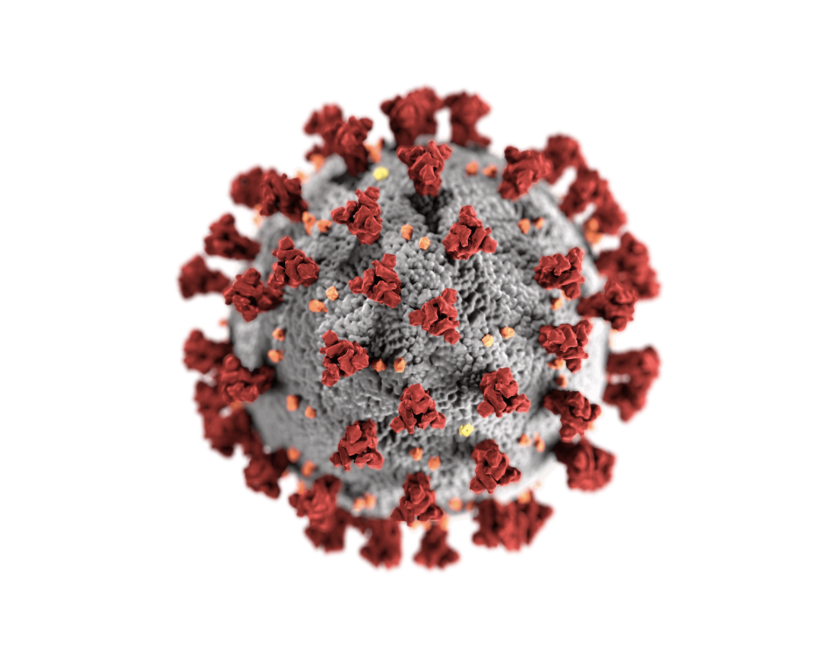
Problem
In the last 2 years, Covid-19 has forced healthcare industry to evolve.
The increasement of patients results in a faster growth of technology.
Organization must be performed with high efficiency with multi-level and roles interiorly.
=> DBMS is a tool effectively controlling the flow of system becoming paperless.

Slide 5
Background
Hospital Database Management System (HDMS)
- A system that facilities managing the functioning of a hospital
- Help making the whole functioning paperless
- The disease history, reports, prescribed treatment can be accessed by doctors without much delay in order to make an accurate diagnosis and monitor the patient’s health.

Slide 6
02
Requirement description

Slide 7
Requirement description
Doctor
is identified by id and belongs to at least 1 department
Patient
is identified by SSN, consults doctors and has a test or an operation done by doctors
Nurse
is identified by id, belongs to at least 1 department and takes care of the patients
Read the report for detailed description

Slide 8
03
Conceptual design

Slide 9
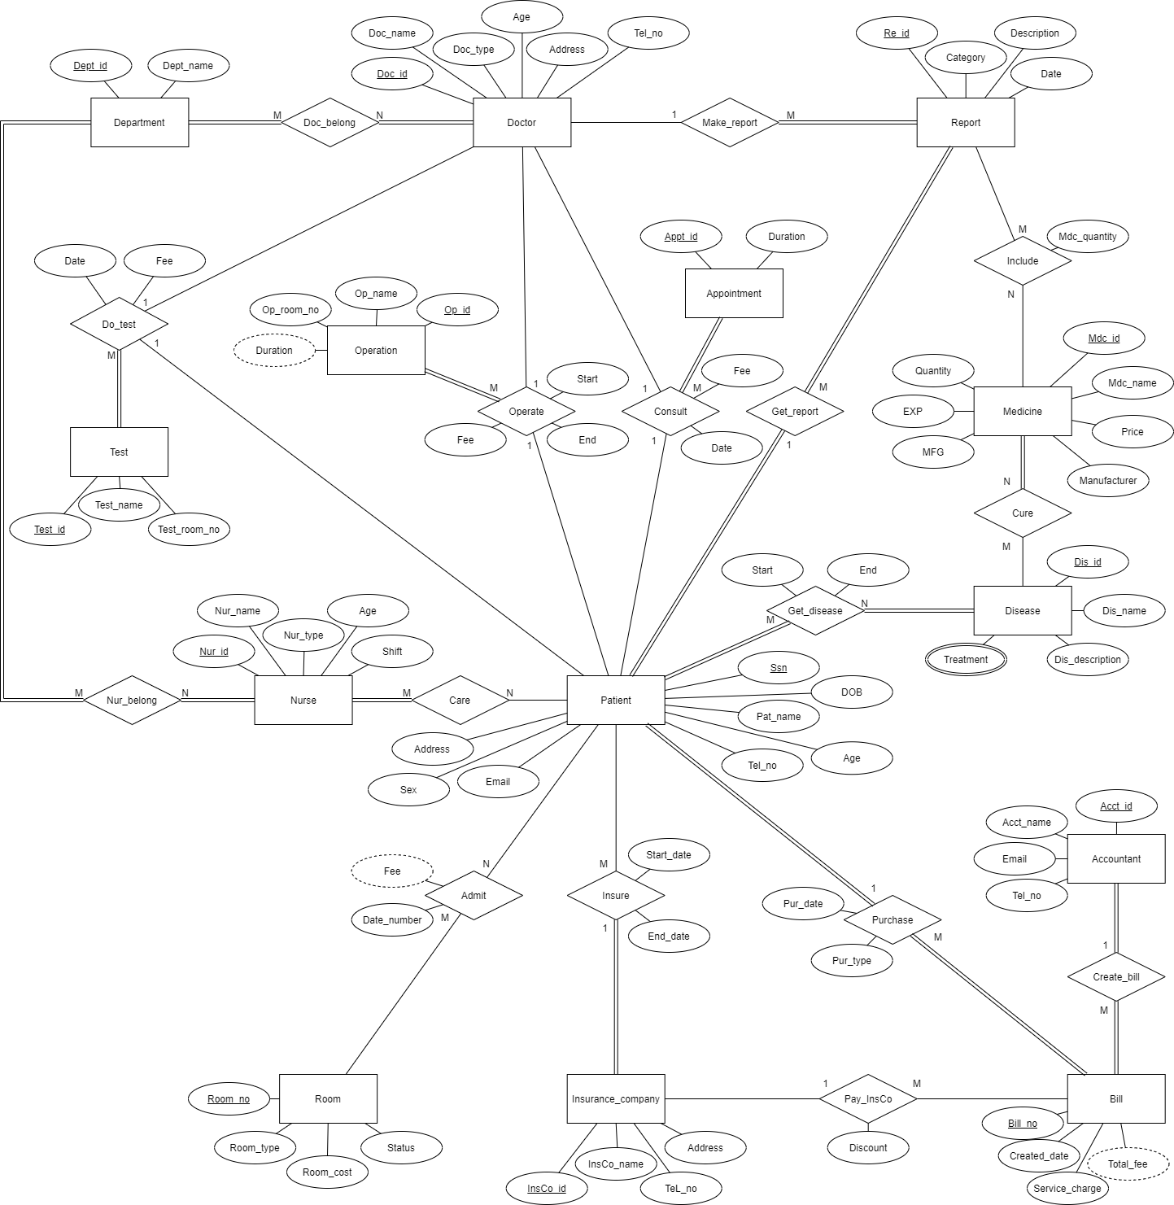
ERD Model

Slide 10
04
Logical design

Slide 11
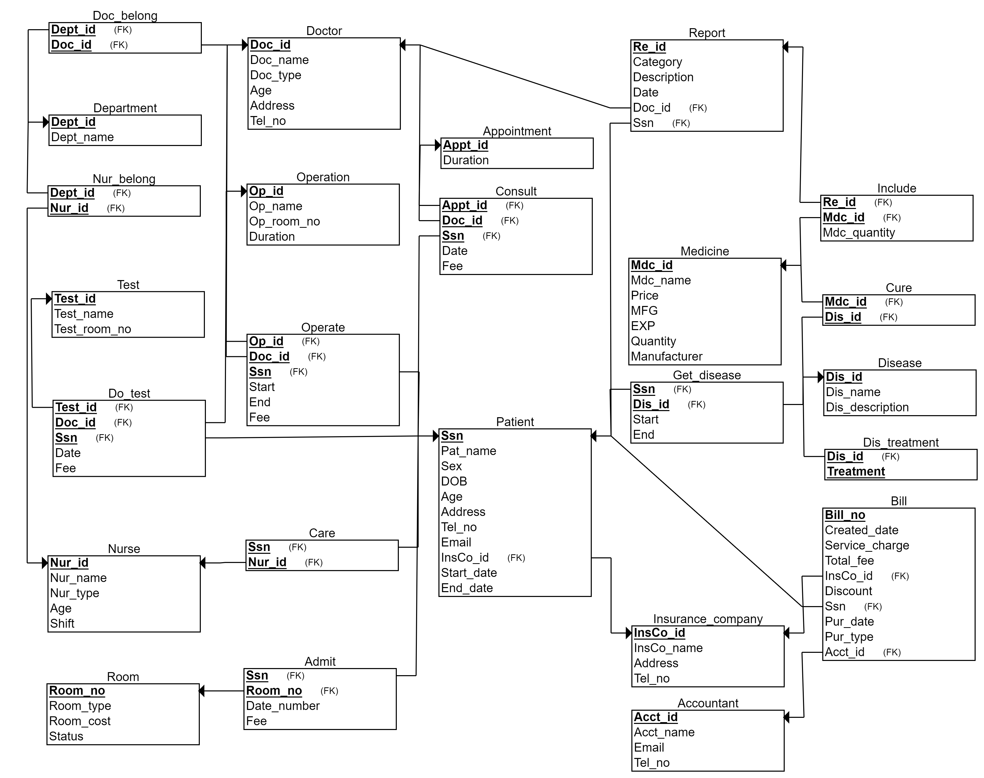
ERD to Relational Mapping

Slide 12
05
Normalization form

Slide 13
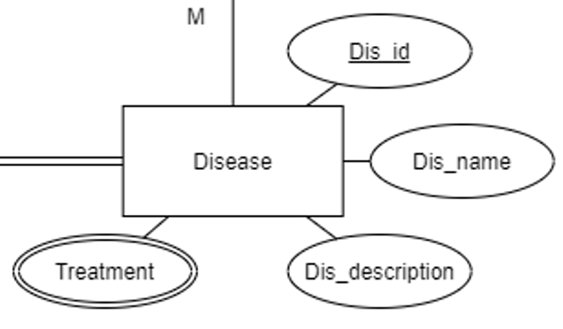
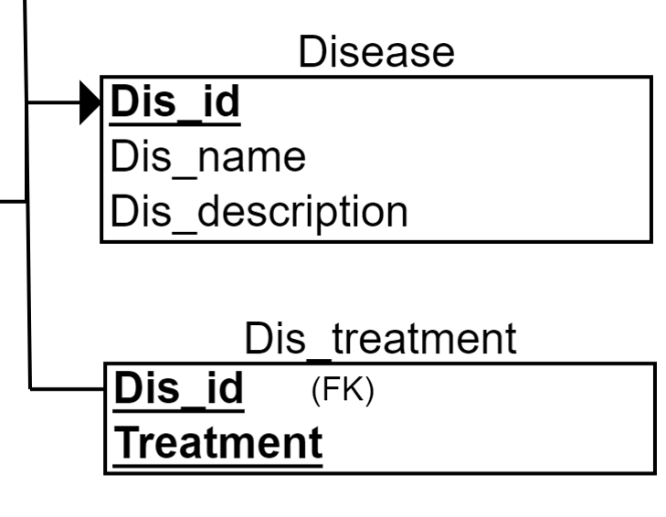
First Normal Form
There are not any 1NF violations
Mapping

Slide 14
Second Normal Form
There are not any 2NF violations
Doctor
Doc_id | Doc_name | Doc_type | Age | Address | Tel_no
Include
Re_id | Mdc_id | Mdc_quantity

Slide 15
Third Normal Form
There are not any 3NF violations
Patient
Ssn | Pat_name | Sex | DOB | Age | Address | Tel_no | Email | InsCo_id | Start_date | End_date

Slide 16
Boyce-Codd Normal Form
Stop at 3NF
since BCNF does not allows functional dependencies have the RHS as a prime attribute
Patient
Ssn | Pat_name | Sex | DOB | Age | Address | Tel_no | Email | InsCo_id | Start_date | End_date

Slide 17
06
Physical design

Slide 18
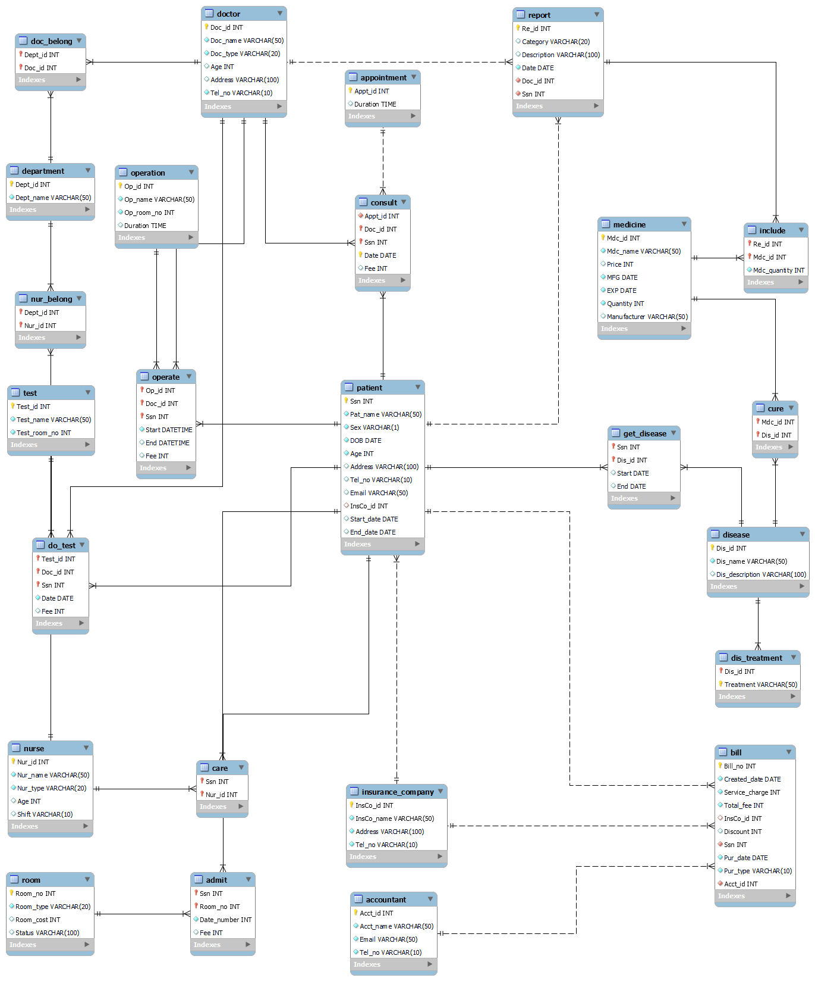
Data type
INT
VARCHAR()
DATE
TIME

Slide 19
07
Implementation

Slide 20
Setting up
CREATE SCHEMA Hospital
USE Hospital
CREATE 25 TABLES
INSERT DATA INTO 25 TABLES
DELETE Command
UPDATE Command

Slide 21
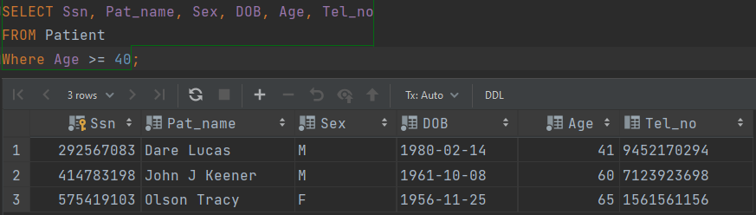
Query
Select patients whose ages are greater than or equal to 40

Slide 22
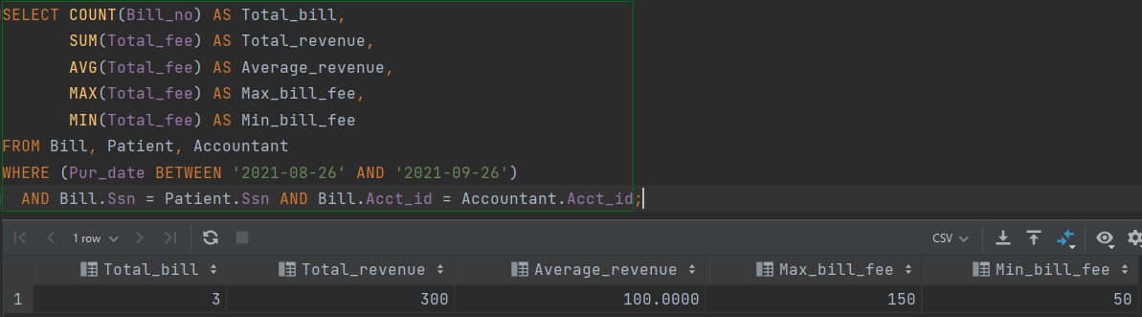
Query
Apply some aggregate functions to investigate the bills

Slide 23
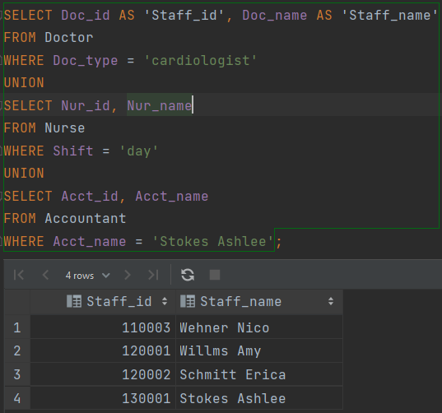
Query
Select id and name of all staff including doctors, nurses and accountants

Slide 24
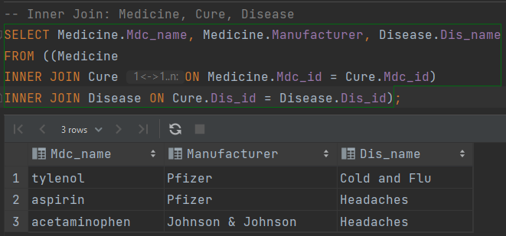
Query

Slide 25
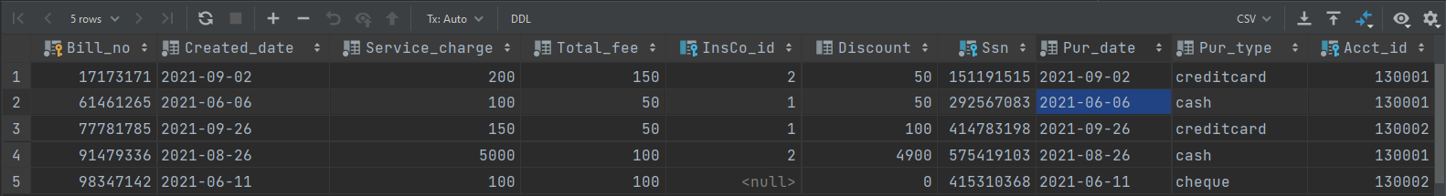
Stored procedures
Reusable, time saving and flexible
Bill table
Report about the bills from 2021-06-06 to 2021-07-06

Slide 26
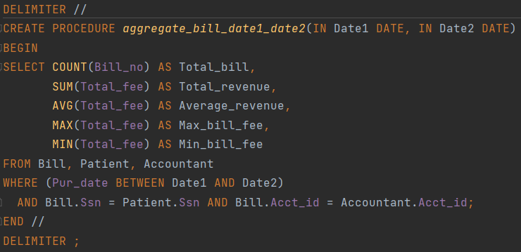
Stored procedures

Slide 27
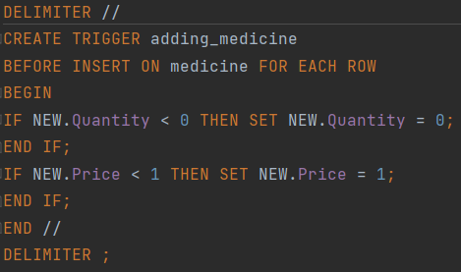
Trigger
Procedure that starts automatically if specified changes occur to the DBMS

Slide 28
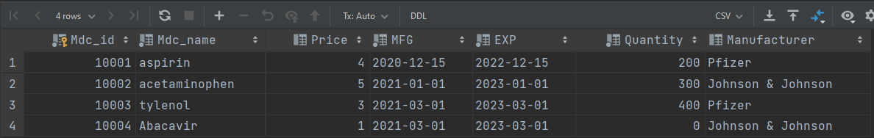
Trigger
Procedure that starts automatically if specified changes occur to the DBMS

Slide 29


Indexing

Slide 30
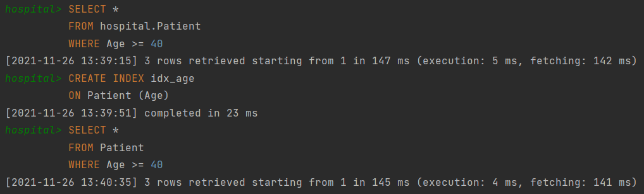
Indexing
Performance improved a little bit due to small data

Slide 31
08
Security

Slide 32
Database Attack Categories
SQL injection:
Taking advantage of query vulnerabilities in applications
Denial of service:
Slowing down a database server and can even make it unavailable to all users.
Insecure system architecture:
Weak authentication.
Loosy system classification

Slide 33
Role-Based Access Control (RBAC)
Advantages
Disadvantages
Improve operational efficiency
Enhance compliance
Increased administrator visibility
Discount
Reduce the risk of data breaches and leaks
Difficult to manage and maintain
It is static
Evaluating access rights is difficult, error-prone, and lengthy

Slide 34
09
Application
Demonstration

Slide 35
10
Conclusion

Slide 36
Lessons learnt
DBMS designing
Understand the pipeline and apply theory into real problem
App
Know how to attach a database to an hospital app
Teamwork
Handle unexpected problems

Slide 37
Thanks
Do you have any questions?

