Slide 1
HCMUT • Capstone Project P6
Boolean Network Analyzer
Parsing, simulating, and analyzing Boolean networks
Tran Phan Dang Khoi • Student ID 2352626
Faculty of Computer Science & Engineering — HCMUT
Capstone Project — Artificial Intelligence Track • 2025–2026

Slide 2
Agenda
What we cover today
01
Motivation
Why model with Boolean networks?
02
Theory
Influence graph, update schemes, STG, attractors
03
System design
Architecture and module overview
04
Implementation
Parser, engine, UI
05
Demo
Live walkthrough of the Streamlit app
06
Validation
Reference networks and test results
07
Conclusion
Limitations and future work
Boolean Network Analyzer • Tran Phan Dang Khoi • HCMUT CSE
2 / 14

Slide 3
Motivation
Why Boolean networks?
ON/OFF abstraction of complex regulatory circuits
Reproduce qualitative dynamics when quantitative parameters are unknown
Cell-cycle, signal-transduction, gene regulatory networks
Synthetic biology design and analysis
Discrete state space — exhaustively analysable for small n
2ⁿ
states for n nodes
n = 10 → 1,024
n = 20 → ~1 million
n = 30 → ~1 billion
But: 2^n curse of dimensionality
A 20-node network has ~10^6 states; 30-node has ~10^9. Manual inspection is impossible — tooling is essential.
Boolean Network Analyzer • Tran Phan Dang Khoi • HCMUT CSE
3 / 14

Slide 4
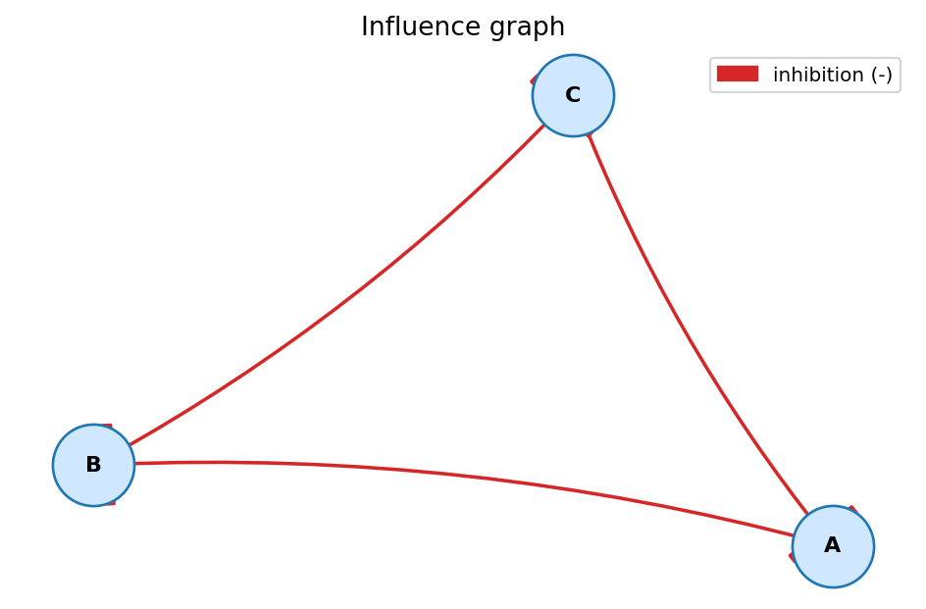
Boolean networks — formal definition
A Boolean network is a tuple (V, F)
V = {x₁, …, xₙ} — finite set of Boolean variables (genes, proteins, …)
F = {f₁, …, fₙ} — Boolean update rules: fᵢ : {0,1}ⁿ → {0,1}
State at time t : s(t) ∈ {0,1}ⁿ
Dynamics: s(t+1) determined by F and the chosen update scheme
Example — bistable toggle switch (.bnet)
targets, factors A, !B B, !A
Influence graph of the
3-gene repressilator
Boolean Network Analyzer • Tran Phan Dang Khoi • HCMUT CSE
4 / 14

Slide 5
Update schemes
Which nodes update at each time step?
Synchronous
Asynchronous
Every node updates simultaneously
sᵢ(t+1) = fᵢ(s(t)) for all i
Fully deterministic — out-degree 1 in the STG
Original Kauffman (1969) formulation
Simple to analyse, but biologically idealised
Exactly one node updates per step
Choice is non-deterministic among nodes whose rule disagrees
STG branches — out-degree ≥ 1
Self-loop on every fixed point
Biologically more realistic
Boolean Network Analyzer • Tran Phan Dang Khoi • HCMUT CSE
5 / 14

Slide 6
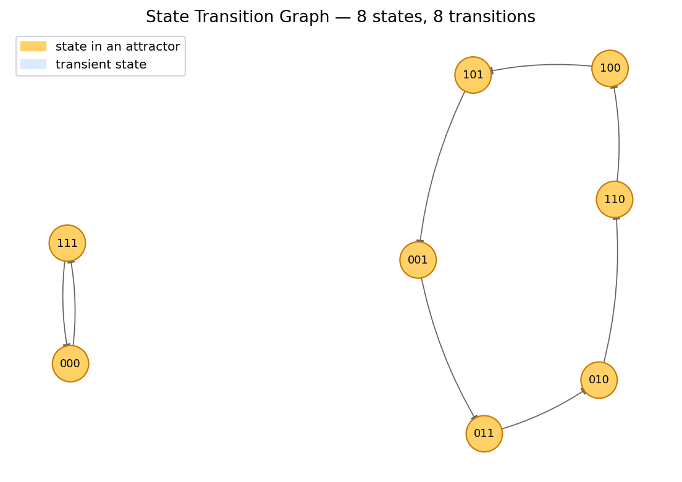
State-Transition Graph & attractors
STG
Nodes = the 2ⁿ possible states
Edges = one-step transitions under the chosen update scheme
Attractor = terminal SCC
Fixed point — singleton SCC, stable steady state
Cyclic — SCC is a single directed cycle
Complex — branching SCC (only under async)
Basin of attraction = states whose trajectory ends in A
Synchronous STG of the repressilator — yellow = attractor
Boolean Network Analyzer • Tran Phan Dang Khoi • HCMUT CSE
6 / 14

Slide 7
System architecture
Presentation layer
app.py — Streamlit web UI: sidebar (load / scheme), 5 tabs (influence graph, STG, attractors, simulate, source)
Engine — bnanalyzer Python package
parser • network • stg • attractors • visualize
Storage & I/O
.bnet files (samples + user uploads) • PNG export of figures • validation through pytest
Boolean Network Analyzer • Tran Phan Dang Khoi • HCMUT CSE
7 / 14

Slide 8
Implementation highlights
Parser & evaluator
STG & attractors
Tokenises both symbolic (!, &, |) and word (not, and, or) operators
Validates: unique targets, declared inputs, syntactic correctness
Compiles each rule with Python compile() → fast evaluation
Sign inference: enumerate other inputs, compare output for source 0/1
build_state_transition_graph(net, scheme): full 2ⁿ enumeration
Sync: out-degree = 1 (deterministic)
Async: branch on every node whose rule disagrees with current value
Attractors = terminal SCCs in nx.condensation(g)
Classify by structure: fixed / cyclic / complex
def evaluate_all(self, state):
ctx = self.state_to_dict(state)
return tuple(
eval(c, {}, ctx)
for c in self._compiled.values())
def find_attractors(g): cond = nx.condensation(g) return [members(c) for c in cond if cond.out_degree(c) == 0]
Boolean Network Analyzer • Tran Phan Dang Khoi • HCMUT CSE
8 / 14

Slide 9
Streamlit UI
Five tabs over a shared sidebar
+ available as a no-install in-browser JavaScript port (docs/app.html) — same panels, validated to match the Python engine on every sample
1
Influence graph
Sign-coloured network drawing: + activation, - inhibition, ? non-monotonic
2
STG
Full state-transition graph; attractor states highlighted in yellow
3
Attractors
Every attractor with its kind, member states, and weak basin
4
Simulate trajectory
Step from any initial state; sync or async
5
Source
Raw .bnet text with download button
Boolean Network Analyzer • Tran Phan Dang Khoi • HCMUT CSE
9 / 14

Slide 10
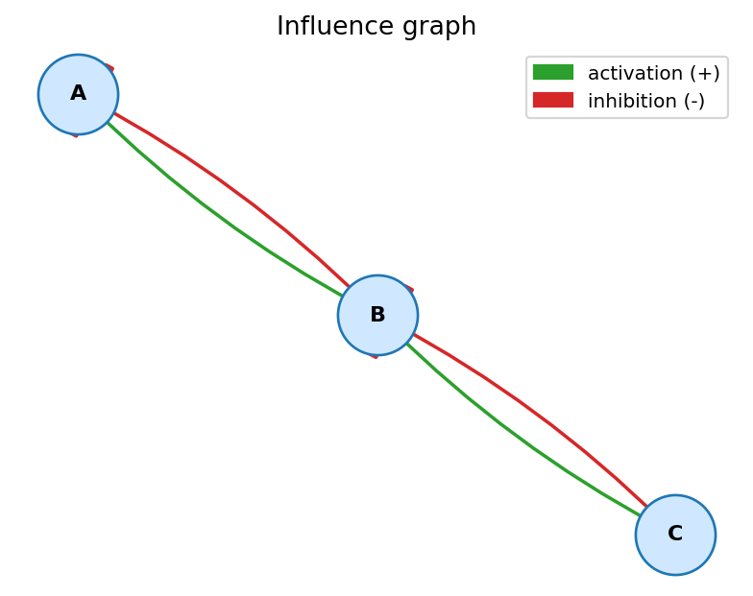
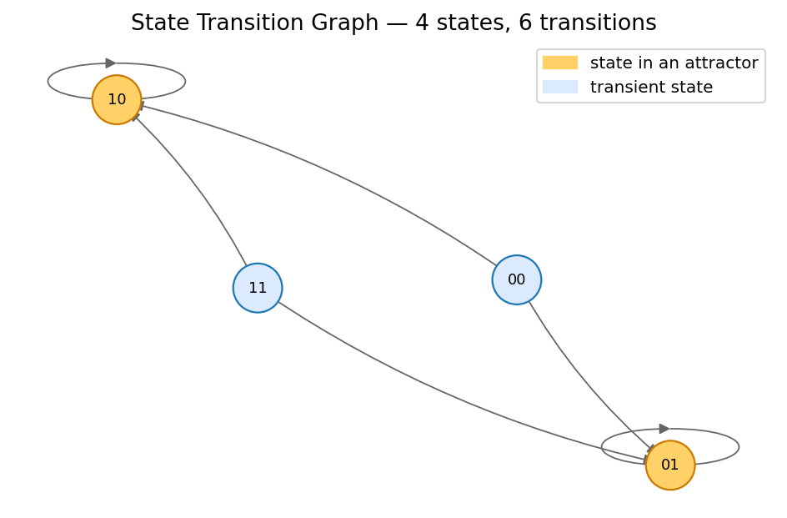
Demo & case studies
toy_switch.bnet — single length-4 cyclic attractor
repressilator.bnet — 3 inhibitions in a cycle
Sync STG — length-6 cycle + length-2 cycle
Async STG — bistable toggle, 2 fixed points
Boolean Network Analyzer • Tran Phan Dang Khoi • HCMUT CSE
10 / 14

Slide 11
Validation against reference networks
Network | n | Sync attractors (kind / basin %) | Async attractors (kind / basin %) | Verdict
toy_switch (pedagogical) | 3 | 1 cyclic-4 (100 %) | 1 complex-8 (100 %) | OK
bistable_toggle (Gardner 2000) | 2 | 2 fixed pts (25 % each) + 1 cyclic-2 (50 %, sync artefact) | 2 fixed pts (75 % each) | MATCH bistability
repressilator (Elowitz 2000) | 3 | 1 cyclic-6 (75 %) + 1 cyclic-2 (25 %, artefact) | 1 cyclic-6 (100 %) | MATCH oscillation
fission_yeast (Davidich 2008) | 9 | 3 cyclic-2: basins 456 / 50 / 6 (89.1 / 9.8 / 1.2 %) | 1 complex-8 (100 %) | MATCH G1 dominance
mammalian_cycle (Faure 2006) | 10 | 1 FP (G0, 50 %) + 1 cyclic-7 (50 %) | 1 FP (50 %) + 1 complex-112 (50 %) | MATCH cycling region
Independently re-verified: on every (network × scheme) pair the Python reference engine and the in-browser JavaScript engine return attractors with identical kind, size, and member states.
Boolean Network Analyzer • Tran Phan Dang Khoi • HCMUT CSE
11 / 14

Slide 12
Testing & engineering quality
23
5
<1s
pytest tests, all passing
reference networks bundled
runtime for the full suite
Coverage
Parser: malformed inputs, dangling references, comments, word/symbol operators
Engine: rule evaluation, state encoding, influence-graph signs
STG: out-degree under sync vs async, self-loops on fixed points
Attractors: bistable toggle, repressilator (length-6 cycle), constant rules
Boolean Network Analyzer • Tran Phan Dang Khoi • HCMUT CSE
12 / 14

Slide 13
Limitations & future work
Current limits
Roadmap
Explicit 2ⁿ enumeration → comfortable up to ~16 nodes
Static layout for the STG: hard to read past 100 states
No probabilistic transitions
Only synchronous and full asynchronous schemes
Symbolic attractor detection (BDD / SAT) for n ≥ 30
Probabilistic Boolean networks
Knock-out / over-expression perturbation analysis
Export / import to GINsim and SBML-qual
Interactive STG layout (D3 or pyvis)
Boolean Network Analyzer • Tran Phan Dang Khoi • HCMUT CSE
13 / 14

Slide 14
Thank you
Questions & discussion
Tran Phan Dang Khoi • Student ID 2352626
dangkhointmk@gmail.com
GitHub repository — see README.md for the live link

