Slide 1

Sales
Quantity
Customers

Slide 2




Customer Analytics
Warehouse Analytics

Slide 3
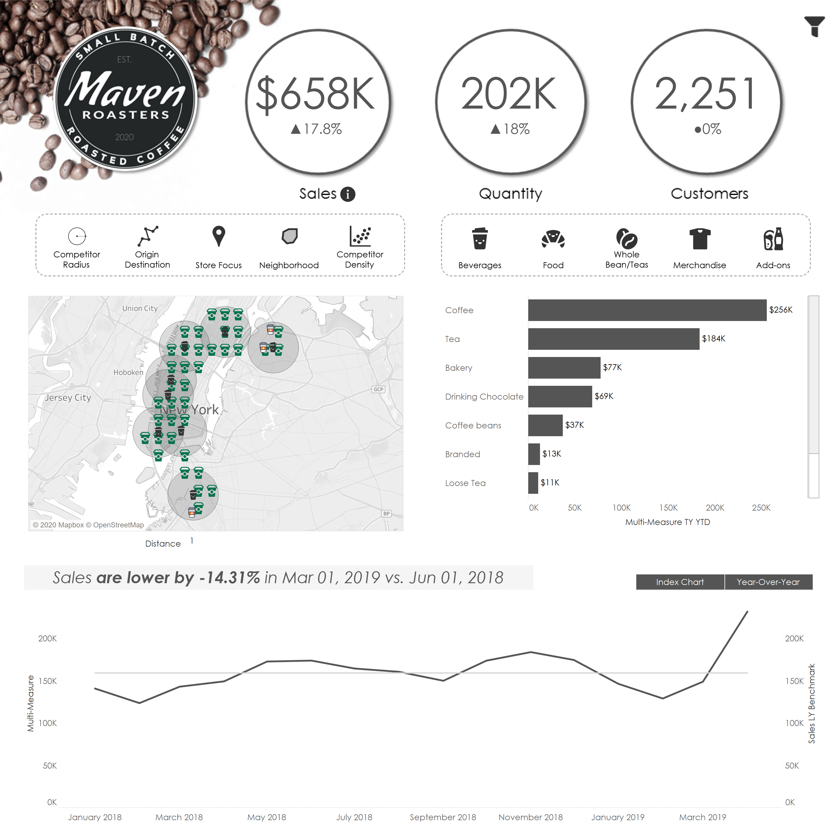
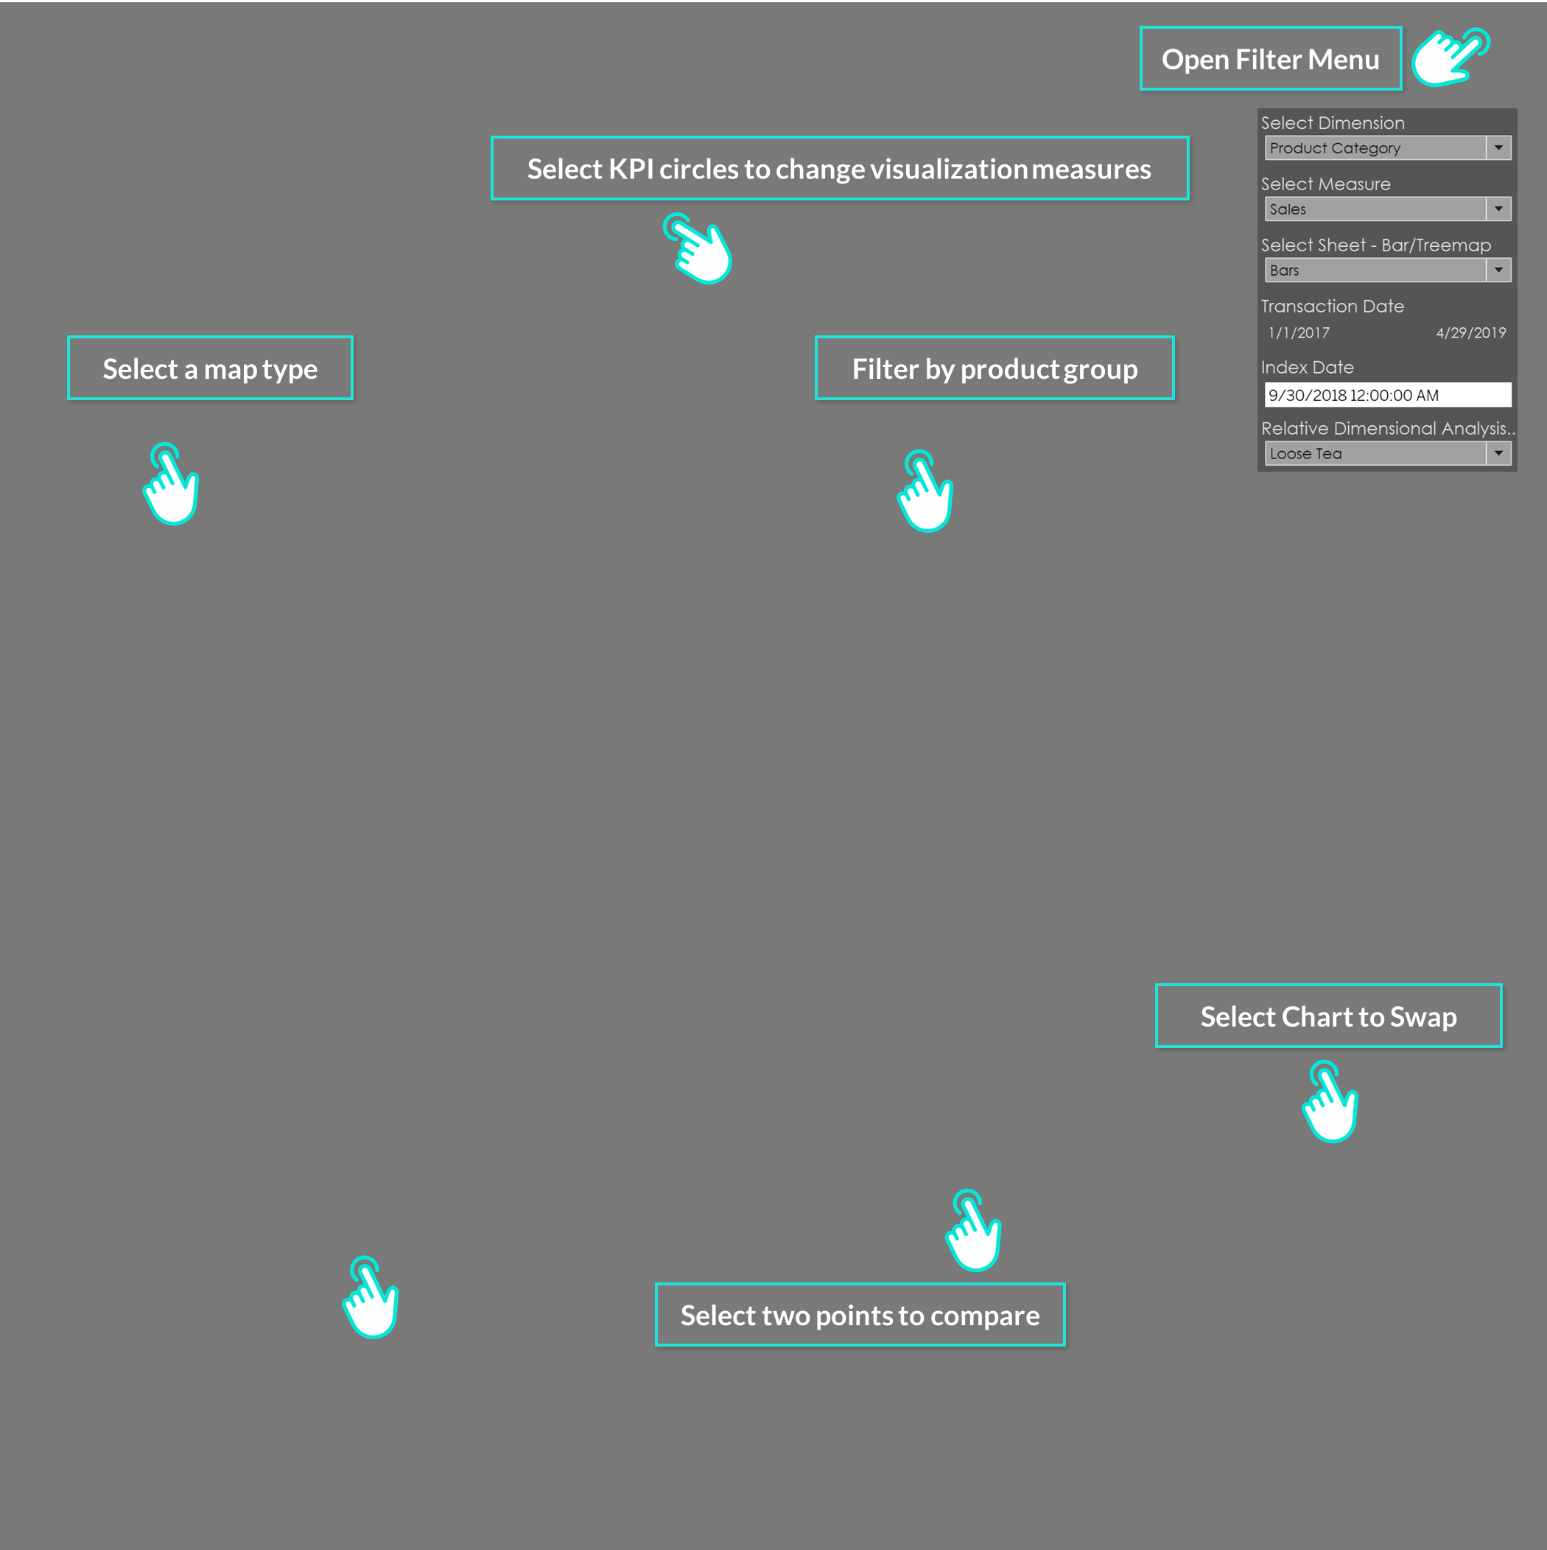

Slide 4

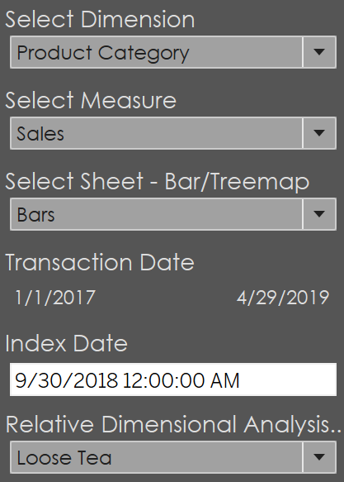
Open Filter Menu
Select KPI circles to change visualization measures
Select a map type
Filter by product group
Select Chart to Swap
Select two points to compare

