Slide 1
Presentation Title
By Author
Date

Slide 2
PowerPoint Resources
Corporate PowerPoint Template FAQ and Resources
This page provides resources, tips, and best practices for updating existing presentations as well as how to get started if you are creating a new presentation.
Presentation Guidelines
These guidelines explain how to keep your presentation visually up-to-date, when to use the confidential and nonconfidential templates, how to design visually compelling slides, and other best practices.
Highspot Sales Content System
Highspot (license required) is the centralized, up-to-date source for customer-facing slides and presentations, including release and product-related presentations as well as user story and technical article summary slides.
V26.0 Delete this slide before finalizing your presentation.
Questions concerning presentation design?
Contact Gabby Vendetti, glydon@mathworks.com

Slide 3
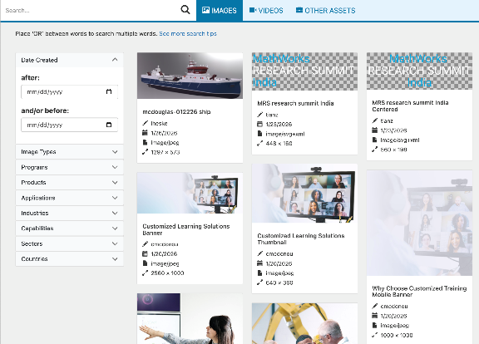
Image Resources
MathWorks Design System (Parula)
Learn how to create content that better represents the MathWorks brand and access MathWorks logos and release and service marks.
Best Practices for Finding Images and Stock Photos
Get guidelines for using the MathWorks Asset Library (with over 30k images), stock photography, illustrations, clip art, and more.
Pictogram Library
A standard collection of MathWorks pictograms available for use in presentations, diagrams, etc.
V26.0 Delete this slide before finalizing your presentation.

Slide 4

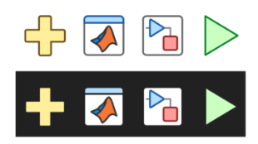
Image Resources
Technical and Workflow Diagram Toolkit
Create simple or complex technical diagrams using provided elements. Each component is an individual artifact for use in presentation materials or video assets.
Illustration Style
Get illustrations in categories including Avatars, Personas, Technology, Transportation, Sports, and more. Find the complete set alongside some rules and recommendations.
Icon ID Catalog (theme-able)
Find toolstrip, block, plot, and other in-product icons.
V26.0 Delete this slide before finalizing your presentation.

Slide 5
Using the Corporate Template
Avoid manually formatting whenever possible. Instead, use built-in styles, templates, layouts, and colors.
When creating new presentations, select the slide layout that best suits your needs from the built-in theme, then add content.
When creating custom shapes, text boxes, and other elements, start from scratch rather than reformatting template shapes.
When applying the new template to existing presentations, review your presentation carefully and manually adjust any formatting issues that have occurred. For additional help, contact Creative Services.
V26.0 Delete this slide before finalizing your presentation.

Slide 6

Color Palette
MathWorks Brand Colors
The corporate colors are included in the Theme Colors of this PowerPoint file; the primary brand colors and HEX values are shown below. For more colors such as utility and neutral colors, visit the brand guide Color Palette.
MATLAB Code Colors
They are not included in this file’s default Color Themes due to limited colors, but you can either enter the values below or use the Eyedropper or Format Painter to copy and apply them.
PRIMARY COLORS
UTILITY COLORS
HEX: 0076A8
HEX: B7312C
HEX: 00A9E0
REGULAR CODE
HEX: 000000
RGB: 0, 0, 0
KEYWORD
HEX: 0000ff
RGB: 0, 0, 255
HEX: D78825
HEX: F2A900
HEX: 715091
STRING
HEX: A020F6
RGB: 160, 32, 240
COMMENT
HEX: 228B22
RGB: 34, 139, 34
SECONDARY COLOR
HEX: 004B87
HEX: 48A23F
HEX: 636569
WARNING
HEX: FF6400
RGB: 255, 100, 0
ERROR
HEX: FF0000
RGB: 255, 0, 0
Swatches of these colors are included below. To apply them, select the element you’d like to apply a color to, select the eyedropper tool from the appropriate color palette menu, and click the swatch for the color you’d like to apply.
V26.0 Delete this slide before finalizing your presentation.

