Slide 1
Project
Big Data Storage and Processing

Slide 2
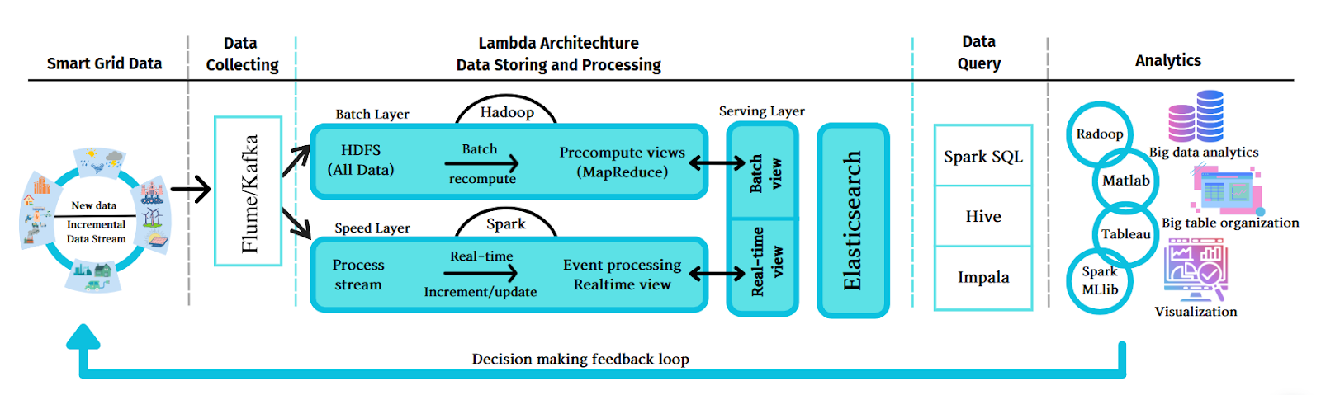
Objective
Build a big data storage and processing architecture with a full range of components as shown below including : data collection, storage, analysis and visualization
Notes:
Data Collecting: Kafka, ..
Database: GG bucket, Elasticsearch, MongoDB, …
Data query and process: Spark
Analytics: Kibana, …

Slide 3
Requirements
Functions
Building and installing an architecture
Collecting/Storing data having bigdata characteristics (minimum 3V volume-velocity-variety)
Dashboard with charts that help understand an overview of the data analysis
Data analysis: exploring the knowledge/information hidden under the data, helping to solve practical problems.

Slide 4
Some directions
Trend analysis
Detect unusual/typical events
Forecast price fluctuations
Detect fakes and scams
Evaluate KOLs on social networks
Analyze sentiments
Evaluate/forecast potential products
Data sources: kaggle.com, ourworldindata.org, data.world

Slide 5
Project description
Title:
  E.g: apartment rental price analysis in Vietnam
Data sources
  E.g: Crawl from internet (list url)
Requirements/Functions
  Collecting data: describe data to be collected including key features such as apartment area, location, number of rooms, price…, identify problems/challenges (missing data, irregular data structure, heterogeneity…)
  Storage requirement: expected volume of data for storage ….
  Processing/analysis: list the various types of analysis and visualization requirement. E.g calculating the average price over a period, predicting the rental price …. (statistical calculations should be included, and the use of machine learning/AI models is encouraged to discover hidden information within the data and assist in solving the practical problems identified)

