Slide 1

Database Project
Dang-Uy Nguyen
Professor Ostrow
IS410
May 15, 2023

Slide 2
Business Situation
Uber will use this database. Uber is a phone transportation app in which people can request rides to their destination. Uber drivers are on standby in their own vehicle and accept the rides request by the customers. Uber can use this database to store data about their customers, their drivers, the vehicle that the drivers own, and the ride data that links the driver and customer. Using this database, Uber will be able to view vehicle information that drivers own, the rides that drivers completed, who was the customer and driver of each ride, the pick-up address, the destination address, etc. Basic and contact information of both customer and driver are needed. The vehicle’s make, model, year, color, and license plate are needed. Finally, the pick-up address, destination address, customer ID, driver ID, and ride ID are needed.

Slide 3
Project Schedule
Understand and create the business situation: March 1, 2023
Create the ER diagram: March 10, 2023
Create the EER diagram: March 17, 2023
Create a Relational & SQL Schema: April 3, 2023
Create the database using SQL programming: May 16, 2023

Slide 4
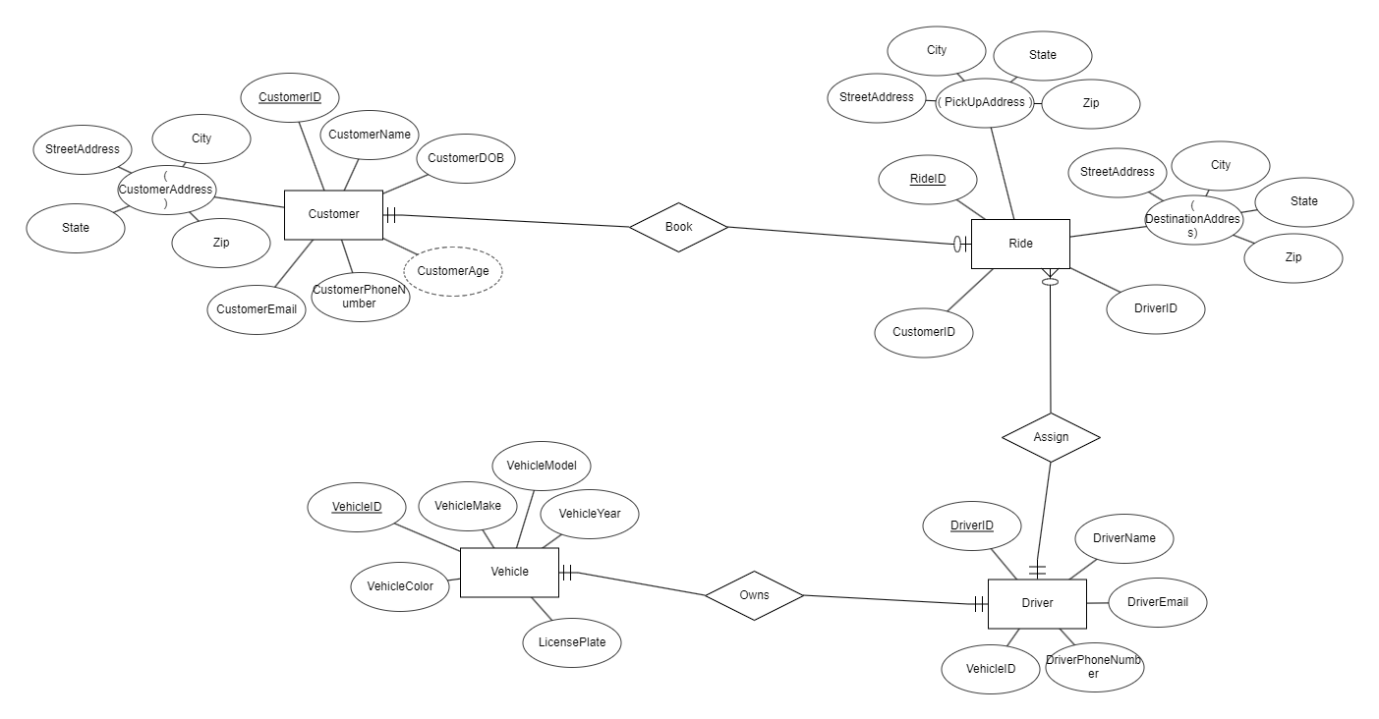
ER Diagram

Slide 5
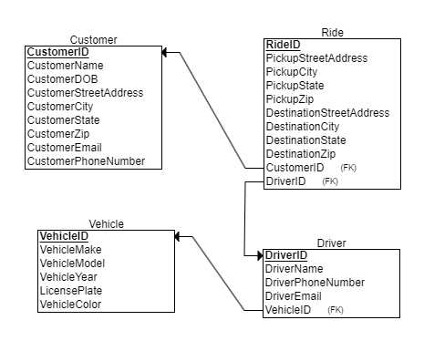
EER Diagram
Vehicle and Driver have a mandatory one-to-one relationship. Driver owns one vehicle for Uber.
Customer entity is optionally related to Ride entity. It is mandatory for Ride to have one customer. Customers can have many rides
Ride entity is mandatory one related to Driver, Driver is optional many related to Ride. Ride needs one driver. Driver can have many rides.

Slide 6
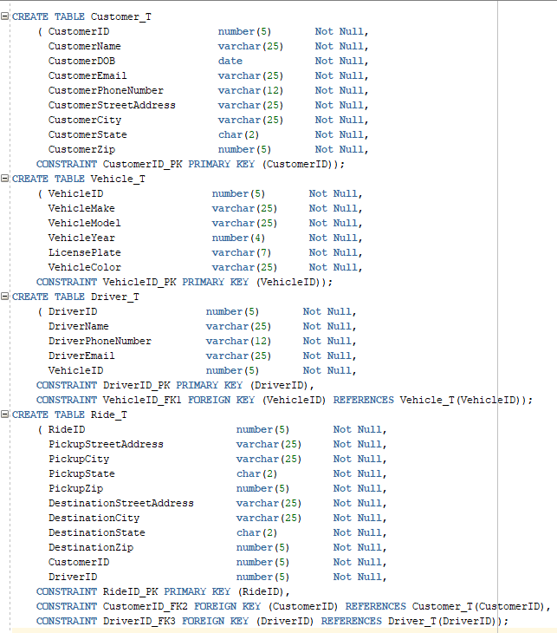
Creation of Tables SQL Commands

Slide 7
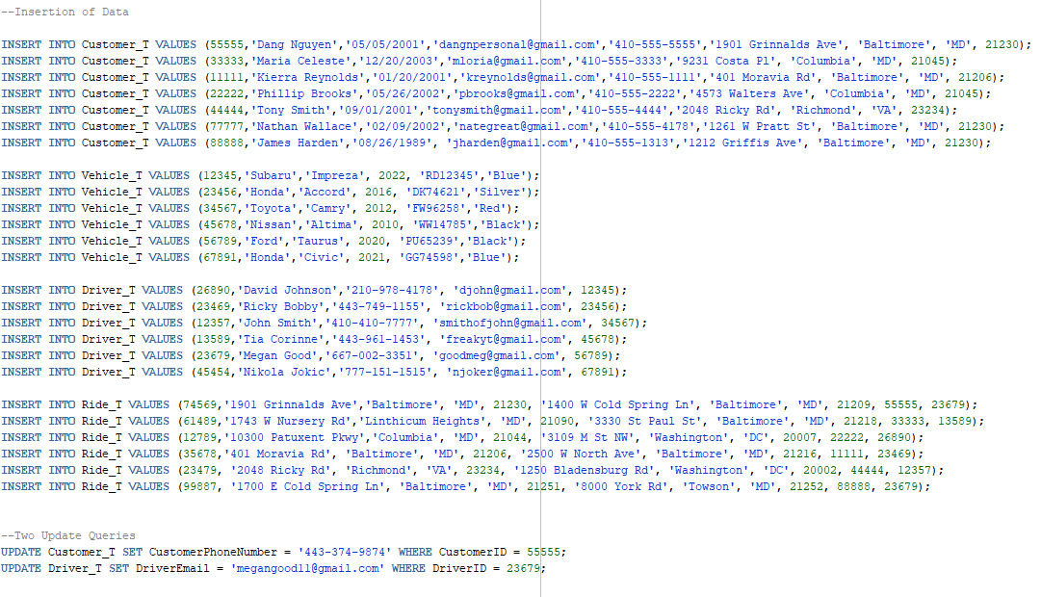
Insertion of Data & Updates SQL Commands

Slide 8
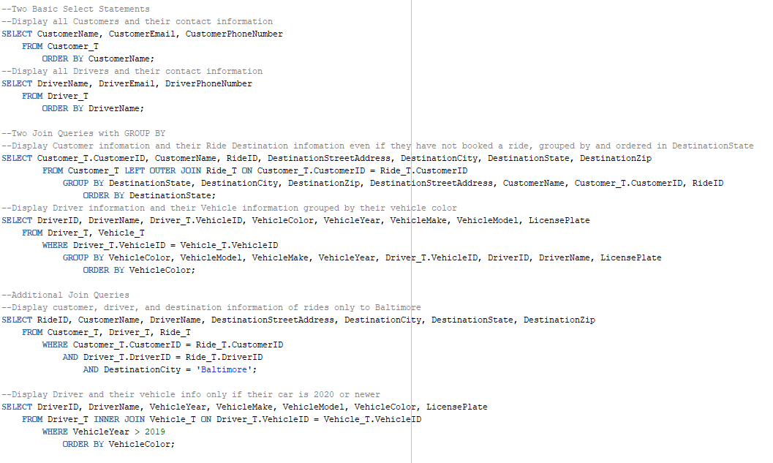
Join Queries ½ SQL Command

Slide 9
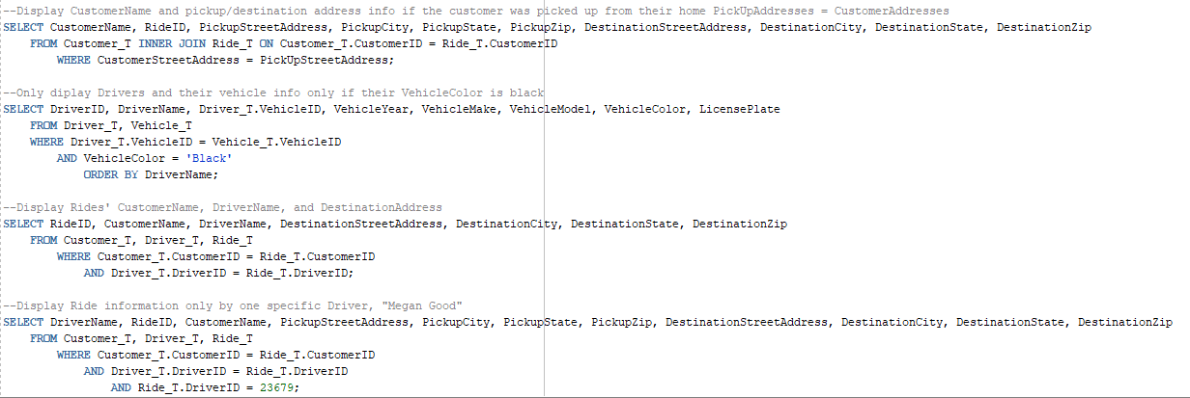
Join Queries 2/2 SQL Commands

