Slide 1

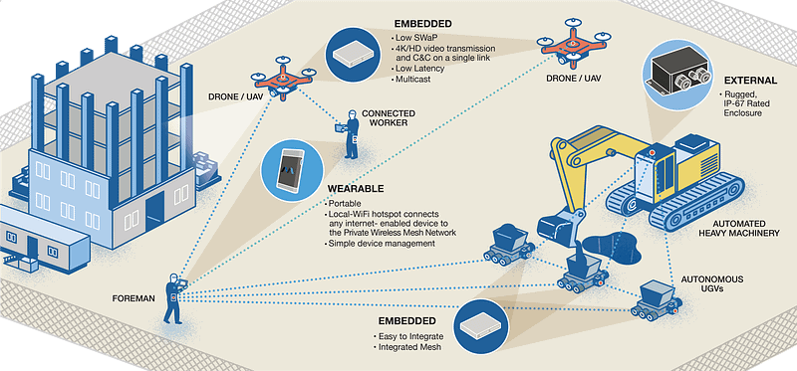
Nhat (Nick) Pham
Lecture 2: “Localization, Routing, and Networking”
(With grateful thanks to Andrew Markham)
https://www.wired.com/story/amazon-warehouse-robots/

Slide 2
Localization
Notes:
Ok, so now let’s talk a little bit about localization, or the problem of finding out where you are.

Slide 3
Overview
Acquiring sensor data without knowing where it came from is meaningless
How do we know where a thing is?
Notes:
Ok, so as you know, IoT clearly involves collecting data from a lot of different sensors, but acquiring sensor data without knowing where it came from is arguably a bit meaningless. And so this quickly raises the important question of how we can find out where a thing is, which is clearly a localization challenge.

Slide 4
Manual
Simplest way is to manually record where a device was left
No additional device hardware required
Hugely labour intensive
Not suitable for dense or mobile deployments
Notes:
So the simplest way of doing localization is clearly to just manually record where any devices were left, and for coarse localization this does have some advantages. For example, there’s no additional device hardware required, and it’s technically trivial to implement.
However, if you’re using lots of devices, it quickly gets hugely labour intensive, and there’s a limit to how precise your localisation is going to be in practice when done this way. This makes it difficult to put lots of devices close together, for instance.
It’s also obviously not going to work if your sensors can move around, or at any rate not on its own.

Slide 5
GPS/GNSS
De facto outdoor positioning solution
Typical accuracies of:
a few metres (standard mode)
a few millimetres (real-time kinematic mode)
As a side-effect of navigation, also provide nanosecond level timing reference
Notes:
So outdoors, at least on Earth, we do have an established way of doing localization, namely GPS/GNSS. And considering that this operates at a global scale, it’s pretty good, in that it’s able to give us accuracies of a few metres in standard mode, and a few millimetres in real-time kinematic (or RTK) mode. It’s also capable of giving us nanosecond-level timing based on the GPS clock, which is accurate to around 14 billionths of a second.

Slide 6
GPS/GNSS
Not available indoors/underground/in cluttered environments
High power consumption to obtain a fix
Increases physical size
Increases system cost by ~£10-20 per unit
Notes:
However, GPS/GNSS isn’t a cure for all our woes, unfortunately. For starters, it doesn’t work at all indoors or underground, and performs poorly in cluttered environments and urban canyons. Moreover, the power consumption required to obtain a fix can be quite high, the GPS receiver takes up some space, and the overall cost of a system using GPS will generally be around £10-20 higher than one not using it (based on the current price of GPS receivers).

Slide 7
WiFi
WiFi access points are ubiquitous
Recall our channel modelling
If we assume free-space model, we can relate received signal strength (RSSI) to distance
Given three or more distance measurements, simple trilateration can determine the position of the receiver
Notes:
So what else can we use for localization?
Well, one interesting choice, which has the potential to work well indoors, is to use WiFi access points.
This makes a lot of sense, since WiFi access points are ubiquitous in indoor environments. Moreover, by assuming a free-space model, we can relate the strength of the received signals (RSSI) to distance, and given three or more such distance measurements, simple trilateration can be used to determine the position of the receiver.

Slide 8
Trilateration
1.0
0.8
0.6
Location
0.4
0.2
0.0
0.2
0.0
0.2
0.4
0.6
0.8
1.0
1.2
Notes:
And so here’s a visual example of what we mean by trilateration. So the idea here is that you have distance measurements from each of the three landmarks, shown in blue, and that the location of the object is at the point where all three circles meet, so it’s possible to recover it by finding that intersection point.
Of course, that would be all well and good if we had accurate distance measurements, but in practice we only have noisy ones. And so in practice, trying to make a system like this work gets a little bit fiddly.
For example, in one approach, you first find all of the intersection points of the circles (together with those landmarks that support them). Then, you find the nearby intersection points for each intersection point, and blend them together to create a location candidate. Next, you try to compute a consistent orientation for each candidate based on its landmarks’ bearings. If this isn’t possible, you mark the candidate as inconsistent. Finally, you pick a consistent candidate with the most support and return it.

Slide 9
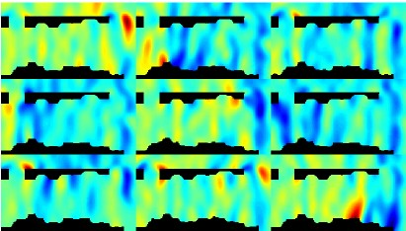
Radio map
In reality, especially indoors, trilateration does not work, as the channel is too complex to model, so we use techniques such as fingerprinting¹ instead.
¹Christian Beder, Alan McGibney, and Martin Klepal. “Predicting the expected accuracy for fingerprinting based WiFi localisation systems”. In: Indoor Positioning and Indoor Navigation (IPIN), 2011 International Conference on. IEEE. 2011, pp. 1–6.
Notes:
Even if you do all of that, though, trilateration often doesn’t work very well, especially indoors, as the channel tends to be too complex to model. So in reality, we tend to use techniques such as fingerprinting instead, as we’ll talk about on the next slide. And the paper mentioned on this slide is one example of a system that does that.

Slide 10
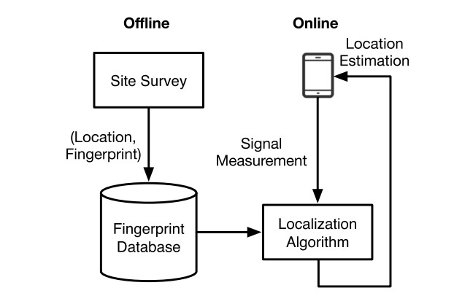
Fingerprinting
Rather than trying to model the variability, a simple way is to exploit these variations to determine location
Offline Phase: Survey (measure) WiFi fingerprints at multiple locations to build a fingerprint map
Online Phase: Given a measurement, determine the most likely location that would have produced it
Notes:
Ok, so fingerprinting is a conceptually simple approach in practice.
So initially, ahead of time, you survey the scene to measure a so-called WiFi fingerprint at each known location of interest. And here, a WiFi fingerprint can basically be thought of as some feature based on the strengths of all the different WiFi signals at a particular point. So this survey essentially produces a list of fingerprint and location pairs, which you can use to make a fingerprint -> location lookup table. And then later, when you’re in a live setting and you want to relocalise, all you need to do is create the WiFi fingerprint for your current location and compare it to all the existing fingerprints in the table. If there’s at least one that’s sufficiently similar to yours, you return the location of the most similar one; if not, you can’t relocalise at the moment, so you give up.
More complicated fingerprinting schemes are also possible, of course – for example, the paper mentioned on the previous slide describes an approach for creating a dense fingerprint map from a sparse set of survey points, and then using maximum likelihood estimation to estimate the position in a live setting.
One thing that’s interesting to note is that in practice, sparse fingerprinting schemes are very similar to the keyframe-based systems that see a lot of use in visual localisation: the only real difference is that here the features being used are based on WiFi signals, whereas in that case they would be based on the images.
Of course, one downside of both fingerprinting and keyframe-based localisation is that if we can’t compute a feature consistently for each location in the scene, then relocalisation will tend to fail. And one thing that’s pretty much guaranteed to cause that is changes to the scene, so techniques such as these are only usable in scenes that are mostly static.

Slide 11
The Horus Localization System
Horus² is a simple, probabilistic WiFi localization system
It builds a map that captures:
the mean signal strength
the variance (variability of readings)
the temporal stability (autocorrelation of readings)
It uses these surveyed parameters to estimate location
²Moustafa Youssef and Ashok Agrawala. “The Horus WLAN location determination system”. In: Proceedings of the 3rd international conference on Mobile systems, applications, and services. ACM. 2005, pp. 205–218.
Notes:
Ok, so now we’re going to talk a little bit about a specific WiFi localization system called Horus. And so this is quite an old approach from 2005, but it was notable for achieving average errors of less than 60cm, and with computational requirements that were more than an order of magnitude better than other WiFi localization systems at the time.
So in terms of how it works, it’s basically a simple, probabilistic approach. In its offline survey phase, it builds a radio map that captures the means and variances of the signal strengths from the various access points, and the stability of the readings over time. And then in its online phase, it uses this map to estimate the location. The details are a little beyond the scope of this course, but please see the paper if you’re interested. We’re also going to discuss a couple of interesting points made by the paper in the next couple of slides.

Slide 12
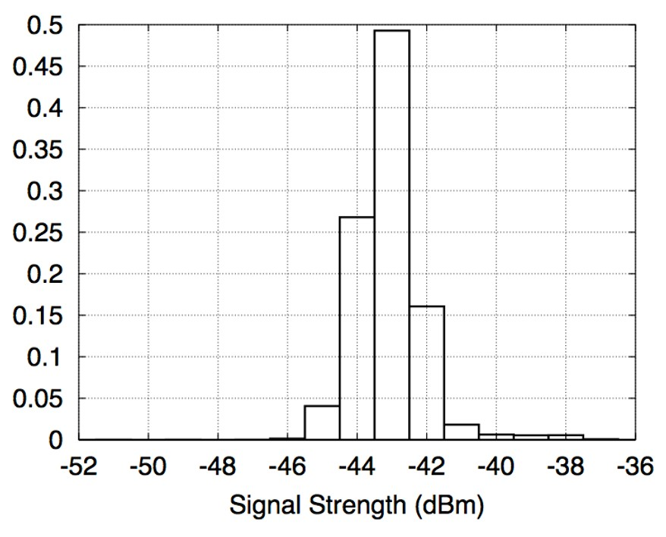
Temporal variation
5 minute WiFi signal variability histogram at a single location
Notes:
Ok, so here’s a graph from the paper of the signal strength as measured from a single access point over a five minute period. And what’s noticeable from this is that the histogram range can be as large as 10 dBm or more over that time period, largely due to changes in the physical environment such as people moving about.
And this is clearly quite a lot, and implies two things: firstly that it makes sense for the radio map to reflect this range of values to increase the accuracy, and secondly that the system should use more than one sample at test time to get a better estimate of the signal strength at a particular location.

Slide 13
Localization Weird and wonderful positioning techniques
Notes:
Ok, so we’ve just seen a bit about WiFi localization, but there are lots of other weird and wonderful positioning techniques out there, and in the next few slides we’re going to take a look at some of them to get a feel for what’s possible.

Slide 14
Where in the world am I?
We are not limited to using radio signals for localization
We can use any physical property that captures either absolute location or relative motion
We often use more than one modality (sensor fusion) to enhance robustness and accuracy
Notes:
So the first thing to note is that we’re not at all limited to using radio signals for localization!
In fact, we can use any physical property that captures either absolute location or relative motion to track our position.
And indeed, it’s often advantageous to use more than one modality to enhance robustness and accuracy, an area of study known as sensor fusion.

Slide 15
Inertial Measurement Units
Force must be applied to a device to move it around
By measuring the body acceleration, the device’s trajectory can be reconstructed
This can be done through double integration:
acceleration → velocity → displacement
Double integration suffers from accumulative drift
IMU sensors are present in all modern smartphones
Notes:
So one type of device that’s very useful for localization is an inertial measurement unit, or IMU, which commonly consists of an accelerometer that measures linear acceleration (or more precisely, specific force), a gyroscope that measures the rate of rotation, and sometimes also a magnetometer that measures heading.
And the reason this is useful for positioning is that a force must be applied to the device to move it around, and this will cause an acceleration that can be measured by the accelerometer. And this acceleration can be double-integrated to obtain the displacement of the device, from which we can reconstruct the device’s trajectory as it moves.
In practice, this isn’t quite as good as it sounds, because the process of double-integrating the acceleration suffers from significant accumulative drift. But despite this, IMUs are still very useful, for a number of reasons:
First, the angular velocity readings yielded by their gyroscopes only need to be integrated once and are thus subject to much less drift, making IMUs quite an accurate orientation sensor.
Second, like cameras, IMUs are ubiquitous, making them a natural target for use. And as an example of this, they’re included in all modern smartphones.
And finally, IMUs have strengths and weaknesses that naturally complement those of other localization approaches, and so they are ideal for combining with other approaches in sensor fusion schemes. For example, they can be used to convert a visual odometry approach to camera tracking into a visual-inertial one that’s much more accurate and can also survive brief movements of the camera in front of a blank white wall.

Slide 16
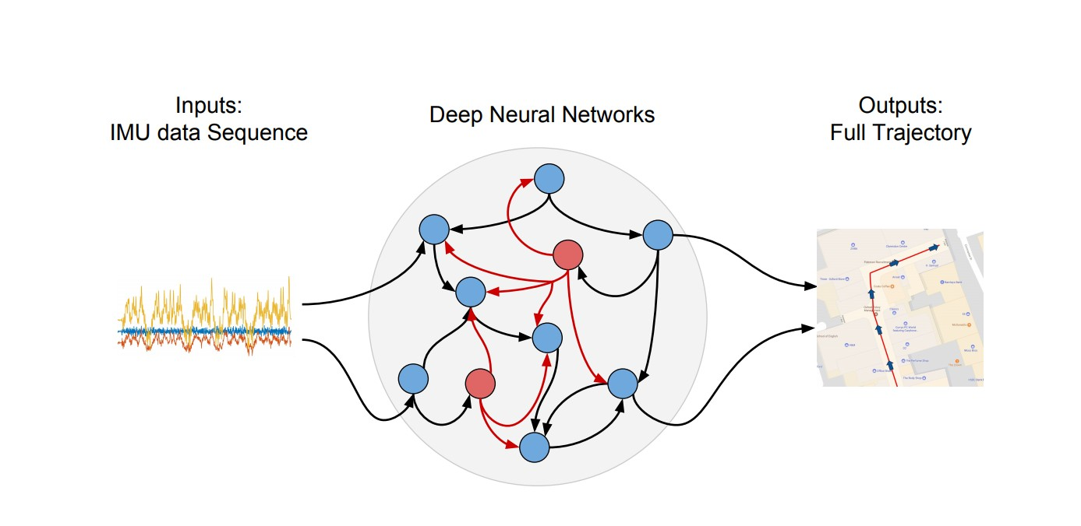
Inertial Measurement
Deep-learning the relationship between inertial sensors and resultant trajectory³
³Changhao Chen et al. “IONet: Learning to Cure the Curse of Drift in Inertial Odometry”. In: IEEE Transactions on Mobile Computing 2020.
Notes:
It’s also worth noting that the errors caused by double-integrating the acceleration can be mitigated to some extent using a deep recurrent neural network, as described in the paper mentioned in this slide. And this paper was actually worked on by some people who used to be in our group, so if you’re interested in talking about that then I’m sure Niki and Andrew would be very keen to have a conversation about it.

Slide 17
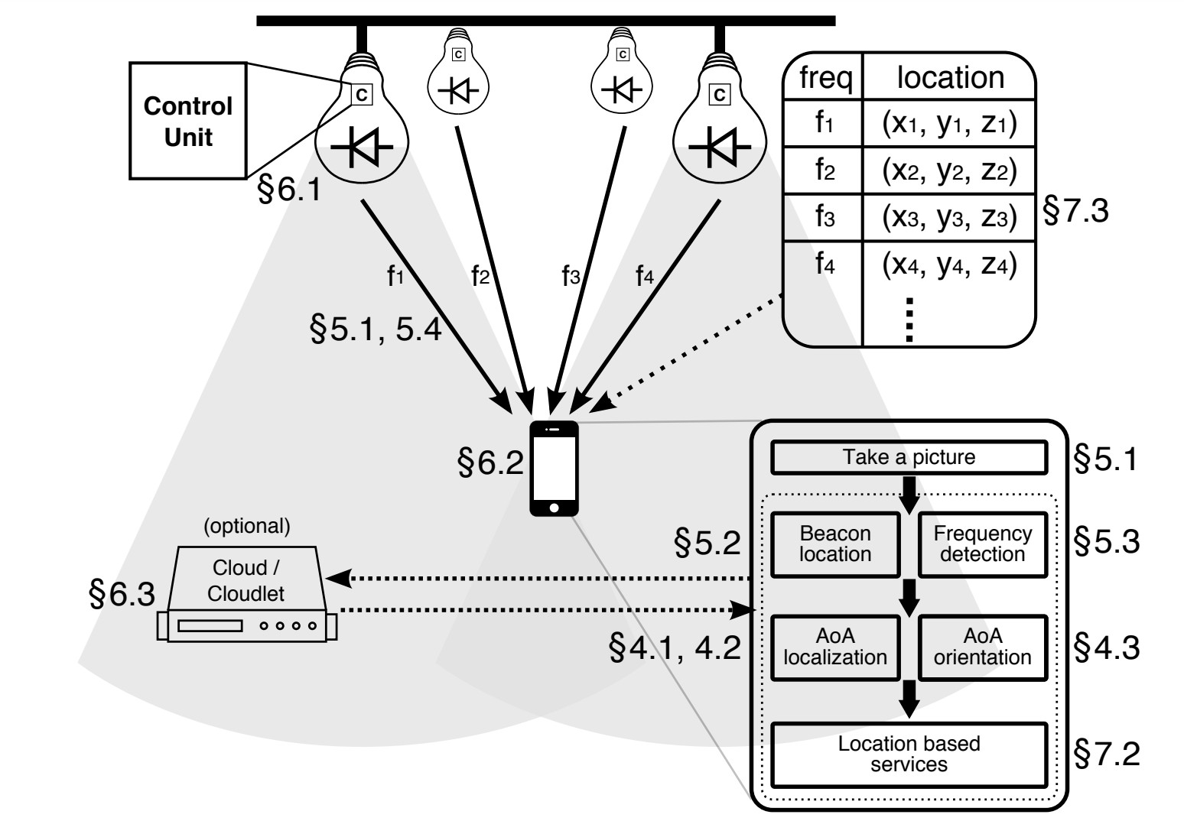
LiFi⁴
Use constellation of LEDs to determine 3-D location
⁴Ye-Sheng Kuo et al. “Luxapose: Indoor positioning with mobile phones and visible light”. In: Proceedings of the 20th annual international conference on Mobile computing and networking. ACM. 2014, pp. 447–458.
16
Notes:
Ok, so moving on, here’s yet another localization approach, this time using a constellation of LEDs to determine 3D location.
And so the basic idea here is that you have a number of LED luminaires in the scene, and these transmit their identifiers and/or locations in human-imperceptible optical pulses.
And then a smartphone with a camera can detect these luminaires in an image, and use their locations to determine the smartphone’s pose relative to the luminaires.
As usual, more details about all of this can be found in the referenced paper.

Slide 18
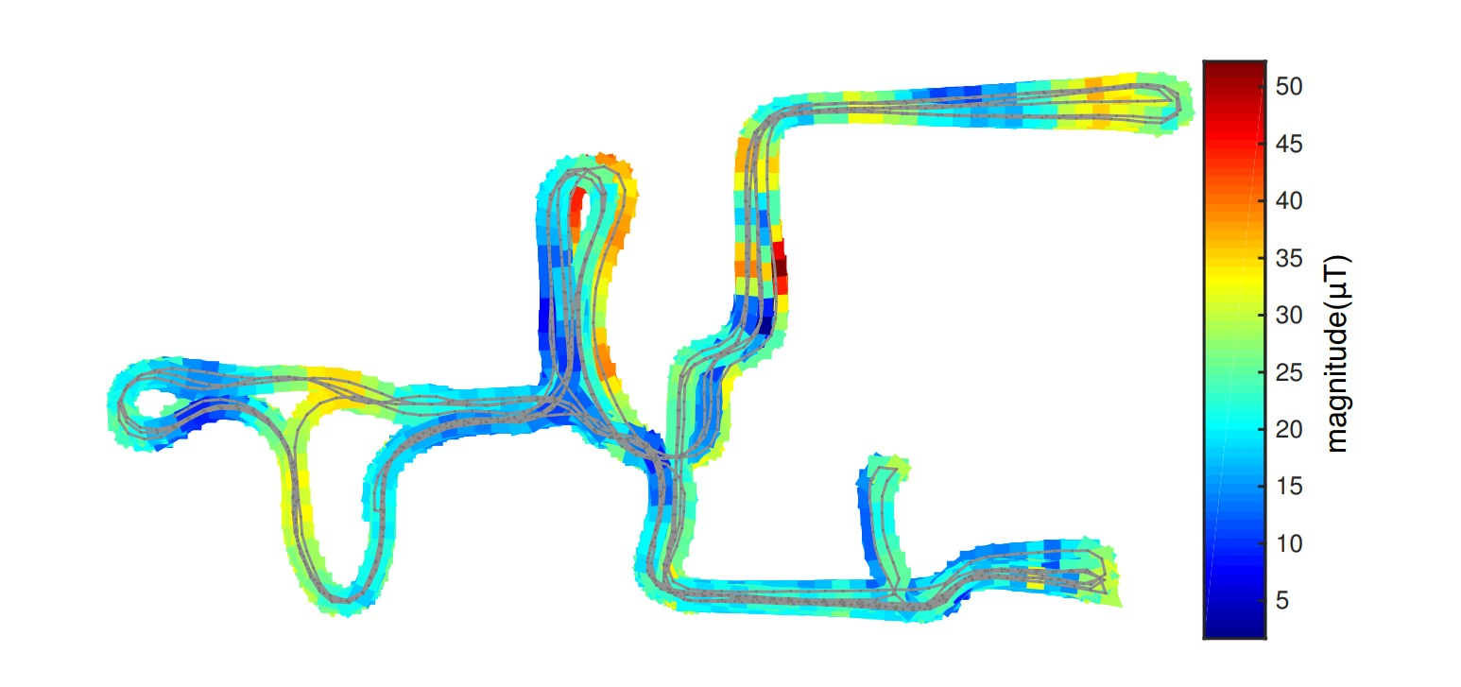
Geomagnetic⁵
Use distortion of Earth’s magnetic field caused by building itself
⁵Sen Wang et al. “Keyframe based large-scale indoor localisation using geomagnetic field and motion pattern”. In: Intelligent Robots and Systems (IROS), 2016 IEEE/RSJ International Conference on. IEEE. 2016, pp. 1910–1917.
Notes:
So another way in which we can perform localization is using magnetism, for example by measuring the distortion of the Earth’s magnetic field caused by the building itself.
And this approach is taken by the paper mentioned in this slide, which is able to achieve high localisation accuracy that is similar to or better than that achieved even by Google’s Project Tango.
So magnetic localization can actually work really well, and we’ll talk a lot more about it in the later lectures.

Slide 19
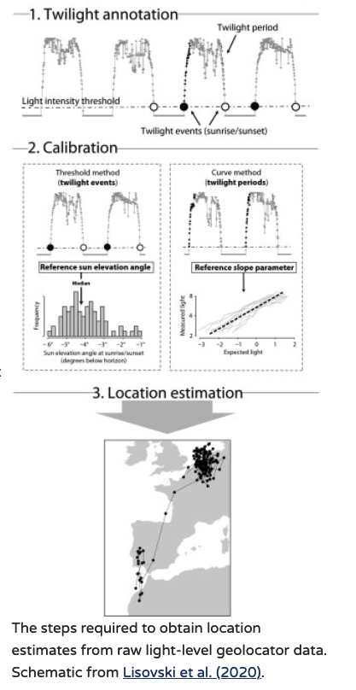
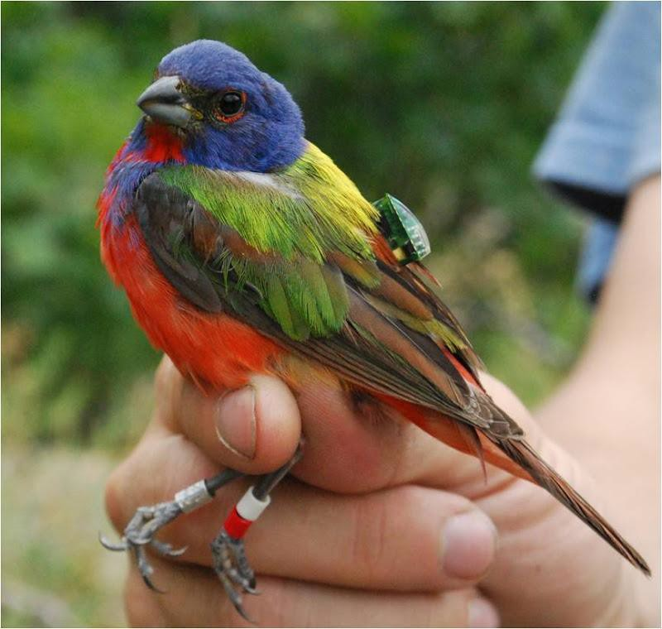
Light-level geolocators
Use length of day and time of sunrise/sunset to determine global location
http://migratoryconnectivityproject.org/geolocators/
Notes:
As a final example of a creative way of doing localization, note that outdoors, it’s also possible to use the length of the day (which varies with latitude), and the times of sunrise and sunset (which can be used to calculate solar noon, which varies with longitude) to determine global location.
And so the image in this slide is taken from the Migratory Connectivity project, and shows a geolocator based on this principle that’s been attached to a bird to keep a rough track of its latitude and longitude as it migrates.

Slide 20
Further reading
Suining He and S-H Gary Chan. “Wi-Fi fingerprint-based indoor positioning: Recent advances and comparisons”. In: IEEE Communications Surveys & Tutorials 18.1 (2016), pp. 466–490
Pavel Davidson and Robert Piché. “A survey of selected indoor positioning methods for smartphones”. In: IEEE Communications Surveys & Tutorials 19.2 (2017), pp. 1347–1370
Trong-Hop Do and Myungsik Yoo. “An in-depth survey of visible light communication based positioning systems”. In: Sensors 16.5 (2016), p. 678
Notes:
So to conclude this section, here are a few references that you might like to read to get a more in-depth overview of what localization approaches are possible.

Slide 21
Routing and Networking
Notes:
Ok, so now let’s talk a bit about routing and networking.

Slide 22
Overview
How can devices form a network?
How do we deal with factors such as mobility or limited power?
Notes:
So in this section, we’re going to be thinking about how devices can form a network, and how we can handle routing and networking in a context in which devices may move around, or may suffer from constraints such as limited power.

Slide 23
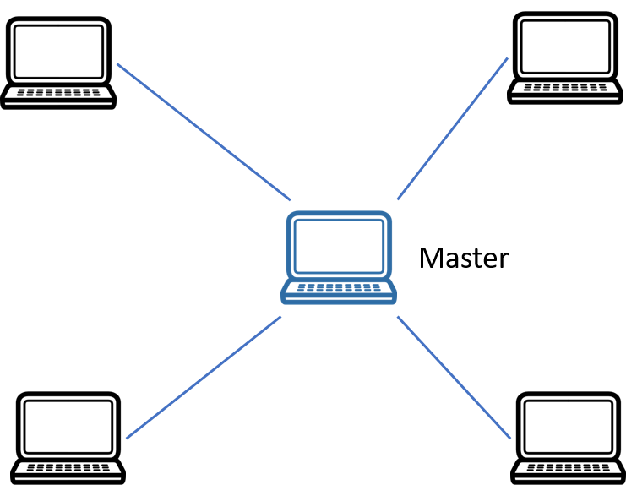
Star topology
Simplest topology
Master controls entire 1-hop network
Notes:
So as a starting point, let’s consider a network with the topology shown in the slide.
This is known as a star topology, and it’s the simplest kind of network topology you can get.
And the usual reason for choosing this topology is that you’ve got a single master device that you want to control the entire network, and you want to put it in the centre so that all of the other devices are only a single hop away from it.

Slide 24
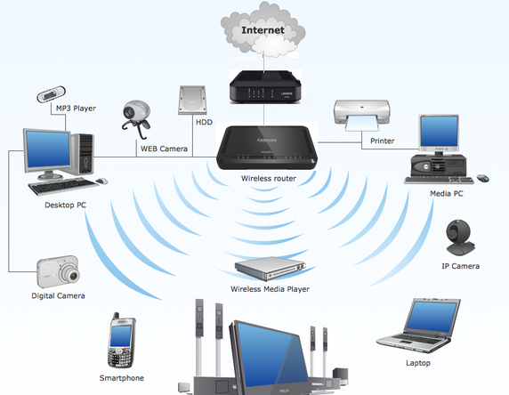
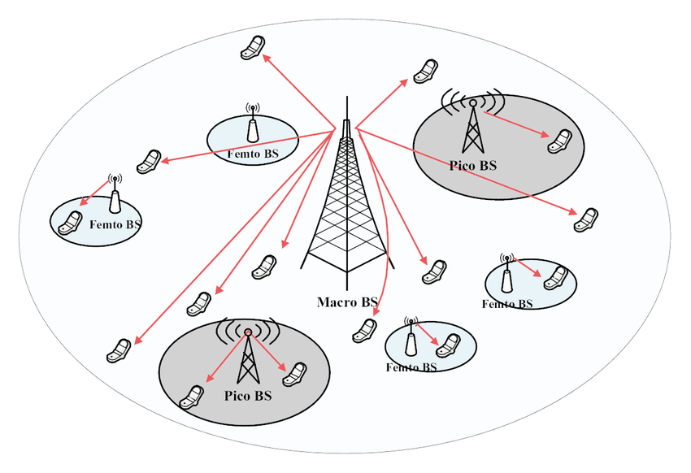
Star topology examples:
802.11 PCF: WiFi Access Points
Cellular connectivity
LoRaWAN: low-power nodes communicate with a single basestation
[1]
www.engeniusnetworks.eu
[1] Ye, Qiaoyang, et al. "User association for load balancing in heterogeneous cellular networks." IEEE Transactions on Wireless Communications 12.6 (2013): 2706-2716.
Notes:
And so here are some types of network that are quite likely to have a star topology.
===
So in the case of a WiFi access point, the access point itself would be the master, and various other devices such as mobile phones, laptops, and so on would directly connect to it.
And in the case of cellular connectivity, the base station (or more likely a relay node) would be the master, and again mobile phones would directly connect to it.
And in the case of LoRaWAN, you’d again have a single base station as the master, and various low-power devices would again directly connect to it.

Slide 25
Star topology
Expensive, complex master
Simple, low-power end-devices
All slaves must be in range of the master
Communication between slaves must go through the master
Typical low latency and no collisions
Notes:
So what are the basic features of a star topology network?
Well in general, the master device is likely to be comparatively expensive and complex, because it has to communicate with and process information from all of the other devices.
By contrast, the slave devices at least have the potential to be quite simple, and have low power requirements, since all they have to do is communicate with the master.
And clearly each slave must be within range of the master to communicate, since that’s its only point of connection to the network.
And if two slaves do want to communicate with each other, they have to do it via the master in this type of network.
So what are the advantages of this topology? Well, for one thing, the latency’s likely to be pretty low, since any two devices are at most two hops away from each other. And for another thing, we’re not going to have to worry about collisions.
But there are also some downsides, of which the biggest one is perhaps that if the master fails for any reason, or is knocked out, then the whole network will go down with it. And that’s clearly not ideal from a resilience perspective.
Another key downside is that a heavyweight master may complicate deployment in a mobile context, for example controlling a swarm of micro drones using a laptop might not be so good because then you have to carry the laptop around with you everywhere, and all the drones have to stay within range of it.

Slide 26
Routing and Networking
Routing in mobile ad-hoc networks
Notes:
Ok, so as an alternative to a centralised system based on a star topology, let’s now talk about routing in mobile ad-hoc networks, and how that can enable us to build decentralised systems that don’t require any one node to be the master.

Slide 27
Mobile Ad-hoc Network (MANET)
Mobile devices opportunistically form a network
Vehicle-to-vehicle (V2V) networks
Distributed comms (battlefield)
Peer-to-peer (pocket switched networks)
Notes:
Ok, so the basic concept of a mobile ad-hoc network, or MANET, is of a number of mobile devices coming together to opportunistically form a network.
And this can clearly be useful for various things, such as vehicle-to-vehicle communication in an autonomous driving context, or distributed comms on the battlefield, or peer-to-peer pocket-switched networks for transferring data between mobile users’ devices.

Slide 28
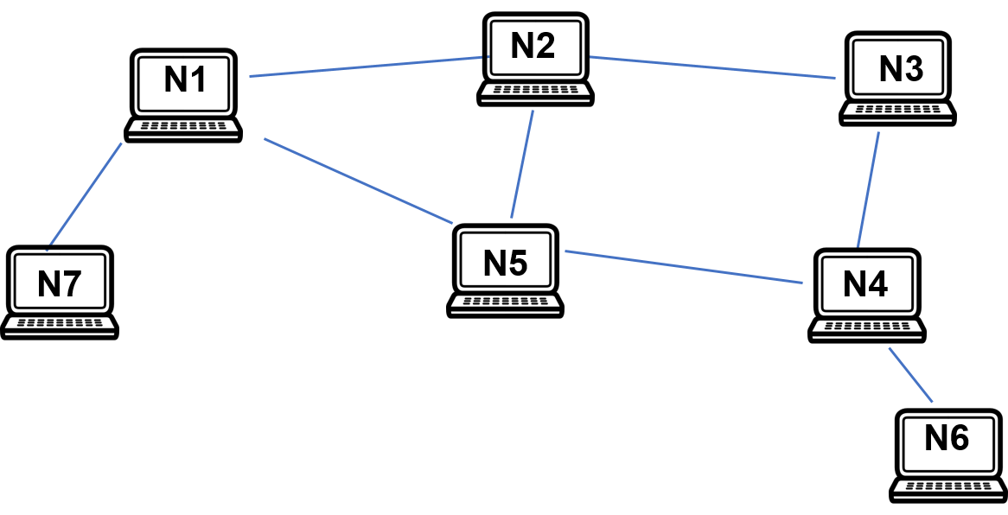
Why do we need network routing?
Not possible to directly communicate with all other nodes
Packets must travel over multiple hops
Notes:
So why is routing important in this context? Well, unlike with a star topology, the routes from one node to another are not obvious here. And in general, an individual node won’t be able to directly communicate with all of the other nodes in the network, only with its direct neighbours, and so any packets that it wants to send may potentially have to travel over multiple hops.

Slide 29
Routing problem
For each node find the best path to the destination
‘Best’ can be:
Shortest (fewest hops)
Fastest (lowest latency)
Most robust
Combination of the above
Distributed routing problem: no master that performs routing
Notes:
So what should the goal of routing be in this case?
Well essentially, it should be to find the best path to the destination for each node, where “best” can for example be defined either in terms of number of hops, or latency, or robustness, or some combination of the above.
And one thing that makes it a bit more complicated in this case is that it’s necessarily a distributed problem, in the sense that there’s no master available that can perform the routing centrally.

Slide 30
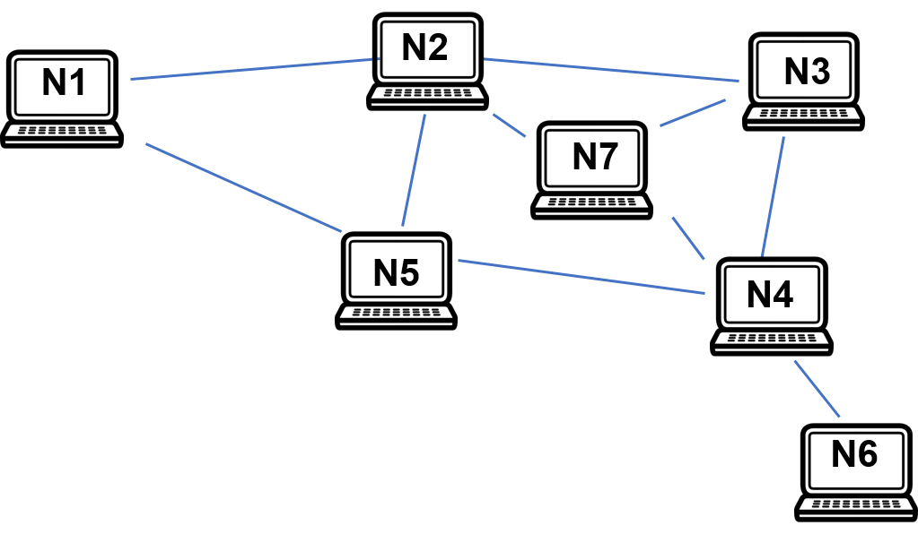
Challenges: Dynamic Connectivity
Nodes can move, be added or removed, breaking existing links and forming new links
Links may be intermittent (see fading)
Notes:
Another major challenge is that we need to make it possible for individual nodes to move around, and to be added and removed from the network.
This can result in existing links being broken and new links being formed on the fly. Note that intermittent links are also possible, for example when a peripheral node repeatedly moves in and out of range of its nearest neighbour, or when changes in the environmental conditions cause the strength of a link to fluctuate over time.

Slide 31
Challenges
Mobile nodes often have stringent energy and memory constraints
Wireless links have limited bandwidth, and time-varying link error probability
Some applications require real-time data delivery
Some applications require robust data delivery
Notes:
There are lots of other challenges as well.
For example, mobile nodes often have stringent energy and memory constraints, and this can have all sorts of implications, such as it being desirable to route packets around certain nodes to avoid overloading them.
The wireless links between the nodes also need to be taken into account, so for example they may have limited bandwidth, or link error probabilities that vary over time.
And then there are the requirements of individual applications to consider, so for example certain applications might need their data to be delivered in real time, or alternatively it might be absolutely essential that the data arrives, but without the timing being especially important.

Slide 32
Design goals
Fully distributed - no centralized control
Adaptivity to topology changes
Loop-free paths
Fast route discovery (for real-time applications)
Low control overhead (for bandwidth-/energy- constrained applications)
Fault-tolerance (for security/emergency applications)
Notes:
So our design goals for a routing algorithm in this case look something like this.
So first of all, we’re targeting a fully distributed system with no centralised control.
And we want it to be adaptive to topology changes, for example those caused by nodes joining or leaving the network.
Obviously it’s quite important for any paths planned by the routing algorithm to be loop-free.
And moreover, we want our route discovery to be fast, so as to support real-time applications.
We definitely don’t want to spend too much bandwidth or energy on controlling the process, since some applications are likely to face constraints in those areas.
And we want to be as tolerant as we can to faults, as this is extremely important for certain classes of application, such as security or emergency ones.

Slide 33
Link-State (Source) Routing
Each node obtains global knowledge about which nodes have links between them
This is done by periodically exchanging packets with neighbours
A table (adjacency matrix) is populated and shared
Adjacency matrix is a binary matrix which indicates whether a pair of nodes have a link or not
Notes:
Ok, so now let’s talk about one well-known routing approach, known as link-state routing.
So in this approach, each node obtains global knowledge about which nodes have links between them, and this is achieved by nodes periodically exchanging packets with their neighbours.
And this global knowledge will essentially amount to an adjacency matrix for the nodes in the network, which is a binary matrix in which each entry indicates whether or not a particular pair of nodes are connected by a link.

Slide 34
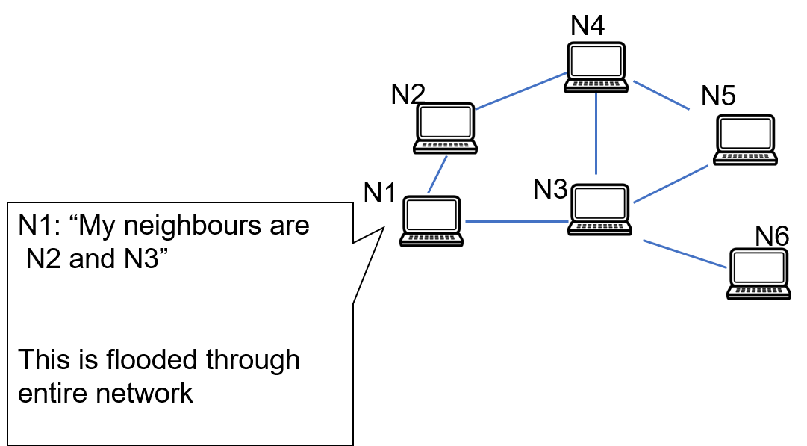
Link-State Routing
Notes:
So for example, in this network, node N1 knows that it has links to N2 and N3, and will aim to flood this information through the entire network.

Slide 35
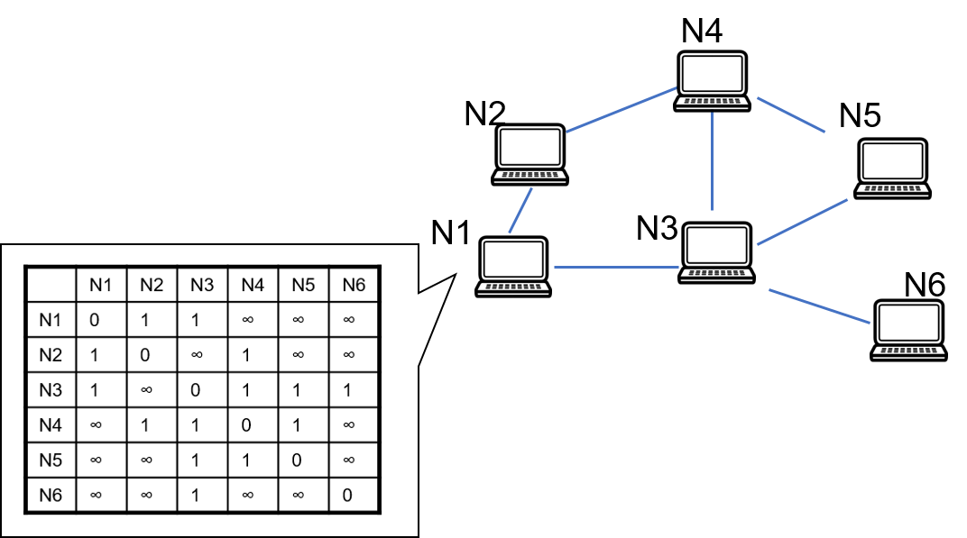
Link-State Routing
Notes:
So at a particular point in time, the adjacency matrix it holds for the network might look something like this.
And in this matrix, the information it has about more distant nodes has clearly been received from elsewhere in the network, and might be out of date, but the information it has about its own links to its neighbours is clearly fresh. So in practice, a sequence number will be associated with each known link when the information is shared, which allows other nodes to know how recent the sharing node’s knowledge of that link is. We won’t cover that in detail in this course, but bear in mind that that’s happening behind the scenes.
And so N1 will share the links it knows about and their sequence numbers with the rest of the network via its neighbours, and the other nodes in the network will use the information to update their own knowledge of the network topology accordingly.

Slide 36
Dijkstra’s algorithm
Dijkstra’s algorithm is an efficient, shortest path algorithm¹
It calculates the min-cost tree from a single source throughout the network
¹By example: https://www.cs.usfca.edu/~galles/visualization/Dijkstra.html
Notes:
Once a node has a map of the overall network topology, it can simply use an efficient single-source shortest path algorithm like Dijkstra’s algorithm to calculate the shortest path from it to every other node in the network. And so this is what each node individually does, and that allows every node in the network to know where to route packets when they arrive.
However, note that each node has to re-run Dijkstra’s algorithm whenever new routing information arrives that changes the network topology, which can clearly get a little expensive. More on that later.

Slide 37
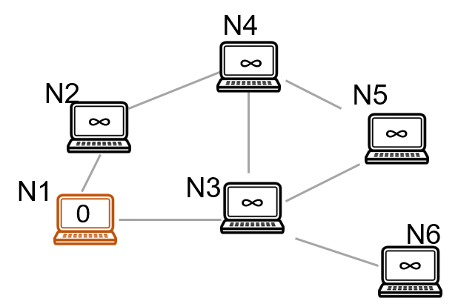
Dijkstra’s algorithm example
Start from self. All other nodes are unknown, hence infinite costs
Notes:
Ok, so now let’s look at a short example of how Dijkstra’s algorithm works, starting from N1. And I guess some of you may have seen this before, but it’s helpful to go through it even if only to remind ourselves of how it works.
So initially, the cost to N1 itself is 0, and all other nodes are unknown, hence the costs to them are infinite.

Slide 38
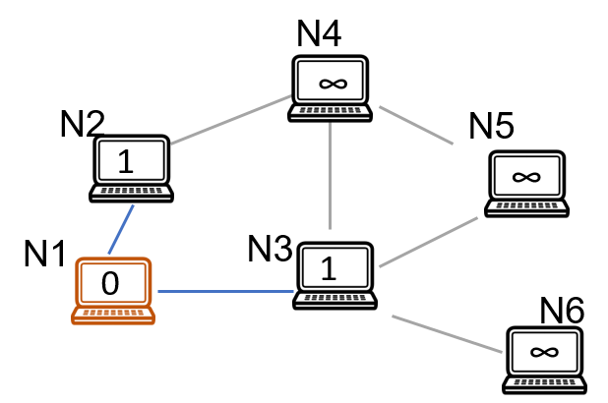
Dijkstra’s algorithm example
Update neighbours with their costs
Notes:
So first we update the costs of the direct neighbours of N1, as shown.

Slide 39
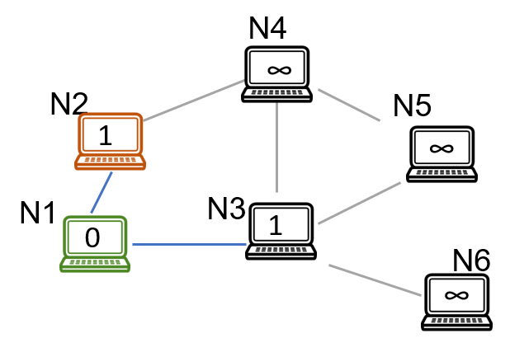
Dijkstra’s algorithm example
N1 is marked as done. Choose next lowest cost (either N2 or N3 at random)
Notes:
And then we mark N1 as done, and pick one of the unfinished nodes that has the lowest cost to process next. So in this case, we could have picked either N2 or N3, and we chose N2.

Slide 40
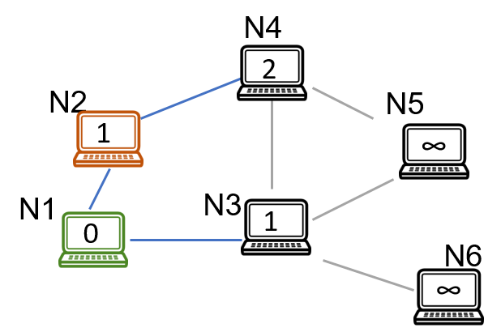
Dijkstra’s algorithm example
Update cost of reachable nodes that are not done
Notes:
So now we update the costs of any of N2’s neighbours that are not yet done.

Slide 41
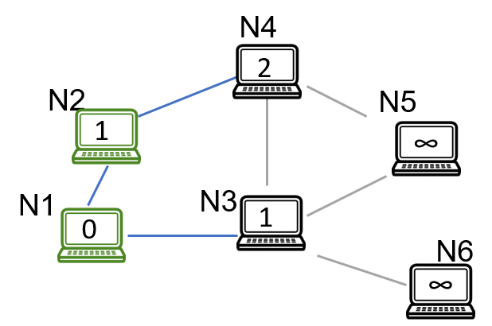
Dijkstra’s algorithm example
Mark N2 as done
Notes:
And then we mark N2 as done.

Slide 42
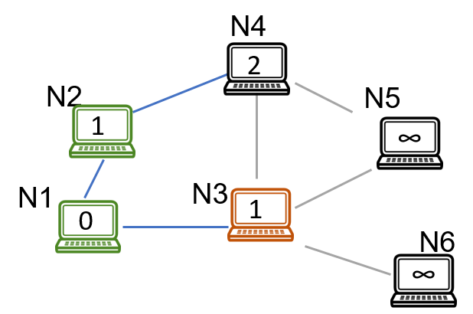
Dijkstra’s algorithm example
Choose next lowest cost, N3 in this case
Notes:
And then we again pick an unfinished node with the lowest cost, which in this case now has to be N3.

Slide 43

Dijkstra’s algorithm example
Update reachable nodes which are not done
Notes:
And then again we update the costs of the unfinished neighbours of N3.

Slide 44
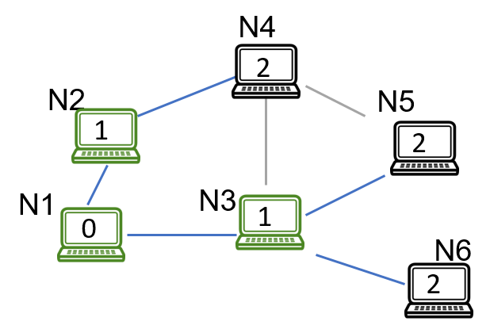
Dijkstra’s algorithm example
Mark N3 as done
Notes:
And mark N3 as done.

Slide 45
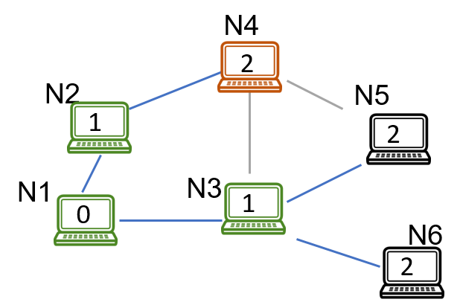
Dijkstra’s algorithm example
Choose next lowest cost, N4 in this case
Notes:
And choose an unfinished node with the lowest cost, which in this case could have been either N4, N5 or N6.

Slide 46
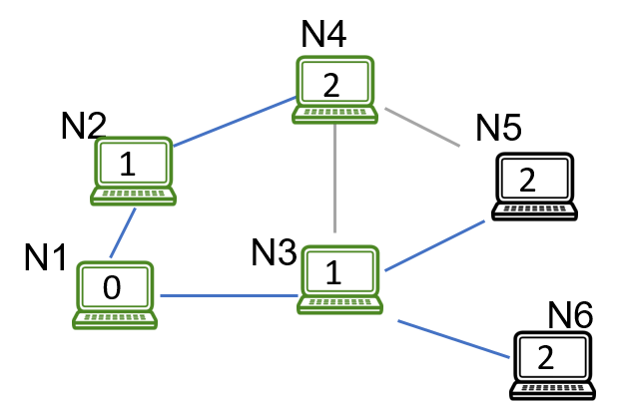
Dijkstra’s algorithm example
N4 can’t improve anything, so mark as done
Notes:
Now N4 can’t improve anything, so we can simply mark it as done.

Slide 47
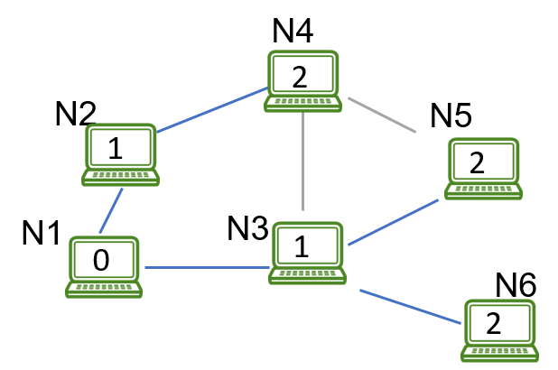
Dijkstra’s algorithm example
Eventually, the entire topology routed at N1 is computed
Notes:
And then we do the same thing for N5 and N6, and finally we’re done, and the entire topology routed at N1 is computed.

Slide 48
Link-State Routing
All nodes know the exact path the packet should take at source
Obtaining global information can be expensive
Small network changes lead to new routing tables
This ‘churn’ can be expensive, especially with high mobility
Notes:
So once every node has run Dijkstra’s, then all of them know how to route any packets that arrive at them, as mentioned earlier. Actually, since they all have the topology of the whole network, any node could if it wanted figure out the exact path a packet should take between any two nodes in the network. But for efficiency reasons, there’s no need to do this.
So that’s all well and good, but as we mentioned earlier, this whole process is unfortunately quite expensive in practice, because even small network changes are going to affect the routing tables, and that will lead to every node in the network having to run Dijkstra’s algorithm all over again. And this “churn” can get very costly, particularly when the nodes are moving around a lot.

Slide 49
Distance Vector Routing
Store next hop and which edge (vector) to take
No need for global topology knowledge
Nodes share routing tables with direct neighbours
Use their information to update paths
Notes:
Ok, so given that link-state routing is quite costly, let’s now take a look at a less expensive approach, called distance vector routing.
So in this approach, rather than each node maintaining a copy of the topology of the whole network, it simply maintains a table of the costs to each destination via each of its direct neighbours, and thereby which link a packet to each destination should be routed along.
Nodes share relevant parts of these routing tables with their direct neighbours, and use the equivalent information they receive from their neighbours to update their own paths.

Slide 50
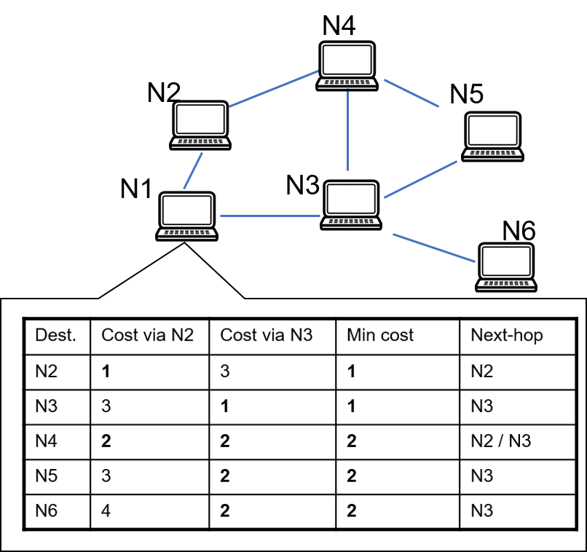
Distance Vector Routing
Notes:
And so here’s an example of a routing table that N1 might hold at a particular point in time.
So if you wanted to send a packet from N1 to N5, for instance, then the first step would be to look up the next hop for N5 in N1’s routing table, namely N3. And then you’d send the packet to N3, where the process would be repeated. So in this case, N3’s routing table would specify the next hop for N5 to be N5, and then the packet would be forwarded on directly to N5, where the routing would terminate.

Slide 51

Distance Vector Routing
Notes:
And here’s an example of the sort of update packet N1 might send out to its direct neighbours. So in this case, it’s simply sharing its own best costs to all of the different destination nodes. And N1’s neighbours can use this information to update the costs of their own paths via N1, and thereby determine what their new best paths are to all possible destinations.

Slide 52
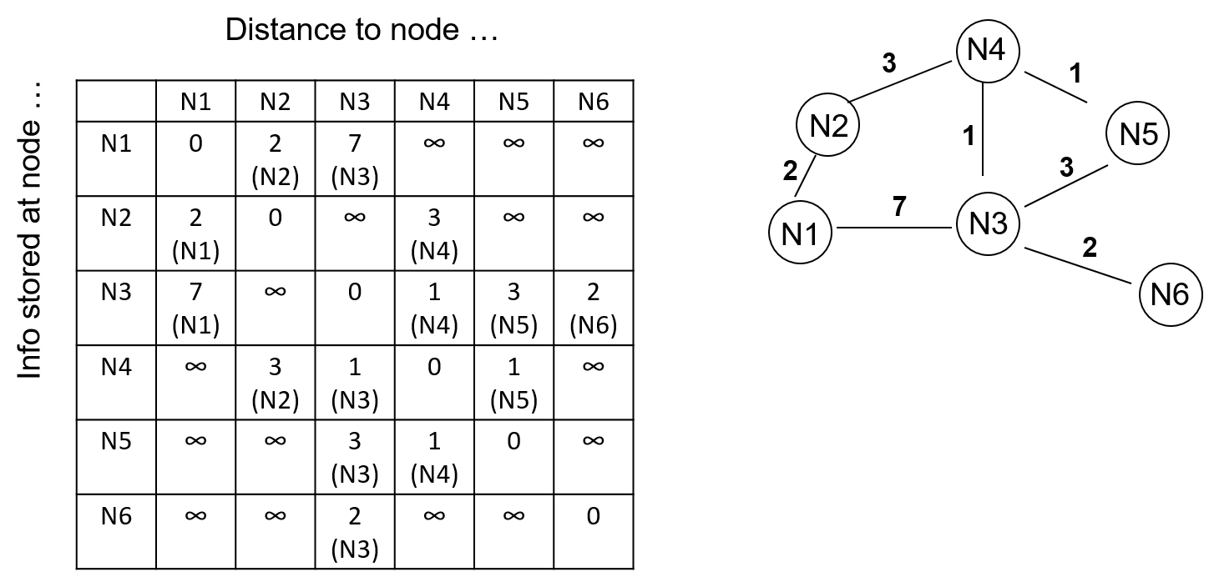
Distributed Bellman-Ford Algorithm
Initially, nodes only know their neighbours’ costs
Notes:
So now let’s look at an example of how the routing information propagates around the network in this case, using an approach known as the Distributed Bellman-Ford Algorithm.
So initially, nodes only know the costs of the routes to their direct neighbours.

Slide 53
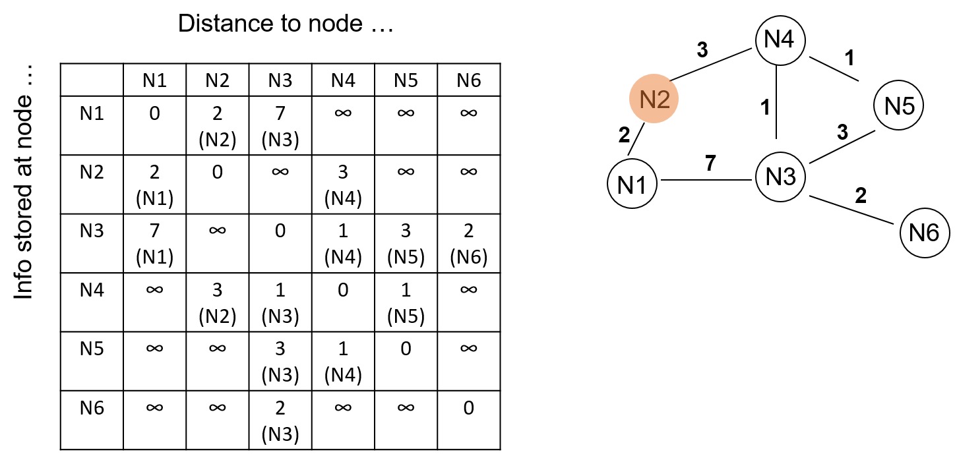
Distributed Bellman-Ford Algorithm
N2 broadcasts
Notes:
Now let’s imagine that one of the nodes, N2 in this case, decides to share its routing information with its direct neighbours.

Slide 54
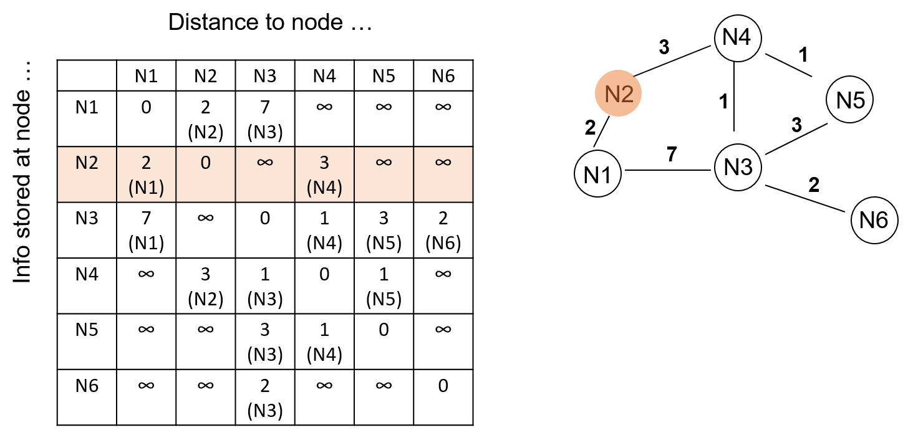
Distributed Bellman-Ford Algorithm
N2 sends its routing table
Notes:
So to do this, it sends out the relevant part of its routing table, as shown.

Slide 55
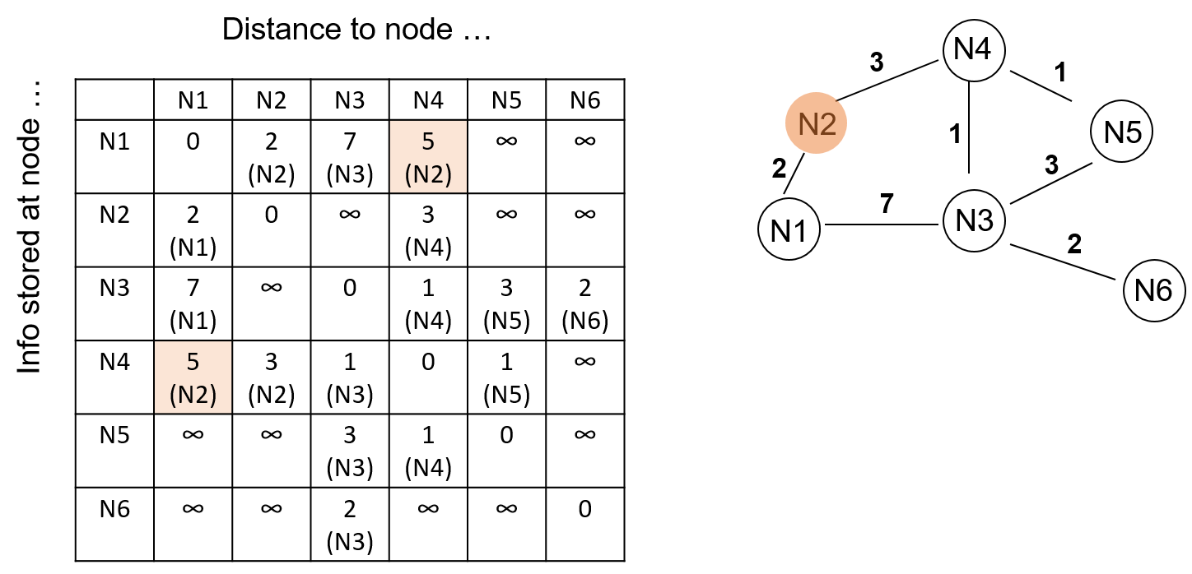
Distributed Bellman-Ford Algorithm
N1 and N4 can update their routing tables
Notes:
And this is then received by its direct neighbours, N1 and N4, who can update their routing tables accordingly.

Slide 56
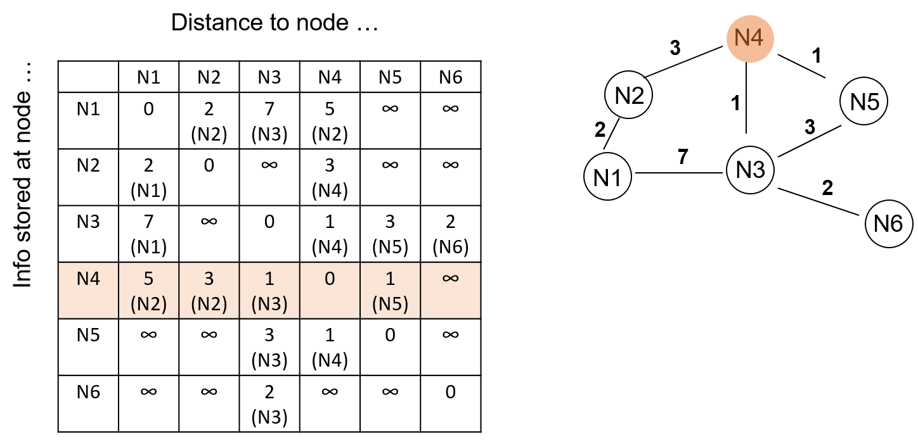
Distributed Bellman-Ford Algorithm
N4 sends its routing table
Notes:
So let’s imagine that N4 now sends out its routing table as well.

Slide 57
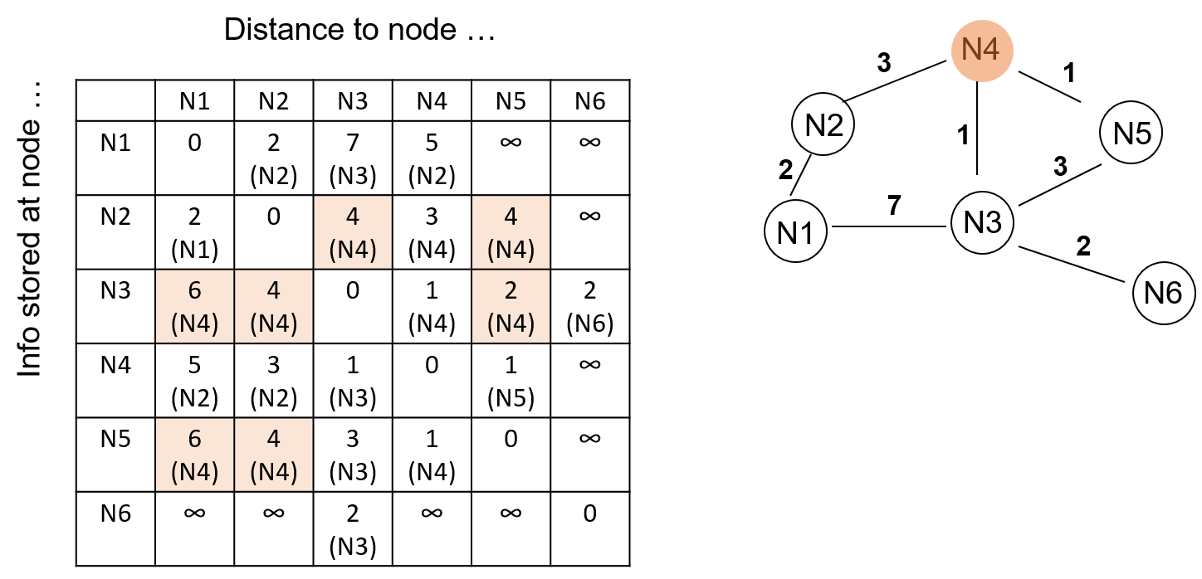
Distributed Bellman-Ford Algorithm
Entire table starts to become populated
Notes:
This is then received by N4’s direct neighbours, namely N2, N3 and N5, who use it to update their own routing tables. And note for example that N5 now knows about a route to N1, since N4 itself found out that it had a route to N1 after the N2 update, and it’s now propagating that information to its own more distant neighbour. And so hopefully you can see how the entire table will gradually become populated over time.

Slide 58
Distance Vector Routing
Only need to know link state and routing tables of neighbours
Less sensitive to network perturbations
Network convergence can take a long time
Can suffer from instability and routing loops
Notes:
Ok, so the big advantage of distance vector routing is that individual nodes now only need to know the state of their links and the routing tables of their neighbours, rather than the topology of the entire network. And this makes the whole approach much less sensitive to changes in the network than link-state routing.
However, the flip side of that is that it can take a while for the routing tables of the different nodes to re-converge after a change. And so unless appropriate care is taken, this approach can suffer from instability and routing loops.

Slide 59
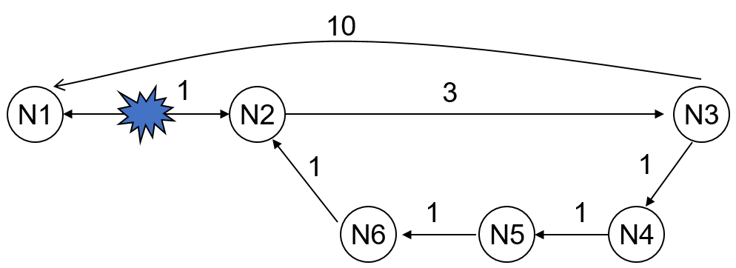
Routing loops
Path from N1 to N2 breaks
N3 updates that it has a path of cost 5 to N1, which is stale information
N2 updates its routing table with a cost of 8 to N1
Notes:
Ok, so let’s look at an example of how a routing loop can arise in practice.
So supposing we have the network shown in this slide, and the path from N1 to N2 breaks, what’s going to happen?
Well, it depends on the timing of the next updates, but let’s suppose that N3 sends out its next update before N2 does. This update is going to advertise that N3 has a path of cost 4 to N1, because it had one a minute ago, and it hasn’t heard anything to suggest otherwise in the interim. And this information is going to get propagated to N2 via N4, N5 and N6, such that N2 will get told that there’s a path to N1 via N6 that has cost 7. Now if the link to N1 was still up, then N2 would ignore this, because a cost 7 path is a lot worse than a cost 1 path. But since the link to N1 has broken, N2 will now see the cost 7 path via N6 as its best option, and will update its routing table accordingly.
That’s already not good, but what makes it even worse is that N2 will then send out its own advertisement of a cost 7 path to N1. And this will be received by N3, which will see that its cost 4 path to N1 has vanished, and update its own routing table accordingly. It will then propagate this information around the loop again. And so you can see how the costs for paths to N1 in the routing tables around the loop are going to keep gradually increasing over time. So that’s clearly all very bad.

Slide 60
Routing loops
A packet sent will now traverse N6→N2→N3→N4→N5→N6→
The routing costs will slowly climb to infinity
Use of Distributed Bellman-Ford as-is cannot handle mobility and link changes
Modified versions are used in practice
Notes:
Incidentally, note that a packet sent from anywhere around the loop will now just follow the loop round and round, never getting to its destination and causing network congestion.
Meanwhile, as mentioned, the routing costs in the tables will keep slowly climbing to infinity as updates keep being propagated around the loop.
So the use of the distributed Bellman-Ford algorithm as it stands cannot handle the mobility and link changes that occur in mobile ad-hoc networks, and we’ll need to use modified versions of it in practice.

Slide 61
Practical Distance Vector Routing
Proactive protocols identify optimal paths to destination nodes in advance, so that they are already there whenever needed e.g. DSDV
Reactive protocols identify optimal paths to destination nodes on-demand (when needed) e.g. AODV
Hybrid protocols use the proactive approach to find paths to nodes within a nearby zone, and the reactive approach to find paths to nodes beyond this zone e.g. ZRP
Notes:
Ok, so what changes can we make to distance vector routing that will make it work for us in practice in a mobile ad-hoc context?
Well, there are essentially three main types of protocol that we can use instead of vanilla distance vector routing, namely proactive protocols, reactive protocols, and hybrid protocols.
So proactive protocols basically work by identifying optimal paths to destination nodes in advance, so that they are already there whenever they’re needed, and a good example of this type of approach is the Destination Sequence Distance Vector, or DSDV, method that we’ll see over the next few slides.
By contrast, reactive protocols identify optimal paths to destination nodes on-demand when needed, and a good example would be the Ad-hoc On-Demand Vector, or AODV, approach, which we’ll talk about later on in the lecture.
Finally, hybrid protocols use the proactive approach to find paths to nodes within a nearby zone, and the reactive approach to find paths to nodes beyond this zone, and a good example would be the Zone Routing Protocol, or ZRP, approach. That’s beyond the scope of this course, but you might want to look into it on your own time.

Slide 62
Destination Sequence Distance Vector²
DSDV is an enhanced version of the Bellman-Ford algorithm
When nodes send routing table updates, they also include a monotonically increasing sequence number
Nodes will trigger a routing table update if they identify a failed link in their neighbourhood
Tables compare the sequence number with their cached sequence number and only update if it is fresher
This helps to address problems with loops and stale information
²Charles E Perkins and Pravin Bhagwat. “Highly dynamic destination-sequenced distance-vector routing (DSDV) for mobile computers”. In: ACM SIGCOMM computer communication review. Vol. 24. 4. ACM. 1994, pp. 234–244.
Notes:
Ok, so now let’s take a look at the DSDV approach in more detail.
So basically, DSDV is a variant of Bellman-Ford that augments each routing table update sent by a node with a monotonically increasing sequence number, and makes nodes trigger a routing table update if they identify a failed link in their neighbourhood.
When a node receives a routing table update, it only uses it to update its own routing table if the incoming sequence number is fresher than its own, which helps to address the problems we’ve observed with routing loops and stale information.

Slide 63
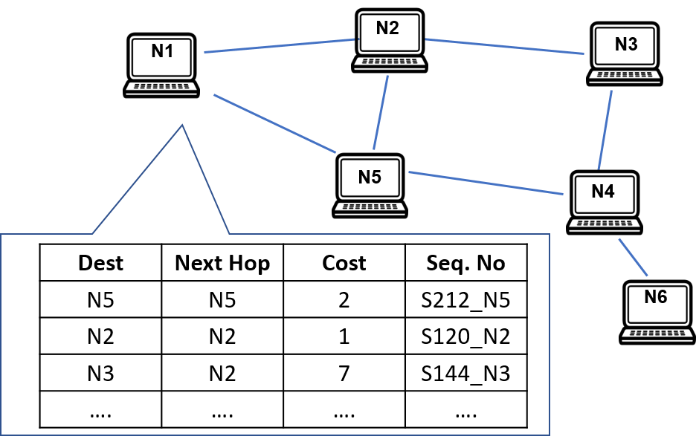
DSDV by example
Notes:
So now let’s take a look at an example to see how this works in practice.
And so here’s an example of a DSDV routing table that N1 might hold at a particular point in time. And you can see that in comparison to the routing tables we’ve been using, this one now has a sequence number for each entry.
And the sequence numbers are based on having a separate counter for each destination, so for example S144_N3 denotes the 144th route that has been advertised to get to N3. (Actually, that’s not quite the case, because even numbers are used by the destination itself to start the advertisement of a route, whilst odd numbers are used on an as-needed basis by other nodes to indicate that a link has dropped, but in this lecture I’ll still refer to a route with sequence number n as the n^{th} route for simplicity. Note that we’ll see an example of an odd-numbered route in a few slides’ time.)

Slide 64
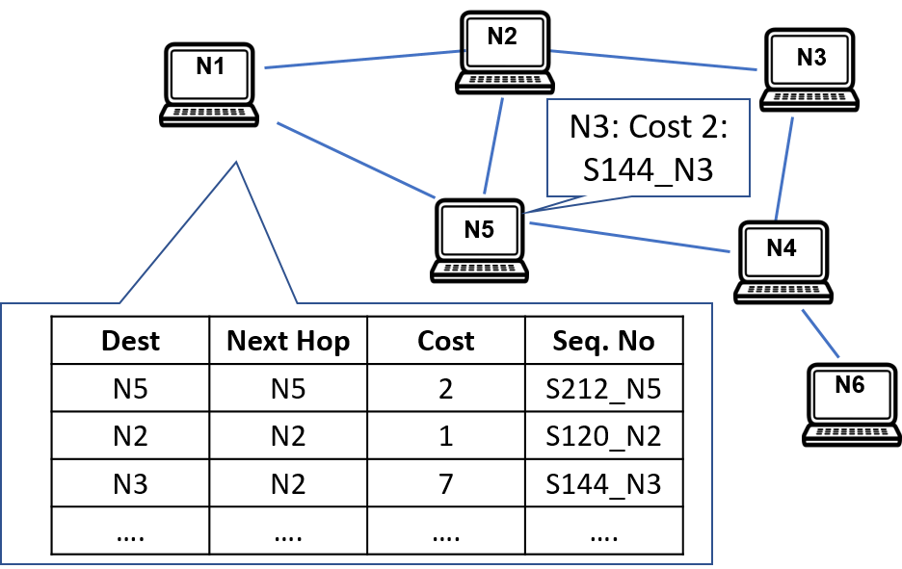
DSDV by example
Notes:
So now let’s suppose that N5 publishes the most recent route to N3 that it knows about, namely the 144th one.

Slide 65
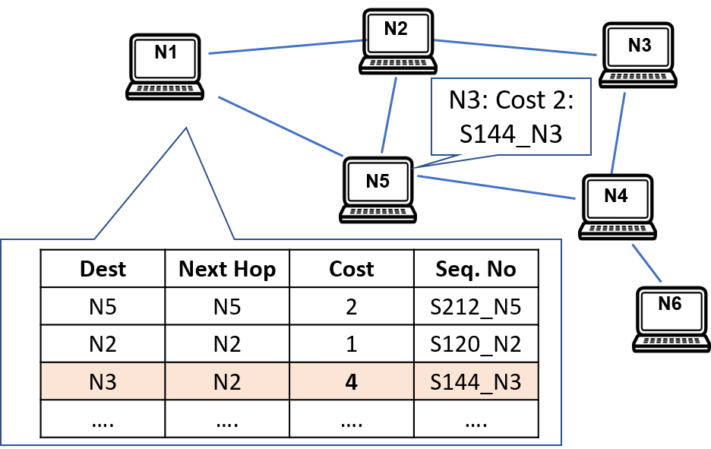
DSDV by example
Notes:
This will be picked up N1, which will first check to see that it doesn’t already know about a more recent route to N3. In this case, the most recent one it knows about is the 144th one, and there might be a better path via N5, so it needs to consider the update from N5.
So to do this, it will add the cost of its current best route to N5 (in this case 2) to the advertised cost of the route to N3 via N5 (also 2 in this case), and then check the total cost of 4 against the existing cost it has for the 144th route to N3, namely 7. And since 4 is lower, it will replace the cost in its routing table accordingly.

Slide 66

DSDV by example
Notes:
So let’s suppose that N5 now sends out another update of the route to N3 with a later sequence number.

Slide 67
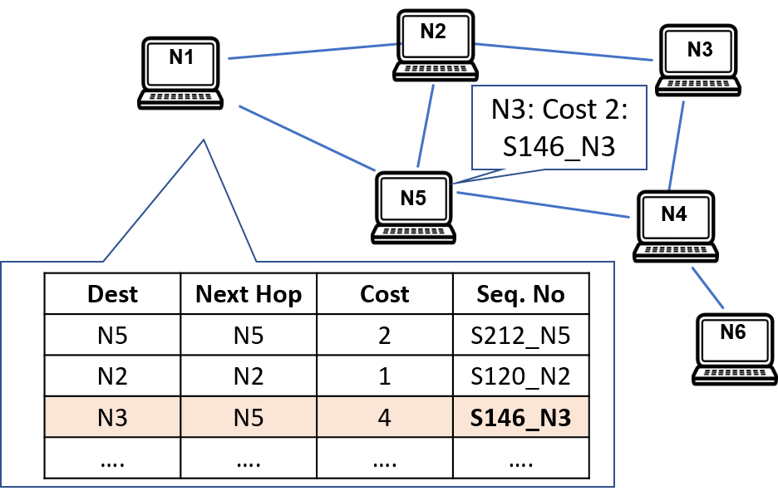
DSDV by example
Notes:
Again, this will be received by N1. But this time, since the sequence number is later, it can simply update the sequence number for N3 in its routing table accordingly. Incidentally, note that the cost of the route didn’t change with this update, but if it had done, then the cost associated with the (strictly) later sequence number would have been stored in N1’s routing table, even if it was higher than the cost that was already there.

Slide 68
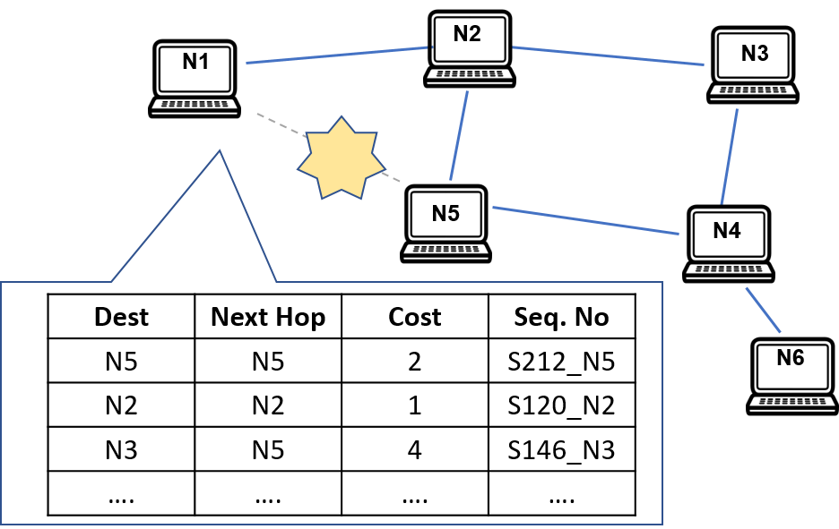
DSDV by example
Notes:
Ok, so now let’s consider what would happen if the link between N1 and N5 drops.

Slide 69
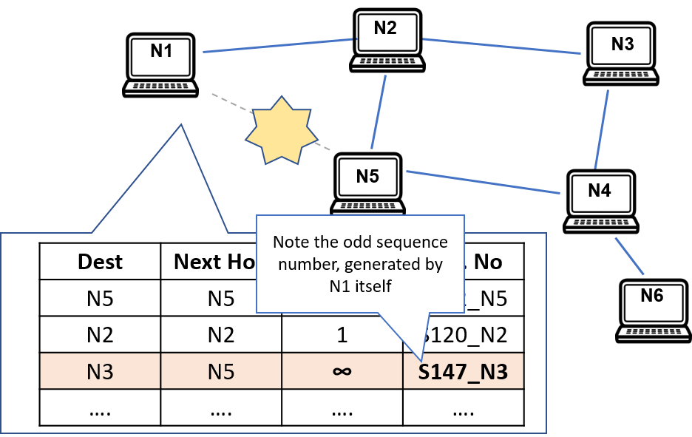
DSDV by example
Notes:
In that case, N1 will detect the change, and advertise an odd-numbered route to N3 with a new sequence number and an infinite cost. Since this has a higher sequence number than previous routes to N3, it will take precedence over them when it reaches other nodes, and the stale information in the routing tables for those nodes will be replaced accordingly.
This raises the question of what happens if N3 itself sends out a new advertisement with an even higher sequence number in the meantime. In that case, the new even-numbered route will be propagated around the network as normal, and take precedence over the odd-numbered route from N1. But that’s exactly what ought to happen, and won’t result in a routing loop.

Slide 70
DSDV
Handles issues with stale information
Does not scale well to very large networks, as routing tables for all destinations need to be maintained
As tables grow in size, they consume more network overhead
Notes:
So DSDV solves the stale information problem that was causing routing loops in the standard distance vector approach.
But at the same time, it doesn’t scale well to very large networks, because you need to maintain an all-destination routing table at each node, which can get quite expensive.
And in particular, as these tables grow in size, they get more expensive to share, which consumes more network overhead.

Slide 71
Routing and Networking
Resource-constrained routing
Notes:
Ok, so thus far we’ve been assuming that all of the devices in the network have no resource constraints on them at all, and are to all intents and purposes completely equivalent to each other. But of course in the real world, this is quite unlikely to be the case, and in this section, we’re going to talk a little about what we can do about that.

Slide 72
Resource-constrained routing
Nodes may be energy or computationally limited
Need more efficient techniques for routing data
May not have space or resources to store entire routing tables
Notes:
So to start with, let’s consider what sort of resource constraints an individual node might have.
So for example, this might include things like a limited amount of available energy, or limited computational power, or a limited amount of memory in which to store data, which might prevent them from storing entire routing tables.
And so when we have nodes with these sorts of constraints, we start to need more efficient techniques for routing data round the network than we’ve been looking at so far.

Slide 73
Mesh networks
Densely connected networks with little or no mobility
Data travels over multiple hops to save energy
Long-lived, low-power networks
Notes:
Ok, so now let’s look at a different type of network than the ones we’ve been considering so far, namely mesh networks.
So these are basically densely connected networks, with little or no mobility, in which data travels over multiple hops to save energy.
And they’re particularly useful for constructing long-lived, low-power networks.

Slide 74
Geographical routing
Rather than sending data to a particular destination by ID, data can be sent by location
At each hop, the aim is to get (physically) closer to the target location
Assume all nodes know their location
Assume all nodes know their one-hop neighbours
Notes:
And in terms of how we can perform routing in such networks, one way is a technique called geographical routing.
So the key idea of this is to devise a physically based localisation scheme in which each node knows both its location and its direct neighbours, and to then send data by location rather than ID. And at each hop, the aim is then to get physically closer to the target location, which can be done in various ways.

Slide 75
Geographical routing
Simplest approach: greedy forwarding
At each hop, forward to a neighbour which is closer to the destination
Notes:
So the simplest way of trying to get closer to the destination location is obviously greedy forwarding, in which at each hop, you simply forward to any neighbour which is closer to the destination than you are.
But even a simple example should hopefully convince you fairly quickly that that’s not a very good idea.

Slide 76
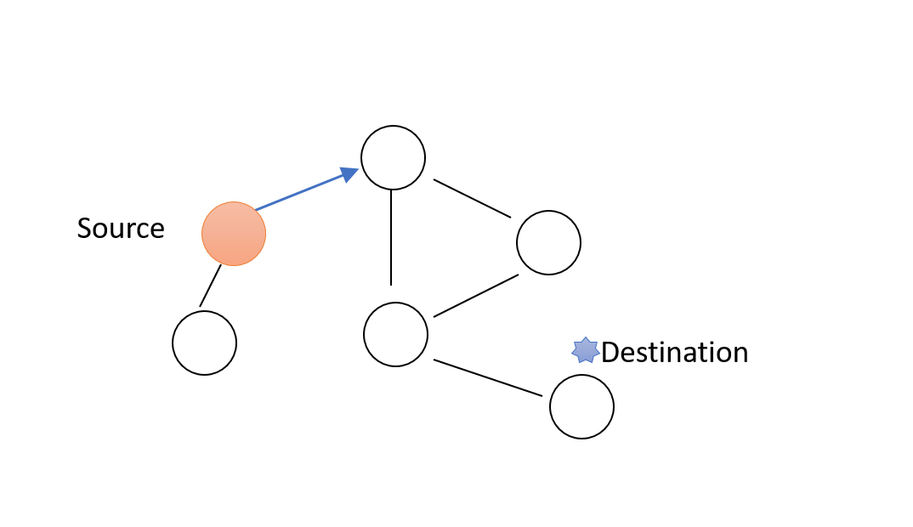
Greedy forwarding
Notes:
So for example, let’s suppose we start at the node highlighted in orange here and, as prescribed, always move to a neighbouring node that’s closer to the destination than we are.
Well, there’s only one neighbour that we can move to initially, so let’s move to that.

Slide 77
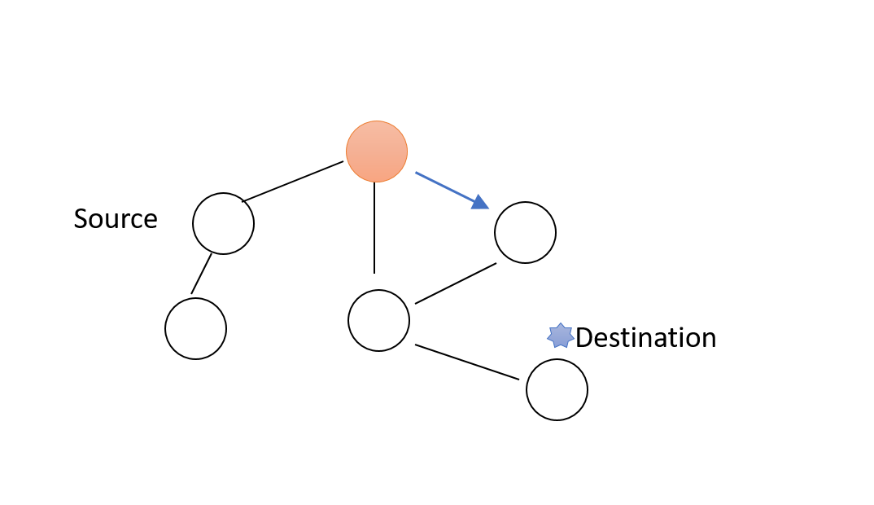
Greedy forwarding
Notes:
And now we have a choice of two neighbours, both of which are closer to the destination than us, so let’s just pick one and move to it.

Slide 78
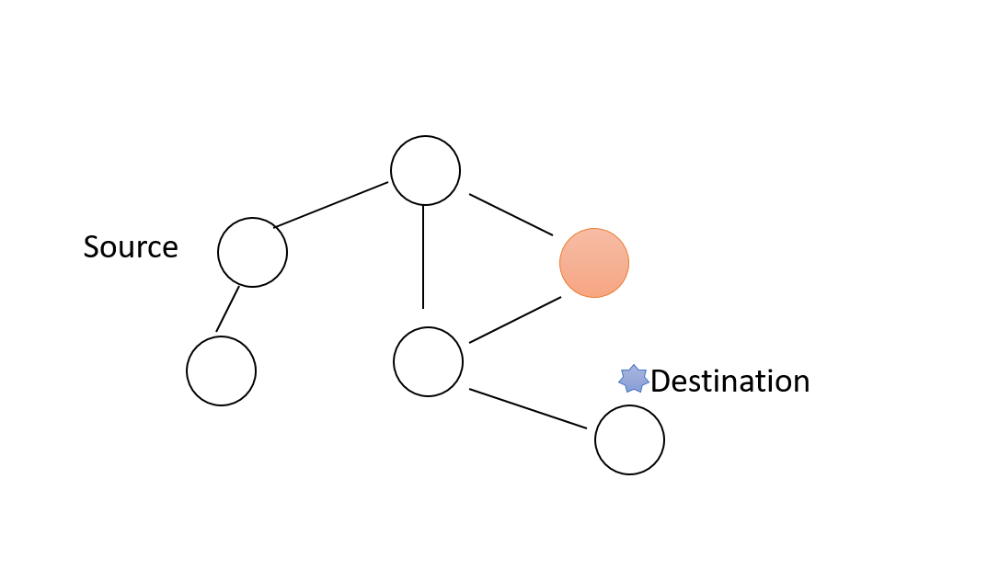
Greedy forwarding
Notes:
But now we’re in trouble, because both of our neighbours are farther away from the destination than we are, so we can’t make any further progress.

Slide 79
Face routing
Greedy geographical forwading will get trapped in voids or local minima
An alternative to greedy routing is to use face routing
Face routing works correctly on planar graphs, that is, graphs with no crossing edges
Face routing uses two primitive operations to route
Right-hand rule
Face changes
Notes:
Ok, so as we’ve just seen, the problem with greedy geographical forwarding is that it can get trapped in voids or local minima.
So instead of greedy routing, we can consider face routing, which is an alternative approach that works correctly on planar graphs, which are graphs that don’t have any crossing edges.
And so this approach uses two primitive operations to actually perform the routing, as we’ll see in the next couple of slides.

Slide 80
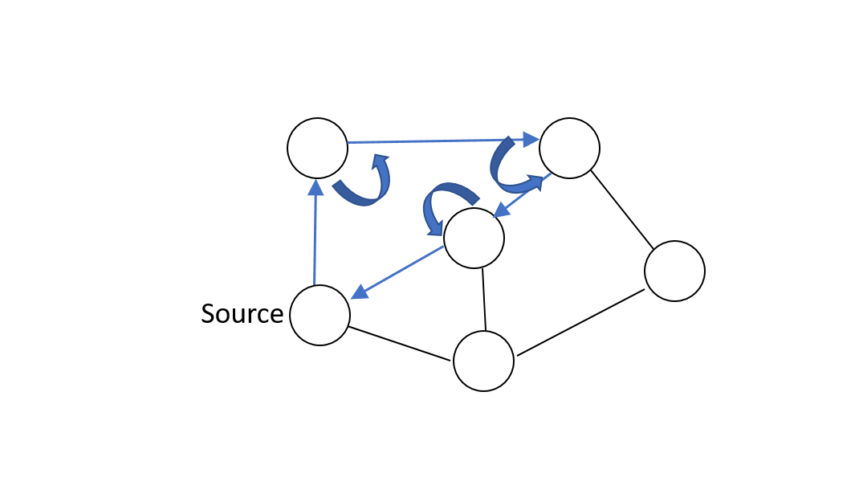
Face routing: Right-hand rule
Right-hand rule - send to next edge counter-clockwise relative to incoming edge
Notes:
So the first of these operations is known as the right-hand rule, where at each node, you leave from the next edge counter-clockwise relative to the incoming edge. But clearly on its own this wouldn’t be enough, since you can get into the sort of loops shown on this slide.

Slide 81
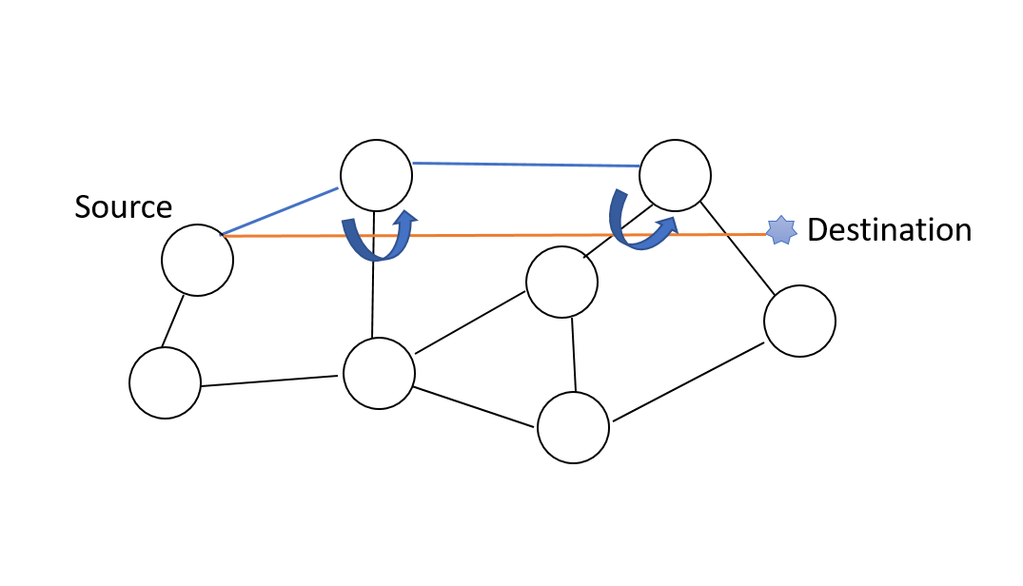
Face routing: Face changes
A virtual line is drawn from source to destination
Any edge which crosses this line switches the primitive from right-hand rule to face traversal
Change to next face if this occurs
Notes:
So face routing also uses a second rule, in which a virtual line is drawn from the source to the destination, and any edge that crosses this line switches the primitive from the right-hand rule to face traversal, which causes the algorithm to change to the next face.

Slide 82
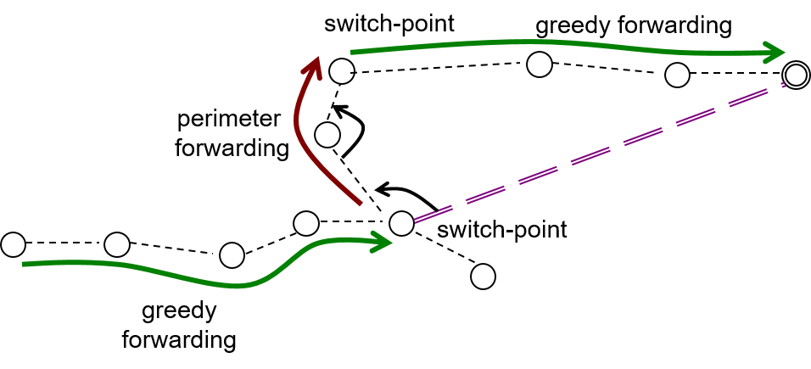
Greedy Perimeter Stateless Routing (GPSR)
GPSR⁴ combines greedy routing with face routing when local minima are encountered
⁴Brad Karp and Hsiang-Tsung Kung. “GPSR: Greedy perimeter stateless routing for wireless networks”. In: Proceedings of the 6th annual international conference on Mobile computing and networking. ACM. 2000, pp. 243–254.
Notes:
Ok, so that’s how face routing works, but although it provides guaranteed routing from the source to the destination, it doesn’t always produce the most efficient routes.
So for that reason, hybrid greedy-face-greedy approaches that combine greedy routing with face routing are quite common. And basically, the way these work are that they use greedy routing until it gets stuck, and then temporarily switch to face routing as necessary to get themselves out of trouble, before switching back to greedy routing again later.
And an example of that is shown in this slide.

Slide 83
Geographical Routing: Overview
Geographical routing is a way of routing without explicitly constructing a routing tree
Decisions are taken locally based on co-ordinates of neighbouring nodes
Handles node mobility elegantly
Does require location of all nodes to be known
Notes:
So to summarise, geographical routing is a way of routing that involves taking decisions locally based on the coordinates of neighbouring nodes, and doesn’t need to involve explicit construction of a routing tree.
And it’s quite good at handling moving nodes, although it does require the locations of all the nodes to be known.
One thing that we haven’t touched on here is how you can perform geographical routing in 3D, which it turns out is not just a simple extension of the 2D case. For anyone who’s interested, you might want to take a look into that offline.

Slide 84
Routing Tree: Collection Tree Protocol⁵
Degenerate form of a mesh network with a single destination
All data concentrates at a single point (basestation)
Basestation has a cost/metric of 0
Nodes don’t need to know basestation ID beforehand
⁵Omprakash Gnawali et al. “Collection tree protocol”. In: Proceedings of the 7th ACM conference on embedded networked sensor systems. ACM. 2009, pp. 1–14.
Notes:
Ok, so now let’s move on to another protocol, known as the Collection Tree Protocol, which is based on a routing tree, a degenerate form of mesh network with a single destination.
And so in this protocol, all data concentrates at a single point, known as the basestation, which is given a cost of zero.
And one thing that’s important to note is that nodes don’t need to know the ID of the basestation in advance.

Slide 85
Routing Tree Construction
Basestation initiates construction by broadcasting its hop-count (0)
Nodes increase hop-count and rebroadcast beacon
Nodes choose a parent with lowest distance to root
Increase hop-count if parent beacon is not received within timeout period
Notes:
So how does this work? Well, initially, the basestation initiates tree construction by broadcasting its hop count, which will be zero.
And then any time another node receives a message, it will increment the hop count it has received and rebroadcast the beacon. It will also use the messages it receives to choose a parent with the lowest distance to the basestation.
It will also increase the hop count if its parent beacon has not been received within a timeout period.

Slide 86
Routing tree metrics
Different costs can be used
Hops to root
Remaining node energy
Link reliability
Some weighted combination of the above
Notes:
Different cost functions can be used in practice when choosing between potential parents. So for example, these can include hops to root, remaining node energy, link reliability, or indeed some weighted combination of the above.

Slide 87
Do we even need routing protocols?
Glossy⁹ is an emerging approach which does away with explicit routing protocols
It achieves reliability of 99.99% for flooding data through a network
Glossy relies on constructive interference through simultaneous rebroadcasts
By exploiting the properties of the PHYsical layer, it provides an alternative network primitive
⁹Federico Ferrari et al. “Efficient network flooding and time synchronization with glossy”. In: Information Processing in Sensor Networks (IPSN), 2011 10th International Conference on. IEEE. 2011, pp. 73–84.
Notes:
So we’ve talked a lot about routing protocols at this point, but one interesting question to ask is whether it might be desirable to do away with explicit routing protocols altogether.
And so an approach called Glossy does just this, and achieves 99.99% reliability for flooding data through a network.
So we’re not going to go into too much detail here about how it works, but basically it relies on constructive interference through simultaneous rebroadcasts, and exploits the properties of the physical layer to provide an alternative network primitive. And if you’re interested in finding out more about it, there’s a reference to the paper on the slide.

Slide 88
Comparison of resource-constrained approaches
In dense or resource-constrained networks, the identity of the node is often not as important as:
Location (geographical routing)
Distance from root (collection tree)
These are akin to semantic overlays, where node identity is irrelevant
Notes:
So to conclude, the key message that I’d like you to take away from this section is that in dense or resource-constrained networks, a node’s identity is often not as important as its location, its attributes, and/or its distance from the root, and there are many successful routing protocols that have been based on this principle.
And if it helps, you can think of these things as essentially semantic overlays over the network that make node identity irrelevant.

