Slide 1
Cavity Testing for High Q
Dan Gonnella
Matthias Liepe
Cornell University

Slide 2
The Experiment
A. Romanenko saw an improvement in Q with fast (>few K/min) on N₂ doped and EP+120ºC baked cavities.
Two single-cell ILC shaped cavities were tested with fast (>5 K/min) and slow (<<1 K/min) cool down.
N₂ doped cavity (prepared at FNAL by A. Grassellino)
EP+120ºC baked cavity
Q vs Temperature was measured for each cool down and residual resistance was extracted.
For the N₂ doped cavity, Q vs E was measured at 2 K.

Slide 3
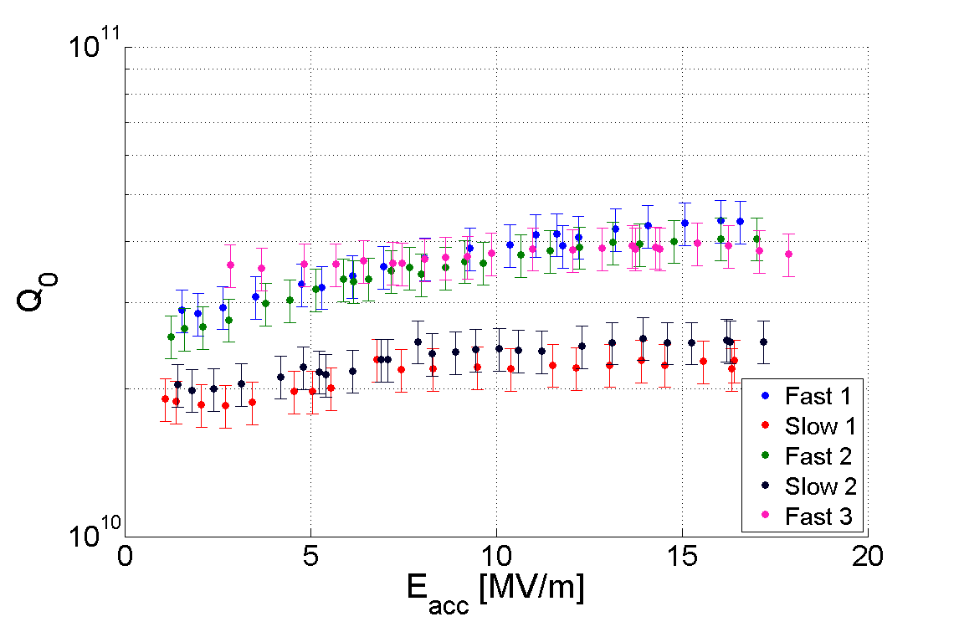
N₂ Doped: Q vs E at 2 K
Fast Cool Downs
Q₀ increases from 1.5x10¹⁰ to 4x10¹⁰
Slow Cool Downs

Slide 4
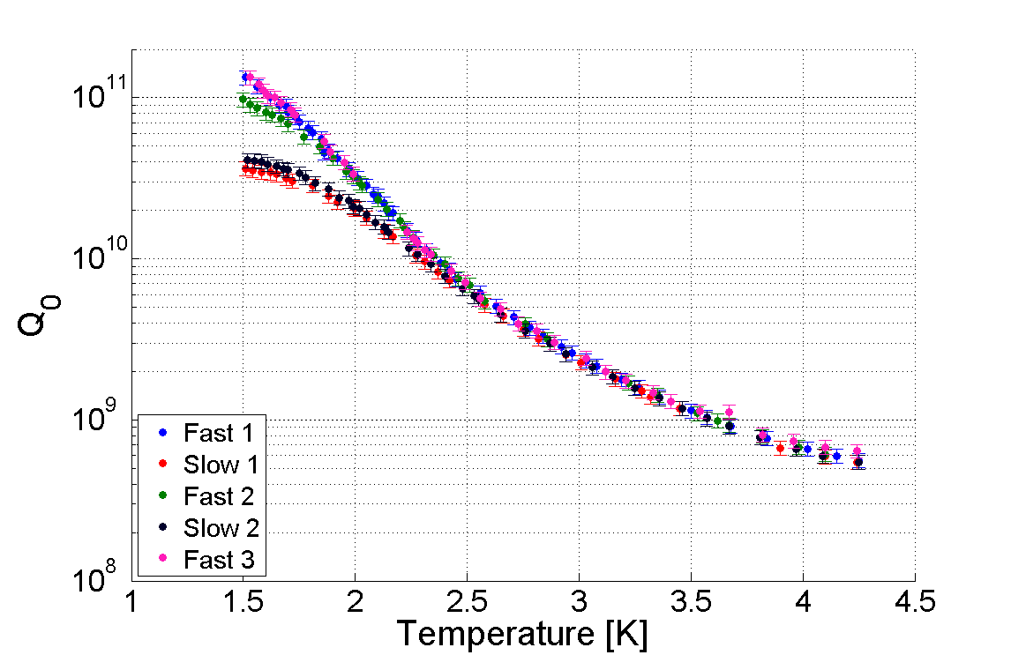
N₂ Doped: Q vs Temperature
Fast Cool Downs
Cool Down Speed | Average R_{res} [nΩ]
Fast (>5 K/min) | 1.9
Slow (<<1 K/min) | 6.5
Slow Cool Downs

Slide 5
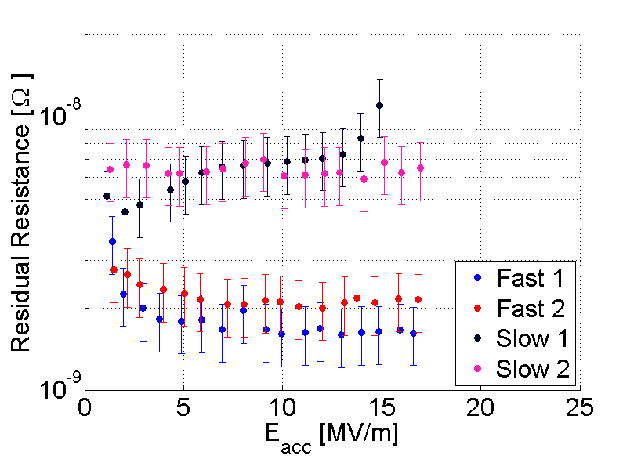
N₂ Doped: Residual Resistance
Residual resistance decreases with faster cool down speed.

Slide 6
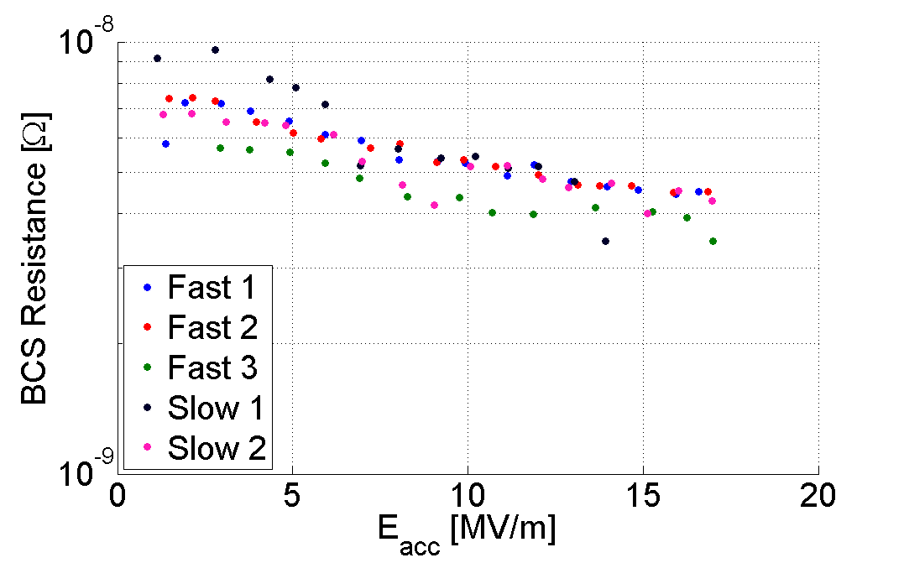
N₂ Doped: BCS Resistance
Anti-Q slope is caused by decreasing BCS resistance which is unaffected by cool down speed
Note: Errors are approximately 20% on R_{BCS}

Slide 7
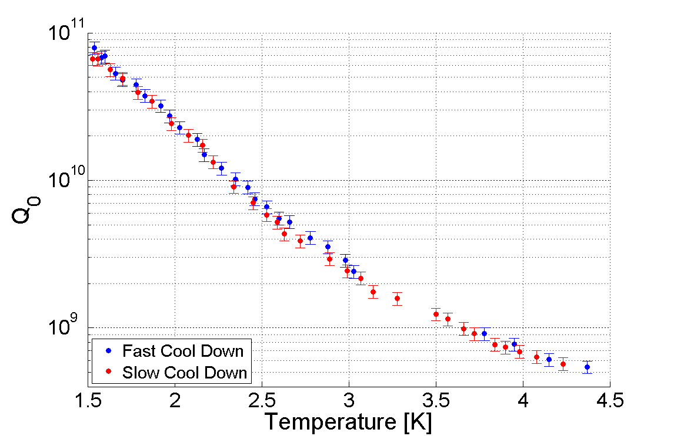
EP+120ºC: Q vs Temperature
Fast: 8x10¹⁰
Cool Down Speed | R_{res} [nΩ]
Fast (>5 K/min) | 3.0
Slow (<<1 K/min) | 3.6
Slow: 6x10¹⁰

Slide 8
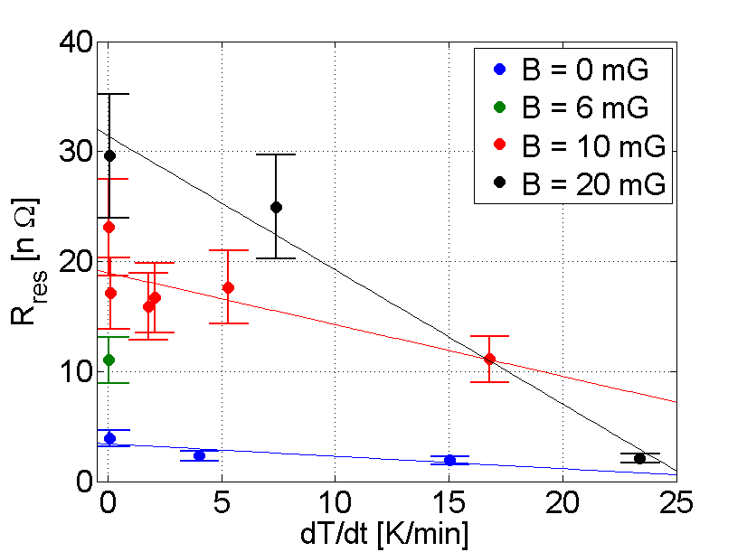
N₂ Doped Cavity in External Magnetic Field
Applied Field [mG] | Normalized Slope [nΩ/(K/min)/nΩ]
0 | -0.03 ±0.02
10 | -0.02 ±0.01
20 | -0.038 ±0.007
Cavity was placed in a Helmholtz coil with field parallel to cavity axis.
3 different fields were applied and residual resistance was measured at different cool down rates for each field.
For more details see my other talk in WG7: “Effects of External Magnetic Field on Cavity Performance”

Slide 9
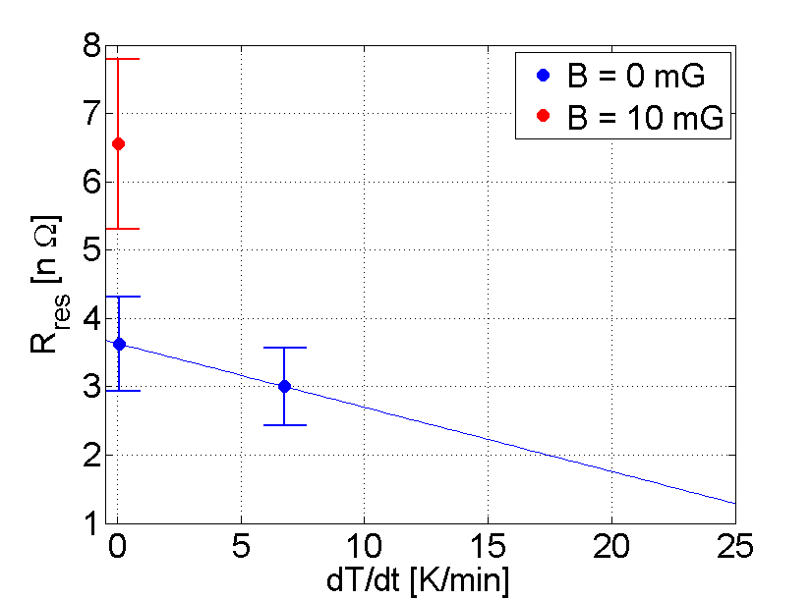
EP+120ºC Baked Cavity in External Magnetic Field
EP+120ºC cavity is less susceptible to residual losses from magnetic field.
Faster cool down rate gives less residual for both cavity treatments.
More cool downs with other external fields are needed.
Normalized Slope:
-0.010 ±0.005

Slide 10
Conclusions
For N₂ Doped cavities, fast cool down results in a significantly less R_{res} (75% lower) than slow cool down.
For the EP+120ºC cavity in vertical test, fast cool down results in a slightly lower R_{res} (20%) than with slow cool down.
N₂ doped cavities are more susceptible to residual losses from external magnetic field than EP+120ºC baked cavities – see “Effects of External Field on Cavity Performance” in WG7 .
Future work will focus on continued studies on cavities with other preparations (EP, BCP).

