Slide 1
Experience with Cavity Testing at Cornell
Dan Gonnella
TTC Meeting
December, 2014

Slide 2
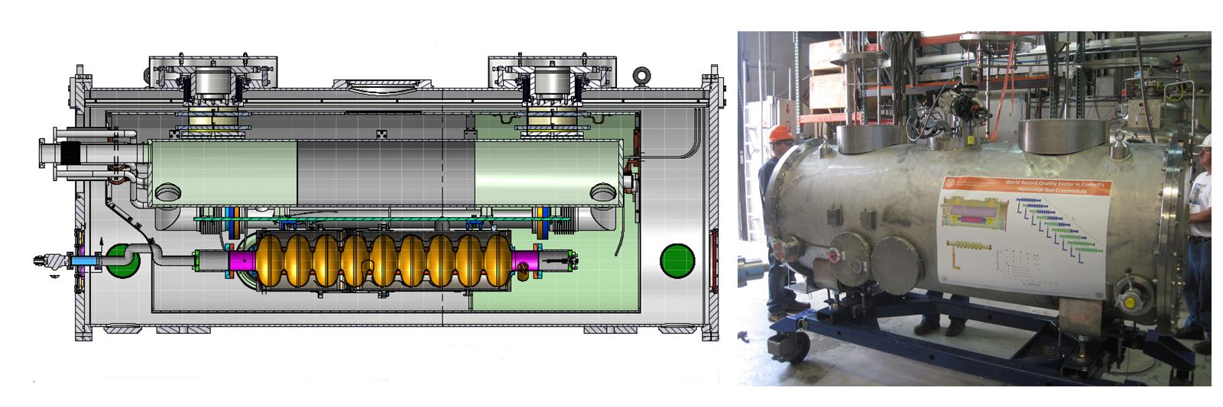
The HTC
The Cornell Horizontal Test Cryomodule (HTC) is a full cryomodule that can hold one 9-cell cavity.
Ambient magnetic fields are ~2 mG with 2 layers of magnetic shielding.
Notes:
Very similar to LCLS-II cryomodule. 2 m section of the LCLS-II cryomodule. This is different than the HTS at FNAL or Jlab
Label things

Slide 3
Cryomodule Tests
5 cryomodule tests have been performed in the Cornell HTC:
3 tests with a 7-cell Cornell ERL Cavity
  With high Q input coupler
  With high power input coupler
  With high power input coupler and beamline HOM loads
2 tests with nitrogen-doped 9-cell cavities prepared at FNAL

Slide 4
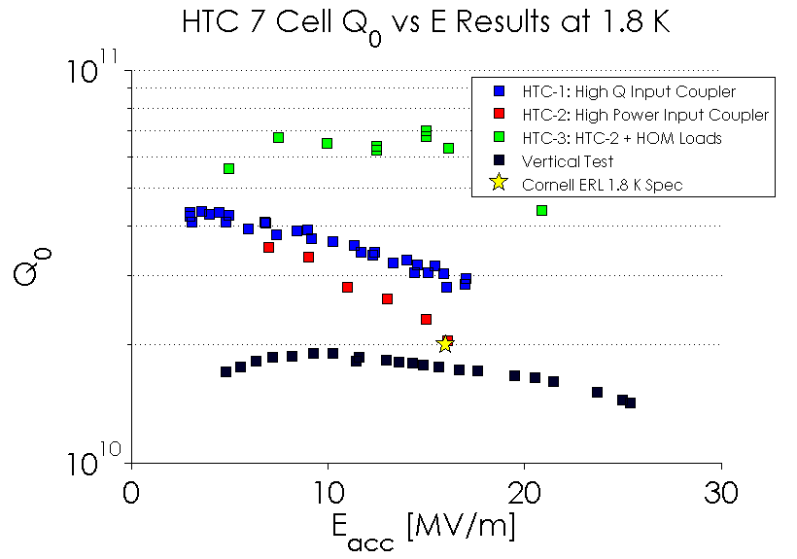
7-Cell Results
All three HTC tests of the ERL 7-cell cavity resulted in better performance than in vertical test.
Resulted in a decrease of ~5 nΩ of residual resistance from vertical to horizontal.
ΔR_{res}=5 nΩ
VT was done in high magnetic field.
Slow cool down gives best performance in HT since ambient field was so low (~1 mG).

Slide 5
9-Cell Results
Cavity | HTC Test | VT Result | HT Result | ΔR_{res,VT->HT} [nΩ]
TB9AES012 | HTC9-1 | 3.5x10¹⁰ | 3.2x10¹⁰ | ~1
TB9AES012 | HTC9-2 | 3.4x10¹⁰ | 2.7x10¹⁰ | ~3
1 to 3 nΩ increase in residual resistance from VT to HT. (HT in ~2 mG ambient magnetic field)
  First data for performance degradation margin VT->HT for N-doped cavities!
Consistent with ~0.5 to 1 nΩ/mG residual resistance increase due to ambient magnetic field in horizontal test with fast cool down.

Slide 6
9-Cell Results
Why was performance worse in the HTC with 9-cell cavities?
Vertical tests were done in very small ambient magnetic fields and with very fast cool downs.
  Minimal flux trapping
  Thermal currents are not an issue in vertical test
In the HTC, ambient fields were somewhat higher giving a larger R_{res}.
  Thermal currents ARE an issue in horizontal test

Slide 7
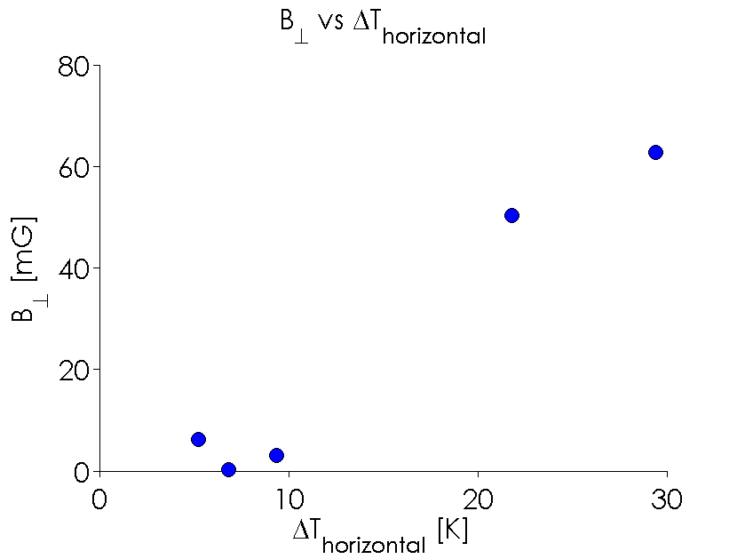
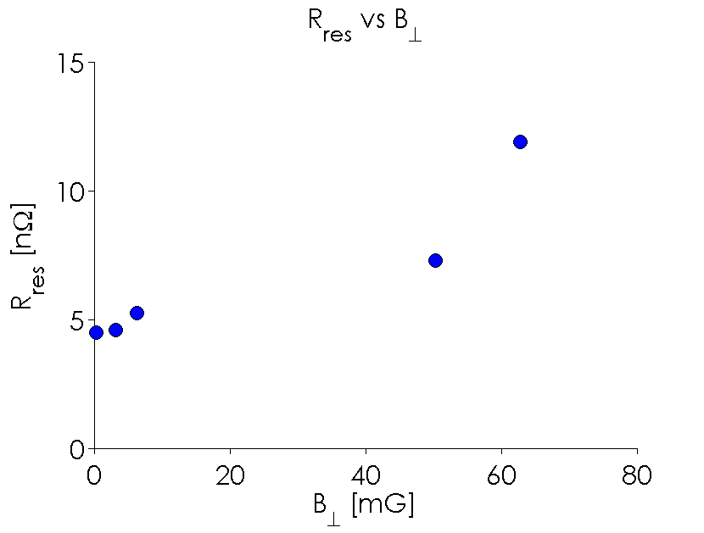
Heater Studies, cont.
Larger horizontal temperature gradient causes a larger perpendicular magnetic field by thermal currents.
Larger perpendicular magnetic field causes significant increases in R_{res} even with large vertical gradients (unlike in vertical test).
See my talk in WG 1 on Cool Down Procedure for more details

Slide 8
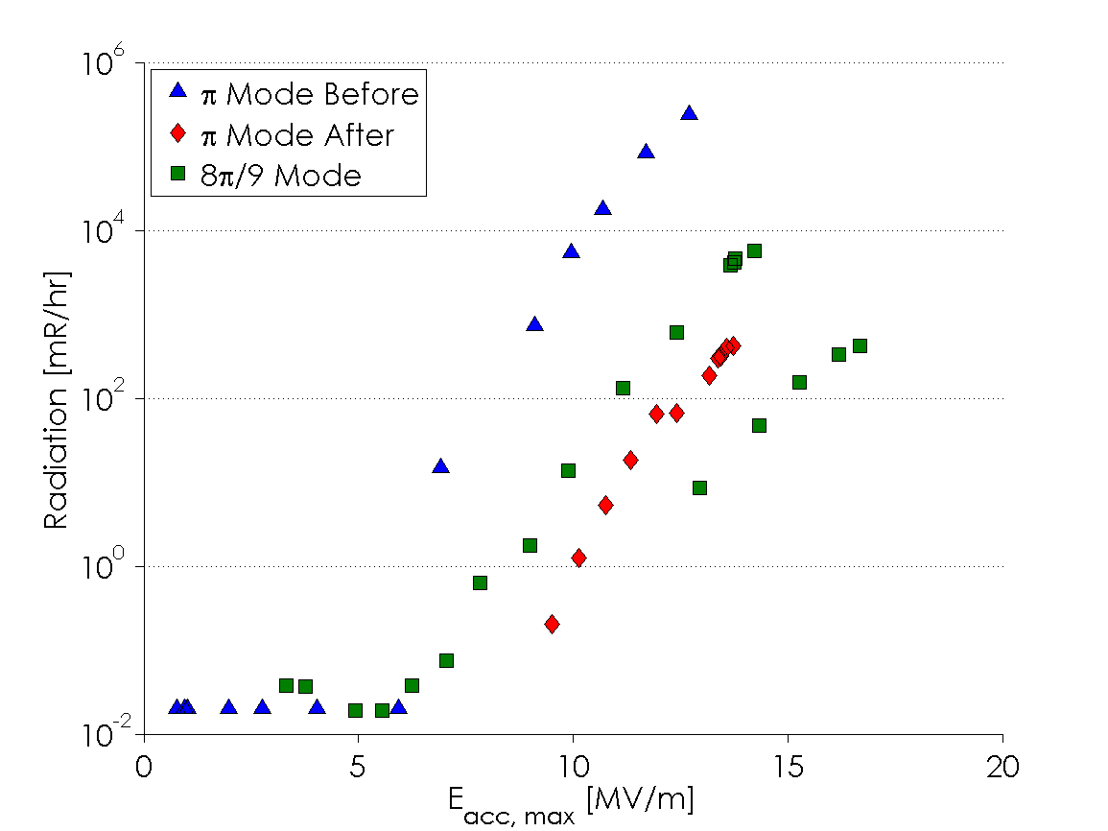
Conditioning
Due to quench limitations, field emission couldn’t be conditioned in the π mode.
By driving the cavity in the 8π/9 mode, field in the cell with the field emitter could be pushed higher and field emission was conditioned.
Radiation dropped by a factor of 1000!

Slide 9
Conclusions
Cornell has demonstrated better performance of 7-cells in full cryomodule than in vertical test due to improved magnetic shielding.
Nitrogen-doped cavities have shown an increase of 1-3 nΩ of R_{res} from vertical to horizontal test due to worse magnetic shielding, smaller vertical gradients during cool down, and magnetic fields from thermal currents.
We have demonstrated conditioning of field emission using a different TM010 mode in a
9-cell cavity.

Slide 10
Thank you for your attention!
Two relevant papers on arXiv:
Nitrogen-Doped 9-Cell Cavity Performance in a Test Cryomodule for LCLS-II.
D. Gonnella et. al. arXiv: 1411.1659
Thermocurrents and their Role in high Q Cavity Performance.
R. Eichhorn et. al. arXiv: 1411.5285

