Slide 1
Update on Nitrogen Doping at Cornell
Dan Gonnella
TTC Meeting
December, 2014

Slide 2
Nitrogen-Doping at Cornell
Nitrogen-doping was first proposed at FNAL.
The Cornell recipe, focusing on strong doping:
Given 800ºC in vacuum for 3 hours followed by 20 minutes in 60 mTorr of N₂ followed by 30 minutes in vacuum.
Applied to 5 single-cells and given differing amounts of final EP to study how performance changes with depth.
Additionally applied to 5 9-cells.
Notes:
Plot of pressure

Slide 3
Cavity Preparation
Cavity | Treatment | Final EP [µm] | Quench Field [MV/m] | Q₀(2 K, 16 MV/m)
TE1-1 | Standard N-Doping | 18 | 19 | 3.5x10¹⁰
TE1-2 | Standard N-Doping | 6 | 17 | 4x10¹⁰
TE1-3 | Standard N-Doping | 12 | 35 | 4.5x10¹⁰
TE1-4 | Standard N-Doping | 24 | 36 | 3.5x10¹⁰
TE1-5 | Standard N-Doping | 30 | 27 | 3x10¹⁰
TE1-1 | Argon Doping | 0 | 24* | 1.9x10¹⁰
TE1-4 | Standard N-Doping + 120ºC Bake | 24 before bake | 18 | 3.6x10¹⁰
Average first pass quench field: 27 MV/m
Average first pass Q₀(2 K, 16 MV/m): 3.7x10¹⁰
For reference LCLS-II specification is a Q₀ of 2.7x10¹⁰ at 16 MV/m and 2.0 K.

Slide 4
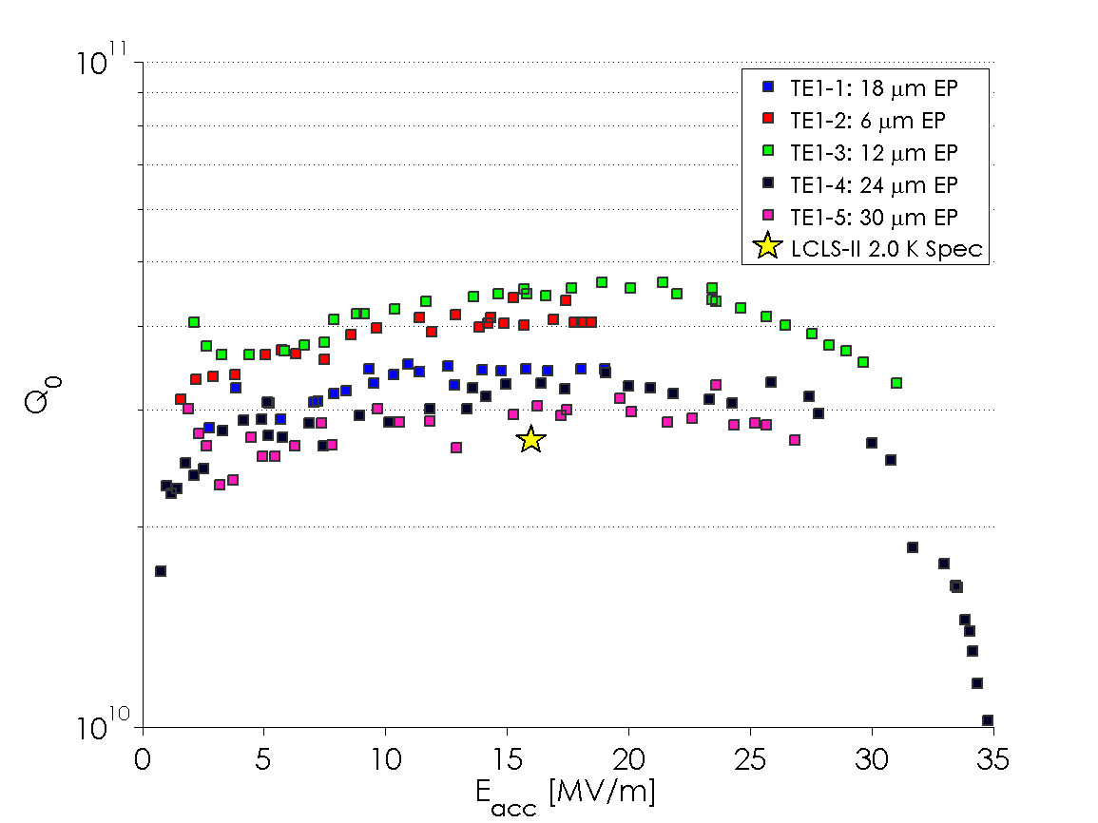
Q₀ vs E: Single-Cells (first-pass)

Slide 5
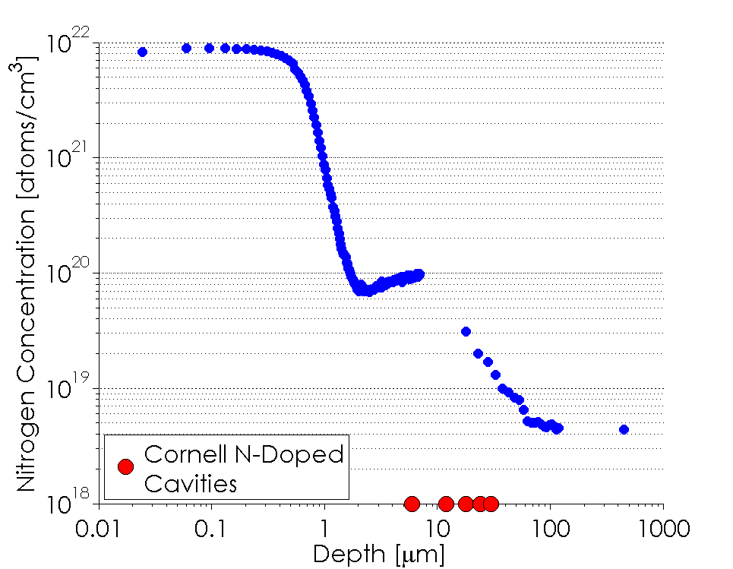
Sample Analysis
A sample treated with the cavities was analyzed using SIMS.
Nitrogen was found to be present above the background at least 50 µm into the material.

Slide 6
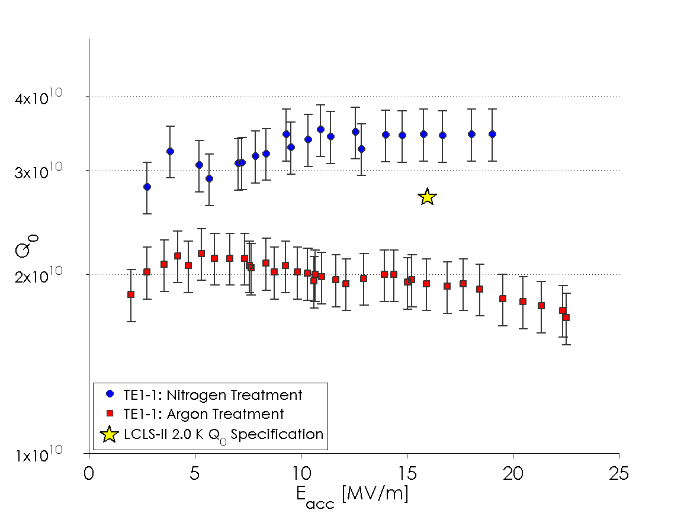
Argon Doping
Argon doping produces significantly worse Q₀ than nitrogen-doping
There was no discernable difference in Q₀ between the argon doping and standard cavity preparation.
Quench is suspected to be fundamental to the cavity
Notes:
Two slides comparing cavities

Slide 7
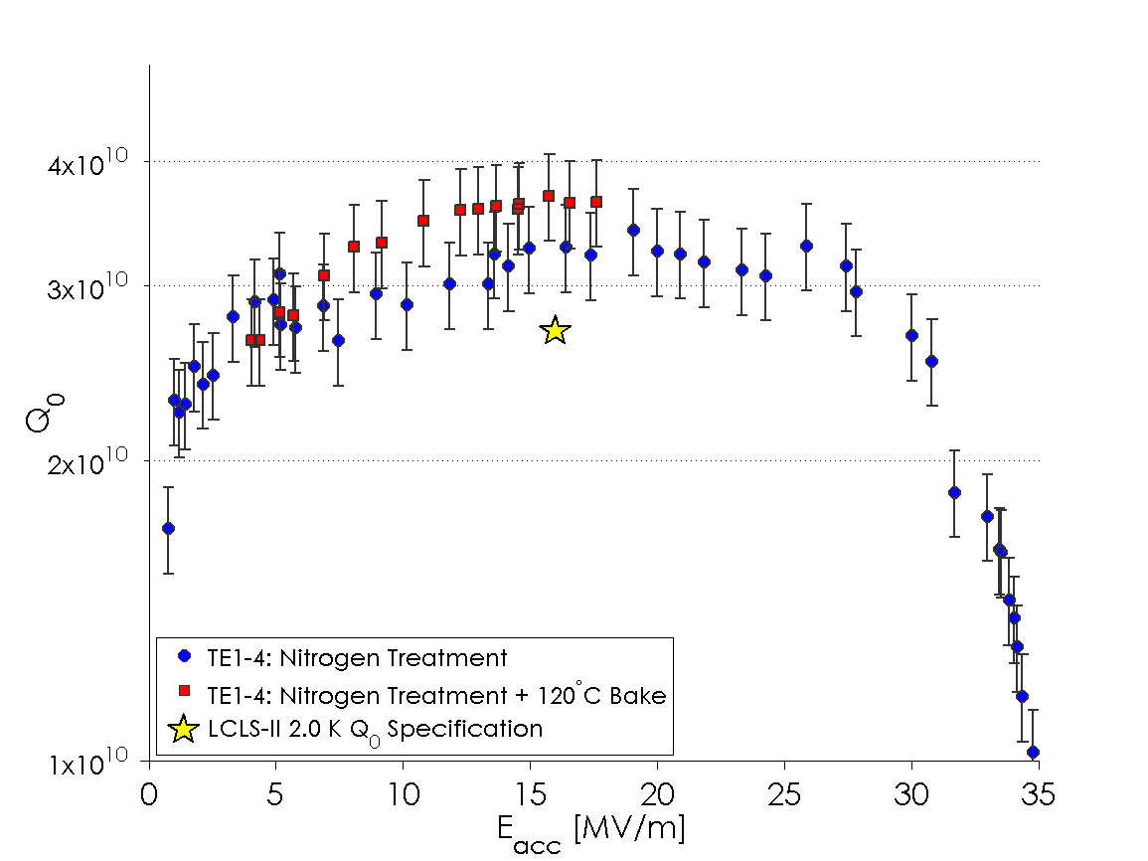
Nitrogen Doping + 120ºC Bake
120ºC bake resulted in a slight increase in Q₀.
Also resulted in a strong degradation in the quench field.
Notes:
Two slides comparing cavities

Slide 8
Cavity Preparation
N-Doped 9-cell | 1st Pass EP [µm] | 2nd Pass Additional EP [µm] | Qo at 16MV/m, 2K | Quench | Status
AES018 | 14 | 10 | 2.3E10 (2nd) 3.2E10 (3rd) | 28MV/m 21MV/m | FE (onset 10MV/m) Quench
AES022 | 14 | 0 (re-HPR) | 2.0E10 (1st) 3.4E10 (2nd) | 24MV/m 17MV/m | FE (onset 8MV/m) Quench, FE free
AES023 | 17 | 10 | 3.4E10 (1st) 3.0E10 (2nd) | 14MV/m 16MV/m | Quench, FE free Quench, FE free
AES029 | 27 | None | 2.7E10 | 15MV/m | Quench, FE free
AES030 | 26 | 0 (re-HPR) | 2.7E10 (1st) 3.0E10 (2nd) | 17MV/m 16.6MV/m | Quench, leak at 1.8K Quench, FE free
Average quench field: 18 MV/m
Average Q₀(2 K, 16 MV/m): 3.2x10¹⁰
For reference LCLS-II specification is a Q₀ of 2.7x10¹⁰ at 16 MV/m and 2.0 K.

Slide 9
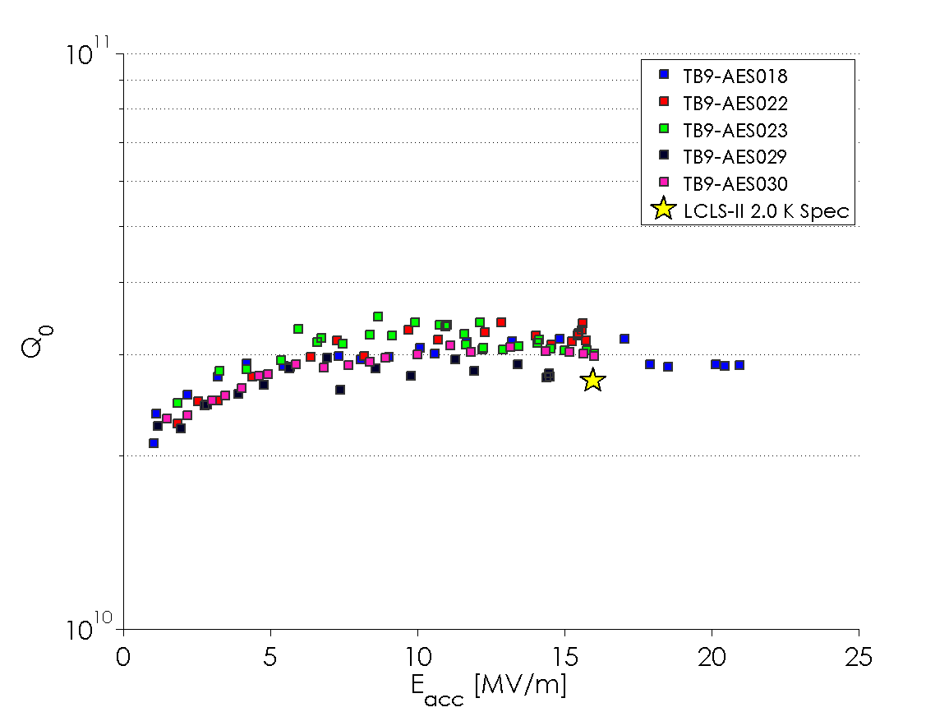
Q₀ vs E: 9-Cells
All 9-cells meet or exceed LCLS-II Q₀ specification!

Slide 10
Conclusions and Outlook
Nitrogen-doping at Cornell has repeatedly shown Q₀’s higher than 3x10¹⁰ at 2.0 K.
We have developed a recipe that results in quench fields > 25 MV/m in single-cells.
Average quench fields and Q₀ significantly exceed LCLS-II specifications in single and 9-cells.
Argon doping caused no significant improvement compared with standard treatments.
Future work will focus on looking at additional treatments including doping with gases other than nitrogen and argon.

Slide 11
Thanks for your attention!

