Slide 1
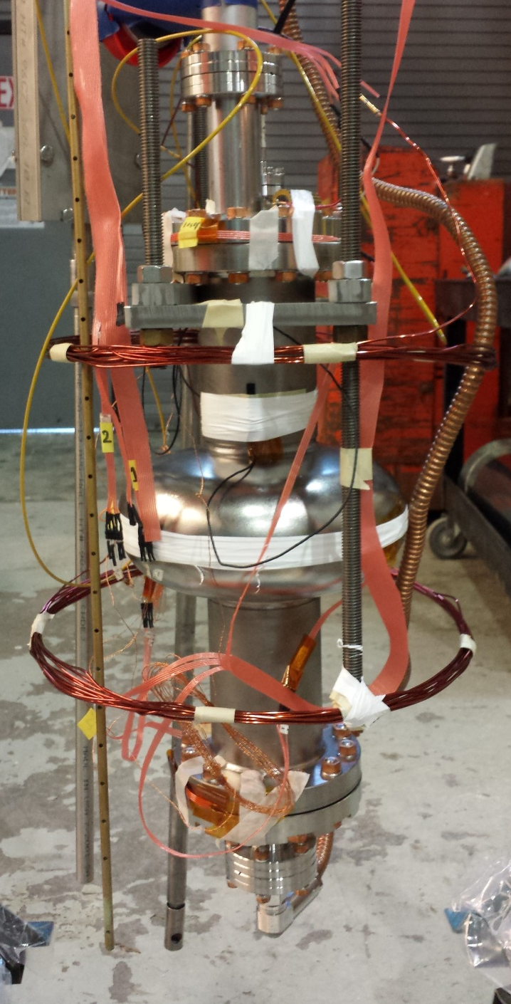
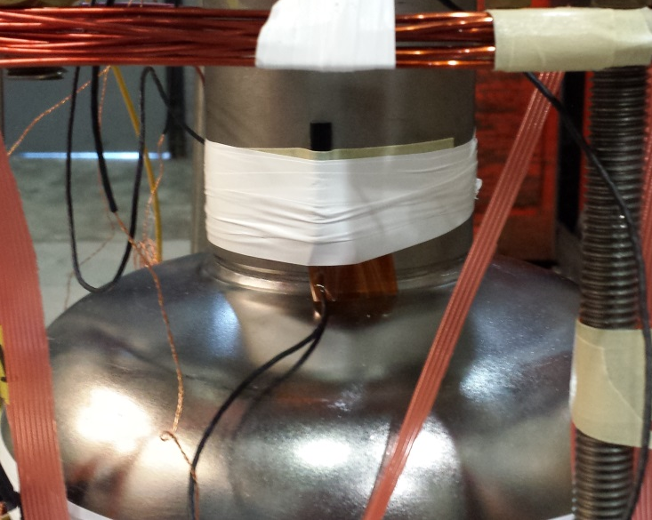
Slow Cool
Down System
Temperature Sensors
Fluxgate
Magnetometer
Helmholtz
Coil

