Slide 1

💎
Lumina
AI-Powered Personalized Learning
Learn anything, your way

Slide 2

The Problem
One-size-fits-all education doesn't work
Learners have different styles, levels, and goals
Content is static, not adaptive to individual needs
No way to assess what you already know before diving in
Every learner deserves content that meets them where they are.

Slide 3
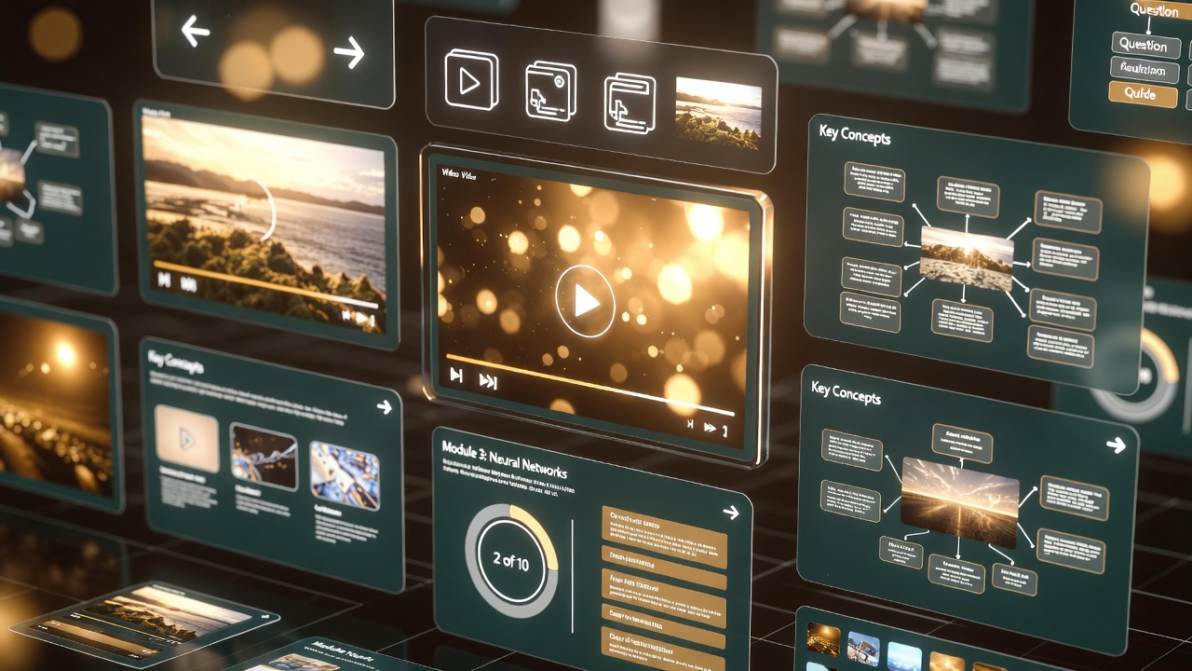
Our Solution
Lumina creates personalized, multi-modal learning experiences:
Pre-assessment chat to gauge existing knowledge before generating content
AI-generated lessons tailored to your level, style, and interests
Videos, slides, quizzes, and flashcards — all auto-generated from one topic
AI Chat Tutor — streaming conversational tutor grounded in lesson content
Animated video with Grok — static images converted to 6s animated clips
Knowledge graph tracking concepts learned across sessions
Study plan with AI-recommended next topics based on your progress

Slide 4
How It Works
User Profile
→
Pre-Assessment (LangGraph)
→
Web Search (Firecrawl)
→
Content Synthesis (LLM)
→
Grok Imagine (Animated Video)
→
Multi-modal Output (Video/Slides/Quiz)
Tech Stack
Frontend: React + Vite + Tailwind CSS
Backend: FastAPI + SQLAlchemy + PostgreSQL
AI Pipeline: LangGraph (assessment + chat) → FuseAPI (multi-model LLM routing) → Remotion (video)
Search: Firecrawl (web scraping + search)
Voice: mlx-whisper (alignment), TTS narration
Visualization: Markmap (mind maps), react-force-graph (knowledge graph)

Slide 5
Key Features
1
Chat-based Pre-Assessment
LangGraph-powered conversation to gauge knowledge before lesson generation
6
7 Visual Styles
Cartoon, watercolor, photorealistic, minimalist, anime, scientific, 3D render
2
AI Chat Tutor with Streaming
Real-time SSE conversational tutor grounded in lesson content + web search
7
Cross-session Knowledge Graph
Force-graph linking topics to concepts across all sessions
3
Animated Video Generation
Grok Imagine converts images to 6s clips, Remotion renders with timing sync
8
Mind Map & Flashcards
Markmap concept trees + flip cards with mastery tracking
4
Playbook Mode
Per-section audio with auto-play and auto-advance in slide presenter
9
Learning Analytics & Study Plan
Timeline, session stats, and AI-recommended next topics
5
Interactive Slide Presenter
In-browser slides with AI images, keyboard nav, and PPTX download

Slide 6
DEMO FLOW
Live Walkthrough
1
Enter topic
Type any learning topic into the search bar
2
Pre-assessment chat
AI asks targeted questions to gauge existing knowledge
3
AI generates lesson
Web search + LLM synthesizes personalized content
4
View slides with images
Navigate AI-generated slides with multiple images per section
5
Chat with AI tutor
Ask follow-up questions with streaming responses and source citations
6
Watch animated video
AI-generated animated clips with narrated audio
7
Take quiz
Test understanding with auto-generated questions
8
Explore mind map
Interactive concept tree visualization
9
Review knowledge graph
See connections across all learning sessions

Slide 7

What Makes Us Different
Pre-assessment BEFORE content generation
Most platforms test you after — Lumina adapts the lesson itself based on what you already know
Multi-modal from ONE topic
Video + slides + quiz + flashcards + mind map — all generated from a single topic input
Real-time streaming AI chat
LangGraph-powered conversational tutor with SSE streaming and source citations from web search
Cross-session knowledge graph
Obsidian-style concept linking across all your learning sessions
Open architecture
FuseAPI routes to any LLM (Gemini, Claude, GPT). Grok for animation. Swap any component.

Slide 8
ARCHITECTURE
Tech Stack
Frontend
Animation
React, Vite, Tailwind CSS
Grok Imagine API (image-to-video)
Backend
Voice
FastAPI, SQLAlchemy, PostgreSQL
mlx-whisper (alignment), TTS narration
AI / LLM
Visualization
LangGraph (assessment + chat), FuseAPI (multi-model routing)
Markmap (mind maps), react-force-graph (knowledge graph)
Search
Infrastructure
Firecrawl (web scraping + search)
Docker Compose (4 services: frontend, backend, db, remotion)
Video
Remotion (programmatic video generation)

Slide 9

Future Vision
Real-time collaborative learning (study groups)
Spaced repetition algorithm for flashcard scheduling
Teacher / instructor mode with class analytics
Mobile app (Capacitor integration already scaffolded)
Multi-language support with localized narration
Adaptive difficulty that adjusts in real-time during lessons

Slide 10
💎
Thank You
Built at FuseAPI AI Hackathon 2025
Try it: localhost:3000
Lumina — Learn anything, your way

