Slide 1
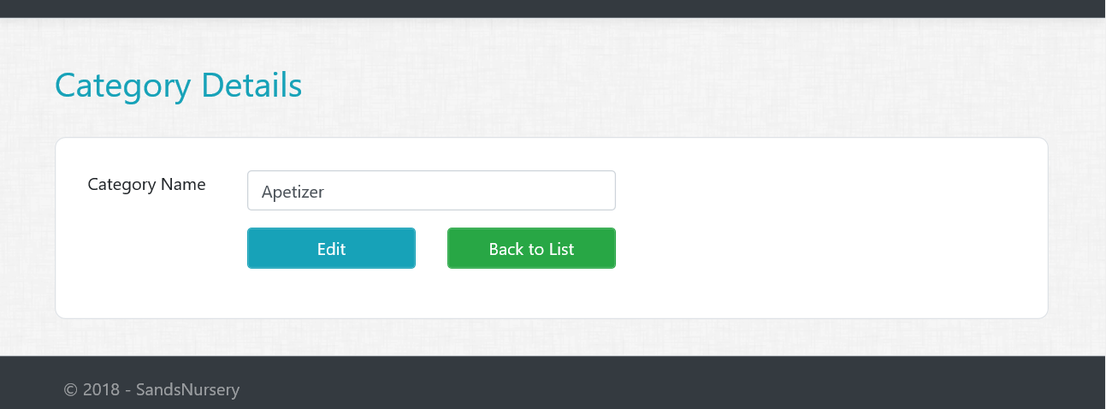
Assignment 1
Category Details Views/Actions
Create Details GET action method in Category controller.
Create Category Details View.
All fields should be disabled or read only
Create a Partial view for buttons (_DetailsAndBackToListButton
HINT : Partial View will take ID as model to pass to edit page.

