Slide 1
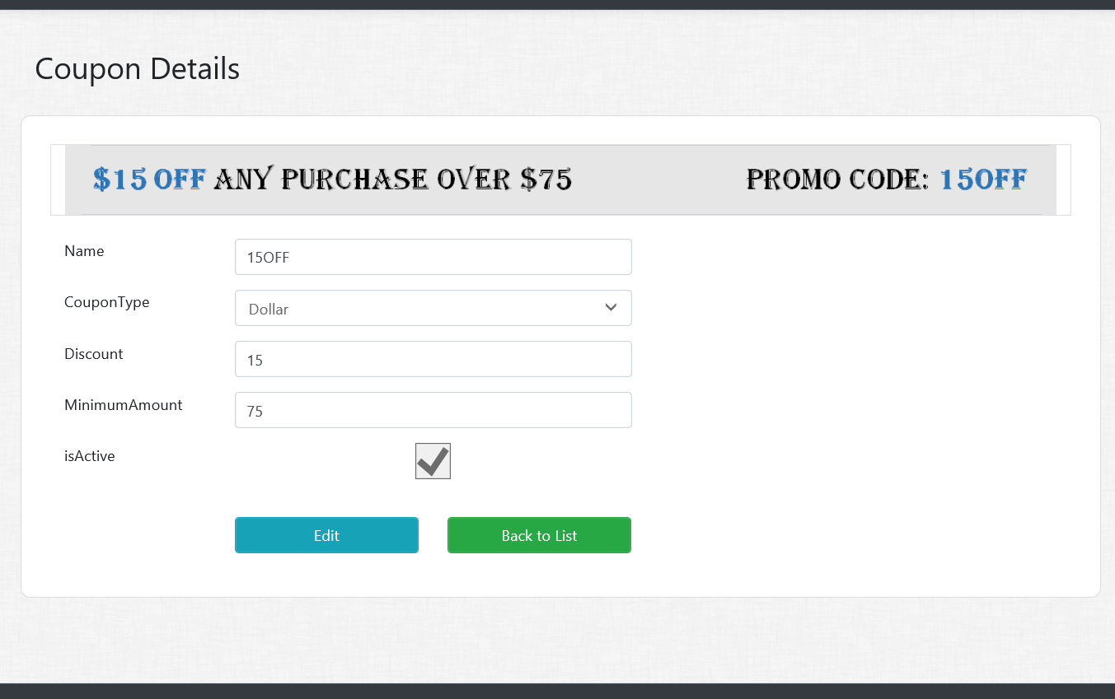
Assignment 4 – Part 1
Coupons Details Views/Actions
Create Details GET action method in Coupon controller.
Create Coupon Details View.
All fields should be disabled or read only

Slide 2
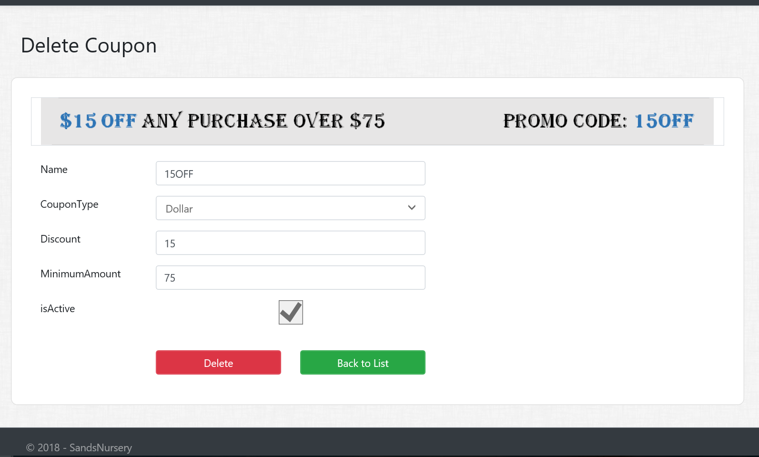
Assignment 4 – Part 2
Coupons Delete Views/Actions
Create Delete GET action method in Coupon controller.
Create Coupon Delete View.
All fields should be disabled or read only
HINT : Consume Partial View for Buttons
Create Delete POST action method in Coupon controller.

