Slide 1
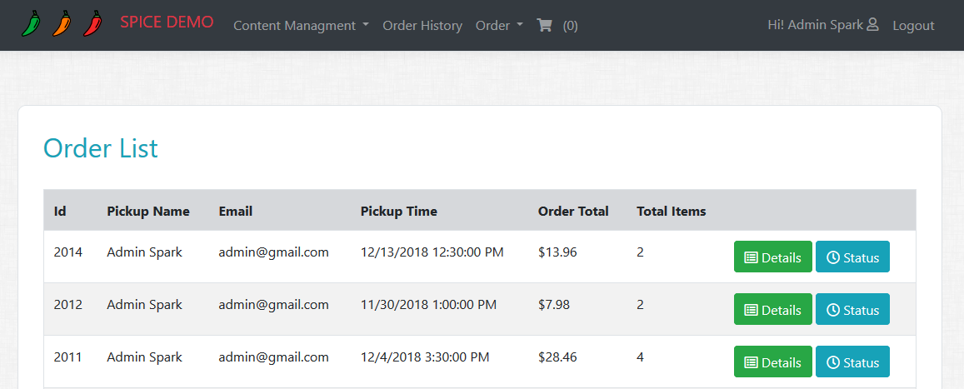
Assignment 5 – Step 1
Order Status Tracking on Order History Page
Create a “Status” button next to Details button in Order history view
Status button should not be visible if order status is Cancelled.

Slide 2
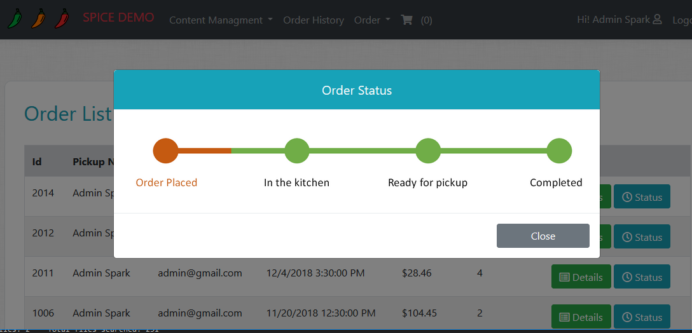
Assignment 5 – Step 2
Order Status Tracking on Order History Page
Create partial View for displaying Order Status Image (_OrderStatus).
Based on the order status display its corresponding Images.
Images Attached
OrderPlaced.png
InKitchen.png
ReadyForPickup.png
Completed.png
HINT : Add constants in SD class for all images and use them over magic string.
Create an action in OrderController that will return the new PartialView (_OrderStatus).
Add a new Modal to display
‘Order Status’ in PopUp like we did
for Order Details.

