Slide 1
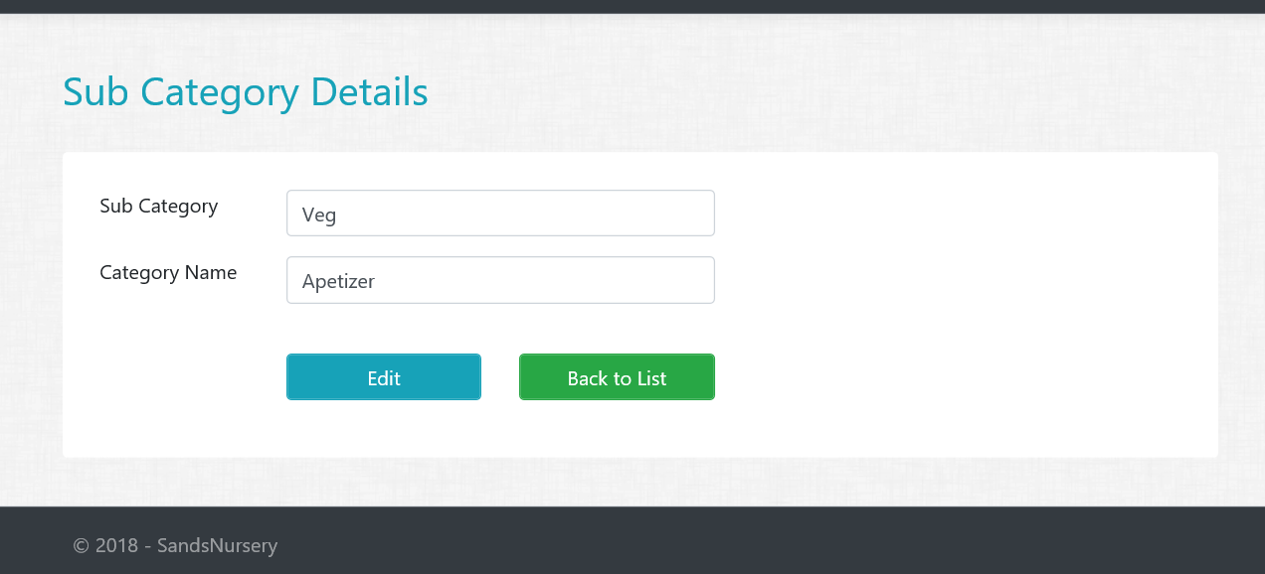
Assignment 2 – Part 1
SubCategory Details Views/Actions
Create Details GET action method in SubCategory controller.
Create SubCategory Details View.
All fields should be disabled or read only
HINT : Consume Partial View for Buttons

Slide 2
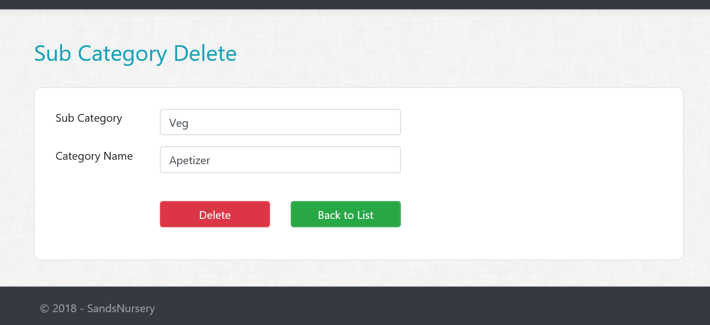
Assignment 2 – Part 2
SubCategory Delete Views/Actions
Create Delete GET action method in SubCategory controller.
Create SubCategory Delete View.
All fields should be disabled or read only
HINT : Consume Partial View for Buttons
Create Delete POST action method in SubCategory controller.

