Slide 1
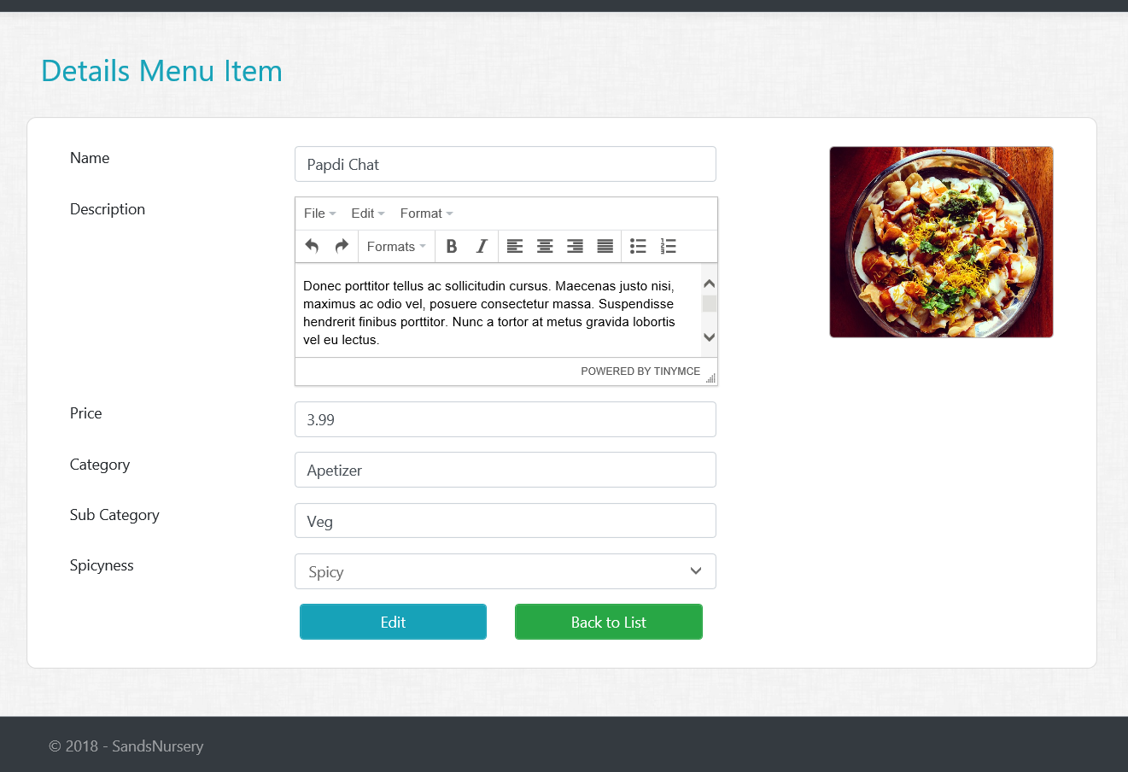
Assignment 3 – Part 1
MenuItem Details Views/Actions
Create Details GET action method in MenuItem controller.
Create MenuItem Details View.
All fields should be disabled or read only
HINT : TinyMce has property (readonly: 1) to make textarea read only

Slide 2
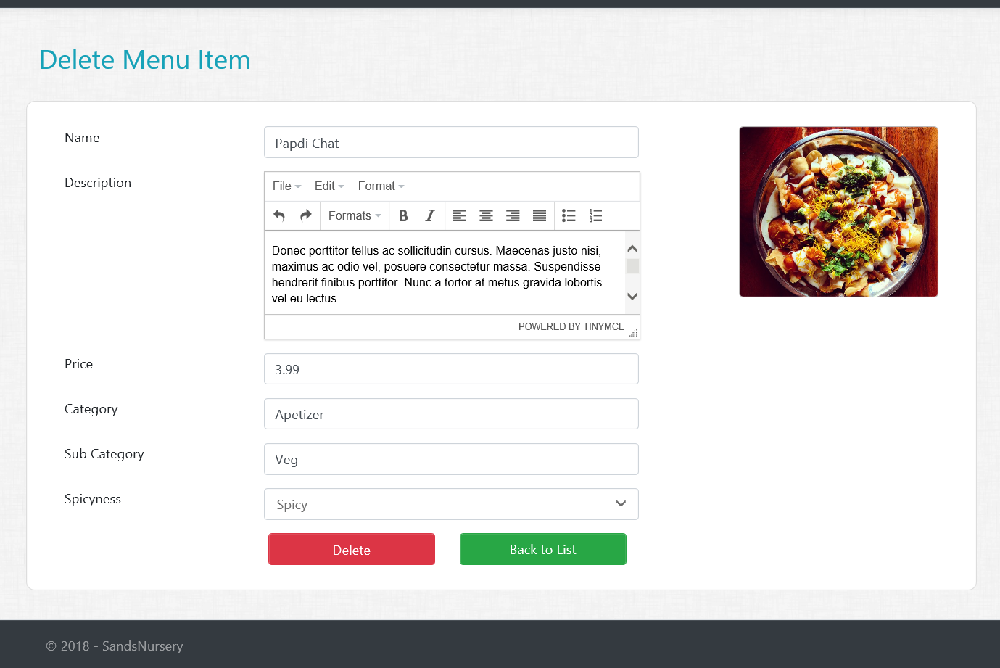
Assignment 3 – Part 2
MenuItem Delete Views/Actions
Create Delete GET action method in MenuItem controller.
Create MenuItem Delete View.
All fields should be disabled or read only
HINT : Consume Partial View for Buttons
Create Delete POST action method in MenuItem controller.
HINT : Make sure to delete the MenuItem Image from the server!

