Slide 1
EasyWeb A revolution framework for websites
Trịnh Ngọc Quốc Bảo

Slide 2
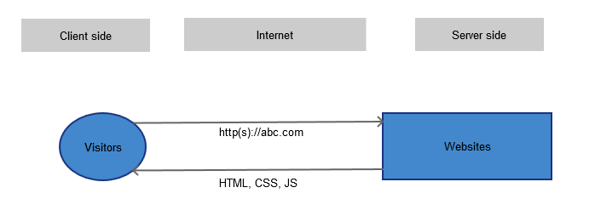
How a website works
(*) ngoài ra còn hình ảnh, video, pdf, …

Slide 3
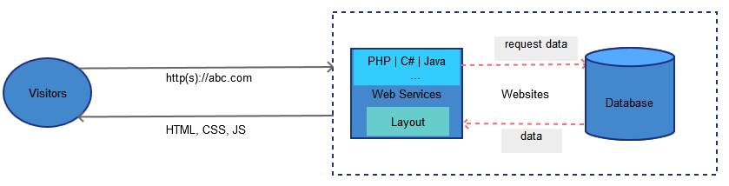
Dynamic websites: > 90% websites world wide
Wordpress, drupal, magento, shopify,…
Apple, microsoft, google,…
Server languages
Database
Repeat the process for each view

Slide 4
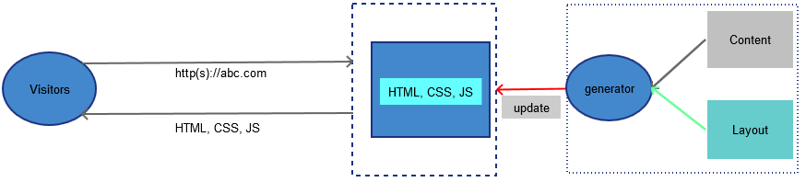
A EasyWeb website
EasyBuilder
Only accepts and returns, no processing
Update when content changes
No database, no server languagues
One update for thousands, millions views

Slide 5
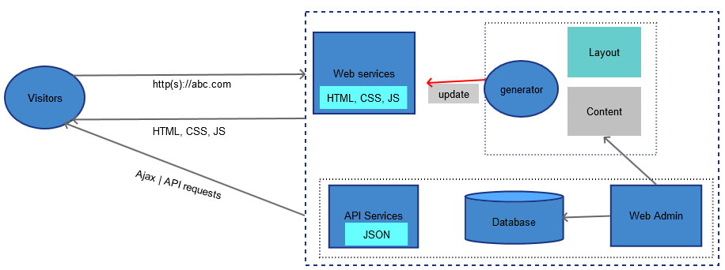
EasyWeb with dynamic content
Dynamic content: API microservices
Static/Dynamic content requests > 90%

Slide 6
EasyWeb technologies
NoSQL: Content Model (replaced for database)
Static page Generator
Micro services: dynamic API services
(*) https://github.com/easywebhub/easyapp/wiki/EasyWeb,-a--revolution-framework-of-future-websites

Slide 7
Three big advantages
Convert millions old websites to EasyWeb
Don’t care old framework: PHP, C#, Java,….
Possible and low cost of converting
Low cost for operating and mantanance
Prototype: an efficient approach to build
Similar the real website
Build fast with low cost
Reuse for building real website
Low cost for websites developing, operating and mantanances

Slide 8
Demo EasyWeb

