Slide 1
B6015 – Decision Models
Review Session 4 – Confidence Intervals on the mean
(CC) Daniel Guetta, February 2012

Slide 2

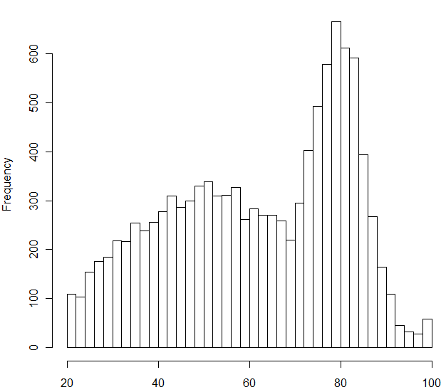
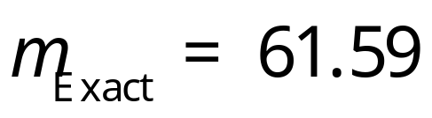
Introduction
11,000 DM Grades
…84.97 73.22 77.64 79.50 83.76 84.75 78.04 81.47 84.71 79.00 90.15 77.22 71.79 80.54 82.87 78.03 84.97 75.12 80.47 74.28 76.71 79.67 84.46 73.58 67.38 64.88 82.97 83.34 90.07 82.34 74.07 76.04 73.74 83.74 71.93
11,000 MBAs

Slide 3
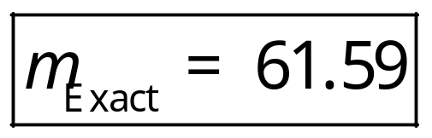
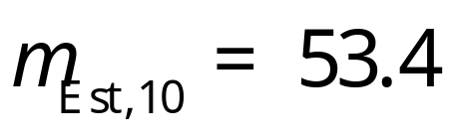
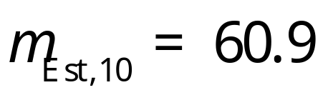
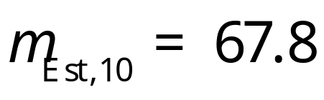
What if we only have a sample…?
80 67 81 42 32 30 24 76 37 65
84 31 40 79 41 83 81 89 28 53
75 78 67 77 59 86 56 79 68 33

Slide 4

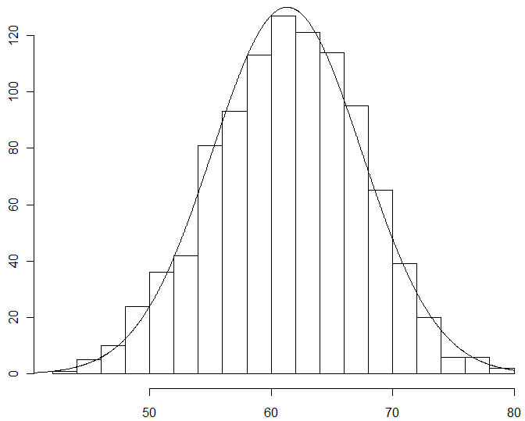
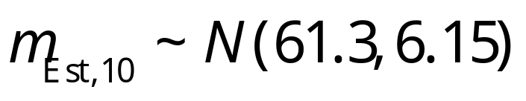
What if we only have a sample…?
1,000 estimates _{Est,} ₁₀
…84.97 73.22 77.64 79.50 83.76 84.75 78.04 81.47 84.71 79.00 90.15 77.22 71.79 80.54 79.67 84.46 73.58 67.38 64.88 82.97 83.34 90.07 82.34 74.07 76.04 73.74 83.74 71.93
1,000 Groups of 10

Slide 5
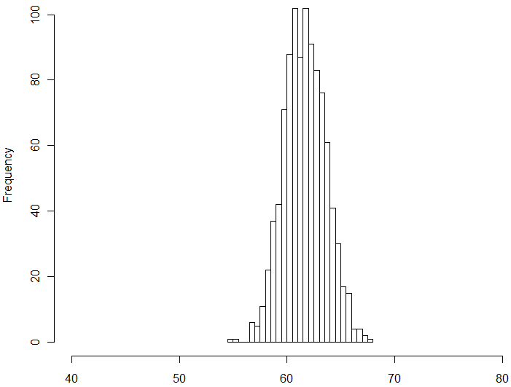
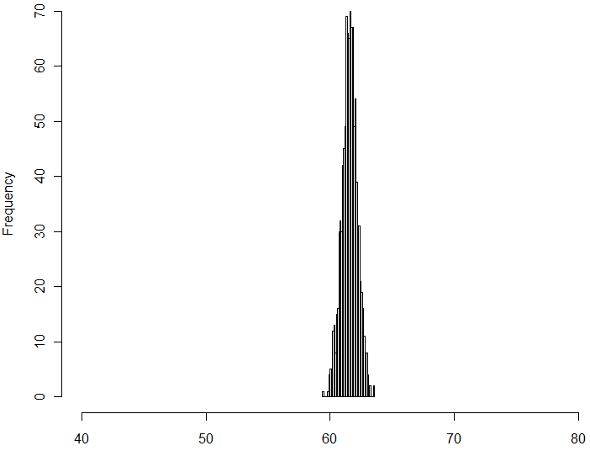
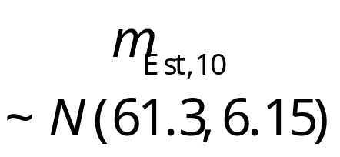
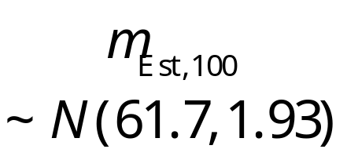
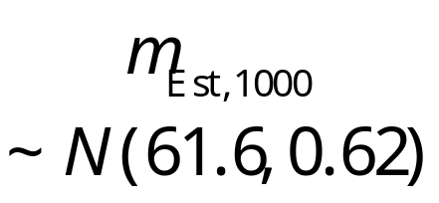
What if we use a larger sample size?
10 Points
100 Points
1000 Points

Slide 6
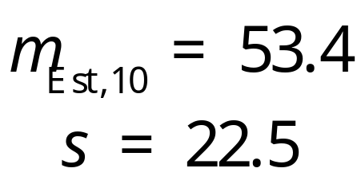
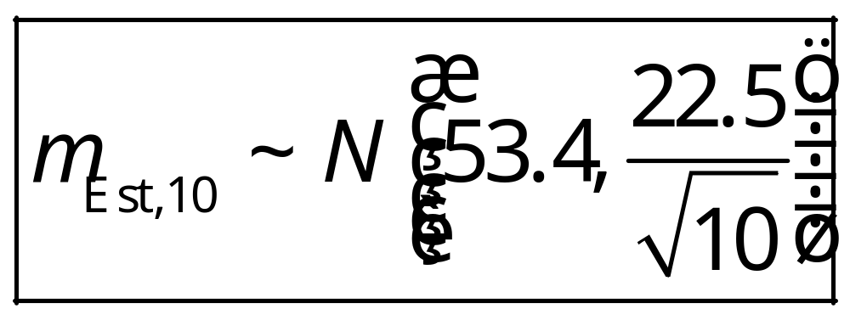
How do we find the distribution?
80 67 81 42 32 30 24 76 37 65

Slide 7
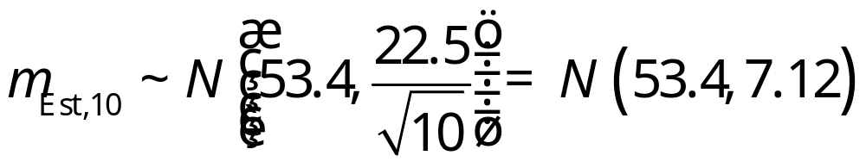
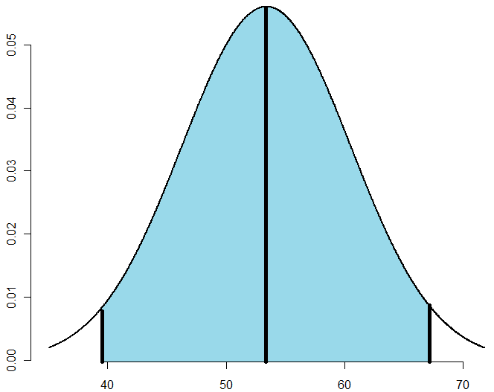

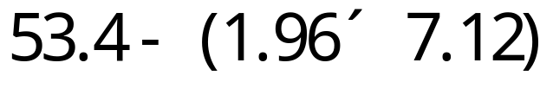
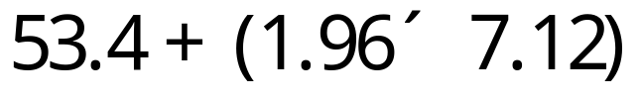
Confidence intervals

Slide 8
Confidence intervals
…with 95% confidence…

Slide 9
Exercises
Imagine we have a sample of size 100. The mean of the sample is 61.21 and its standard deviation is 19.86. What is the 95% confidence interval around the mean?
Approximately how many more samples would you need for the width of the confidence interval to become 4? Why is this approximate?

