Slide 1
Transitional Care Units
IEOR 8100.003 Final Project
9th May 2012
Daniel Guetta
Joint work with Carri Chan

Slide 2
This talk
Hospitals
Modified EM Algorithm
Data!
Convex optimization
Structure
Bayesian Networks
Learning
First results
Instrumental variables
Where to?

Slide 3
Context – hospitals
Intensive Care Unit
Emergency department
Operating room
Medical Floor

Slide 4
Context – hospitals
Intensive Care Unit
Emergency department
Operating room
Medical Floor

Slide 5
Context – hospitals
Intensive Care Unit
Emergency department
Operating room
Medical Floor

Slide 6
Context – hospitals
Intensive Care Unit
Emergency department
TransitionalCare Unit
Operating room
Medical Floor

Slide 7
The Question
Does the “introduction” of Transitional Care Units (TCUs) “improve” the “quality” of a hospital?

Slide 8
Literature
TCUs are good…
K. M. Stacy. Progressive Care Units: Different but the Same. Critical Care Nurse
A.D. Harding. What Can an Intermediate Care Unit Do For You? Journal of Nursing Administration
TCUs are bad…
J. L. Vincent and H. Burchardi. Do we need intermediate care units? Intensive Care Medicine.
We don’t know…
S. P. Keenan et. al. A Systematic Review of the Cost-Effectiveness of Noncardiac Transitional Care Units. Chest.

Slide 9
Available Data & Related Issues

Slide 10
Available data
Removed for Confidentiality Reasons

Slide 11
Complications
Mounds and mounds of unobserved data
Periods of low hospital utilization
Critically ill patients getting rush treatment
Variation across doctors/wards, etc…
Endless additional complications
Endogeneity
Difficult to use TCU sizes for comparisons across hospitals.
Determining capacities

Slide 12
Unit capacities
Removed for Confidentiality Reasons
Notes:
No idea what happens when capacity changes – random change sin the middle of the month

Slide 13
Convex optimization
Consider the following optimization program with 365 decision variables C₁ to C₃₆₅, representing the capacities at each of the 365 days in the year.
We wish to find the values of these decision variables that
Best fit the observed occupancies O₁ to O₃₆₅.
Reduce the number of occupancy changes
Ideally, we’d like to solve

Slide 14
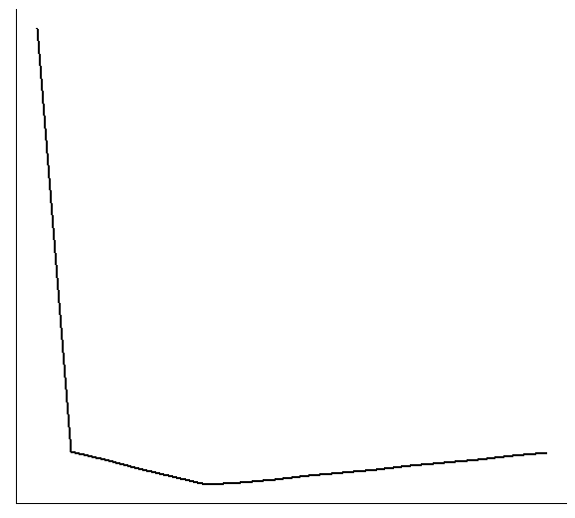
Convex optimization
(C_{i}, O_{i})
O_{i} – 5
O_{i}
Fitted Capacity

Slide 15
E-M Algorithm
Decide how many clusters to use
Assign each point to a random cluster
Repeat
For each cluster, given the points therein, find the MLE capacity
Go through each point, and find the most likely cluster it might belong to

Slide 16
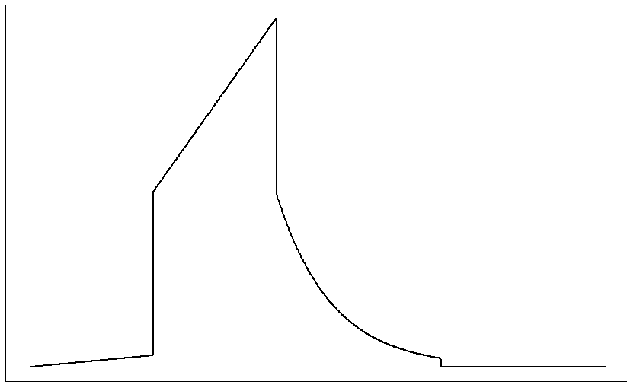
E-M Algorithm – distribution
Probability
C/2
C
C + 10
Occupancy
Notes:
Do a non-parametric fit to check?
No measure of spread
Even a non-parametric fit at each step of EM
Good tries:
HOSP3, ICU
HOSP7, FLR
HOSP7, TCU
clusteringCaps v4
clusteringCaps warpper
BN Demo

Slide 17
Bayesian Networks

Slide 18
Bayesian Networks
Season
Flu
Hayfever
Muscle pain
Congestion

Slide 19
Bayesian Networks
Season
Flu
Hayfever
Assuming the X are topologically ordered, the set X₁ _{ i – 1} contains every parent of X_{i}, and none of its descendants
Muscle pain
Congestion
Thus, since , we can write

Slide 20
Bayesian Networks
Season
Flu
Hayfever
Muscle pain
Congestion

Slide 21
Why Bayesian Networks?
Representation
The distribution of n binary RVs requires 2^{n} – 1 numbers.
A Bayesian network introduces some independences and dramatically reduces this.
It also adds some transparency to the distribution.
Inference
Many specialized algorithms exist for performing efficient inference on Bayesian networks.
These algorithms are generally astronomically faster than equivalent algorithms using the full joint distribution.
Notes:
For example, if we know a patient has congestion and that it’s winter, what can we say about the illness they probably have?

Slide 22
Application to TCUs
Many algorithms exist to learn BN structure from data. These elicit structure from “messy” data.
My hope with this project was to use these algorithms to discover structure in the hospital data, and therefore get some insight into the effect of TCUs on various performance measures.
Seems especially relevant in this case,
“Performance” is not easy to summarize using a single number, which makes regression-like methods difficult.
It’s unclear where variation comes from.
I had high hopes that the method would be able to cope with endogeneity issues (more on this later).
Notes:
Hospital endgeneity

Slide 23
Learning Bayesian Networks
Structural methods
Score-based methods
Bayesian methods

Slide 24
Structural methods
We have already seen that in Bayesian Network
As we explained, it turns out that there are many more independencies encoded in a Bayesian Network. Two networks are said to be I-Equivalent if they encode the same set of independencies.
Notes:
When we learn a network from data, the best we can hope to do is to identify an I-Equivalence class to which the network belongs.

Slide 25
Structural methods
We have already seen that in Bayesian Network
As we explained, it turns out that there are many more independencies encoded in a Bayesian Network. Two networks are said to be I-Equivalent if they encode the same set of independencies.
It can be shown that two networks are in the same I-Equivalence class if and only if
The networks have the same skeleton
The networks have the same set of immoralities
An immorality is any set of three nodes arranged in the following pattern
X
Y
Z
Notes:
When we learn a network from data, the best we can hope to do is to identify an I-Equivalence class to which the network belongs.

Slide 26
Structural methods
Finding the skeleton
If X – Y exists (in either direction), there will be no set U such that X is independent of Y given U.
Thus, if we find any such witness set U, the edge does not exist.
If the graph has bounded in-degree (< d, say), we only need to consider witness sets of size < d.
Finding the immoralities
Any set of edges X – Y – Z with no X – Z link is a potential immorality.
It can be shown that the set is an immorality if and only if all witness sets U contain Z.

Slide 27
Score-based methods
Given network structure
Data
Maximum likelihood parameters for a given structure
A multinomial distribution for each variable is often assumed when calculating the maximum likelihood parameters.
Recall that given a network structure, the distribution factors as
this reduces the search for a global ML parameter to a series of small local searches.
Notes:
Have to carry out a search over network structures – not easy!
Shrinkage methods

Slide 28
Bayesian methods
This score is typically calculated assuming multinomial distributions for the variables and Dirichlet priors on the parameters.

Slide 29
Bayesian methods
“Easy” and “palatable” are relative terms…
This score is typically calculated assuming multinomial distributions for the variables and Dirichlet priors on the parameters.
For those distributions and priors satisfying certain (not-too-restrictive) properties, the Bayesian score can easily be expressed in a more palatable form.

Slide 30
An example
Season
Flu
Hayfever
Muscle pain
Congestion
ILL | WIN | SPR | SUM | FAL
Flu | .6 | .4 | .1 | .4
Hay | .05 | .9 | .5 | .2
 | WIN | SPR | SUM | FAL
Prob | .50 | .21 | .16 | .13
CON. |  | Hay
 |  | No | Yes
Flu | No | .1 | .9
 | Yes | .8 | .95
M.P. |  | Prob
Flu | No | .1
 | Yes | .9

Slide 31
Motivating Results
Motivating Results

Slide 32
The plan
Without TCU
With TCU
ICU Length of Stay
ICU Length of Stay
ED Length of Stay
ED Length of Stay

Slide 33
The problem & the solution
–
Gravity of illness
+
ED Length-of-stay
+
ICU Length-of-stay
+
ICU Congested?
Hospital in question

Slide 34
The problem & the solution
Gravity of illness
Gravity of illness
No significant difference
ICU not Congested
ICU Congested
ED Length-of-stay
Yes significant difference
ED Length-of-stay
ICU Length-of-stay
ICU Length-of-stay

Slide 35
The problem – technical version
=
+
ICU Length-of-stay
ED Length-of-stay
Gravity of illness
Hospital in question
etc...

Slide 36
The solution – technical version
Consider fitting the following model.
In ordinary-least squares, we’d take the covariance of both sides with EDLOS, to obtain
Instead, take the covariance of each side with I, to obtain

Slide 37
The solution – technical version
We can divide both sides by the variance of I
We can write this as
Suppose we carry out regression (1) above, and then…

Slide 38
TCU Data
Removed for Confidentiality Reasons

Slide 39
First Results with Bayesian Networks

Slide 40
Excluded effects
Removed for Confidentiality Reasons

Slide 41
Result
Removed for Confidentiality Reasons
Notes:
Use factor bins

Slide 42
Where to?

Slide 43
Simplify, simplify, simplify…
Looks at specific pathways rather than entire data sets
Operating room  TCU vs. Operating room  ICU.
How TCUs affect the Operating room  ICU pathway.
When considering ICU patients, look at ICU readmission
Look at specific types of patients (cardiac, for example – especially in hospital 24)
Explore different types of methods for fitting Bayesian networks (ie: structural or Bayesian approaches)
Obtain more data in regard to capacities
Notes:
For example, if we know a patient has congestion and that it’s winter, what can we say about the illness they probably have?

