Slide 1
Detecting Bubbles Using Option Prices
Summer Research Project
Daniel Guetta
with Prof. Paul Glasserman

Slide 2

Bubbles

Slide 3
What is a Bubble?
In the context of financial markets, bubbles refer to asset prices that exceed the asset's fundamental, intrinsic value possibly because those that own the asset believe that they can sell the asset at a higher price in the future.
Bubbles are often associated with a large increase in the asset price followed by a collapse when the bubble “bursts”.

Slide 4
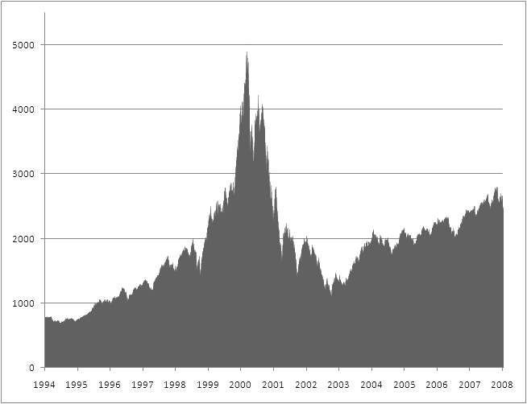
What is a Bubble?
“Asset Price Bubbles in Complete Markets”, Jarrow, Protter & Shimbo, 2007
“Asset Price Bubbles in Incomplete Markets”, Jarrow, Protter & Shimbo, 2010
Notes:
Dutch tulip mania in the 1600s – netherlands

Slide 5
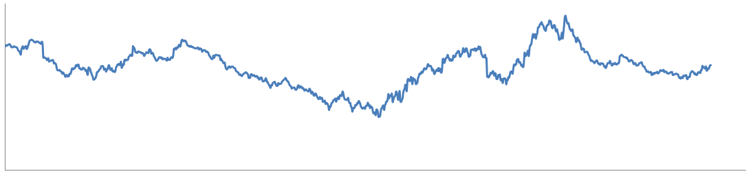
A Very (Very, Very) Short Introduction to Financial Math

Slide 6
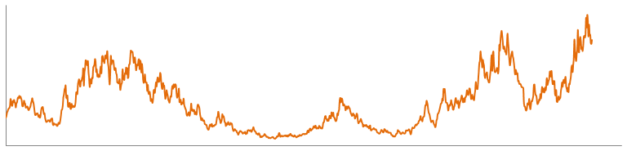
Financial Mathematics
Google Stock – 1st January 2007 to 1st January 2011
Notes:
Mention other possibilities; smile and term structure. Mention this is the local volatility model

Slide 7
Financial Mathematics
First Fundamental Theorem of Asset Pricing

Slide 8
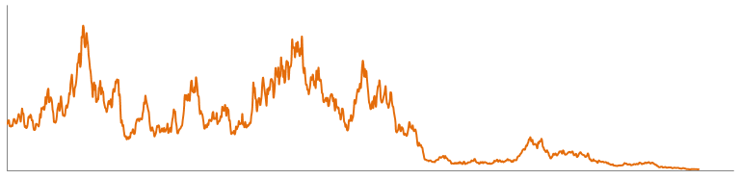
Price Distributions

Slide 9
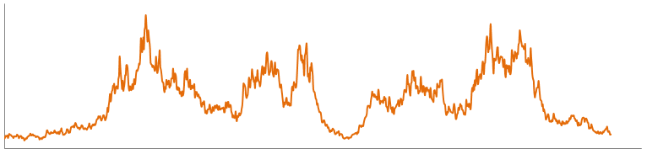
Price Distributions

Slide 10
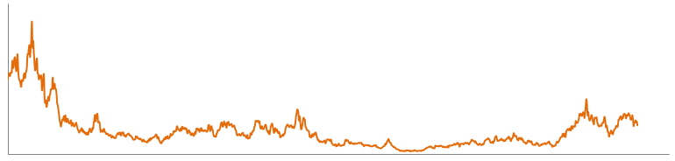
Price Distributions

Slide 11
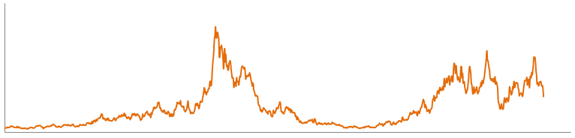
Price Distributions

Slide 12
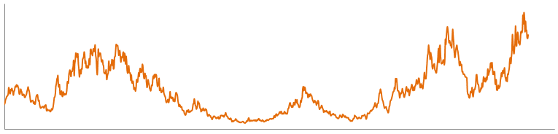
Price Distributions

Slide 13
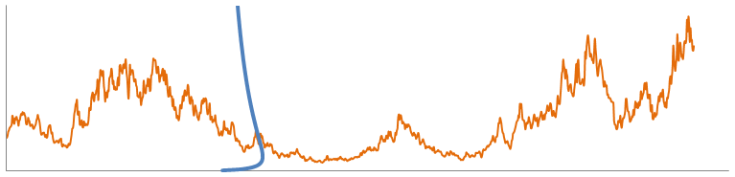
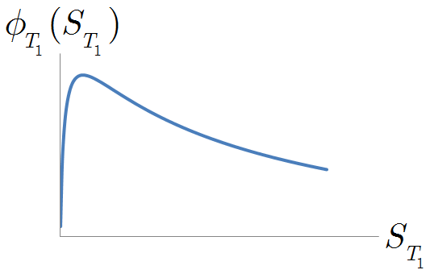
Price Distributions

Slide 14
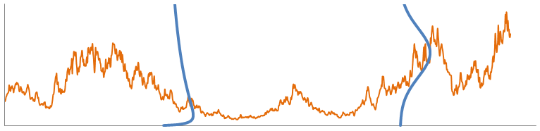
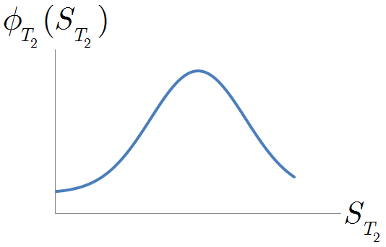
Price Distributions
Notes:
Distinguish dummy variable from S

Slide 15
The Kolmogorov Forward Equation
Notes:
Karlin Taylor, volume 2

Slide 16

Detecting Bubbles

Slide 17
The Bubble Test
“How to Detect an Asset Bubble”, Jarrow, Kchia & Protter, March 2011
Assumption:

Slide 18
The Bubble Test
“How to Detect an Asset Bubble”, Jarrow, Kchia & Protter, March 2011
Assumption:
Bubble exists in the asset price S_{t}
S_{t} is a strict local martingale
Notes:
Mention success of method

Slide 19
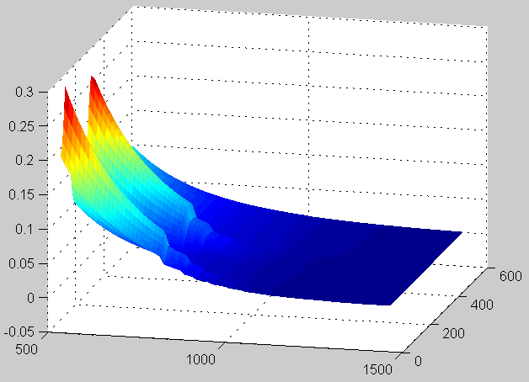
Using Options to Find 

Slide 20
What is an Option?
Strike
Maturity
When time T comes along, the call option gives its owner the right, but not the obligation, to buy one unit of the financial asset at price K.
Notes:
A call option is cahracterized by two numbers

Slide 21
Pricing Options
Notes:
Assume interest rates are 0, risk neutral measure
Can make profit out of an option, so must cost something

Slide 22
Magic!

Slide 23
The Dupire Equation
Kolmogorov Forward Equation
+
=
The Dupire Equation
Notes:
(One strand – also from implied vol)

Slide 24
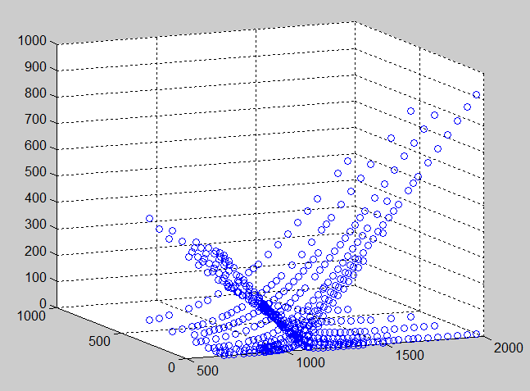
Reality
1st September 2006, Options on the S&P 500
Option price
Maturity
Strike
Notes:
Detail on the data srouce, tc…

Slide 25
Local Least Squares
“Arbitrage-free Approximation of Call Price Surfaces and Input Data Risk”, Glaser and Heider, March 2010

Slide 26
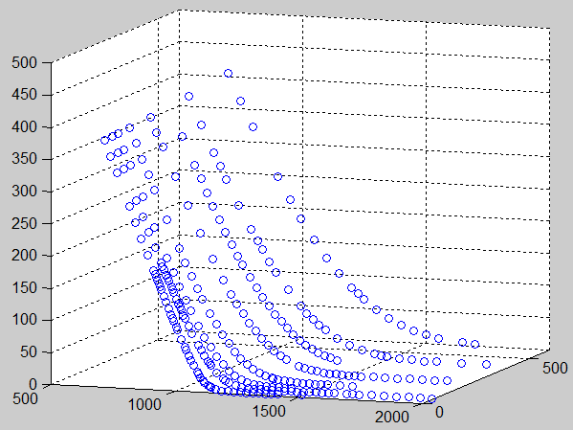
Local Least Squares
1st September 2006, calls
Option price
Maturity
Strike

Slide 27
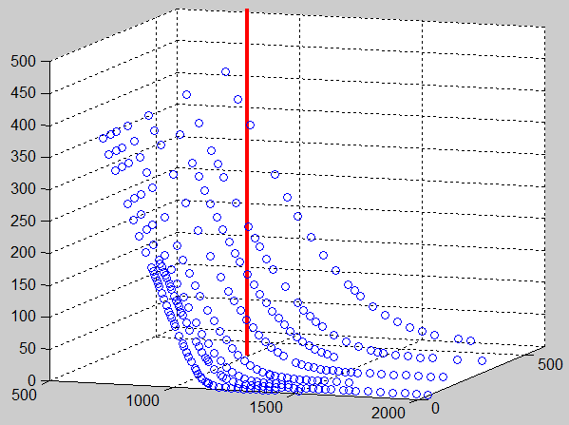
Local Least Squares
Option price
Maturity
Strike

Slide 28
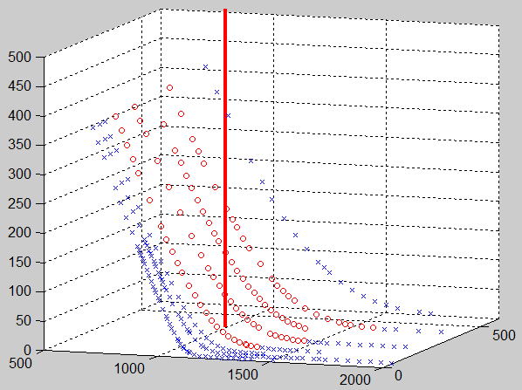
Local Least Squares
Option price
Maturity
Strike

Slide 29
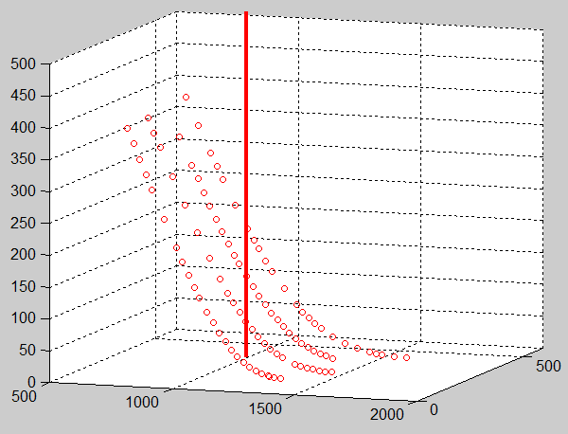
Local Least Squares
Option price
Maturity
Strike

Slide 30
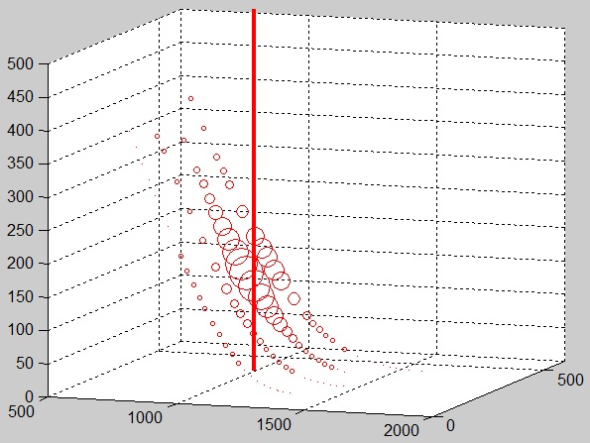
Local Least Squares
Option price
Maturity
Strike

Slide 31
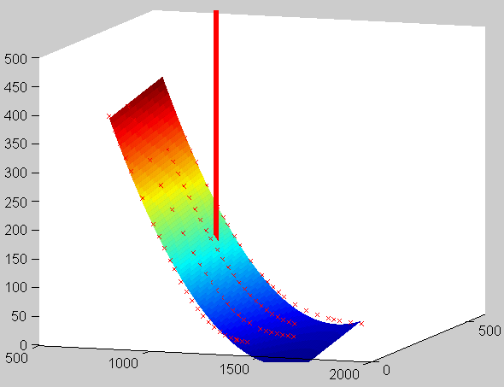
Local Least Squares
Option price
Maturity
Strike

Slide 32
Local Least Squares
1st September 2006, calls
Option price
Maturity
Strike

Slide 33
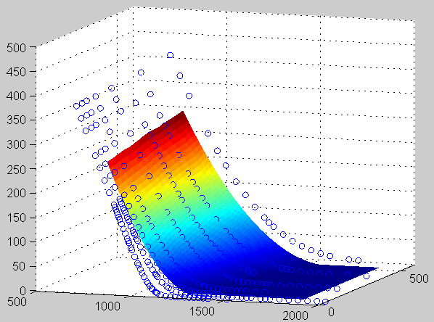
Local Least Squares
1st September 2006, calls
Option price
Maturity
Strike
Notes:
Mention arbitrage free

Slide 34
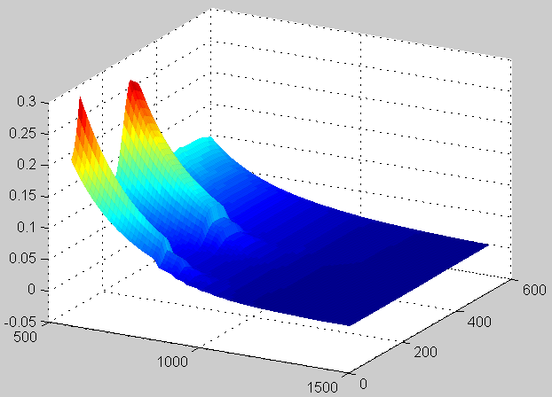
The Local Volatility
1st March 2004, calls
²(K,T)
T
K

Slide 35
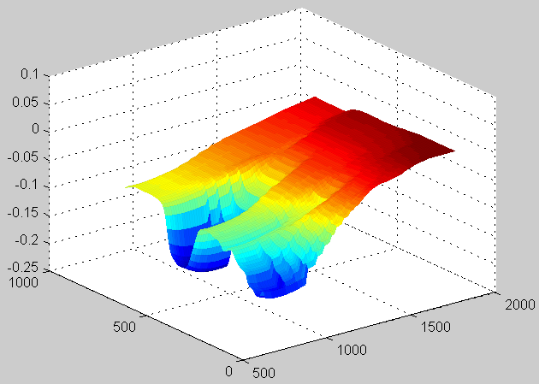
The Local Volatility
2nd July 2007, calls
²(K,T)
T
K

Slide 36
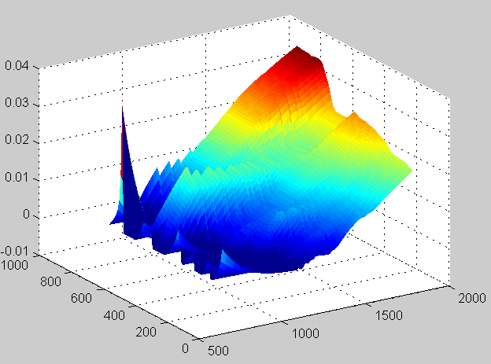
The Local Volatility
2nd July 2007, puts
²(K,T)
T
K

Slide 37
Results

Slide 38
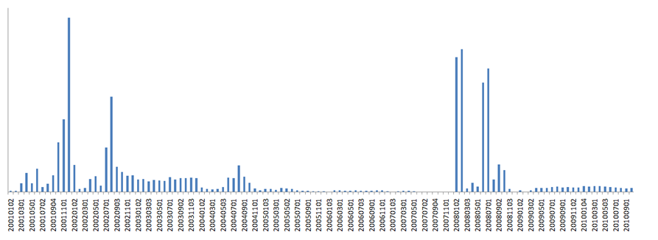
Bubble Indicator
Date
Notes:
Absolute values
Up until 2004, creddible, then interest rates cut
Put vix

Slide 39
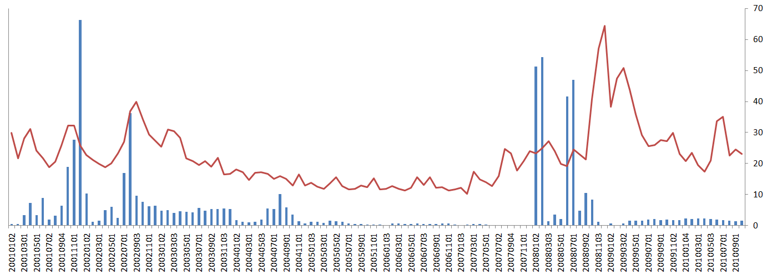
Bubble Indicator
VIX Index
Date
Correlation coefficient: 0.15
Notes:
Absolute values
Up until 2004, creddible, then interest rates cut
Put vix

Slide 40
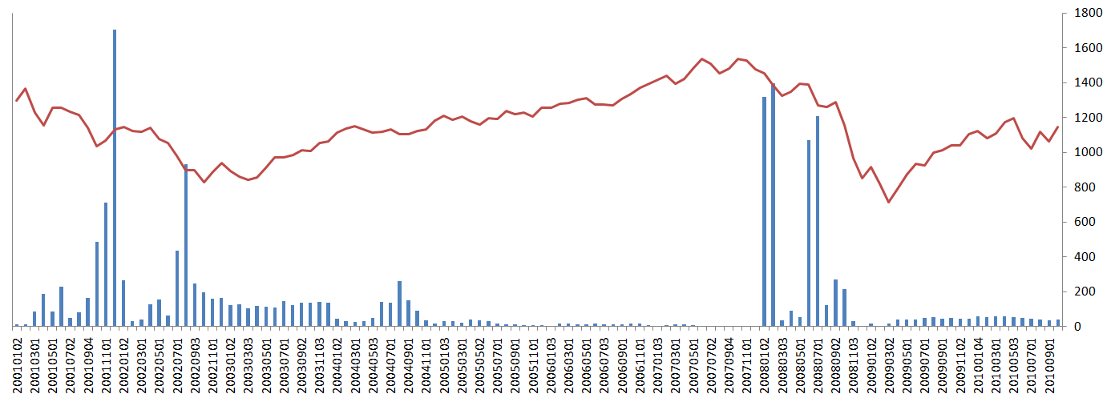
Bubble Indicator
S&P 500
Date
Correlation coefficient: 0.01
Notes:
Absolute values
Up until 2004, creddible, then interest rates cut
Put vix

Slide 41
Concluding Remarks

Slide 42
Conclusions
A promising approach to implementing the bubble test.
The non-parametric approach we used might have been slightly too ambitious.
Fitting options prices rather than volatilities might have compounded the problem.
Notes:
- more options. Options reflect the market’s thoughts – good for bubbles
That said, promissing results

Slide 43
Other Approaches
Use some sort of spline (“Reconstructing the Unknown Volatility Function”, Coleman, Li and Verma, “Computation of Deterministic Volatility Surfaces”, 2001. Jackson, Suli and Howison, 1999. “Improved Implementation of Local Volatility and Its Application to S&P 500 Index Options”, 2010.)
Estimate the local volatility via the implied volatility.

Slide 44
Other Approaches
Assume the volatility is piecewise constant, and solve the Dupire Equation to find the “best” constants. (“Volatility Interpolation”, Andreasen and Huge, 2011).
Assume some sort of parametric pricing model (such as Heston or SABR), fit to option price data and then deduce local volatility.
Notes:
Coleman li and verma very complicated

Slide 45

Questions

Slide 46
notes
Notes:
Dividie the strike width b y 50 in the calculation thing

Slide 47
The Implied Volatility

