Slide 1
The Odds Algorithm
E8100/B9801 Class Project
Daniel Guetta
Notes:
This talk is going to be on odds algorithm
Actually started this project in different way
IID case
But stumbled across this – interesting!
Project changed direction
Will still talk about IID case

Slide 2
Outline
The odds algorithm
The classical secretary problem
The secretary problem with group interviews
A continuous-time secretary problem
The secretary problem with rejection
The IID case – known distributions
Notes:
So let’s first look at a list of what I plan to do.
Unfortunately, I have a bit too much planned for 25 minutes
So I’ll only cover a subset of this – in fact, will make the talk slightly interactive and give you the choice at various points as to which topic you want to cover.
We’ll begin with a description of this mysterious odds algorithm. And it turns out there is a proof associated, but we’ll skip it the first time and decide whether to return to it.

Slide 3
The Odds Algorithm
Notes:
For a moment, I want you to forget everything about the secretary problem
Known number of indicators
Each success or failure

Slide 4
A Simple Example
Throw a fair six-sided die n times – want to stop at the last 6 obtained.
Maximized at s = 6
Notes:
Oracle

Slide 5
The Odds Theorem
Theorem:
Let be a sequence of n independent indicators
Let , r_{k} = p_{k} / (1 – p_{k}) = p_{k}/q_{k}.
Then, there exist an optimal rule which maximizes the probability of stopping at the last success.
It prescribes to stop on the first success with index > s, where s is…
Bruss (2000), Ann. Probab. Volume 28, Number 3 (2000), 1384-1391

Slide 6
The Odds Theorem
contd…
…where s is…
For example
p_{k} | 1 | 0.5 | 0.3 | 0.3 | 0.2 | 0.17 | 0.14
r_{k} | ∞ | 1 | 0.5 | 0.5 | 0.25 | 0.2 | 0.17
1.12
0.62
0.37
0.17
Optimal Strategy: from the 4th observation onwards, stop at any success.
Notes:
There are some points of pedantry
Theorem also gives probability result

Slide 7
The Odds Theorem
Proof:
Three steps
Find the a-priori probability
Find the s that maximizes this probability.
Show that the optimal strategy ignores everything up to s and then picks the next success.
Bruss (2000), Ann. Probab. Volume 28, Number 3 (2000), 1384-1391

Slide 8
The Odds Theorem
Probability Generating Function (PGF)
Step 1:
Let . We need .
Notes:
Independence

Slide 9
The Odds Theorem
Step 1:
Let . We need .
Notes:
Independence
This, btw, is probability of getting best sec

Slide 10
The Odds Theorem
Step 1:
Let . We need .

Slide 11
The Odds Theorem
Proof:
Three steps
Find the a-priori probability
Find the s that maximizes this probability.
Show that the optimal strategy ignores everything up to s and then picks the next success.
✓

Slide 12
The Odds Theorem
Step 2:
Notes:
Independence

Slide 13
The Odds Theorem
Proof:
Three steps
Find the a-priori probability
Find the s that maximizes this probability.
Show that the optimal strategy ignores everything up to s and then picks the next success.
✓
✓

Slide 14
The Odds Theorem
Step 3:
Most general strategy stops at a random time W such that .
However, note that
We have shown, however, that this last probability is unimodal; it is therefore maximized at a fixed k.
Notes:
Shown that this is the a-priori maximum probability, but maybe as we gather more info…

Slide 15
The Classical Secretary Problem
1
1
1
1
Notes:
Known number of indicators
Each success or failure

Slide 16
Classical Result
Odds algorithm tells us to ignore all secretaries until secretary s and then to choose the first “success” (ie: the first secretary that is the best so far)

Slide 17
The Secretary Problem with Group Interviews
n groups of size
Members of a group are interviewed together. After the interview, either one group member is chosen or the whole group is ignored without a chance of recall
from Bruss (2000)
Notes:
Known number of indicators
Each success or failure

Slide 18
Group Interviews
Associate indicator to each group. Aim to stop at last 1
So pick the first “best” item after group s, where
Hsiau and Yang (2000)
Notes:
independence

Slide 19
The Odds Theorem & Secretary Problem in Continuous Time
0
0
1
1
0
1
0
1
1
0
1
0
1
t = 0
t = T
Random arrivals in [0, T] form an inhomogeneous Poisson process with density (t)
from Bruss (2000)
Notes:
Known number of indicators
Each success or failure

Slide 20
Continuous Time Problem
Consider an interval _{k} = (t_{k – 1},t_{k}]
As such, the “odds of success” has a well-defined density, (t) = (t)h(t)
Notes:
Discontinuiities

Slide 21
The Secretary Problem in Continuous Time
Notes:
Discontinuiities

Slide 22
The Secretary Problem with Rejection
Suppose we desire to model the fact each secretary might reject an offer of employment, with probability 1 – p (independent of everything else).
Notes:
Known number of indicators
Each success or failure

Slide 23
What’s the Objective?
Best of all
Best of all available
“No regrets”
Notes:
All comes down to whether we can model things using the indicator approach…
If best of all available, all reduce to the same thing

Slide 24
Best of all
Difficult to model using the indicator approach
Might be tempted to use
1
1
But what if the best secretary of all refuses employment?
Smith (1975) and Freeman (1983) find that the best strategy is to explore until s = np^{1/(1} – ^{p)}
Notes:
independence

Slide 25
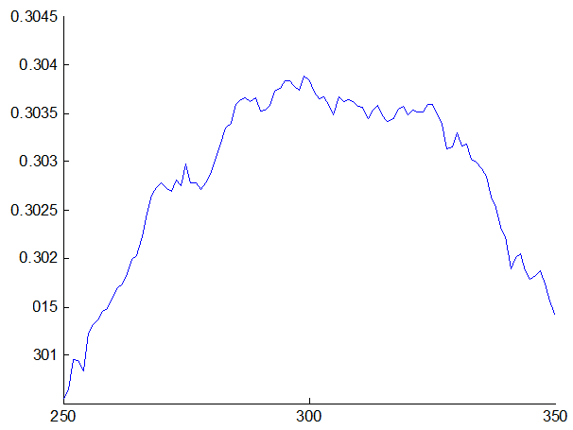
Best of all – Numerical Results
Performance of Strategies with Varying “Exploration Thresholds” s, Based on 150,000 Simulations
Probability of Success
Predicted best
s
Notes:
independence

Slide 26
“No Regrets”
1
1
We want to pick the last success from
Notes:
All comes down to whether we can model things using the indicator approach…
If best of all available, all reduce to the same thing

Slide 27
“No Regrets”
We want to pick the last success from
Notes:
independence

Slide 28
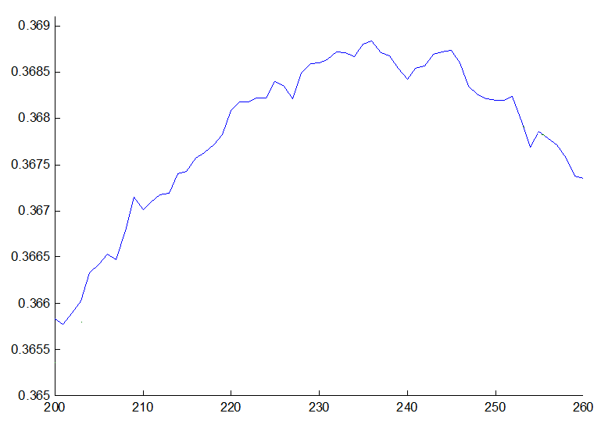
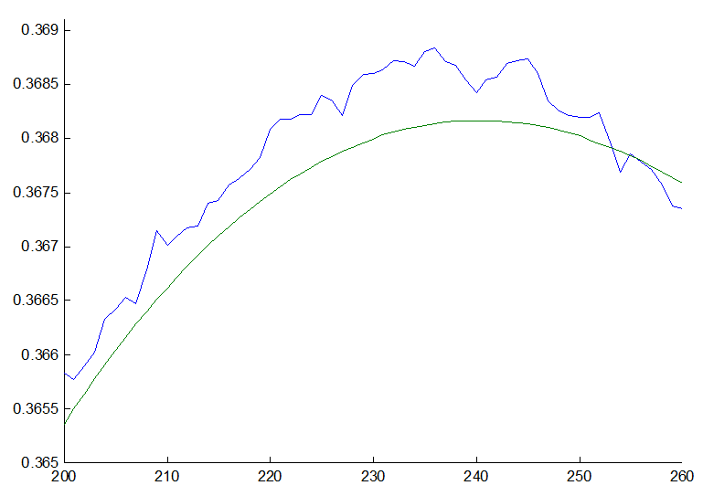
“No Regrets” – Numerical Results
Performance of Strategies with Varying “Exploration Thresholds” s, Based on 150,000 Simulations
Simulation
Probability of Success
Prediction from the odds algorithm
s
Notes:
independence

Slide 29
Best of all available
1
1
1
1
1
We want to pick the last indicator from
Partial information case harder! See Tamaki (1991)

Slide 30
Best of All Available – Full Information
We want to pick the last indicator from
Max of Bin(k – 1, p) + 1 values
Bin(k – 1, p) accepted
k
k – 1 items
Notes:
independence

Slide 31
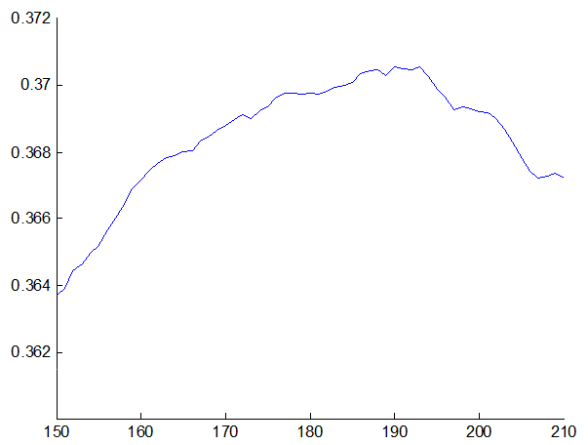
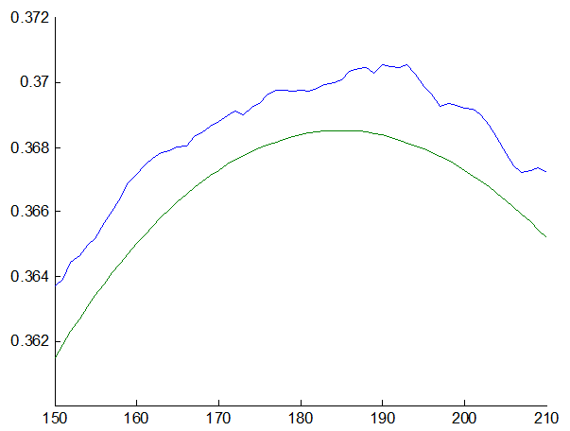
Best of All Available – Numerical Results
Performance of Strategies with Varying “Exploration Thresholds” s, Based on 150,000 Simulations
Probability of Success
Simulation
Prediction from the odds algorithm
s
Notes:
independence

Slide 32
… However …
In this particular problem, we discover new, separate data as we observe the indicators
We originally assume the number of availabilities is binomially distributed. But as we observe the indicators, we start observing actual availabilities.
The previous strategy is indeed the best if we restrict ourselves to a fixed threshold chosen at the start. But there must be a way to exploit this new data.
Notes:
independence

Slide 33
The Odds Theorem on Steroids
Tamaki (1991) solves this problem for the particular case of the secretary problem with rejection
More interesting is Ferguson (2008), who generalizes the odds Theorem to a situation in which external data becomes available during the selection process.
For the sake of this project, we will take a more pedestrian approach. We will recalculate the optimal threshold at each step using newfound information.
Notes:
In a way, it’s very elegant – we sum the odds of what’s left, and if it’s too small, wee stop here.

Slide 34

Best of All Available – Full Information
But consider – if we’ve now observed secretary v, and so far, x secretaries have accepted (including v, if applicable)…
Max of x + Bin(k – v – 1, p) + 1 values
Bin(k – v – 1, p) accepted
x accepted
1
v
k
k – v – 1 items
Notes:
independence

Slide 35
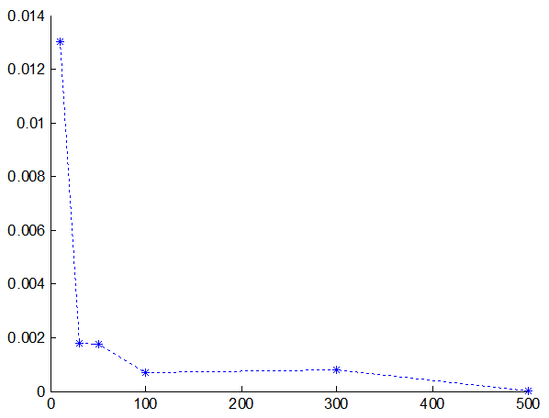
Best of All Available – Numerical Results
Improvements Obtained using a Dynamic Algorithm over a Static one – based on 150,000 simulations
Additional Probability of Success using Dynamic Algorithm
Number of secretaries
Notes:
independence

Slide 36
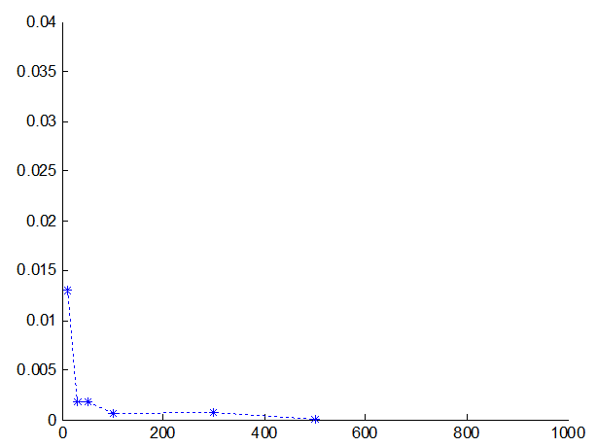
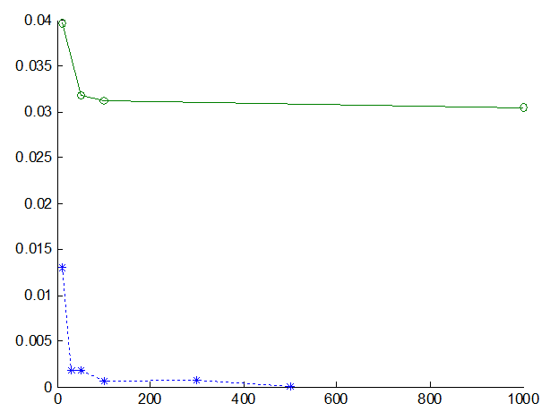
Best of All Available – Numerical Results
Improvements Obtained using a Dynamic Algorithm over a Static one – based on 150,000 simulations
Additional Probability of Success using Dynamic Algorithm
Difference between Gilbert and Mosteller (1966) and Tamaki (1991)
Number of secretaries
Notes:
independence

Slide 37
The Secretary Problem with IID Utilities from a known Dist^{n}
Notes:
Assume uniform without loss of generality

Slide 38
Maximum of n IID Uniform RVs
Consider n independent U[0,1] RVs
Let M be the max of those n RVs. Then
As such .
Notes:
independence

Slide 39
IID Case – Known Distribution
Maximum is m
k
Imagine we have observed all secretaries up to v, and we have found the maximum so far to be m.
1
v
k – v items
Notes:
independence

Slide 40
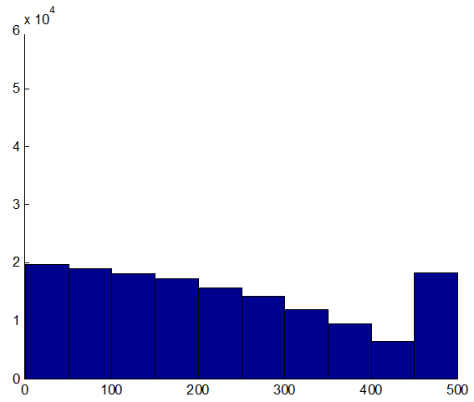
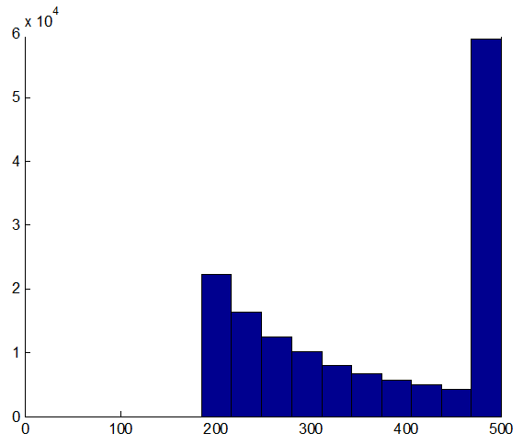
IID Case – Numerical Results
Based on 150,000 trials with 500 secretaries, the best secretary is chosen with probability 0.5409.
This approaches the “best” probability of success, of 0.5802 (Gilbert and Mosteller, 1966. Tamaki, 2009).
Stopping Time
Stopping Time
Notes:
independence

Slide 41
Other Literature
Bruss (2003) – bounds on the performance of the Odds Algorithm.
Tamaki (2009) – the secretary problem with rejection and IID secretary values.
Tamaki (2010) –extension of the Odds Theorem to picking the last k successes, with application to the k-secretary problem with IID secretary values.
Ferguson (2008) – odds theorem with extra info
etc…
Notes:
Assume uniform without loss of generality

Slide 42

Questions, Comments, Suggestions, Personal Stories or Jokes?
Notes:
Assume uniform without loss of generality

