Slide 1
Simple Harmonic Motion
16th October 2008

Slide 2

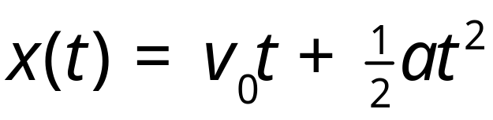
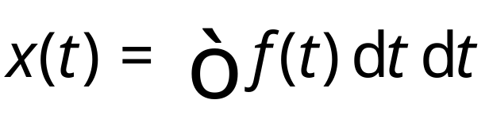
Quick review…
(Nearly) everything we’ve done so far in this course has been about a single equation
a = constant
a = f(t)
a is central
Circular motion…
Notes:
OK, time to move on to the next part on today… We’ll be continuing SHM, which Peter started yesterday

Slide 3

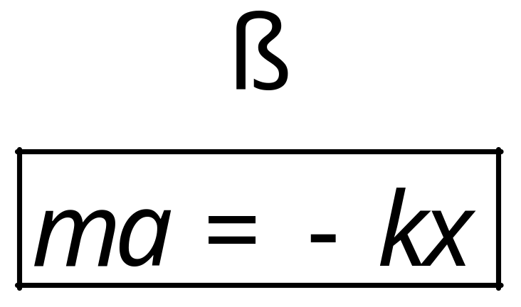
What we’re doing now…
Consider new type of force, to extend the types of situations we can deal with

Slide 4
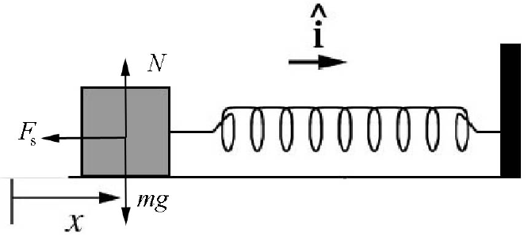

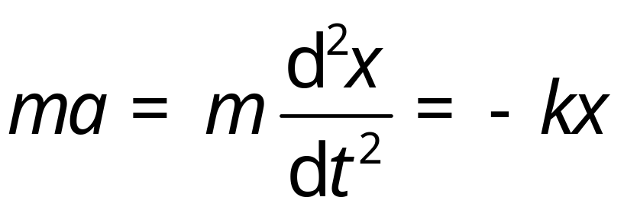
Example… Particle on a spring

Slide 5
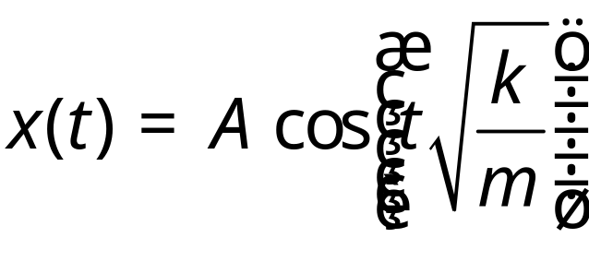
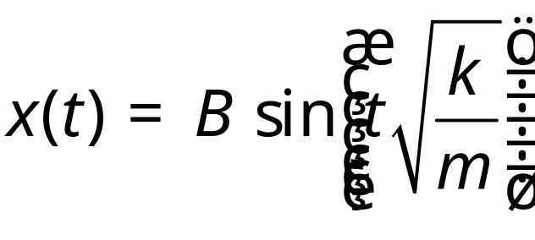
Solutions…
You saw yesterday that one solution to this problem was
However, this is not the only solution… It turns out that the following solution also works

Slide 6
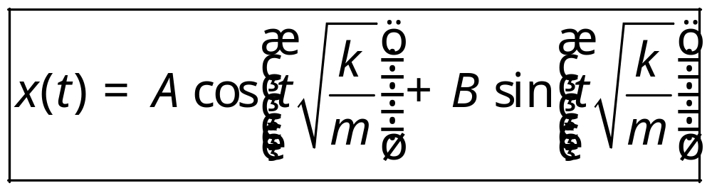
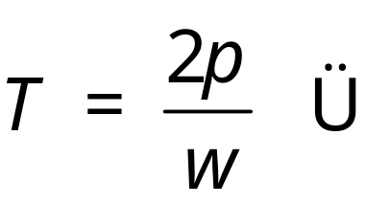
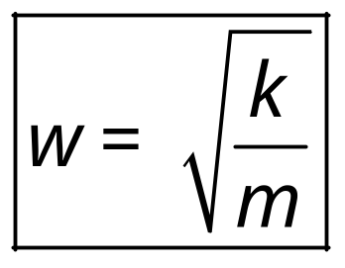
Most general solution
It turns out that the most general solution is given by (see 18.03…)
Angular frequency
Period
Notes:
But the question is, can we find the most general solution to this equation – a solution that will work whatever system we have? The answer is “yes”, and you’ll have to wait till 18.03 to find out why… But in the meantime, here’s what the solution looks like… It’s effectively the sum of both the solutions we found before, each with a constant in front…
And to make writing this simpler, we define two quantities – the ANGULAR FREQUENCY, which is the bit in front of the t in our equation – and the PERIOD, which is 2 pi over the angular frequency.
So, we’ve basically now derived the basic equations of simple-harmonic motion – we’ve learnt how to deal with this new kind of problem. However, there are still a few questions that you ought to be asking yourself at the moment, and we’ll spend the rest of this lecture answering them
What’s this “PERIOD” T?!? We’ve just defined it about, but what significance does it have?
What does the motion look like for this system? Can we plot a displacement time graph?
What about the velocity and acceleration
Those constants A and B clearly depend on the situation – but how can we find them to get the exact equation of motion for a particular situation?

Slide 7
What we’re going to do now
Understand what this “period” means…
See what information we can get about our system from our equation
See what plots of x, v and a against t look like.
See an example of how we can find A and B

Slide 8
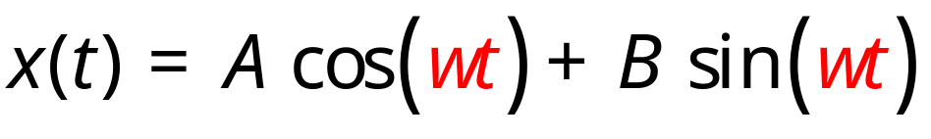
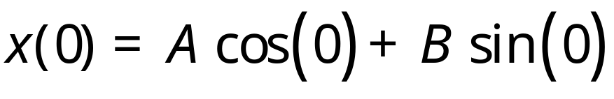
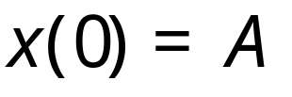
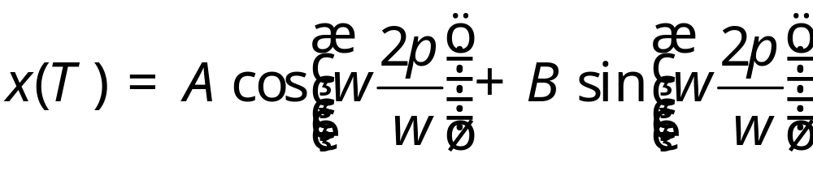
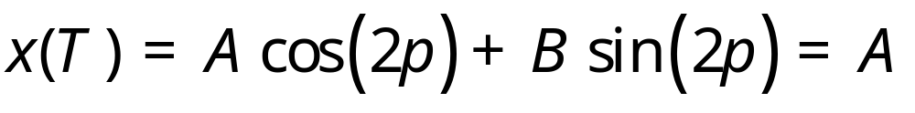
What is the period?
Consider the oscillator at t = 0
Consider the oscillator at t = T = 2/

Slide 9
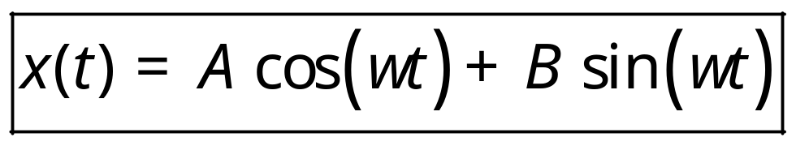
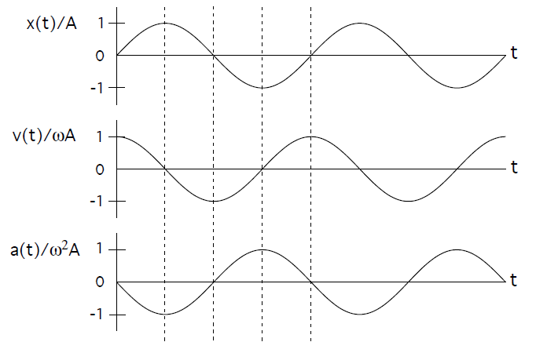

What does the motion look like?

Slide 10
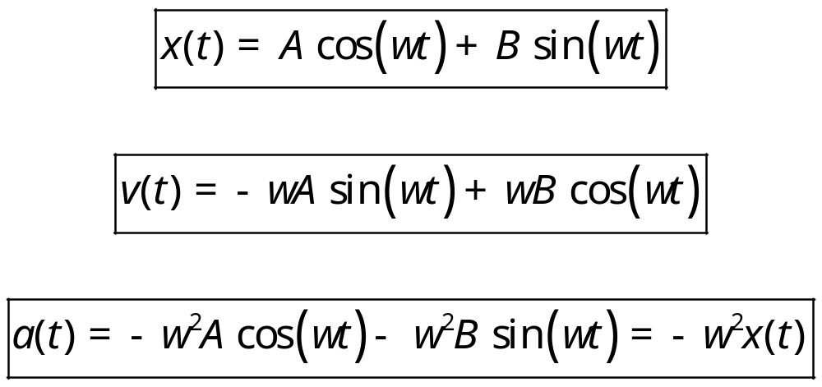
Velocity and acceleration
We can differentiate our expression to find velocity and acceleration

Slide 11
How to find A and B?
Use initial conditions
Since there are two constants, we need two initial conditions
These can be anything, but let’s try an example with initial position x(0) and initial velocity v(0)

Slide 12
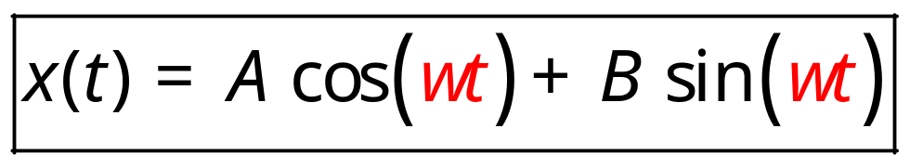
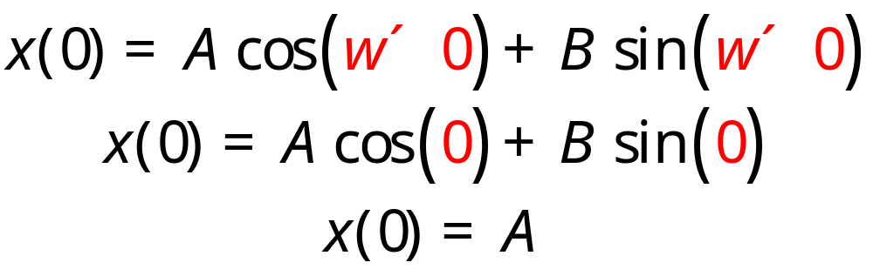
Initial Position
If t = 0
So the constant A is simply equal to the original displacement

Slide 13
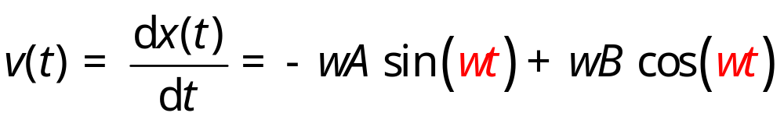
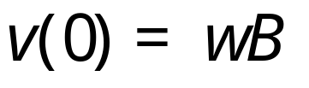
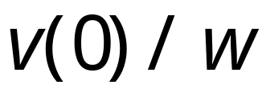
Initial velocity
To find the velocity, we need to differentiate
At t = 0
And so B is equal to

Slide 14
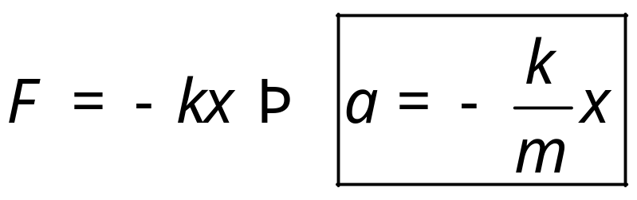
Summary
We’ve learnt how to deal with forces like
We found that the solution looks like
We can use initial conditions to find A and B
We can use this expression to find out anything we want about the motion

