Slide 1
Active-Routing: Compute on the Way for Near-Data Processing
Jiayi Huang, Ramprakash Reddy Puli, Pritam Majumder Sungkeun Kim, Rahul Boyapati, Ki Hwan Yum and EJ Kim

Slide 2
Outline
Motivation
Active-Routing Architecture
Implementation
Enhancements in Active-Routing
Evaluation
Conclusion

Slide 3
Motivation

Slide 4
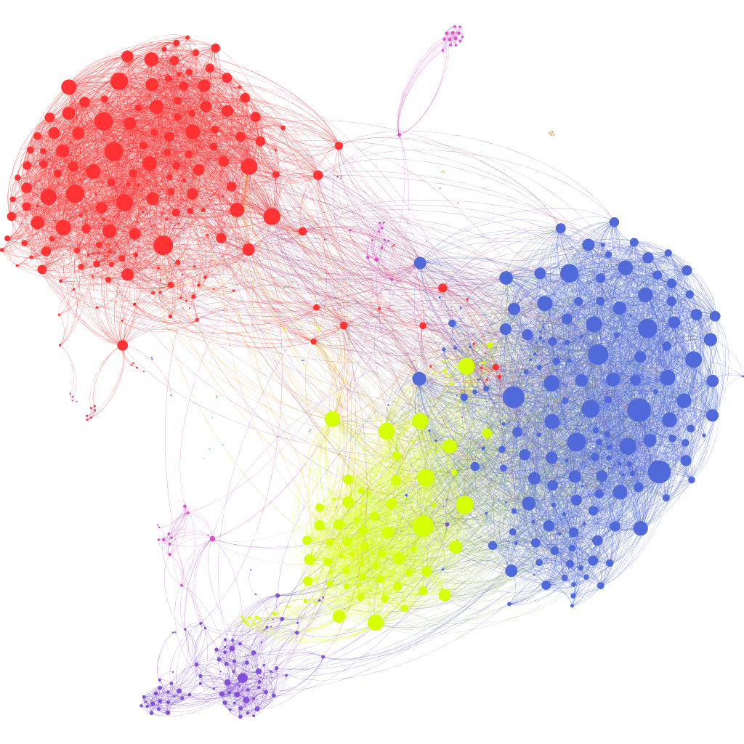
Data Is Exploding
Graph processing (social networks)
Deep learning (NLP) ^{[Hestess et al. 2017]}
Requires more memory to process big data
………
…
Ref: https://griffsgraphs.files.wordpress.com/2012/07/facebook-network.png

Slide 5
Demand More Memory
3D die-stacked memory ^{[Loh ISCA’08]}
HMC and HBM
Denser capacity
higher throughput
Memory network ^{[Kim et al. PACT’13]}
Scalable memory capacity
Better processor bandwidth
Vault Controller
… …
Vault Controller
DRAM layer
Logic Layer
Intra-Cube Network
Vault
I/O
I/O
I/O
I/O

Slide 6
Enormous Data Movement Is Expensive
Stall processor computation
Consume energy
Processing-in-memory (PIM)
PIM-Enabled Instruction (PEI) ^{[Ahn et al. ISCA’2015]}
C = A x B (Can we bring less data?)
In-network computing
Compute in router switches [Panda IPPS’95, Chen et al. SC’11]
MAERI ^{[Kwon et al. ASPLOS’18]}
Active-Routing for dataflow execution in memory network
Reduce data movement and more flexible
Exploit memory throughput and network concurrency
Active-Routing for dataflow execution in memory network
Reduce data movement and more flexible
Active-Routing for dataflow execution in memory network
Near-data processing to reduce data movement

Slide 7
Active-Routing Architecture

Slide 8
System Architecture
O3core
HMC
Network
Interface
Cache
Network-on-Chip
Host CPU
…
…
HMC Controller
O3core
Network
Interface
Cache
Host CPU
Memory Network

Slide 9
Active-Routing Flow
Active-Routing tree dataflow for compute kernel
Compute kernel example
Reduction over intermediate
results
Active-Routing tree dataflow
Ai
Bi
for (i = 0; i < n; i++) {
sum += *Ai × *Bi;
}
Host CPU

Slide 10
Active-Routing Three-Phase Processing
Active-Routing Tree Construction
Ai
Bi
Update Packet
for (i = 0; i < n; i++) {
sum += *Ai × *Bi;
}
Host CPU

Slide 11
Active-Routing Three-Phase Processing
Active-Routing Tree Construction
Update Phase for data processing
Ai
Bi
for (i = 0; i < n; i++) {
sum += *Ai × *Bi;
}
Host CPU
B_{k} Operand response
B_{k} Operand request
A_{k} Operand response
A_{k} Operand request

Slide 12
Active-Routing Three-Phase Processing
Active-Routing Tree Construction
Update Phase for data processing
Gather Phase for tree reduction
Ai
Bi
Gather request
Gather request
Gather request
for (i = 0; i < n; i++) {
sum += *Ai × *Bi;
}
Gather request
Gather request
Host CPU
Gather request

Slide 13
Implementation

Slide 14
Programming interface and ISA extension
API
Extended PIM Instructions
Active-Routing Execution
Update(void *src1, void *src2, void *target, int op);
Gather(void *target, int num_threads);
for (i = 0; i < n; i++) {
sum += *Ai × *Bi;
}
for (i = 0; i < n; i++)
{
Update(Ai, Bi, &sum, MAC);
}
Gather(&sum, 16);

Slide 15
Programming interface and ISA extension
API
Extended PIM Instructions
Active-Routing Execution
Update(void *src1, void *src2, void *target, int op);
Gather(void *target, int num_threads);
Offloading logic in network interface
Dedicated registers for offloading information
Convert to Update/Gather packets

Slide 16
Active-Routing Engine
Packet Processing Unit
Flow Table
Operand Buffers
ALU
…
Vault Controller
… …
Vault Controller
Vault Controller
Active-Routing Engine
Vault Controller
DRAM layer
Logic Layer
Logic Layer
Intra-Cube Network
Intra-Cube Network
Vault
I/O
I/O
I/O
I/O
I/O
I/O
I/O
I/O

Slide 17
Packet Processing Unit
Packet Processing Unit
Flow Table
Operand Buffers
ALU
Process Update/Gather packets
Schedule corresponding actions

Slide 18
Flow Table
Packet Processing Unit
Flow Table
Operand Buffers
ALU
Flow Table Entry
64-bit | 6-bit | 64-bit | 64-bit | 64-bit | 2-bit | 4-bit | 1-bit
flowID | opcode | result | req_counter | resp_counter | parent | children flags | Gflag

Slide 19
Flow Table
Packet Processing Unit
Flow Table
Operand Buffers
ALU
Flow Table Entry
64-bit | 6-bit | 64-bit | 64-bit | 64-bit | 2-bit | 4-bit | 1-bit
flowID | opcode | result | req_counter | resp_counter | parent | children flags | Gflag

Slide 20
Flow Table
Packet Processing Unit
Flow Table
Operand Buffers
ALU
Flow Table Entry
Maintain tree structure
64-bit | 6-bit | 64-bit | 64-bit | 64-bit | 2-bit | 4-bit | 1-bit
flowID | opcode | result | req_counter | resp_counter | parent | children flags | Gflag

Slide 21
Flow Table
Packet Processing Unit
Flow Table
Operand Buffers
ALU
Flow Table Entry
Maintain tree structure
Keep track of state information of each flow
64-bit | 6-bit | 64-bit | 64-bit | 64-bit | 2-bit | 4-bit | 1-bit
flowID | opcode | result | req_counter | resp_counter | parent | children flags | Gflag

Slide 22
Flow Table
Packet Processing Unit
Flow Table
Operand Buffers
ALU
Flow Table Entry
Maintain tree structure
Keep track of state information of each flow
64-bit | 6-bit | 64-bit | 64-bit | 64-bit | 2-bit | 4-bit | 1-bit
flowID | opcode | result | req_counter | resp_counter | parent | children flags | Gflag

Slide 23
Operand Buffers
Packet Processing Unit
Flow Table
Operand Buffers
ALU
Operand Buffer Entry
64-bit | 64-bit | 1-bit | 64-bit | 1-bit
flowID | op_value1 | op_ready1 | op_value2 | op_ready2

Slide 24
Operand Buffers
Packet Processing Unit
Flow Table
Operand Buffers
ALU
Operand Buffer Entry
Shared temporal storage
64-bit | 64-bit | 1-bit | 64-bit | 1-bit
flowID | op_value1 | op_ready1 | op_value2 | op_ready2

Slide 25
Operand Buffers
Packet Processing Unit
Flow Table
Operand Buffers
ALU
Operand Buffer Entry
Shared temporal storage
Fire for computation in dataflow
64-bit | 64-bit | 1-bit | 64-bit | 1-bit
flowID | op_value1 | op_ready1 | op_value2 | op_ready2
More details in our paper

Slide 26
Enhancements in Active-Routing

Slide 27
Multiple Trees Per Flow
Single tree from one memory port
Deep tree
Congestion at memory port
Deep tree
Congestion
Host CPU

Slide 28
Multiple Trees Per Flow
Build multiple trees
ART-tid: interleave the thread ID
ART-addr: nearest port based on operands’ address
Thread 1
Thread 0
Host CPU
Thread 3
Thread 2

Slide 29
Exploit Memory Access Locality
Pure reduction
Irregular (random)
Regular
Reduction on intermediate results
Irregular-Irregular (II)
Regular-Irregular (RI)
Regular-Regular (RR)
Offload cache block granularity for regular accesses
for (i = 0; i < n; i++) {
sum += *Ai;
}
for (i = 0; i < n; i++) {
sum += *Ai × *Bi;
}

Slide 30
Evaluation

Slide 31
Methodology
Compared techniques
HMC Baseline
PIM-Enabled Instruction (PEI)
Active-Routing-threadID (ART-tid)
Active-Routing-address (ART-addr)
Tools: Pin, McSimA+ and CasHMC
System configurations
16 O3 cores at 2 GHz
16 memory cubes in dragonfly topology
Minimum routing with virtual cut-through
Active-Routing Engine
1250 MHz, 16 flow table entries, 128 operand entries

Slide 32
Workloads
Benchmarks (graph app, ML kernels, etc.)
backprop
lud
pagerank
sgemm
spmv
Microbenchmarks
reduce (sum reduction)
rand_reduce
mac (multipy-and-accumulate)
rand_mac

Slide 33
Comparison of Enhancements in Active-Routing

Slide 34
Comparison of Enhancements in Active-Routing

Slide 35
Comparison of Enhancements in Active-Routing
Multiple trees and cache-block grained offloading effectively make ART much better.

Slide 36
Benchmark Performance

Slide 37
Benchmark Performance

Slide 38
Benchmark Performance
Imbalance computations
In general, ART-addr > ART-tid > PEI

Slide 39
Analysis of spmv

Slide 40
Benchmark Performance
PEI cache thrashing
C = A x B

Slide 41
Microbenchmark Performance
ART-addr > ART-tid > PEI

Slide 42
Energy-Delay Product
Reduce EDP by 80% on average

Slide 43
Dynamic Offloading Case Study (lud)
First Phase
Second Phase
ART-tid-adaptive: dynamic offloading based on locality and reuse

Slide 44
Conclusion
Propose Active-Routing in-network computing architecture which computes near-data in the memory network in data-flow style
Present a three-phase processing procedure for Active-Routing
Categorize memory access patterns to exploit the locality and offload computations in various granularities
Active-Routing achieves up to 7x speedup with 60% average performance improvement and reduce energy-delay product by 80% on average

Slide 45
Thank You & Questions
Jiayi Huang
jyhuang@cse.tamu.edu

Slide 46
Active-Routing: Compute on the Way for Near-Data Processing
Jiayi Huang, Ramprakash Reddy Puli, Pritam Majumder Sungkeun Kim, Rahul Boyapati, Ki Hwan Yum and EJ Kim

