Slide 1
Black-Box Testing

Slide 2
Requirements-based testing(RBT)?

Slide 3
What is Requirements-Based Testing?
The process of requirements based testing deals with validating whether the requirements are complete, consistent , unambiguous, complete and logically connected. With such requirements, we can proceed to develop test cases to ensure that the test cases fulfill all the requirements.
Test cases are designed based on test objectives and test conditions that are derived from requirements.
Testing in this technique revolves around requirements.

Slide 4
What is the purpose of requirements based testing?
The purpose of requirements-based tests is to ensure that the software does what it was intended to do and nothing else.
Testing against high level requirements is vital to ensure that the software fulfils its purpose.

Slide 5
Stages in Requirements based Testing
Defining Test Completion Criteria - Testing is completed only when all the functional and non-functional testing is complete.
Design Test Cases - A Test case has five parameters namely the initial state or precondition, data setup, the inputs, expected outcomes and actual outcomes.
Execute Tests - Execute the test cases against the system under test and document the results.

Slide 6
Stages in Requirements based Testing…
Verify Test Results - Verify if the expected and actual results match each other.
Verify Test Coverage - Verify if the tests cover both functional and non-functional aspects of the requirement.
Track and Manage Defects - Any defects detected during the testing process goes through the defect life cycle and are tracked to resolution. Defect Statistics are maintained which will give us the overall status of the project.

Slide 7
Black-Box Testing
Black Box Testing:
Black Box Testing is a software testing method in which the functionalities of software applications are tested without having knowledge of internal code structure, implementation details and internal paths.
Black Box Testing mainly focuses on input and output of software applications and it is entirely based on software requirements and specifications.
It is also known as Behavioral Testing.

Slide 8
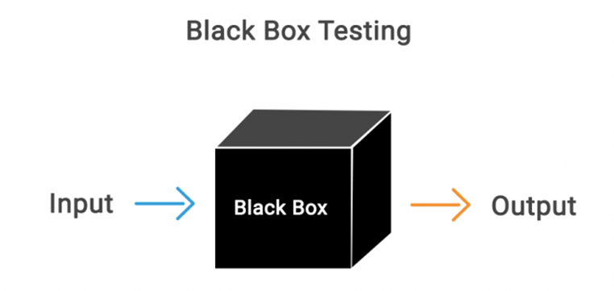
Black-Box Testing…

Slide 9
Black-Box Testing…
The above Black-Box can be any software system you want to test. For Example, an operating system like Windows, a website like Google, a database like Oracle or even your own custom application.
Under Black Box Testing, you can test these applications by just focusing on the inputs and outputs without knowing their internal code implementation.

Slide 10
How to do BlackBox Testing
The generic steps followed to carry out any type of Black Box Testing:
Initially, the requirements and specifications of the system are examined.
Tester chooses valid inputs (positive test scenario) to check whether SUT processes them correctly. Also, some invalid inputs (negative test scenario) are chosen to verify that the SUT is able to detect them.
Tester determines expected outputs for all those inputs.

Slide 11
How to do BlackBox Testing...
Software tester constructs test cases with the selected inputs.
The test cases are executed.
Software tester compares the actual outputs with the expected outputs.
Defects if any are fixed and re-tested.

Slide 12
Types of Black Box Testing
Functional Testing
Non-Functional Testing
Regression Testing

Slide 13
Types of Black Box Testing…
Functional Testing:
This particular type focuses on the functional requirements associated with a system. Software testers are responsible for carrying out this test.
Non-Functional Testing:
This black box testing type doesn’t associate with any specific functionality. It is solely focused on non-functional requirements like usability, scalability and performance.

Slide 14
Types of Black Box Testing…
Regression Testing:
Black box testing also includes Regression Testing that is conducted after code fixes or system upgrades. The motive is to examine the new code and its effect on the existing code.

Slide 15
Black-Box Testing Techniques
Equivalence Partitioning
Boundary-Value Analysis
Decision Table Testing
State Transition Testing
Error Guessing

Slide 16
Equivalence Class Definitions
Equivalence class partitioning is a practice through a test condition that is tested by segregation the data into valid and invalid partitions. Here the same set of data is grouped together as a different segment to derive the test results.
or
An equivalence class of data is a group of data such that any member of the group will cause the same general effect when applied to a specific program.
Equivalence Class Partitioning is also known as Equivalence Partitioning.

Slide 17
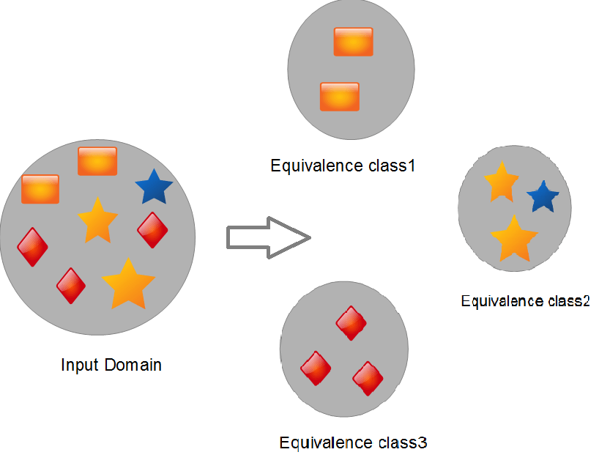
Equivalence Class Definitions

Slide 18
Equivalence Class Definitions
It works on certain assumptions:
The system will handle all the test input variations within a partition in the same way.
If one of the input condition passes, then all other input conditions within the partition will pass as well.
If one of the input conditions fails, then all other input conditions within the partition will fail as well.
Equivalence Class helps to reduce the total number of test cases from infinite to finite.

Slide 19
Equivalence Class Definitions
For example:
Readout shall be Green when 25 <= x <= 50, otherwise readout shall be Red.
Values 25 .. 50 are equivalent.
They all cause the readout to be GREEN.

Slide 20
Equivalence Class Definitions
A valid equivalence class is an equivalence class of valid data.
e.g. 25, 40, 50 ⇒ valid data
An invalid equivalence class is an equivalence class of invalid data.
e.g. x < 25 - Invalid
x > 50 - Invalid
The success of equivalence of partition is dependent on our ability to segment the data and make a partition.

Slide 21
Examples of Equivalence Classes
Equivalence Class | Types of Tests for equivalence conditions | Example
Range of Values | One valid and Two Invalid | In case of Readout shall be Green when 25 <= x <= 50, otherwise readout shall be Red. Valid - x = 25..50 Invalid - x < 25 Invalid - x > 50
Number of Values | One valid and Two Invalid | Valid - correct # Invalid - Too few Invalid - Too many
Set of Values | One valid and One Invalid | Valid - In the set Invalid - Not in the set
Must Be condition | One valid and One Invalid | Valid - condition is TRUE Invalid - condition is FALSE

Slide 22
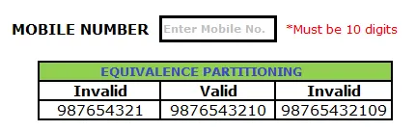
Examples of Equivalence Classes…
Example:
Assume, we have to test a filed which accepts a Mobile Number of ten digits.

Slide 23
Examples of Equivalence Classes…
Valid input: 10 digits
Invalid Input: 9 digits, 11 digits
Valid Class: Enter 10 digit mobile number = 9876543210
Invalid Class Enter mobile number which has less than 10 digits = 987654321
Invalid Class Enter mobile number which has more than 11 digits = 98765432109

Slide 24
Boundary Value Analysis
Based on the principle that the most fruitful place to search for errors is in and around the boundaries of the input and the output.
Focuses on boundaries of both the inputs and the results (or outputs).
Explores the situation on and around the edges of the equivalence classes.
For example, In case of Readout shall be Green when 25 <= x <=50, otherwise readout shall be Red.
25
50
Notes:
E.g. Readout is GREEN when 25 <= x <= 50, otherwise readout is RED.

Slide 25
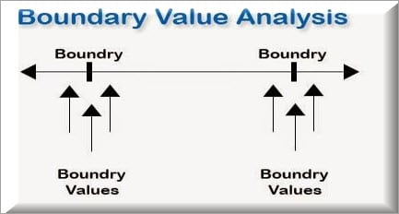
Boundary Value Analysis
Range of input values
Test the ends of the valid input range.
Test invalid inputs just beyond the ends. (For example, 24 and 51) from previous example

Slide 26
Boundary Value Analysis
Number of input values
Test the minimum and maximum number of values.
Test one beneath and one beyond these values.
Range of output values
Test the ends of the valid output range.
Test invalid output just beyond the ends.

Slide 27
Boundary Value Analysis
Number of output values
Test the minimum & maximum number of output values.
Test one beneath & one beyond these output values.
Ordered Set
For a set of input or output conditions, focus attention on the first and last elements of the set.

Slide 28
Boundary Value Analysis Example
Let’s consider the same example that accepts a numeric number as input with a value between 10 to 100.
While testing such application, we will not only test it with values from 10 to 100 but also with other sets of values like – less than 10, greater 10, special characters, alphanumeric, etc.

Slide 29
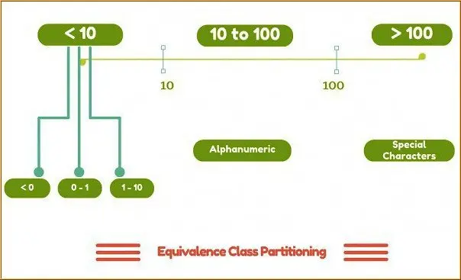
Boundary Value Analysis Example
Equivalence class partitioning of the value 10 and 100

Slide 30
Boundary Value Analysis Example
For increasing the probability of finding errors instead of picking random values from those classes, we can pick the values at the boundaries like below -
Equivalence Classes | Test Data using Boundary Value Analysis
Numbers between 10 to100 | 10, 100
Numbers less than 10 | 9
Numbers greater than 100 | 101

Slide 31
Advantages of Boundary Value Analysis
It is easier and faster to find defects using this technique. This is because the density of defects at boundaries is more.
Instead of testing will all set of test data, we only pick the one at the boundaries. So, the overall test execution time reduces

Slide 32
Disadvantages of boundary value analysis
The success of the testing using this technique depends on the equivalence classes identified, which further depends on the expertise of the tester and his knowledge of the application. Hence, incorrect identification of equivalence classes leads to incorrect boundary value testing.
Applications with open boundaries or applications not having one-dimensional boundaries are not suitable for this technique.

Slide 33
Decision Table Testing
As the name itself suggests, wherever there are logical relationships like:
If { (Condition = True) (user name and pass) then action1 ; } else action2; /*(condition = False)*/
Then a tester will identify two outputs (action1 and action2) for two conditions (True and False). So based on the probable scenarios a Decision table is carved to prepare a set of test cases.

Slide 34
Decision Table Testing…
Example 1: In this example, we see how to create the decision table for a login screen that asks for UserId and Password.
The condition here is that the user will be redirected to the homepage if he enters the correct user name and password, and an error message will be displayed if the input is wrong.
Conditions | Rule 1 | Rule 2 | Rule 3 | Rule 4
Username (T/F) | F | T | F | T
Password (T/F) | F | F | T | T
Output (E/H) | E | E | E | H

Slide 35
Decision Table Testing…
Legend
T - Make sure your login and password are correct.
F - Incorrect login or password
E - An error message appears.
H - The home screen appears.

Slide 36
Decision Table Testing…
Interpretation
Case 1 − Both the username and password were incorrect. An error message is displayed to the user.
Case 2 − The username and password were both right, however, the password was incorrect. An error message is displayed to the user.
Case 3 − Although the username was incorrect, the password was accurate. An error message is displayed to the user.
Case 4 − The user's username and password were both accurate, and the user went to the homepage.

Slide 37
State Transition Testing
State Transition Testing is a technique that is used to test the different states of the system under test. The state of the system changes depending upon the conditions or events. The events trigger states which become scenarios and a tester needs to test them.
A systematic state transition diagram gives a clear view of the state changes but it is effective for simpler applications. More complex projects may lead to more complex transition diagrams thereby making it less effective.

Slide 38
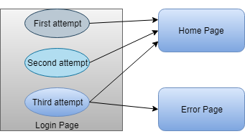
Example of State Transition Testing
There is a login function of an application which provides a maximum three number of attempts, and after exceeding three attempts, it will be directed to an error page.

Slide 39
Example of State Transition Testing
In the above state transition table, we see that state S1 denotes first login attempt. When the first attempt is invalid, the user will be directed to the second attempt (state S2). If the second attempt is also invalid, then the user will be directed to the third attempt (state S3). Now if the third and last attempt is invalid, then the user will be directed to the error page (state S5).
But if the third attempt is valid, then it will be directed to the homepage (state S4).

Slide 40
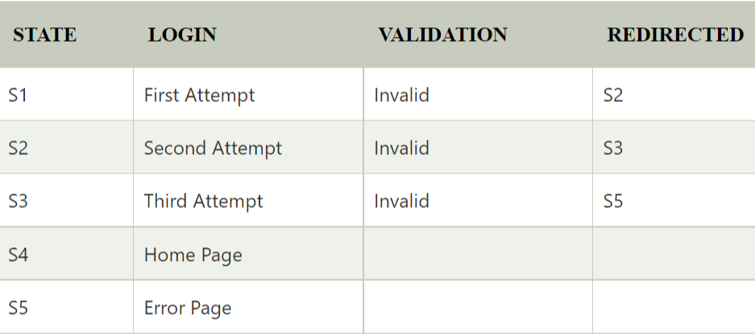
Example of State Transition Testing
State transition table:

Slide 41
Example of State Transition Testing
Let's see state transition table if third attempt is valid:

Slide 42
Error Guessing
This is a classic example of Experience-Based Testing.
Given a particular program, certain problem types of errors are surmised, both by intuition and experience, and test cases are written to expose these errors.
Understanding of the system under test.
Supplement your test cases based on your intuition and experience.

Slide 43
Black Box Testing Advantages
The tester does not need to have a technical background. It is important to test by being in the user’s shoes and think from the user’s point of view.
Testing can start once the development of the project/application is done. Both the testers and developers work independently without interfering in each other’s space.
It is more effective for large and complex applications.
Defects and inconsistencies can be identified in the early stages of testing.

Slide 44
Black Box Testing Disadvantages
Without any technical or programming knowledge, there are chances of ignoring possible conditions of the scenario to be tested.
In a stipulated time there is a possibility of testing less and skipping all possible inputs and their output testing.
Complete Test Coverage is not possible for large and complex projects

Slide 45

Questions?

