Slide 1
MC/DC MODIFIED CONDITIONS and DECISION COVERAGE

Slide 2
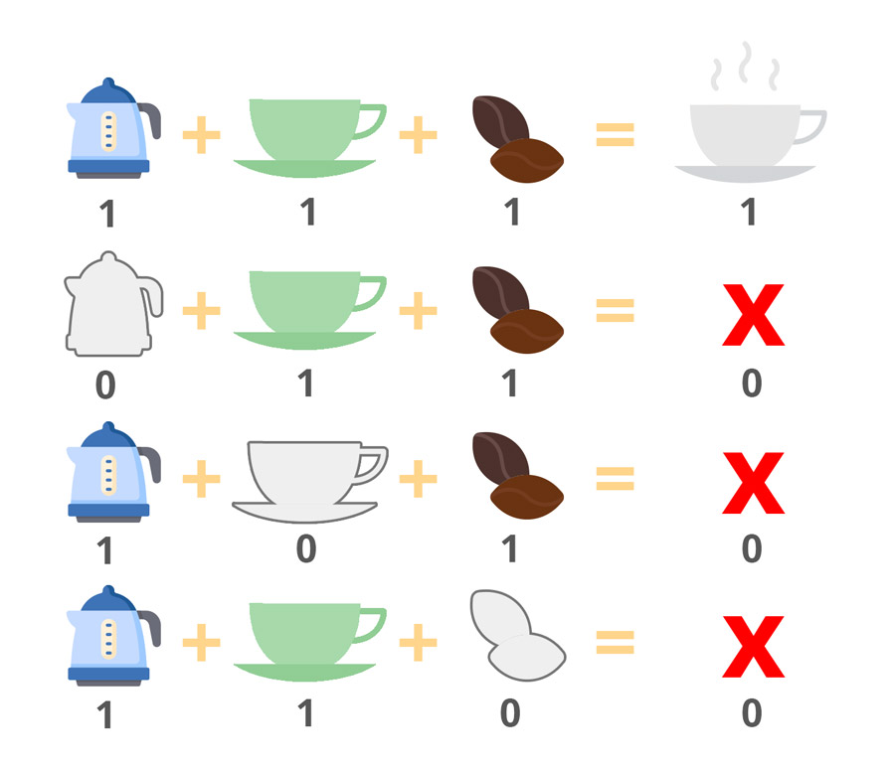
Test-case Design
Modified condition/decision coverage(MC/DC):
Consider the following example
if( kettle && cup && coffee ) {
return cup_of_coffee;
}
else {
return none;
}

Slide 3
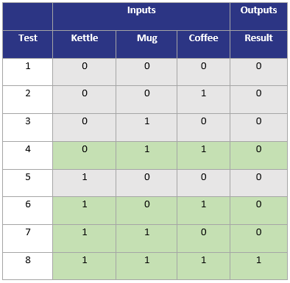
Test-case Design
Modified condition/decision coverage(MC/DC):
Using exhaustive testing method eight test cases are required for complete testing as shown by the following table.

Slide 4
Test-case Design
Modified condition/decision coverage(MC/DC):
Using MC/DC only four test cases are sufficient

Slide 5
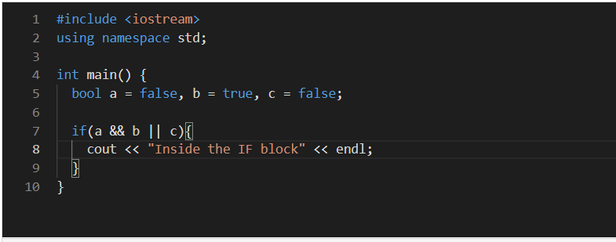
Test-case Design
Modified condition/decision coverage(MC/DC):
Consider the following example

Slide 6
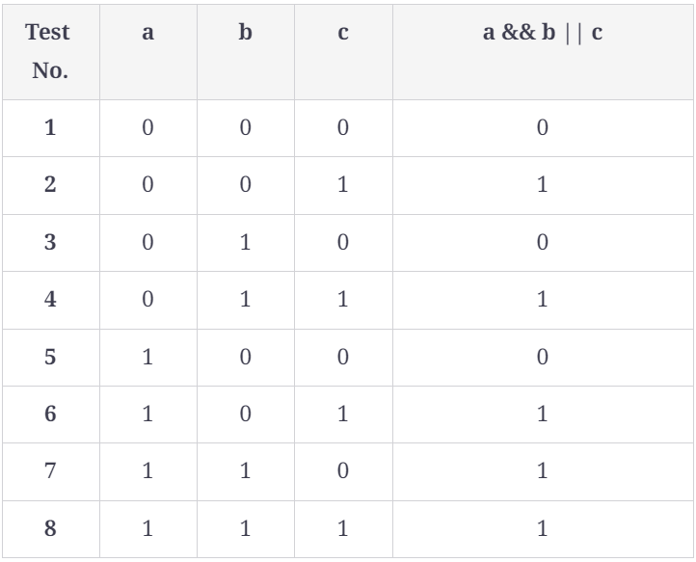
Test-case Design
Modified condition/decision coverage(MC/DC):
Using exhaustive testing method eight test cases are required for complete testing as shown by the following table.

Slide 7
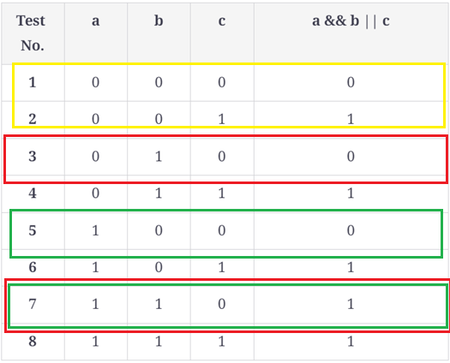
Test-case Design
Modified condition/decision coverage(MC/DC):
Using MC/DC

Slide 8
Test-case Design
Modified condition/decision coverage(MC/DC):
In general Number of test cases required
Using Exhaustive Testing Method = 2^{N}
Using MC/DC = (N + 1)

Slide 9
Thank You

