Slide 1
CAN-Protocol
Fundamentals

Slide 2
Contents
Physical signal transmission
Bus access
Synchronization
Message formats
Data integrity

Slide 3
Bus Logic
Level
Bus line
Notes:
With CAN differentiation is made between the two bus levels dominant and recessive. The dominant bus level overwrites the recessive level. If dominant and recessive bus levels are sent simultaneously by different network nodes, a dominant level occurs on the bus.
The figure shows very clearly how dominant and recessive levels are generated. Furthermore, the polarity of the physical signal response corresponds to the logical signal response. It is advisable to always use this circuit with CAN to make the bus processes clearly understandable.

Slide 4
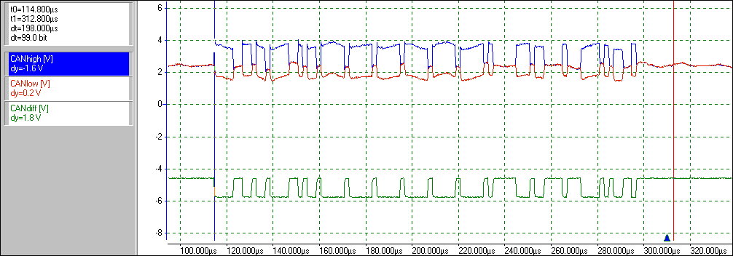
Oscilloscope Trace of a CAN Message
Notes:
The oscilloscope trace shows the level response of a CAN message that might typically occur in a CAN network, whereby the network nodes are connected to the CAN bus via a physical CAN interface conformant to ISO 11898 (CAN High-Speed specification).
In such a CAN network messages are transmitted with the help of differential signal transmission. The lower signal response shows the difference of the CAN Low line and the CAN High line and thereby represents the logical level.

Slide 5
Line Encoding
Clock
Logical bit level
0
1
1
1
0
1
0
0
0
NRZ-Codierung
NRZ encoding
RZ encoding
Manchester encoding
Notes:
Reliable recovery of the information on the receiver side plays an important role in a serial transmission system. To eliminate the need for a separate clock line, line codes were developed in which the clock signal can be obtained from the useful signals arriving at the receiver.
NRZ encoding is used with CAN due to the low electromagnetic emissive power and due to its utilization of the full transmission bandwidth. In this type of encoding each bit is represented by a constant signal level over the bit time. This allows for relatively simple sampling (one sample per bit time is sufficient).

Slide 6
Contents
Physical signal transmission
Bus access
Synchronization
Message formats
Data integrity

Slide 7
Bus Access
Multi-Master
Architecture
Event-
Oriented
CSMA/CA
Random
Priority-driven
Nondestructive
Collisions
Nondestructive
messages
Notes:
Because of the Multi-Master architecture and its need-based or event-based orientation, it is possible to have collisions occur when transmitting messages. To effectively handle such situations the CSMA/CA bus access method is utilized with CAN.
The CSMA/CA method is an event-oriented bus allocation method, which permits a high useful data rate by means of nondestructive bus access with decentralized bus access control. The efficiency of the bus distribution method can be enhanced by exclusively having only those controllers which have outstanding Tx requests occupy the bus. These requests are processed according to their importance.

Slide 8
Message Addressing
Data Frame
Header
ID 10
ID 9
ID 8
ID 7
ID 6
ID 5
ID 4
ID 3
ID 2
ID 1
ID 0
Notes:
A CAN message is characterized by an address (identifier). This message address is comprised of 11 bits. This allows 2048 messages to be differentiated from one another.
This message address is used, on the one hand, to define its priority, and on the other hand to allow the CAN controllers to check whether or not a received message should be accepted. The CAN controllers must perform message filtering for this purpose.
The message address is integral to bitwise bus arbitration, because in this phase the message addresses placed by controllers wishing to transmit are compared with one another.

Slide 9
Message Prioritization
Message priority
Lowest priority
Decreasing priority
Highest priority
Message address
0
2047 (0x7FF)
Notes:
Message prioritization is performed with the help of the identifer. The identifier value should be defined according to the urgency of the message.
Since by definition the dominant level (Low) overwrites the recessive level (High), the CAN message with the lowest address (0x00) has the highest priority. In contrast to this, the highest address (0x7FF) has the lowest priority. Consequently, the priority of the CAN message decreases with increasing values of the message address.

Slide 10
Flow Chart of Bitwise Bus Arbitration
Tx request
Wait for
Interframe Space
Bus is free
Add on the
Start-of-Frame bit
Rx state
SOF added on
Add on the
first / next bit
Bus level not same as Tx level
Bus level same as Tx level
Bit added on
Compare bus level
to Tx level
all bits added on
Bit error
Winner of bitwise arbitration
transmits the rest of its message
Error state

Slide 11
Principle of Bitwise Bus Arbitration
IFS
Identifier
SOF
RTR
rec
Controller 1 ID = 0x653
10 9 8 7 6 5 4 3 2 1 0
dom
Controller 1 wins arbitration
SOF
RTR
rec
Controller 2 ID = 0x65B
10 9 8 7 6 5 4 3 2 1 0
dom
Arbitration phase
SOF
RTR
rec
Bus level
10 9 8 7 6 5 4 3 2 1 0
dom

Slide 12
Exercise 1
1)Three different controllers each want to send a CAN message at the same time. Which controller is able to transmit its CAN message over the CAN bus?
  Transmission controller
  Antilock braking system
  Engine controller
2)At which points in time do the other two controllers lose arbitration?
ID = 0x25D
ID = 0x25B
ID = 0x26E
Notes:
Slide 38

Slide 13
Signal Delay
Sample
Sample
Bit n
Bit n+1
TSEG_1
SYNC
TSEG_1
TSEG_1
Controller A
TSEG_2
SYNC
TSEG_1
TSEG_2
Sample
Sample
t _{Delay}
t _{Delay}
TSEG_1
SYNC
TSEG_1
TSEG_1
Controller B
SYNC
TSEG_1
TSEG_2
TSEG_2
Bit n
Bit n+1
t_{TSEG_1} ≥ 2 • t _{Delay}
t_{TSEG_1} ≥ 2 • (2 • t_{CAN} + t_{Tx} + t_{Rx} + t_{Bus})
t_{Bus} = l_{Bus} / v_{Bus}
v_{Bus} = 0.2 m/nsec
Notes:
During the arbitration phase each controller compares its transmitted bus level with the bus level it receives. This results in the requirement that a dominant bit which is sent by another controller participating in arbitration must arrive before the sampling time point, so that the controller can decide whether or not it may continue to participate in arbitration.
To guarantee proper functioning of bitwise arbitration it is necessary to consider the signal conduction times on the line and the delays of the electronic components.
That is, it must be assured that a signal level is available before the sampling time point. Each bit has a signal delay segment (TSEG_1) for this purpose. This segment must be twice as long as the conduction time between the two controllers located furthest from one another. The signal delay segment describes a relationship between network length (line length) and the transmission rate.

Slide 14
Exercise 2
1) Derive a formula that establishes a relationship between the maximum bus length and the maximum data transmission rate!
2) What is the maximum data rate that can be configured if the bus length is 300 meters and the signal propagation segment should not take up more than 80 percent of the bit time? (t CAN = 75 nsec, tTx= tRX= 25 nsec)
Notes:
Slide 39, 40

Slide 15
Contents
Physical signal transmission
Bus access
Synchronization
Message formats
Data integrity

Slide 16
Synchronization
Hard
Synchronization
Soft
Synchronization
Block synchronization
with start sequence
Bit stuffing
mechanism
Notes:
Since no common clock pulse is in force between the controllers in a CAN network, and since the CAN messages are also transmitted in an event-driven manner, the question arises how synchronization can be produced between the controllers in a CAN network.
On the one hand, a CAN message is characterized by a starting and ending sequence. The controllers connected to the transmission medium can synchronize with the help of the starting sequence (block synchronization). Resynchronization or soft synchronization is performed by the so-called bit stuffing mechanism.

Slide 17
Bit Stuffing Mechanism
Sender
Bit sequence to be sent before bit stuffing
Bus time lengthening
Bus
Bit sequence sent after bit stuffing
S
S
Stuff bits
Receiver
Bit sequence received after destuffing
Notes:
The use of NRZ encoding necessitates stringent requirements with regard to synchronization. To maintain synchronization during message transmission, regular signal edges are needed to permit resynchronization as required. The sampling time point can be corrected by these resynchronizations.
In a CAN network the bit stuffing mechanism is used to ensure that a maximum of five homogeneous bit levels can be transmitted by a controller. This involves having the sender insert a complementary bit (stuff bit) into the bit stream after a count of five identical bit levels. The receiver then removes this stuff bit from the bit stream to obtain the original message.

Slide 18
Exercise 3
1) Sketch the levels of the 7C1H bit sequence both before and after bit stuffing! How many stuff bits are inserted by the CAN controller?
2) With CAN the recessive-dominant edge is used for resynchronization. How long afterwards (maximum) must a receiver wait for a next edge to be used for resynchronization?
3) Which bit sequence results in the maximum number of stuff bits?
Notes:
Slide 41, 42, 43

Slide 19
Resynchronization
Resynchronization opportunity
Nominal bit time t_{Bit}
Nominal bit time t_{Bit}
Bus level (Sender)
t
❶
Synchronous
receiver
S
t _{TSEG_1}
t _{TSEG_2}
S
t _{TSEG_1}
t _{TSEG_2}
S
t _{TSEG_2}
t _{TSEG_1}
e
Adjusted bit time t_{Bit}
❷
Fast
receiver
S
t _{TSEG_1}
t _{TSEG_2}
S
t _{TSEG_1}
t _{TSEG_2}
S
t _{TSEG_1}
e
Adjusted bit time t_{Bit}
❸
Slow
receiver
t _{TSEG_2}
S
t _{TSEG_1}
t _{TSEG_2}
S
t _{TSEG_1}
t _{TSEG_2}
S
t _{TSEG_1}
Notes:
If the received edge does not fall within the synchronization segment (too early or too late), a resynchronization is necessary. The receiver in Example 1 is optimally synchronized, because the edges on the bus arrive at the receiver within the SYNC segment.
In Example 2 the receiver‘s oscillator pulses faster than the sender‘s, and it must therefore adjust its bit timing by lengthening TSEG_1 by the associated phase error. The maximum phase error that can be compensated is given by the SJW (Synchronization Jump Width).
In Example 3 the receiver‘s oscillator is slower than that of the sender, and it must adjust its bit timing by shortening TSEG_2 by the associated phase error. The maximum phase error that can be compensated is given by the SJW (Synchronization Jump Width).

Slide 20
Segmenting of the Bit Time Interval
Bit time interval
SYNC
TSEG_1
TSEG_2
Sampling point
SYNC The SYNC segment is used for synchronization
TSEG_1 TSEG_1 (Time Segment 1) is used to compensate for all delay times within a network. TSEG_1 can be lengthened for resynchronization.
TSEG_2 TSEG_2 (Time Segment 2) is used as a time reserve for resynchronization.

Slide 21
Contents
Physical signal transmission
Bus access
Synchronization
Message formats
Data integrity

Slide 22
Message Transmission
Controller 1
Controller 2
Accept
Send
Accept
Send
Select
Remote
Select
Data
Receive
Prepare
Remote Frame
Receive
Prepare
ID 4
RTR = 1
ID 4
RTR = 0
Data
Data Frame
Notes:
Essentially CAN provides two message formats for communications. These are the Data frame and the Remote frame.
A Data frame is utilized to transmit useful information which is made available to every controller to receive it. A Remote frame is used by a controller to request useful information. A Remote frame is answered by the relevant controller with a suitable Data frame.
A Data frame and a Remote frame are associated with one another if they both share the same message identifier. A Data frame and a Remote frame are differentiated by the RTR bit (Remote Transmission Request) which is also used for arbitration.

Slide 23
Data Frame
recessive
dominant
IDE
r
d₃
d₂
d₁
d₀
Bitstuffing
Data Length Code (DLC)
reserviert
Identifier Extension Bit
Notes:
A CAN message begins with the SOF to identify the beginning of a message transmission and to implement the hard synchronization.
Immediately following this is the Identifier field which contains the message identifier.
The Control field is composed of the Data Length Code and the two bits IDE and r0 (Reserved bit). The IDE bit serves to differentiate between a standard and an extended message transmission.
The Data frame transmits useful information within the Data field. A maximum of eight useful bytes may be transmitted.
The CRC field is composed of the 15-bit wide CRC checksum and the recessively transmitted CRC Delimiter. With the help of the CRC checksum the receiver is capable of detecting a faulty data transmission.
The ACK field is composed of the ACK Slot and the ACK Delimiter. With the help of the ACK Slot the receivers can acknowledge either positively (dominant level) or negatively (recessive level). The acknowledgment occurs independent of whether the CAN message is accepted. Whenever there is a negative acknowledgment the relevant controller must additionally set an error flag so that network-wide data consistency is preserved.
A Data frame is terminated by seven recessive bits, the End-of-Frame (EOF).
After the message has been fully transmitted the Intermission field (ITM), also referred to as the Interframe Space (IFS), immediately follows the message transmission. The ITM consists of three recessive bits. This ITM separates two message transmissions from one another.

Slide 24
Exercise 4
1) How many bits does the longest CAN message contain in standard format without stuff bits?
2) What is the maximum number of stuff bits to be expected with transmission of a CAN message in standard format with eight data bytes? How many bits would then make up the CAN message?
3) How many bits does the shortest CAN message contain in standard format?
Notes:
Slide 44

Slide 25
Remote Frame
recessive
dominant

Slide 26
Standard Format / Extended Format
Arbitration field
Control field
Standard Format
S
O
F
Identifier
R
T
R
r₁
r₀
DLC
11-bit identifier
2048 messsages
1
11
1
1
1
4
Extended Format
S
O
F
Base
identifier
S
R
R
I
D
E
Extended
identifier
R
T
R
r₁
r₀
DLC
29-bit identifier
536 million messages
11
18
1
1
1
1
1
1
The SRR bit replaces the
RTR bit of a
standard frame
The IDE bit is used to differentiate
between standard and
extended frames
Notes:
With regard to the format, three types of CAN controllers may be differentiated from one another:
CAN controllers which can only send and receive CAN messages in Standard format (CAN Specification 2.0A),
CAN controllers which can send and receive CAN messages in Standard format and can also tolerate CAN messages in Extended format (CAN Specification 2.0 B-passive),
and CAN controllers which can send and receive messages in both Standard and Extended formats (CAN Specification 2.0 B-active). The Extended format was introduced due to porting of the SAE-J 1850 Standard.

Slide 27
Contents
Physical signal transmission
Bus access
Synchronization
Message formats
Data integrity

Slide 28
Error Detection Mechanisms
rec
dom
Notes:
The original field of application for CAN was in motor vehicles, and given this background there were very stringent requirements with regard to the reliability of each message transmission. A number of error detection mechanisms allow CAN to detect disturbed messages with a very high probability.
With the help of the CRC check the receivers can determine whether the received CAN message was correct. If it was correct all controllers give a positive acknowledgment; otherwise a negative one. If all controllers acknowledge negatively, then a recessive bit level remains in the ACK slot. This indicates that there is an ACK error.
Each controller monitors the format of a message frame. A format error exists if a bit field with a defined bit value is disturbed. To assure synchronization between the controllers, bit stuffing is implemented in CAN. A bit stuffing error exists if more than five consecutive bits have the same polarity, and they occur outside of the frame segments with a fixed format.
With CAN each transmitting controller compares the level it sends out with the actual bus level (bus monitoring). This allows the sender to detect bit errors. A bit error exists if the two levels do not agree.

Slide 29
Error Frame
Notes:
In the event of an error a controller can abort the ongoing message transmission with the help of an Error Flag. This flag is used to communicate the detected error to the other controllers, which assures network-wide data consistency. An Error Frame consists of the overlayed Error Flag of the participating network nodes and an Error Delimiter.

Slide 30
Local Disturbance at Transmitter
Transmitter
Receiver
Receiver
Bus level
Error Frame
Notes:
The transmitter detects a bit error in the Data field and immediately transmits an Error Flag (Primary Error Flag). At the latest, with the 6th bit of the error flag, the other connected controllers detect a violation of the bit stuffing rule and send their own error flags on the bus (Secondary Error Flags).
After the Error Delimiter and Intermission, the transmitter begins to transmit the CAN message again. In this case, the Error Frame encompasses 20 bits. Therefore, in principle retransmission of the disturbed CAN message is possible after 23 bit times.

Slide 31
Local Disturbance at Receiver
Sender
Receiver
Receiver
Bus level
Error Frame
Notes:
Receiver 1 detects a CRC error in the CAN message and therefore gives a negative acknowledgment (recessive level in the ACK Slot).
Receiver 2, which was not disturbed by the local error at Receiver 1, gives a positive acknowledgment, which overwrites the recessive level.
Immediately after the ACK field, Receiver 1 outputs an active error flag on the bus. The two other connected controllers then detect a format error (they expected a recessive bit for the EOF), and they also send error flags on the bus.
In this case, the Error frame consists of 15 bits. Therefore, in principle a retransmission of the disturbed CAN message is possible after 18 bit times.

Slide 32
Error Tracking
TEC > 127
REC > 127
Software reset and receipt of 128x11 recessive bits
TEC < 128
REC < 128
TEC > 255
Notes:
Internally each CAN controller administers a Tx error counter TEC and a Rx error counter REC, which serve to track errors and detect a failure of the CAN controller. The counters are incremented when errors occur, and they are decremented for successfully transmitted CAN messages. (TEC for sending, REC for receiving). The controller may switch to an error state depending on the specific counter reading.

Slide 33
Rules for Modifying the Error Counter
A CAN message was transmitted successfully
A CAN message was received successfully
TEC => TEC - 1
REC => REC - 1
Sender transmits an Error Flag
Receiver transmits an Error Flag
TEC => TEC + 8
REC => REC + 1
Important exception:
If a sender that was already error-passive detects an ACK error, the TEC is not incremented any more.
Receiver is first to transmit an Error Flag
REC => REC + 8

Slide 34
Error Handling
1
An error is detected with the help of error detection mechanisms
2
An Error Flag is transmitted immediately
→ For CRC error after the ACK Delimiter
→ In the error-active state six dominant bits
→ In the error-passive state six recessive bits after
the Suspend Transmission Time (8 recessive bits)
3
The Error Frame causes the message transmission that is running to be aborted
4
Every CAN controller rejects the CAN message
→ Network-wide data consistency
5
The error counters are incremented properly
6
The aborted CAN message is repeated automatically

Slide 35
Exercise 5
What errors does the CAN controller find in this case, and how does it handle them? Assume local disturbances and error-active CAN controllers!
EOF
ITM
Bus-Idle
Notes:
Slide 45

Slide 36
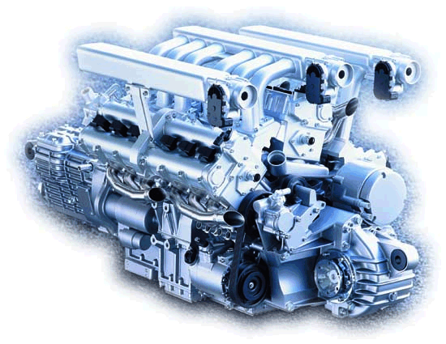
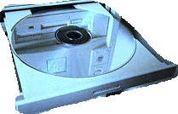



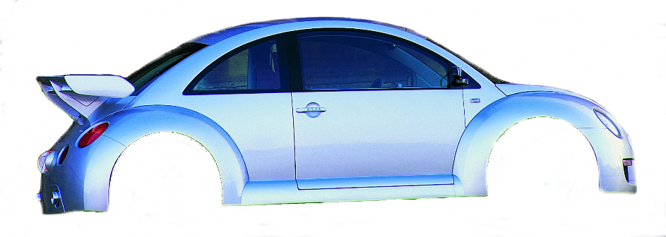

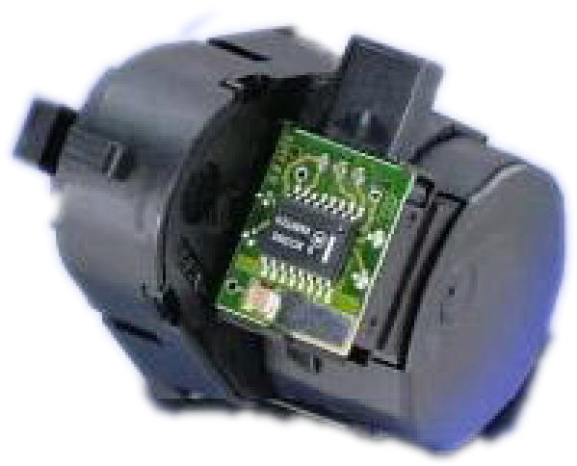
Trends
Motor
ABS
Getriebe
CAN
Future
Safety-related bus systems
Sub-buses
Powertrain
Radio
Navigation
CAN
Multimedia
Kombi
Gateway
MOST/D²B
Body-CAN
CD-Wechsler
Telefon
CAN
Klima
Computer
Tür
Dach
Sitz
Sub-Net
LIN
Sensor 1
Sensor 2
Sensor 3
Notes:
Network protocols can be utilized in several distinct areas of the motor vehicle. There is no protocol that can cover all application areas. Each area has special requirements for protocol characteristics.
Multimedia applications require high transmission rates, large bandwidth, and usually a wireless connection. Examples are MOST, D2B and Bluetooth.
Safety-critical applications for body and powertrain (X-by-wire) require a high degree of error tolerance and reliability. Examples are CAN, TTP/C, Byteflight and TT-CAN. Most comfort function applications utilize CAN.
Low-end protocols such as LIN can be used to achieve simple network capability in networking intelligent sensors and actuators as well as controllers. Usually application-specific protocols are also used in this area.

Slide 37
Solutions

Slide 38
Solution to Exercise 1
Inter
Frame
Space
S
O
F
Identifier
R
T
R
Control
Field
Data Field
10
9
8
7
6
5
4
3
2
1
0
Pwrtr. ECU (ID=26EH)
Transm. ECU (ID=25DH)
ABS (ID=25BH)
Bus
A
B

Slide 39
Solution to Exercise 2a
Notes:
t_{TSEG_1} ≥ 2 • (t_{El} + t_{Bus}) where t_{El} = 2 • t_{CAN} + t_{Tx} + t_{Rx}
and t_{Bus} = l_{Bus} / v_{Bus} , v_{Bus} = 0.2 m/nsec
t_{TSEG_1} / 2 ≥ t_{El} + l_{Bus} / v_{Bus}
((t_{TSEG_1} / 2) – t_{El})) ≥ l_{Bus} / v_{Bus}
((t_{TSEG_1} / 2) – t_{El} ) • v_{Bus} ≥ l_{Bus} where t_{TSEG_1} = x • t_{Bit} = x / Üg
→ l_{Bus} ≤ v_{Bus} • ((x / (2 • Baudrate)) – t_{El} )

Slide 40
Solution to Exercise 2b
ECU 1
ECU 2
CAN
Controller
CAN
Controller
t_{CAN}
t_{CAN}
t_{CAN}
t_{CAN}
CAN
Transceiver
CAN
Transceiver
t_{Tx}
t_{Rx}
t_{Tx}
t_{Rx}
t_{Bus}
t_{TSEG_1} ≥ 2 • t _{Delay}
t_{TSEG_1} ≥ 2 • (2 • t_{CAN} + t_{Tx} + t_{Rx} + t_{Bus})
t_{Bus} = l_{Bus} / v_{Bus}
v_{Bus} = 0.2 m/nsec
Notes:
❶ t_{El} = 2 • t_{CAN} + t_{Tx} + t_{Rx} = 2 • 75 nsec + 2 • 25 nsec = 200 nsec
❷ t_{Bus} = l_{Bus} / v_{Bus} = 300m • nsec / 0.2 m = 1500 nsec = 1.5µsec
❸ t_{TSEG_1} ≥ 2 • (t_{El} + t_{Bus}) = 2 • (0.2µsec + 1.5 µsec) = 3.4 µsec
❹ t_{TSEG_1} = x • t_{Bit} = x / Üg  Üg = x / t_{TSEG_1} = 0.8 / 3.4 µsec = 235 Kbit/s
→ Data rate ≤ 235 Kbit/s
Note: Üg= Übertragungsgeschwindigkeit = Transmission speed or data rate

Slide 41
Solution to Exercise 3a
Before bit stuffing
0
1
1
1
1
1
0
0
0
0
0
1
After bit stuffing
0
1
1
1
1
1
0
0
0
0
0
1
0
1
S
S

Slide 42
Solution to Exercise 3b
First resynchronization opportunity
Second resynchronization opportunity
1
0
0
0
0
0
1
1
1
1
1
0
S
S
10 bit times

Slide 43
Solution to Exercise 3c
Ratio of useful bits to stuff bits 4:1 → s_max = (n-1)/4

Slide 44
Solution to Exercise 4
Bit Stuffing Area
Notes:
1) 108 (exclude ITM)
2) In a Worst Case estimate the maximum number of stuff bits is:
s_max = (n-1) / 4
where n is the number of useful bits in the bit stuffing area of the message. For Data frames in standard format this yields:
s_max = (34 + 8*DLC - 1) / 4 ≈ 8 + 2*DLC
DLC = 0: s_max = 8 (in practice study: 6)
DLC = 8: s_max = 24 (in practice study: 22)
L = 34 + 8*DLC + 10 + s_max
DLC = 0: L = 34 + 10 + 8 (6) = 52 (50)
DLC = 8: L = 34 + 64 + 10 + 24 (22) = 132 (130)
3) DLC = 0: L = 34 +10 + 1 = 45

Slide 45
Solution to Exercise 5
EOF
ITM
Bus-Idle
a
b
c
Notes:
1) In this case there is a EOF violation. The locally disturbed network node aborts the message with an Error flag, and the message is rejected. One bit later the other network nodes also notice a format error, and they also place an Error flag on the bus. An Error flag results from a total of seven dominant bits. The sender can retransmit the aborted CAN message at the latest after 18 bit times.
2) In this case there is a ITM violation. The dominant bit (disturbance) is interpretted as the beginning of an Overload frame. Consequently all network nodes also send out an Overload frame. This does not alter the failure statistics counters.
3) The disturbance is interpretted as a SOF. This leads to a bit stuffing error after another 6 recessive bits, which is handled by Error frames.

