Slide 1
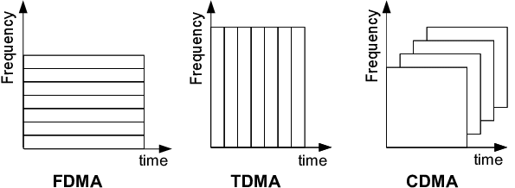
At the basic level a cell phone is just a two-way radio.
It requires one channel or frequency to transmit and one channel or frequency to receive.
Cell phones can both send and receive at the same time, unlike a walkie-talkie that uses a single channel to send and receive where you have to wait your turn and push the button to send.
The reason that there is a requirement for radio frequency reuse planning is both simple and practical
The Federal Communications Commission, (FCC) allots a limited number of radio frequencies to each wireless company.
The number of frequencies available is far too small to accommodate millions of phone calls at the same time.
In order to compensate for this lack of radio frequencies, wireless companies use technology that allows them to split the frequencies into small sections
This allows more phones to use the frequencies than would be possible if a phone took up the entire radio channel.
Two primary methods for “sharing” radio channels are
Time Division Multiple Access (TDMA) which is used in the Global System for Mobile Communications (GSM) network
AT&T, T-Mobile & rest of the world
Code Division Multiple Access (CDMA) used in the CDMA network
Sprint, Verizon, and US Cellular

Slide 2
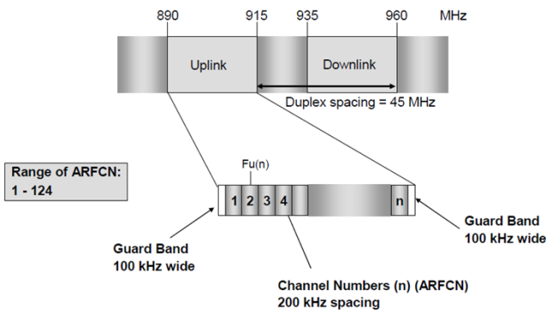
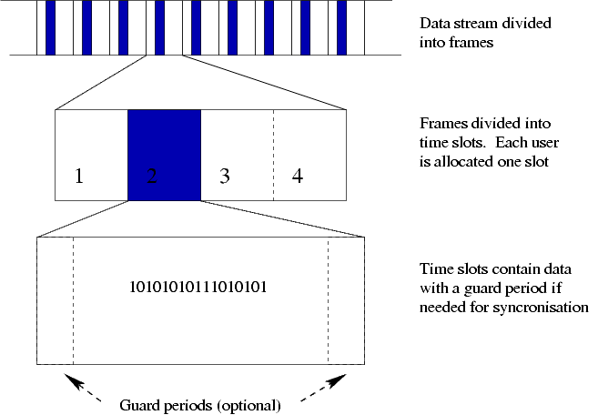
GSM
2G GSM 900 & 1800 MHz
GSM 900 MHz frequency
Uplink 890 – 915 MHz(25 MHz)
Downlink 935 – 960 MHz (25 MHz)
25 MHz / 200 KHz
125 frequencies
200 KHz (2 * 100 KHz) as Guard band
124 usable frequencies
1st frequency is located at 890.2 MHz (+/- 100 KHz)
Eight time slots per frequency
Allows 8 full-rate speech channels per radio frequency
These eight slots (burst periods) are grouped into a TDMA frame
Half-rate channels use alternate frames in the same timeslot.
The channel data rate for all 8 channels is 270.833 kbit/s,
The frame duration is 4.615 ms
4.615*8 = 36.92
1000/36.92 = 27.09 Hz
Absolute Radio Frequency Channel Number (ARFCN)
Upload/download link frequency pairs
Duplex spacing/duplex distance
Difference between paired uplink/downlink frequencies
Typically 45MHz on

Slide 3
CDMA
Each user in a CDMA system uses a different code to modulate their signal.
Choosing the codes used to modulate the signal is very important in the performance of CDMA systems.
The best performance occurs when there is good separation between the signal of a desired user and the signals of other users. The separation of the signals is made by correlating the received signal with the locally generated code of the desired user.
If the signal matches the desired user's code, then the correlation function will be high and the system can extract that signal.
If the desired user's code has nothing in common with the signal, the correlation should be as close to zero as possible (thus eliminating the signal); this is referred to as cross-correlation.
If the code is correlated with the signal at any time offset other than zero, the correlation should be as close to zero as possible.
This is referred to as auto-correlation and is used to reject multi-path interference.
An analogy to the problem of multiple access is a room (channel) in which people wish to talk to each other simultaneously.
To avoid confusion, people could take turns speaking (time division), speak at different pitches (frequency division), or speak in different languages (code division).
CDMA is analogous to the last example where people speaking the same language can understand each other, but other languages are perceived as noise and rejected.
Similarly, in radio CDMA, each group of users is given a shared code. Many codes occupy the same channel, but only users associated with a particular code can communicate.

Slide 4
VoLTE
Voice Telephony is of two types -
Circuit Switched, and
Packet Switched.
Existing 2G, 3G and non-Jio 4G networks use circuit switched technology for voice.
Research POTS vs 2, 3, 4, 5G

Slide 5
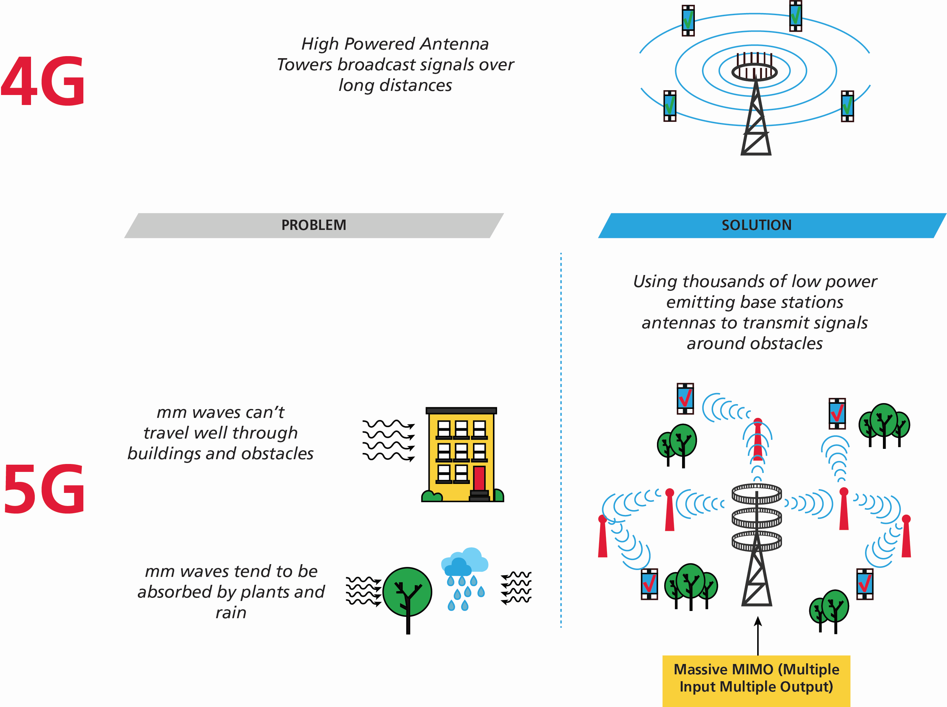
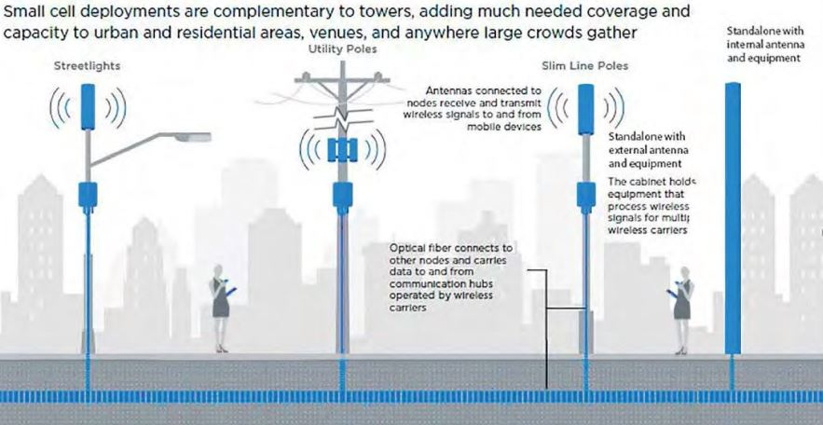

Slide 6
Home Location Registry (HLR)
Subscriber-specific information such as:
International mobile Subscriber Identifier (IMSI)
International Mobile Equipment Identifier (IMEI)
Current/last known location of cell phone
Roaming restrictions
Subscriber supplemental features
Visitor Location Registry (VLR)
Roaming-subscriber information
Autonomous registration
When a roaming phone goes into an area not covered by its carrier it registers with HLR and is added to VLR
Happens from time-to-time automatically
Disconnect
When a phone leaves an area no specific disconnect signal is sent
When phone shuts down a “kiss-off” signal is sent

Slide 7
Calls/Connections
When a cell phone is turned on, it registers with the cellular system by contacting the network via a signaling/control and paging channel.
This channel used by phone to announce its presence to network.
The phone is allowed to access network for its carrier.
Features for that subscriber plan will be activated
The registration system allows cellular system to know how to find the cell phone when system needs to route a call to phone
Data storage of these registration pings is only present for a few hours and are not recoverable after the fact
Making a call. Bob calls Sue.
Bob’s cell phone scans for best signal from a tower
MSC verifies Bob is valid subscriber, checks for available channel
MSC asks HLR for Sue’s account and location
The call is sent to the last tower that Sue’s phone pinged
The tower sends call to Sue
GSM
Periodically pings tower with strongest signal
Camps on tower til stronger signal found
Tower selection made in ‘idle’ mode (not during a call)
Once phone in a call the network will handle the tower selection vis “handoffs”
CDMA
Phone itself sends PREP (Pilot Reports) reports on tower signal strength
Phone does this when idle and in call
Phone performs this function telling network what cell sire to send its traffic over
Types of call
Completed
Call attempt, no answer, caller gives up
Routed call, no answer – the phone cannot be reached
Forwarded call

Slide 8
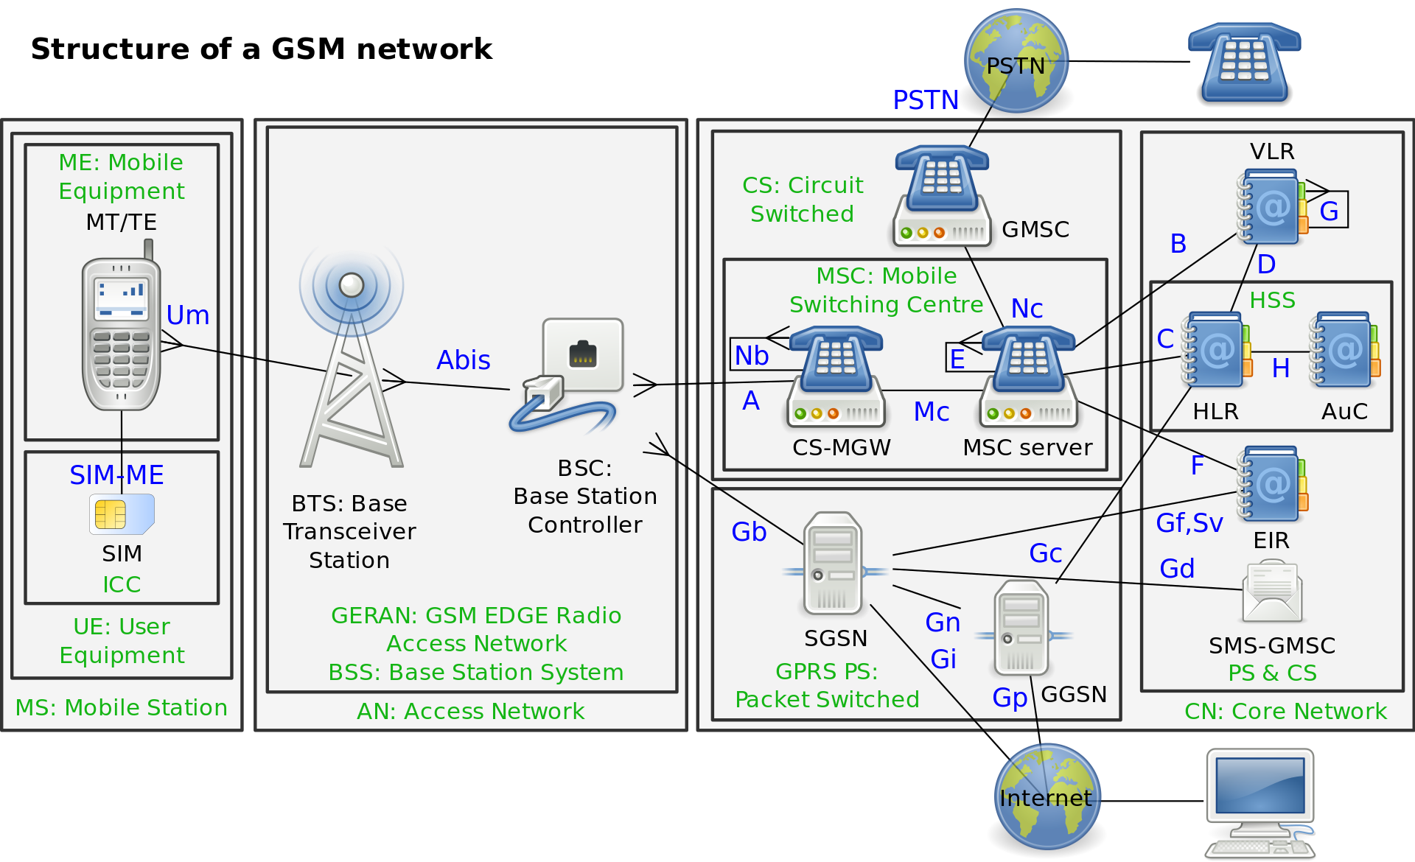

Slide 9
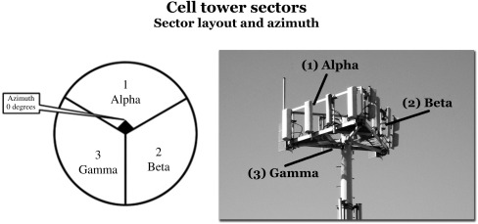
Cell Towers, Cell Sites
Cell Site: remote buildings with cellular radio equipment and antennas on towers
Beam width 120
Can be narrower (longer). Horizontal Beam width
Azimuth is direction radio antennas pointed
Cell Towers do NOT have an “average” coverage area
Co-located antennas from multiple companies
Antennas send and receive signals to and from phones
Base Transceiver Station (3G) and eNode B (4g LTE) manage the tower and calls on the tower.
Talks to phone network via cables.
Plain Old Telephone System (POTS)
Newer non-POTS technology
Integrated Digital Services Network (ISDN)
Digital Subscriber Line (DSL)
Fiber Distributed Data Interface (FDDI)

Slide 10
Phone Locations
Call details records
Cell tower and sector used by cell phone on a map
Real-time Call details records
Warrant required
Bear in mind this does not record pings, user needs to make/receive calls
“Precision location” data (Comes in three forms normally). These are engineering tools to check health of networks, not accurate for phone locations
Per Call Measurement Data (PCMD) Sprint
Based on Round Trip Delay (RTD)… Signal from tower-phone-tower
Periodic timing measurements from three sites to triangulate position
Not reliable because timings are affected by
Multipathing extends distance
Capacity issues
Multiple hand-off connections
Repeaters
Also, Minimum 3 towers signaling phone
Real Time Tool (RTT) Verizon
Also based on Round Trip Delay (RTD)… Signal from tower-phone-tower
Network Event Location System (NELOS) AT&T
GPS technology
These are engineering tools to check health of networks, not accurate for phone locations
Cellular data pings
real-time geolocation tracking of cellular phone by activating E911 system
Subsequently uses a network-based or handset-based method for triangulating cell phone
Gives estimated location of phone itself
Drive testing
Drive around with specialized equipment testing tower connections during calls
Be aware this data may be used in court even if we don’t do it ourself
Emergency 911 System
To provide geo-location to emergency services
FCC’s basic 911 rules require wireless service providers to transmit all 991 calls to a Public Safety Access/Answering Point (PSAP)
A primary PSAP is defined as a PSAP to which 9-1-1 calls are routed directly from the 9-1-1 Control Office, such as, a selective router or 9-1-1 tandem
Phase I 911 rules: Must provide cell number and Cell Site of 911 call
Phase II 911 rules: Must ALSO provide latitude and longitude of caller
Requires a 45s phone call for geolocation
Enhanced 911, Law enforcement request ping of phone to track it

Slide 11
Records
Call detail records can show which cell tower, and sector were used for a phone call
AT&T can show which tower was used for text and data BUT data transmission time stamps are one hour apart and, therefore, not discrete in the time-domain as the actual time of the data transmission within that hour is not known
As a result data transmissions and phone calls may be shown the records to be taking place at DIFFERENT towers
Data transmission continues even if the user is NOT interacting with the phone
AT&T likely to be only company that has usable text/sms & tower data
Text content often kept by wireless company for a few days
Which Tower
Cell phones attempt to connect to tower emitting the highest quality signal at a given moment, not only the closest.
The actual determination of which tower was connected to is complex, hinges on a multitude of factors, none of which are memorialized in the cell records
Rayleigh and Rician fading, multipath, diffraction
Factors may include:
Available capacity of tower at time (sport/live event nearby)
Tower health/functionality at time (get outage data)
Line of sight from phone to cell tower
Radio signal interference from other towers
Signal reflection/diffraction from buildings
Signal scattering
Blocking signal
Dominant vs non-dominant regions of overlapping cell tower strength

Slide 12
Call Detail Records
Most common type of evidence
Common to every carrier and can be obtained after the fact
Network traffic for cell phone transactions is collected by Mobile Switching Centers (MSCs)
Call records generated as a result of a query of this database and put into a report
Business reasons for collecting this data
Proof of service/Customer service/disputes
Transaction record for financial accounting
Technical picture of each transaction
Data contained in Cell Phone Records
Note: Dialed number may contain speed dials
Records may look different for CDMA vs GSM
CDMA records
First cell tower phone call went through and possibly last
Will NOT contain tower info for text messages or data transmissions
Sector numbers for records in CDMA networks for Lucent switches are numbered differently than for Nortel or Ericsson
GSM records
AT&T 1st tower and possibly additional towers in a call (chosen in idle mode)
After the first tower subsequent towers are chosen by the network and are unreliable location indicators
To obtain from wireless company you need to request
Call detail records
Cell tower location records
Can request maintenance and outage records from wireless company’s subpoena compliance dept
See page 43 in “Cell Phone Location Evidence for Legal Professionals” book for example subpoena

Slide 13
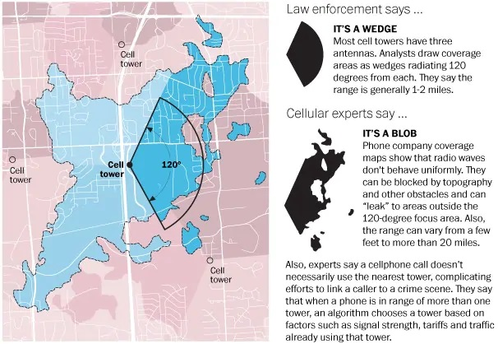
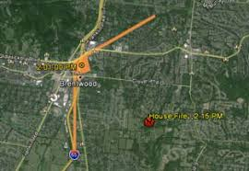
How cell phone location evidence is presented in court
Maps are key
When an analyst tries to show coverage area of a cell tower… unless they are using radio propagation maps created by wireless telephone company they are taking a risk
There is NO way to determine the coverage of a cell tower sector through the use of call detail records.
Coverage area of a cell tower should never be part of an analyst’s mapping or court presentations unless that information comes
directly from the wireless telephone company in the form of a radio propagation map
or drive testing contemporaneous to the date in question
Coverage area: the area around the cell tower where the radio waves reach the ground
A single cell site can contain the hardware for several cells, which are then also known as sectors.
The sectors will operate independently of each other having unique IDs
NO knowledgeable expert should be using pie slices
Be no more detailed than this

Slide 14
Verizon Call data
Excel sheet 1: call data
Excel sheet 2: site data
The call
Record Open Date/Time | Record Open Dt/Tm(GMT) | SID | NID | Cell ID | Cell Face | Market ID | eNB ID | Dir | MSISDN | Called # | CPN | SOU | RAT | ENDPOINT | VZWNE/V4B | User Equip Type
2020/03/29 18:49:42(GMT -5) | 3/29/2020 23:49 | N/A | N/A | N/A | 34 | 121 | 121002 | MT | ??????? | ??????? | ??????? | 13 | LTE | N/A | N/A | 3.55E+15
The site
Site Number | E-911 Latitude | E-911 Longitude | Street Address | City | State | Zip | Sector | Azimuth (deg) | Antenna H-BW (deg) | Channel Type | eNodeB ID | Vendor
2 | 30.343027 | -95.0788 | 120 Peach Ave # A | Cleveland | TX | 77327 | 3 | 270 | 61.25 | LTE | 121002 | Nokia
Change my code to use this

Slide 15
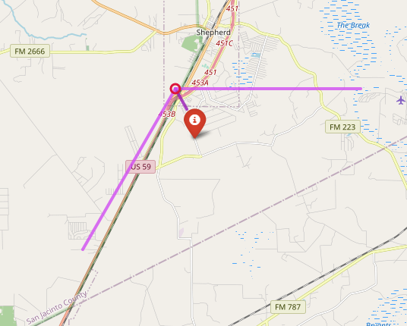
Sectors (usually 3)
We can add multiple addresses:
incident address (i)
alibi address
If a call was made at time of an ‘incident’ we can determine the sector call was made from
3 (gamma)
1 (alpha)
cell tower
2 (beta)
Azimuth
Orientation/Rotation

