Slide 1
Linux
dd if=/dev/zero of=/root/file1.txt bs=1M count=100
sudo –i
du -sh /root/file1.txt
Install
Install
Linux installations are dependent on OS
For Redhat, Amazon Linux, CentOS
yum-config-manager –add-repo https://download.docker.com/linux/centos/docker-ce.repo
yum –y install docker-ce
systemctl start docker
Basic Linux commands
df = disk free
df –h (human readable)
ps = process status
/etc/init.d directory
service "service name" start/stop/status/restart
All these service works on several scripts and these scripts are stored in /etc/init.d location, this init.d is deamon which is the first process of the Linux system. Then other processes, services, daemons, and threats are started by init. So init.d is a configuration database for the init process.
which netstat → /bin/netstat
touch compress.txt
tar –czvf compress.tar.gz compress.txt
ping –c1 google.com
echo $?
0
ping –c1 172.17.0.10
echo $?
1
curl –f http://localhost/ (-f fails silently)
curl –f http://localhost/ || exit 1 (exits container on fail)

Slide 2
Docker Basics
List all binaries in container
cd /bin; ls –l
apt-get update
apt-get install net-tools
netstat –ntlp
which netstat
exit
Execute netstat from outside
docker container exec –it docker-exec netstat –ntlp
Now, netstat is PID1
The exec –it flag
-i --interactive = keeps stdin open
-t –tty = allocates a pseudo tty
Default commands
docker container –name docker-exec run –d nginx sleep 20
docker container exec –it docker-exec bash
apt-get update
apt-get install htop
htop → PID1 “sleep 20”
Restart
--restart (no, on-failure, unless-stopped, always)
unless-stopped is suitable for production
Disk usage
docker system df
Delete container on exit
docker container run –dt –-name test busybox ping –c10 google.com
docker logs test
docker ps → if after 10s container will be stopped
docker container run –dt –rm –name test2 busybox ping –c10 google.com
docker ps –a → should show container deleted
Pull an image and run it
docker pull nginx
docker run –p 8080:80 –dt nginx
Test
curl –I “ip-address”
netstat -ntlp
A container is an instance of a running image
docker ps
docker ps –a
Docker containers contain a container name (can be chosen with –name)
A Universally Unique Identifier (and a short – 1st 12 numbers) identifier
By default docker containers can make connections to outside world but do not accept incoming connections
To accept incoming connections we need to bind docker to a host port
docker run –p 8080:80 –dt nginx
8080: host
80: docker container
Run detached to free the terminal
docker run –d --name detached –p 8080:80 nginx
docker container stop container_name
docker container stop $(docker container ls –aq)
docker container rm container_name
docker container rm $(docker container ls –aq)
Executed command only runs whilst the container’s primary process PID1 is running, not restarted if container restarted
docker container exec
docker container run –d –name docker-exec nginx
docker container exec –it docker-exec bash
/#
/etc/init.d/nginx status
[ ok ] nginx is running.

Slide 3
Image creation, management, registry
The standard nginx Dockerfile has “EXPOSE 80” command in the file
docker run -d --name mynginx nginx
docker run -d --name mynginx2 -p 80:80 nginx
docker ps
CONTAINER ID IMAGE COMMAND CREATED STATUS PORTS NAMES
cd6e853d2102 nginx "/docker-entrypoint.…" 7 seconds ago Up 6 seconds 0.0.0.0:80->80/tcp mynginx2
c0d1d1b9eb6e nginx "/docker-entrypoint.…" 3 minutes ago Up 3 minutes 80/tcp mynginx
HEALTHCHECK instruction is to verify whether application is working as expected. HEALTHCHECK makes use of the exit code
0 Success, 1 Failure, 2 Reserved
FROM busybox
HEALTHCHECK –interval=5s ping –c 1 172.17.0.2
docker build –t monitoring .
docker container run –dt –name mymonitor monitoring sh
docker ps
CONTAINER ID IMAGE COMMAND CREATED STATUS PORTS NAMES
2202aded02ac 08899c501f26 "sh" 8 seconds ago Up 7 seconds (healthy) mymonitor
ping –c1 google.com
echo $?
0
ping –c1 172.17.0.10
echo $?
1
HEALTHCHECK --interval=DURATION (default: 30s)
--timeout=DURATION (default: 30s)
--start-period=DURATION (default: 0s)
--retries=N (default: 3)
Default will retry 3 times, once every 30s
Check every 5 minutes that server able to serve main sites page < 3s
HEALTHCHECK –interval=5m –timeout=3s \
CMD curl –f http://localhost/ || exit 1 # note curl –f option (fails silently)
HEALTHCHECK Can also be specified in Docker run command
docker run -dt --name tmp --health-cmd "curl -f http://localhost" busybox
curl –f http://localhost/ || exit 1 (exits container on fail)
Dockerfile
FROM ubuntu
RUN apt-get update
RUN apt-get -y install nginx
COPY index.nginx-debian.html /var/www/html
CMD ["nginx", "-g", "daemon off;"]
Docker build .
docker images
REPOSITORY TAG IMAGE ID CREATED SIZE
<none> <none> 641fdbe08c35 13 seconds ago 158MB
docker container run –d –p 80:80 641fdbe08c35
curl 127.0.0.1
COPY
src and destination of local file to host
ADD
Can use IRL instead of local file
Can extract a tar file to destination. Will extract contents during build
ADD discouraged for fetching packages from remote URLs
Use curl or wget with && to reduce layers and image size
RUN mkdir –p /usr/src/things \
&& curl –SL http://example.com/big.tar.xz \
| tar –xJC /usr/src/things \
&& make –C /usr/src/things all
EXPOSE informs Docker container listens on specified network ports at runtime
EXPOSE does not publish the port but functions as a type of documentation about which port(s) intend to be published
Use –e to publish a port
TAGGING
docker build –t image_name .
docker build –t image_name :v1 .
Tag existing image
docker tag 30fb3a7c5f75 image_name:v2

Slide 4
CMD vs ENTRYPOINT
Dockerfile
FROM busybox
CMD [“sh”] ← can be overridden
docker build –t base01 .
docker container run –dt –name base01 base01 ping –c10 google.com
docker ps → shows command overridden
Dockerfile
FROM busybox
ENTRYPOINT [“/bin/ping”] ←NOT overridden but appended
docker container run -dt --name base05 base02 -c 100 bbc.com
docker ps
CONTAINER ID IMAGE COMMAND
df37c15cee4f base02 "/bin/ping -c 100 bb…” ← ENTRYPOINT appended
WORKDIR
sets working directory for any RUN, CMD, ENTRYPOINT, COPY and ADD instructions that follow it in Dockerfile
Dockerfile
FROM busybox
RUN mkdir -p /root/demo
WORKDIR /root/demo
RUN touch file01.txt
CMD ["/bin/sh"]
docker build -t baserino0 .
docker exec -it baserino0 sh ← this command is executed we get sh into WORKDIR
~/demo # ls
file01.txt
Dockerfile
FROM busybox
RUN mkdir -p /root/demo/context1/context2
WORKDIR /root/demo
WORKDIR context1
WORKDIR context2
RUN touch file01.txt
CMD ["/bin/sh"]
ENV
Set the environment variable as a Key: Value pair
ENV Instruction used in Dockerfile:
FROM busybox
ENV NGINX 1.2
RUN touch web-$NGINX.txt
CMD ["/bin/sh"]
docker build -t env .
docker run -dt --name env env sh
docker exec -it env sh
/ # ls
bin dev etc home proc root sys tmp usr var web-1.2.txt
You can use –e, --env, and –env-file on CLI to overwrite environment variables declared in Dockerfile
Using ENV in CLI:
docker run -dt --name env02 --env USER=ADMINUSER busybox sh
docker exec -it env02 sh
echo $USER
DOCKER COMMIT
When you make changes inside a container, can commit a container’s file changes/settings into a new image
docker container commit CONTAINER-ID myimage01
docker run –dt –name busybox busybox
docker ps
docker container exec –it busybox sh
ls –l
cd root
touch change.txt
Now save modified container
docker container commit busybox busybox-modified-01
docker container commit –change=‘CMD [“ash”]’ busybox
docker images
REPOSITORY TAG IMAGE ID CREATED SIZE
<none> <none> 7af203ea9660 11 seconds ago 1.23MB
--change options CMD, ENTRYPOINT, ENV, EXPOSE, LABEL, ONBUILD, USER, VOLUME, WORKDIR

Slide 5
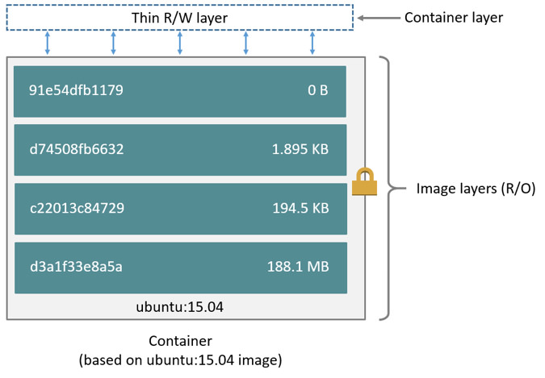
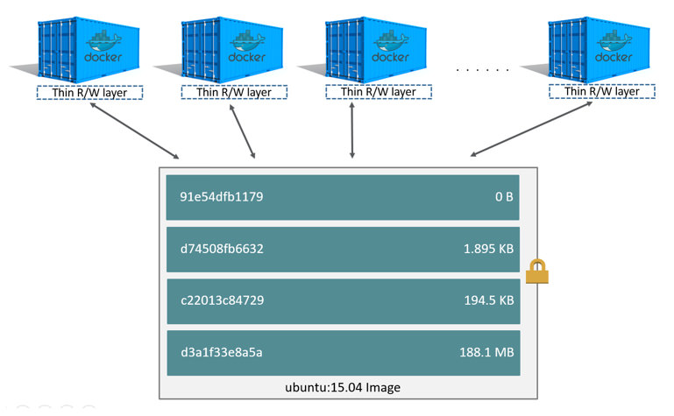
DOCKER IMAGES
Docker image is built from a series of layers
Each layer represents an instruction in the images Dockerfile
The major difference between an image and container is the top writable layer
All writes to container that add/modify existing data are written to this layer
docker image child-commands
docker image --help
build Build an image from a Dockerfile
history Show the history of an image
import Import the contents from a tarball to create a filesystem image
inspect Display detailed information on one or more images
load Load an image from a tar archive or STDIN
ls List images
prune Remove unused images
pull Pull an image or a repository from a registry
push Push an image or a repository to a registry
rm Remove one or more images
save Save one or more images to a tar archive (streamed to STDOUT by default)
tag Create a tag TARGET_IMAGE that refers to SOURCE_IMAGE
docker image inspect
docker image inspect nginx
Id: sha256 value… etc
To tease out specific we can grep
docker image inspect nginx | grep Hostname
Recommended way is with format command
docker image inspect --help
Usage: docker image inspect [OPTIONS] IMAGE [IMAGE...]
Display detailed information on one or more images
Options:
-f, --format string Format the output using the given Go template
docker image inspect nginx -f='{{.Id}}’
docker image inspect nginx -f='{{.ContainerConfig.Hostname}}’
docker image prune
Cleans up dangling images
Dangling images = Images without tags && not referenced by any container
docker image prune
docker image prune –a (unreferenced by container)
LAYERS
docker images
docker history image_name
Layers for any image you built will be in here in addition to the layers contained in your FROM base_image
RUN rm –f /root/file1.txt
will remove this file later in image build…. BUT… image size wont change as the earlier layers (pre rm) still require the file1.txt
Reduce layers using &&
RUN apt-get install nano
RUN apt-get install vim
Can be changed to:
RUN apt-get install nano && RUN apt-get install vim

Slide 6
Flattening docker images into a single layer to save space
docker container run -dt --name myubuntu ubuntu
docker ps
CONTAINER ID IMAGE COMMAND CREATED STATUS PORTS NAMES
29c79a5ddd8b ubuntu "/bin/bash" 28 seconds ago Up 27 seconds myubuntu
docker export myubuntu > myubuntudemo.tar
ls -l myubuntudemo.tar
-rwxrwxrwx 1 dhaggerty dhaggerty 75259904 Oct 8 14:45 myubuntudemo.tar
cat myubuntudemo.tar | docker import - myubuntu:latest
sha256:1919b54867d4af87e7070d9e53a1add09a79935a35da6109d64564a785e3f9f9
docker images
REPOSITORY TAG IMAGE ID CREATED SIZE
myubuntu latest 1919b54867d4 8 seconds ago 72.9MB ← ? same size ?
ubuntu latest 9140108b62dc 12 days ago 72.9MB
docker image history myubuntu
IMAGE CREATED CREATED BY SIZE COMMENT
1919b54867d4 2 minutes ago 72.9MB Imported from –
Docker registry
A registry is a stateless, highly scalable server-side application that stores and lets you distribute docker images
Docker Registry
Docker Trusted Registry
Private Repository (AWS ECR) Elastic Container Registry
Docker Hub
Run a local registry
docker run -d -p 5000:5000 --restart always --name registry registry:2
Then try and push custom image inside registry application
Format for tagging & pushing images to registries
docker tag my_image_name:latest dns_name/my_image_name
docker tag ubuntu:latest localhost:5000/myubuntu
docker images
REPOSITORY TAG IMAGE ID CREATED SIZE
myubuntu latest 1919b54867d4 About an hour ago 72.9MB
ubuntu latest 9140108b62dc 12 days ago 72.9MB
localhost:5000/myubuntu latest 9140108b62dc 12 days ago 72.9MB
registry 2 2d4f4b5309b1 3 months ago 26.2MB
docker push localhost:5000/myubuntu
docker pull localhost:5000/myubuntu
Push images to central registry
Lets push a busybox image to docker hub
Authentication required
docker pull busybox
docker login
docker tag busybox danhagg/mydemo:v1
docker images
REPOSITORY TAG IMAGE ID CREATED SIZE
danhagg/mydemo v1 6858809bf669 4 weeks ago 1.23MB
docker push danhagg/mydemo
To pull we will need to specify the version
docker pull danhagg/mydemo:v1
Docker Search
docker search nginx
docker search nginx --filter "is-official=true“
Moving images across hosts
docker save busybox > busybox.tar
docker load <busybox.tar
Docker build cache
Docker uses layer cache to optimize the process of building Docker images making it faster
Once a layer is changed all subsequent layers will be built NOT using cache

Slide 7
Networking
Docker networking subsystem is pluggable, using drivers. Several drivers are available by default:
bridge
host
overlay
none
Networking
To tease out specific we can grep

Slide 9
docker --help
Usage: docker [OPTIONS] COMMAND
A self-sufficient runtime for containers
Options:
--config string Location of client config files (default "/home/dhaggerty/.docker")
-c, --context string Name of the context to use to connect to the daemon (overrides DOCKER_HOST env var and default context set with "docker context use")
-D, --debug Enable debug mode
-H, --host list Daemon socket(s) to connect to
-l, --log-level string Set the logging level ("debug"|"info"|"warn"|"error"|"fatal") (default "info")
--tls Use TLS; implied by --tlsverify
--tlscacert string Trust certs signed only by this CA (default "/home/dhaggerty/.docker/ca.pem")
--tlscert string Path to TLS certificate file (default "/home/dhaggerty/.docker/cert.pem")
--tlskey string Path to TLS key file (default "/home/dhaggerty/.docker/key.pem")
--tlsverify Use TLS and verify the remote
-v, --version Print version information and quit
Management Commands:
app* Docker Application (Docker Inc., v0.8.0)
builder Manage builds
buildx* Build with BuildKit (Docker Inc., v0.4.2-tp-docker)
config Manage Docker configs
container Manage containers
context Manage contexts
engine Manage the docker engine
image Manage images
manifest Manage Docker image manifests and manifest lists
network Manage networks
node Manage Swarm nodes
plugin Manage plugins
secret Manage Docker secrets
service Manage services
stack Manage Docker stacks
swarm Manage Swarm
system Manage Docker
trust Manage trust on Docker images
volume Manage volumes

