Slide 1
BASICS
pytest.ini
[pytest]
addopts = --strict-markers
markers =
smoke: marks tests as smoke (deselect with '-m "not smoke"')
body: marks tests as body (deselect with '-m "not body"')
engine: marks tests as body (deselect with '-m "not engine"')
entertainment: marks tests as body (deselect with '-m "not entertainment"')
ui: marks tests as ui (deselect with '-m "not ui"')
serial
python_files = test_*
python_classes = *Tests
python_functions = test_*
Folders/Files
pytest.ini can be in app root /
Nest tests in test folder logically
put chromedriver.exe in venv/Scripts
Markers
@mark.body, @mark.engine
smoke tests: Minimum tests that need to be run after changes
pytest –m “body or engine” -v
pytest –m “body and engine” -v
pytest –m “not body” -v
classes can bundle together tests: avoids repetitive markers
pytest –markers
pytest -m ui -s -v
test_engine.py
from pytest import mark
@mark.smoke
@mark.engine
def test_engine_functions_as_expected():
assert True
Fixtures
Fixtures from conftest.py o not need to be imported to tests
Fixtures are best used for predictable, static data, for generating same data the same way each time. Tailored data generation can be obtained with regular python functions and customizable parameters.
If a fixture is scoped at function level and two different classes call it then a different object will be created for each call.
yield performs teardown
test_body.py
from pytest import mark
@mark.body
class BodyTests:
@mark.ui
def test_navigate(self, chrome_browser):
my_browser = chrome_browser
my_browser.get('https://www.google.com')
assert True
@mark.smoke
def test_body_door(self):
assert True
def test_bumper(self):
assert True
def windshield(self):
assert True
conftest.py
from pytest import fixture
from selenium import webdriver
@fixture(scope='function')
def chrome_browser():
browser = webdriver.Chrome()
yield browser
print('Tearing down browser')
no import needed for fixture

Slide 2
REPORTS
An advantage of pytest is that it has many plugins…
pip install pytest-html
pytest –html=“results.html”
pytest –junitxml=“results.xml” (useful in Jenkins)
In Jenkins
cd tests
pytest –junitxml=“BUILD_${BUILD_NUMBER}_results.xml”
Add post build action
Publish Junit test result report
Test report XMLs tests.results*.xml

Slide 3
CONFIG RECIPE
conftest.py
from pytest import fixture
from config import Config
# parser is part of pytest
def pytest_addoption(parser): # adds option view in pytest -h
'''preferable to add longer options, doubledashed'''
parser.addoption(
'--env',
action='store',
help='Environments to run tests against'
)
# Anytime someone uses fixture get me env
@fixture(scope='session')
def env(request): # request is part of pytest, holds info from command line
return request.config.getoption('--env')
# reusable recipe for config
@fixture(scope='session')
def app_config(env): # A fixture can use a fixture
cfg = Config(env) # we dont want to hardcode and env
return cfg # config is reserved word in pytest
config.py
class Config:
def __init__(self, env): # promise to supply an env
'''A simple switch here between dev and qa means testing
can take place in entirely different environments'''
SUPPORTED_ENVS = ['dev', 'qa']
if env.lower() not in SUPPORTED_ENVS:
raise Error(f'{env} is not a supported env (
supported envs = {SUPPORTED_ENVS})'
)
self.base_url = {
'dev': 'https://mydev-env.com',
'qa': 'https://myqa-env.com',
}[env]
self.app_port = {
'dev': 8080,
'qa': 80,
}[env]
get correct config with env
uses env fixture and request --env
config depending upon env
get conftest fixture without import
test_environment.py
def test_environment_is_qa(app_config):
base_url = app_config.base_url
port = app_config.app_port
assert base_url == 'https://myqa-env.com'
assert port == 80
def test_environment_is_dev(app_config):
base_url = app_config.base_url
port = app_config.app_port
assert base_url == 'https://mydev-env.com'
assert port == 8080
we would not normally assert config settings
would test something else

Slide 4
SKIPPING
EXPECTED FAILURES
If your skipping a test for long-period of time that test probably doesn’t belong in that suite
The more skips/failures in test runs the more explanations to fellow devs and weak confidence
Thus, Skips should be used sparingly
Tests are skipped with another imported mark
from pytest import mark
@mark.xfail(reason='env not qa')
def test_environment_is_qa(app_config):
base_url = app_config.base_url
port = app_config.app_port
assert base_url == 'https://myqa-env.com'
assert port == 80
@mark.skip(reason="Broken, fixing next sprint")
def test_this_needs_work():
assert False
def test_environment_is_dev(app_config):
base_url = app_config.base_url
port = app_config.app_port
assert base_url == 'https://mydev-env.com'
assert port == 8080
test_environment.py
from pytest import mark
@mark.skip(reason="broken by deploy #4")
def test_environment_is_qa(app_config):
base_url = app_config.base_url
port = app_config.app_port
assert base_url == 'https://myqa-env.com'
assert port == 80
def test_environment_is_dev(app_config):
base_url = app_config.base_url
port = app_config.app_port
assert base_url == 'https://mydev-env.com'
assert port == 8080
def test_environment_is_staging(app_config):
base_url = app_config.base_url
assert base_url == 'staging'
pytest --env dev -v –rsx …. # x is xfail
============================= test session starts ===================
platform win32 -- Python 3.6.5, pytest-3.5.1, py-1.5.3, pluggy-0.6.0 -- c:\users\dhaggerty\appdata\local\programs\python\python36-32\python.exe
cachedir: .pytest_cache
rootdir: C:\apps_other\pytest_config, inifile: pytest.ini
plugins: cov-2.5.1, dash-1.0.2
collected 3 items
tests/test_environment.py::test_environment_is_qa xfail [ 33%]
tests/test_environment.py::test_this_needs_work SKIPPED [ 66%]
tests/test_environment.py::test_environment_is_dev PASSED [100%]
=========================== short test summary info =================
XFAIL tests/test_environment.py::test_environment_is_qa
env not qa
SKIP [1] tests\test_environment.py:11: Broken, fixing next sprint
=============== 1 passed, 1 skipped, 1 xfailed in 0.46 seconds ===========
pytest --env dev -v –rs
where… -r read more… s skips
============== short test summary info =============
SKIP [1] tests\test_environment.py:3: broken by deploy #4
====== 1 failed, 1 passed, 1 skipped in 0.50 seconds =====
Can add –r to config file to make sure runs everytime

Slide 5
CROSS-BROWSER & DATA-DRIVEN TESTS: PARAMETRIZE
3
test_data.json
[
"Sony",
"Samsung",
"Vizio"
]
Parameterization: running same tests with different data/input without duplicating tests/code
On fly (not ideal – see below as have to keep pasting parameters in for all test cases)
Test against multiple browsers
Data driven tests (from json files)
@mark.parametrize (parametrize is a key word in pytest)
1
conftest.py
from pytest import fixture
import json
# must call pytest from tests dir for this path to work
data_path = 'test_data.json'
# the 'path' would normally be in config
def load_test_data(path):
with open(path) as data_file:
data = json.load(data_file)
return data
# we can call load_test_data as a param as it returns a list
@fixture(params=load_test_data(data_path))
def tv_brand(request):
data = request.param
return data
test_television.py
from pytest import mark
# parametrize takes a string then an iterable
@mark.parametrize('tv_brand', [
('Samsung'),
('Sony'),
('Vizio'),
]
)
def test_television_turns_on(tv_brand):
print(f'{tv_brand} turn on as expected')
pytest -v -s
2
test_television.py
from pytest import fixture
from seleium import webdriver
# By adding 'params' as an arg to fixture decorator we imply that...
# Any test using this feature will run onve per parameter supplied
# this way you can test multiple browser across ALL your tests
@fixture(params=[webdriver.Chrome, webdriver.Firefox, webdriver.Edge])
def browser(request):
driver = request.param
drvr = driver()
yield drvr # shuts down when done
drvr.quit()
test_television.py
def test_television_turns_on(tv_brand):
print(f'{tv_brand} turn on as expected')
pytest -v -s
test_television.py::test_television_turns_on[Sony] Sony turn on as expected
PASSED
test_television.py::test_television_turns_on[Samsung] Samsung turn on as expected
PASSED
test_television.py::test_television_turns_on[Vizio] Vizio turn on as expected
PASSED

Slide 6
FAST-TESTING Pytest-xdist and parallel vs Concurrent
tests run in threads are concurrent
tests run in processes are in parallel AND concurrent
gil means that only one task can be handled at once
pip install pytest-xdist
import time
def test_result_1_completes_as_expected():
time.sleep(5)
print('Result 1 has completed')
def test_result_2_completes_as_expected():
time.sleep(5)
print('Result 2 has completed')
def test_result_3_completes_as_expected():
time.sleep(5)
print('Result 3 has completed')
def test_result_4_completes_as_expected():
time.sleep(5)
print('Result 4 has completed')
THREADS
PROCESSES
Google
API Call
complete
complete
complete
No real shared memory
3 processes (3 cores)
pytest -s -v –n8 # n comes with xdist ~ number of processes
pytest -s -v –nauto # detects your process number
Can also spin up more threads as necessary
i/o bound.
When we are waiting for someone else we can switch our task.
Can spin up threads as much as your memory can support
CANNOT use this method if tests depend on other tests
These tests must be 100% isolated

Slide 7
WRITING UNIT TESTS (White box testing)
titlecase/titlecase.py
NON_CAPS = [
'a',
'an',
'the',
'and',
'but',
'or',
'for',
'on',
'at',
'to',
]
def title_case(text):
text = text.lower() # Start from a known state
tokens = text.split(' ')
capitalized_tokens = []
for t in tokens:
if t and t not in NON_CAPS:
processed = t[0].upper() + t[1:]
elif t and t in NON_CAPS:
processed = t # Remain lower-case
else:
processed = '' # Leave out blanks
capitalized_tokens.append(processed)
return ' '.join(capitalized_tokens)
Unit tests can be kept right next to the code that it will be testing
Unit tests require no dependencies usually. A very small scope.
Convention is to use tests folder, and should be outside the downloadable folder.
This way whenever we bundle up an installable programe then tests can be ignored
tests folder should mimic/reflect the apps actual layout
So, we cd to tests file and run pytest… But we get import errors, the problem is python paths
Pytest detects a pytest.ini file in current tests folder.
Pytest believes tests to be root dir and therefore searches from this root dir for the titlecase module.
But, that module is outside of the tests folder. So, we get import errors.
There are 3 ways around this issue:
Give tests access to titlecase, elegantframeworks dir has access to titlecase
  Then run pytest as a module
  python -m pytest → no tests run as no ini file in this dir
  python -m pytest tests → we have to tell it the dir to look in
Install pytest library in extended mode
  Go to dir above tests
  pip install –e . # this installs all modules (requires the setup.py file)
  pip list → shows elegantcasing module installed extended style
  cd back to tests and run as
    pytest
tox (see next page)
tests/test_titlecase.py
from titlecase import title_case
class TitleCaseTests:
def test_lower_text_is_uppercased_correctly(self):
initial_text = 'this should be capitalized'
expected_text = 'This Should Be Capitalized'
returned_text = title_case(initial_text)
assert returned_text == expected_text

Slide 8
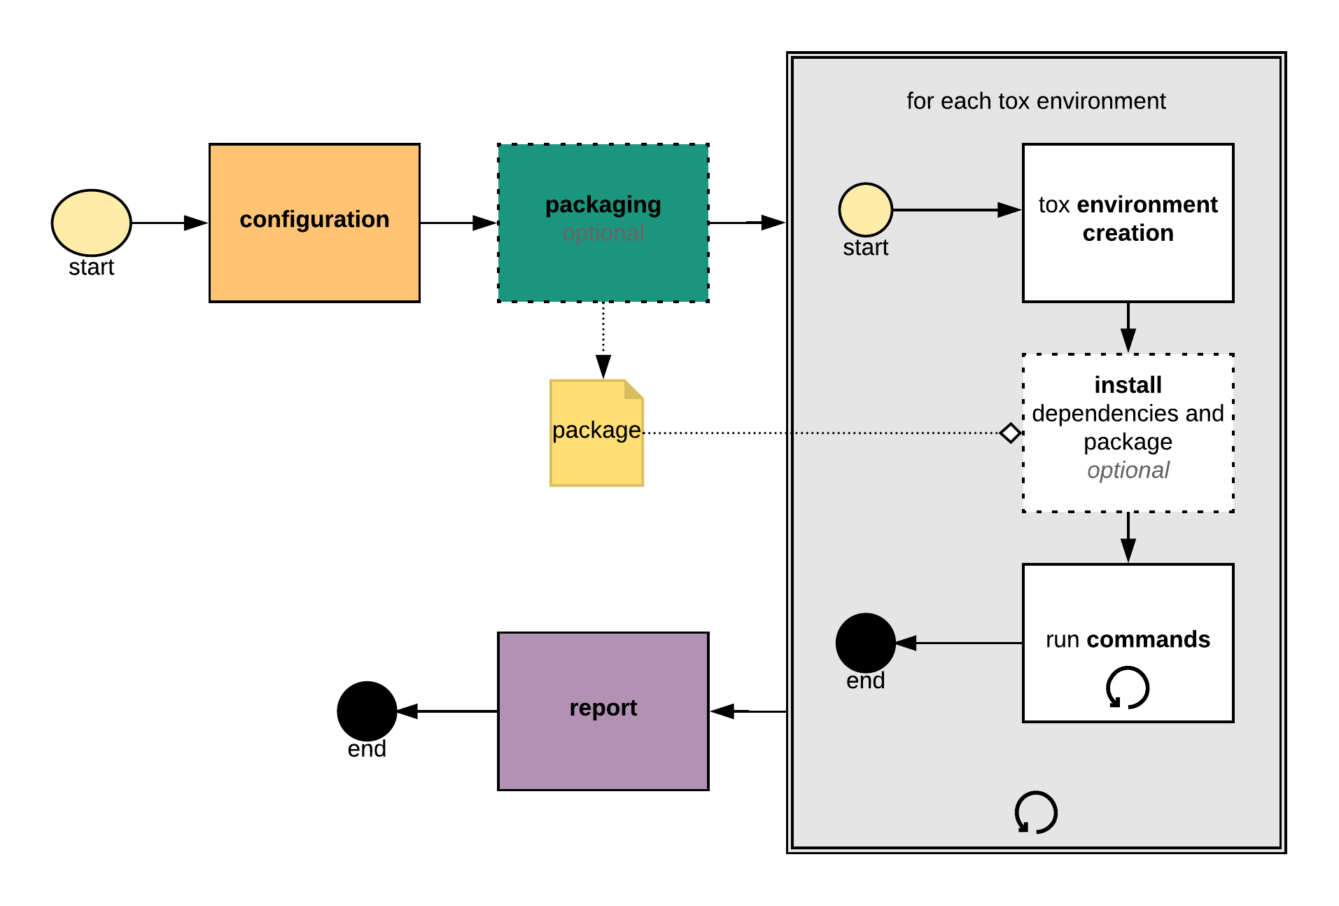
RUNNING UNIT TESTS WITH TOX
tox can test your library and handle all configuration of testing
Creates separation of concern library from tests
For example, pip installing pytest shouldn’t be necessary for using the module.
Pytest is only there for testing. The test folder and all dependencies are not part of the main library we’ve built.
Tox can test against multiple environments all in one go (eg also python 2.7, and 3.6 etc
Tox handles virtual environments for you.
So, deactivate current venv and pip install tox to base python install
Create a tox.ini in root directory
We also assume there is a standard setup.py file in root
From root folder run
tox
A .tox file is created in root. Contains a new virtual env ‘py36’ and installs some packages INCLUDING pytest and elegantcasing/titlecase
With the current dir setup/config situation the run should fail. this is because pytest.ini is in tests folder.
As tox can integrate with pytest library and its ini information that pytest.ini content can be copied directly into the tox.ini file
tox.ini
[tox]
envlist = py36
[testenv]
deps = pytest
commands =
pytest
[pytest]
python_files = test_*
python_functions = test_*
python_classes = *Tests
testpaths = tests

Slide 9
WRITING FUNCTIONAL TESTS (Black/Grey box testing)
For functional testing place pytest.ini outside test dir
pytest.ini
[pytest]
python_files = test_*
python_classes = *Tests
python_functions = test_*
import requests
def test_twitter_is_present():
resp = requests.get('https://techstepacademy.com/training-ground')
assert 'twitter' in resp.text
def test_get_succesful_response():
resp = requests.get('https://techstepacademy.com/training-ground')
assert resp.status_code == 200

Slide 10
POSTGRES
pip install pytest-postgresql

Slide 11
JENKINS
SELENIUM

