Slide 1
Anagrams
Code Kata

Slide 2
Task
Given a file containing one word per line
Print out all the combinations of words that are anagrams
Solution should run in under 10 seconds

Slide 3
Example
Input – smallwordlist.txt | Output - Console
cat act dog stop god pictures at piecrust | act cat cat act dog god god dog pictures piecrust piecrust pictures

Slide 4
Bonus Example
Input – smallwordlist.txt | Output - Console
cat act dog stop god pictures at piecrust | act cat dog god pictures piecrust

Slide 5
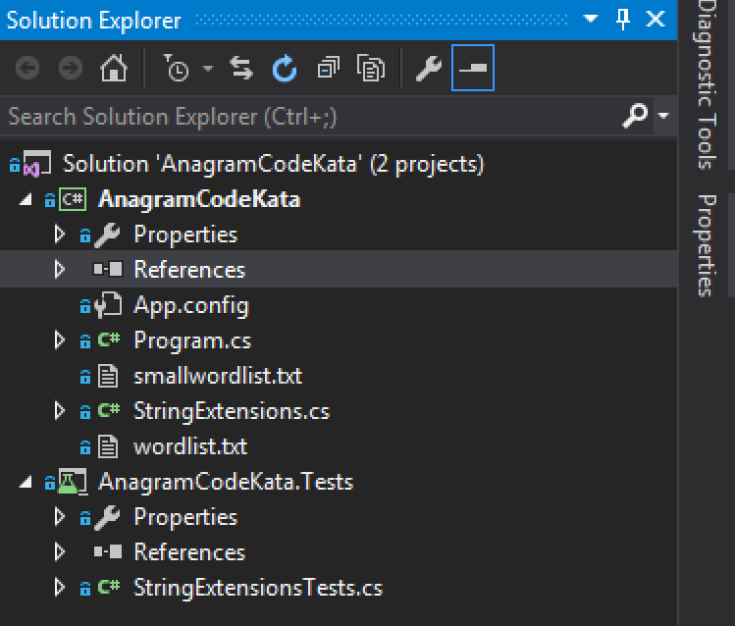
Project Template
Clone https://github.com/orangudan/AnagramCodeKata

Slide 6
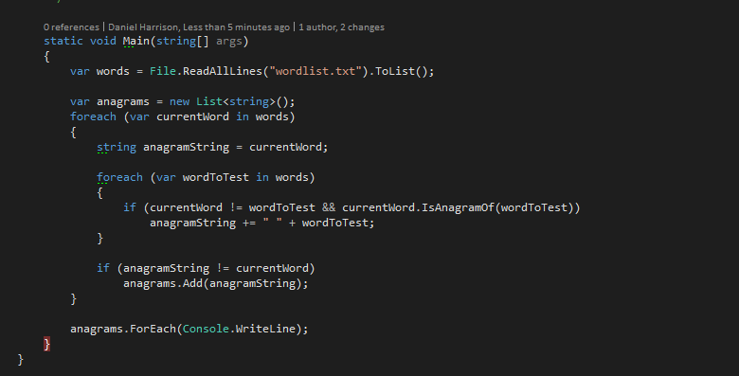
Example Solution

Slide 7
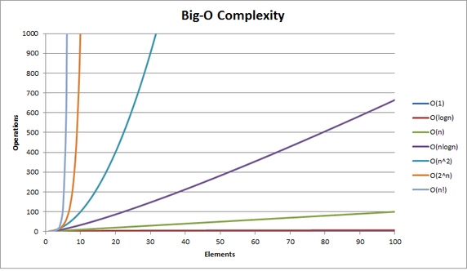
O(n^2)

Slide 8
Join Slack
Join #kata on Slack so you can ask questions when we split up into groups around the office

