Slide 1
RRRADDD!
RIDICULOUSLY RAPID DOMAIN-DRIVEN (AND RESTFUL) APPS WITH APACHE ISIS

Slide 2
Or…

Slide 3
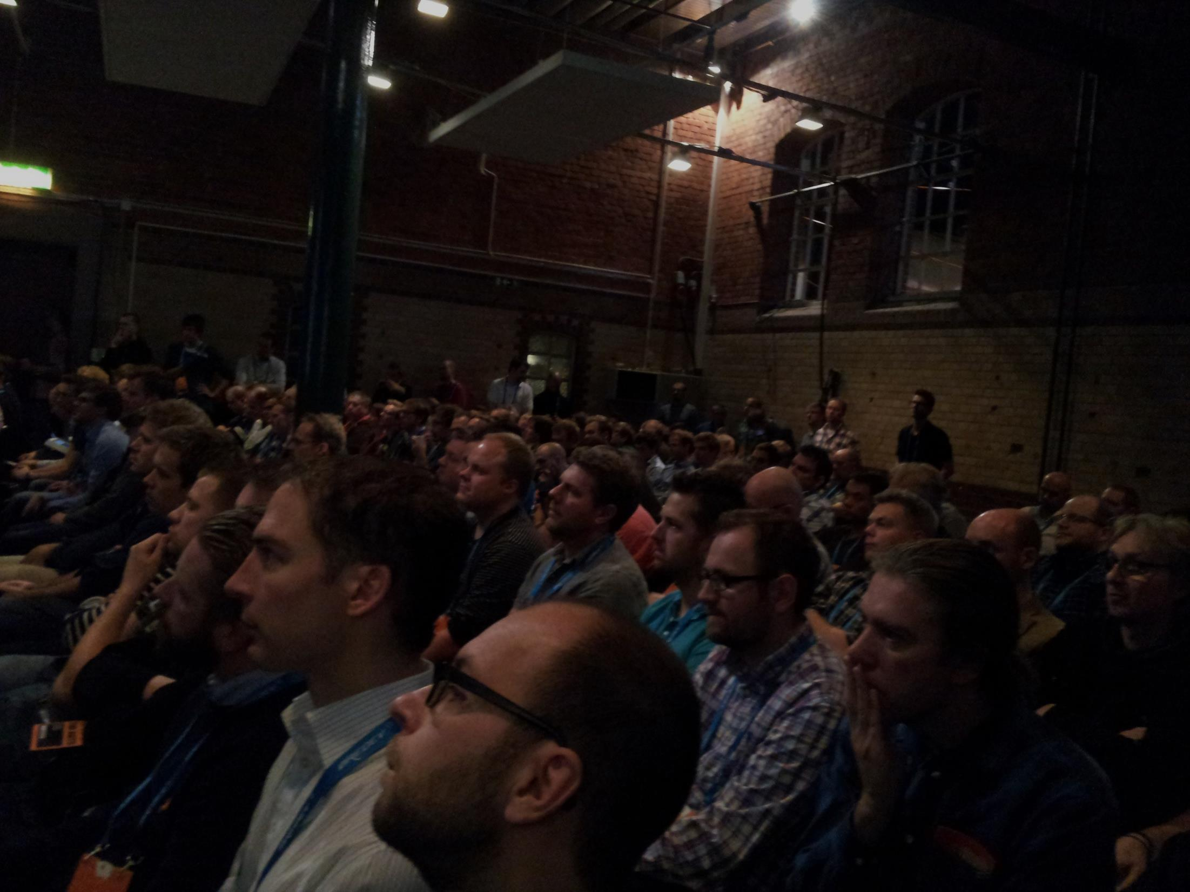
How to eliminate those harmful layers
WITH APACHE ISIS

Slide 4

Domain driven design
Ubiquitous Language
With a conscious effort by the team, the domain model can provide the backbone for that common language

Slide 5

NAKED OBJECTS
An architectural pattern
A principle
“Problem solver, not process follower”

Slide 6

Don’t repeat yourself
UI corresponds to the domain objects
Object instances exposed as web pages
or as RESTful representations
Object actions exposed as links/buttons
Or hypermedia controls

Slide 7
mvn archetype:generate \
-D archetypeGroupId= \ org.apache.isis.archetype \
-D archetypeArtifactId= \ simple_wicket_restful_jdo-archetype \
-D archetypeVersion=1.3.1 \
-D groupId=com.mycompany \
-D artifactId=myapp \
-D version=1.0-SNAPSHOT \
-B

Slide 8
domain objects

Slide 9
domain objects
JDO

Slide 10
layout
domain objects
JDO

Slide 11
CSS
layout
domain objects
JDO

Slide 12
CSS
layout
domain objects
JDO
widgets

Slide 13
CSS
view models
layout
domain objects
JDO
widgets

Slide 14
view models
REST
domain objects
JDO

Slide 15
view models
BDD
domain objects
JDO

Slide 16
Summing up...
Focus on the domain
Iterate, build your ubiquitous language
Add in other layers as you need them
Either
stay within (and customize) Isis’ Wicket viewer
Or
go mad and build your own UI to the REST API

Slide 17
This presentation and demo code
github.com/danhaywood/rrraddd-isis-131
Apache Isis
isis.apache.org
restfulobjects.org
RESTful clients
github.com/NakedObjectsGroup/spiro/wiki/Introduction-to-Spiro
Dan Haywood
danhaywood.com
@dkhaywood

