Slide 1
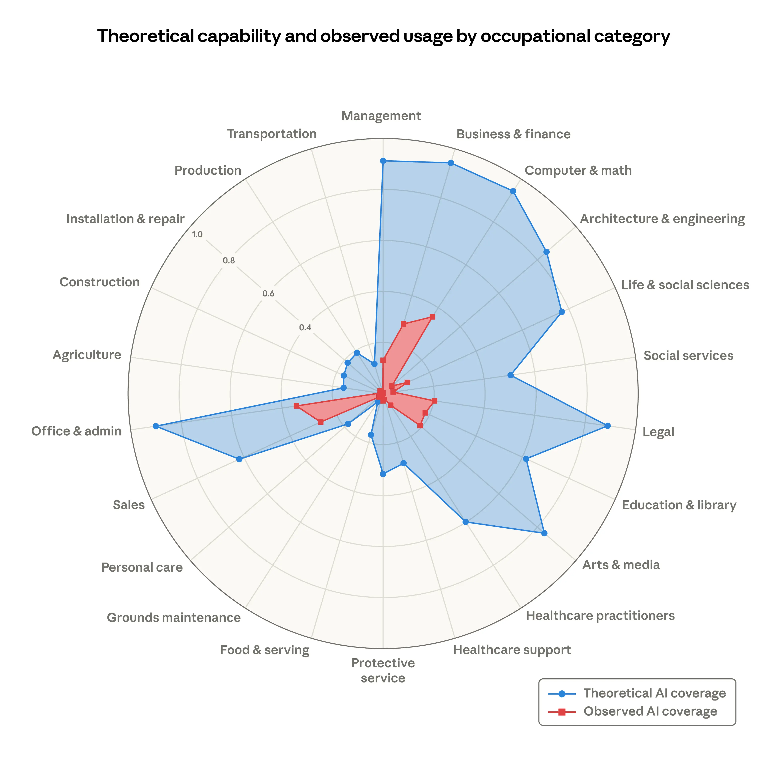
Notes:
Labor market impacts of AI: A new measure and early evidence, March 2026
https://www.anthropic.com/research/labor-market-impacts

