Slide 1
one-sided unsupervised domain mapping

Slide 2
Style transfer
Generative Adversarial Networks
Supervised Mapping
Domain adaptation
Unsupervised Mapping
Weakly Supervised Mapping
Công việc liên quan

Slide 3


Slide 4
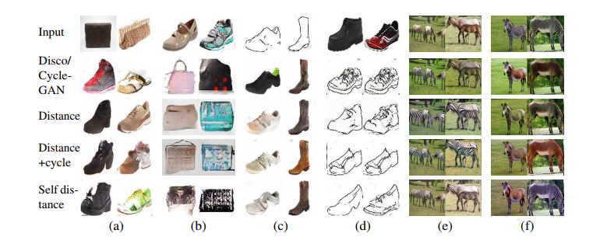

Slide 5
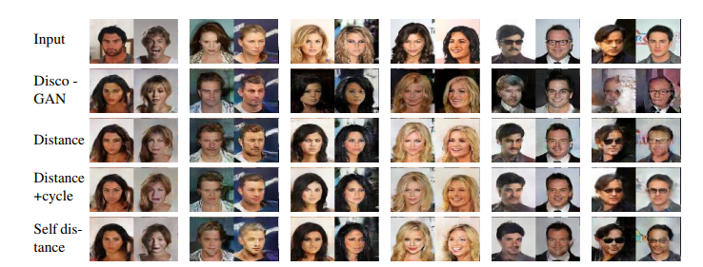

Slide 6
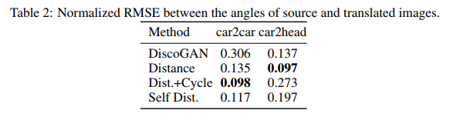
3. thử Nghiệm
3.1. DiscoGAN

Slide 7
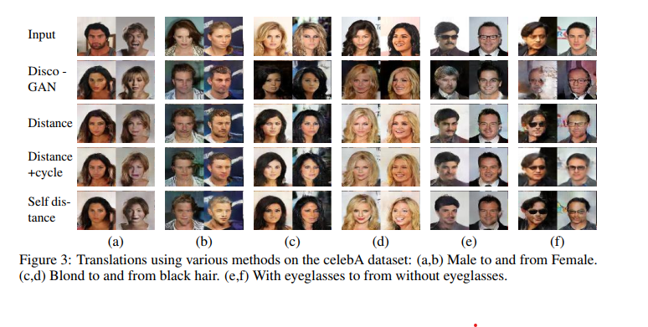

Slide 8
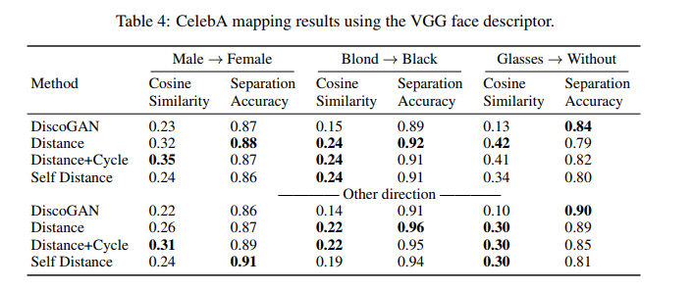

Slide 9
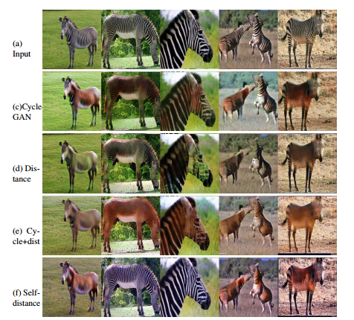
3.2. CycleGAN

Slide 10
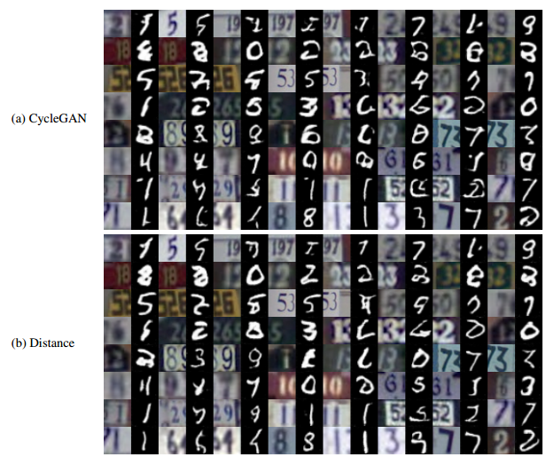
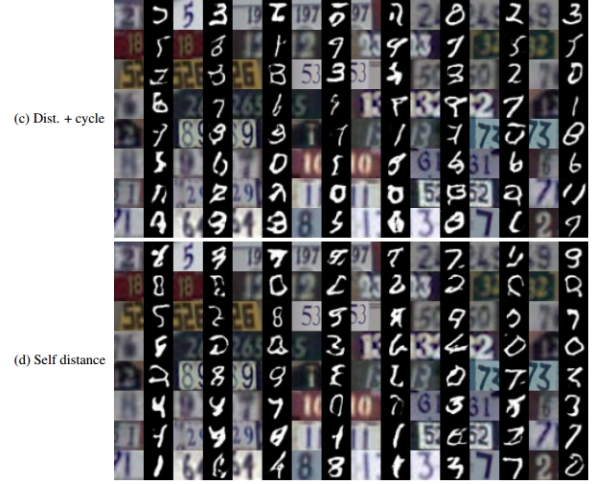
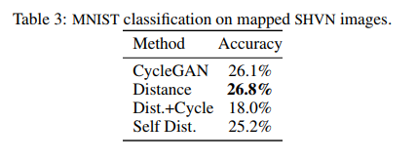

Slide 11
