Slide 1

Gender Classification
Danh Nguyen

Slide 2
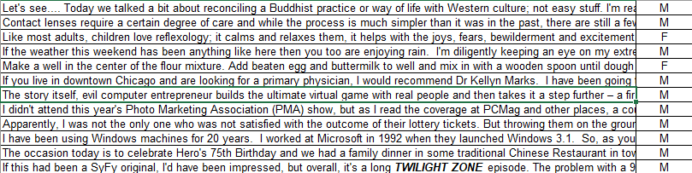
Dataset

Slide 3
Baseline
Inputs: unigram, no stop words, no stem
Logistic Regression: (acc) = 0.62441
Naive Bayes: (acc) = (0.58666)

Slide 4
Factor analysis
Topic 1: know, people, life, just, don,…
Topic 2: nbsp, raw, little, like, lowercase,…
Topic 3: game, baseball, cards, topps, games,…
Topic 4: time, day, got, went, little,…
Topic 5: health, care, insurance, obama, government,…
Topic 6: school, lunch, food, students, eat,…
Topic 7: women, men, weight, fat, muscle,…
Topic 8: friend, ur, person, best, guy,…
Topic 9: blog, book, post, new, read,…
Topic 10: google, social, web, mobile, twitter,…
Logistic Regression: (acc) = 0.61311
Naive Bayes: (acc) = 0.6059

Slide 5
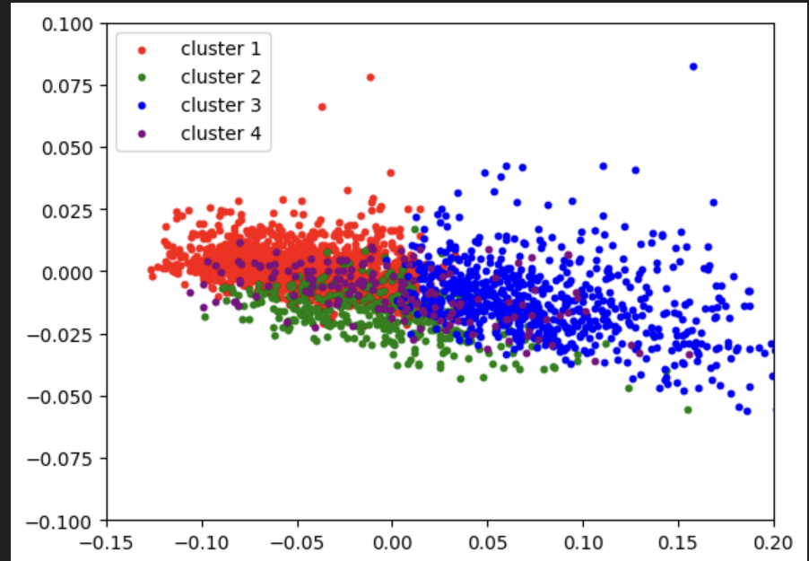
Clustering blogs into topics
Naïve Bayes (acc) = 0.55969
Regression (acc) = 0.59311

Slide 6
Future work
Fine tune models
Deeper analysis of factor analysis
Neural network for clustering

