Slide 1



Double-Double laminates for improved impact and post-impact resistance
Dongwon Lee
Avin Vijay

Slide 2
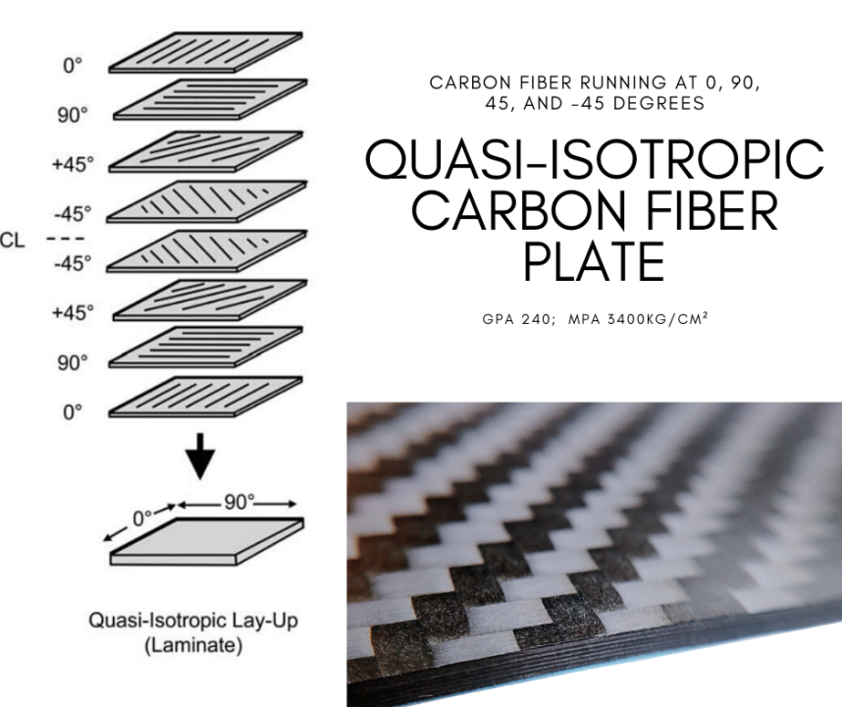
Quasi-isotropic laminates
What is quasi-isotropic laminates?
Quasi-isotropic
Quasi means “almost” and Isotropic means that material that behaves the same in all direction.
Why do we need Quasi-isotropic?
Design
Only using 0, 45, -45, 90 orientation
Lacking rational basis– extension of isotropic mechanics
Weight penalty

Slide 3
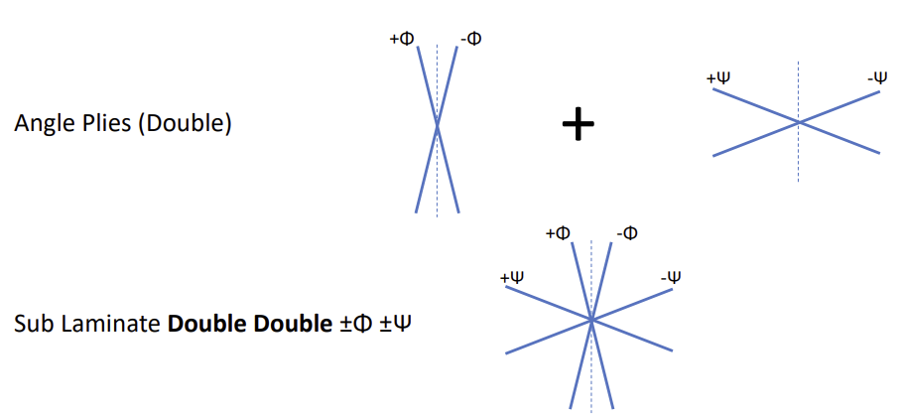
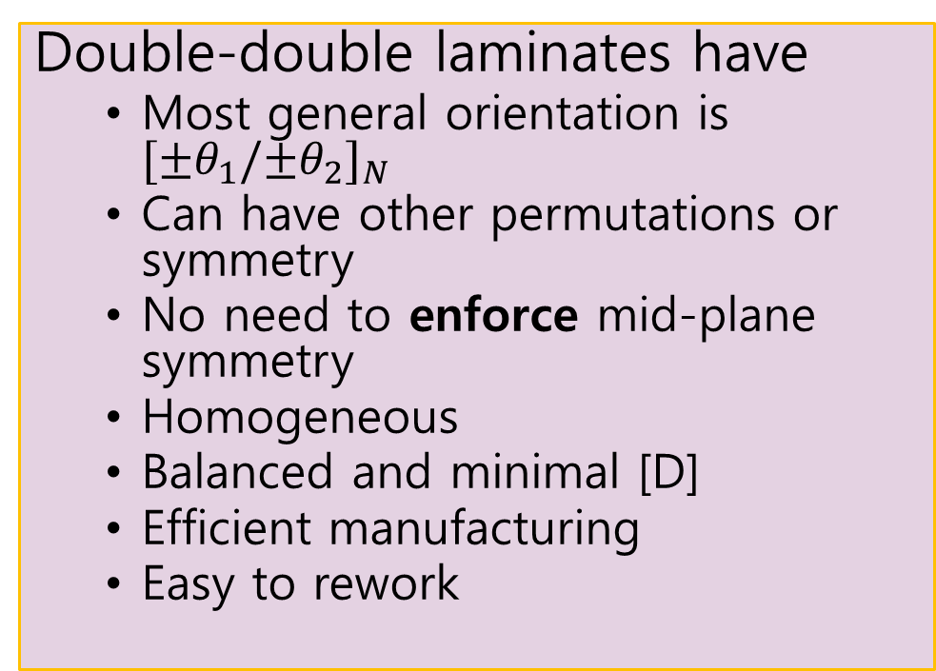
Double-Double (DD) Laminates
What are double-double laminates and its benefits?
Double-double laminates have
Most general orientation is ${[±θ_{1}/{±θ}_{2}]}_{N}$
Can have other permutations or symmetry
No need to enforce mid-plane symmetry
Homogeneous
Balanced and minimal [D]
Efficient manufacturing
Easy to rework

Slide 4
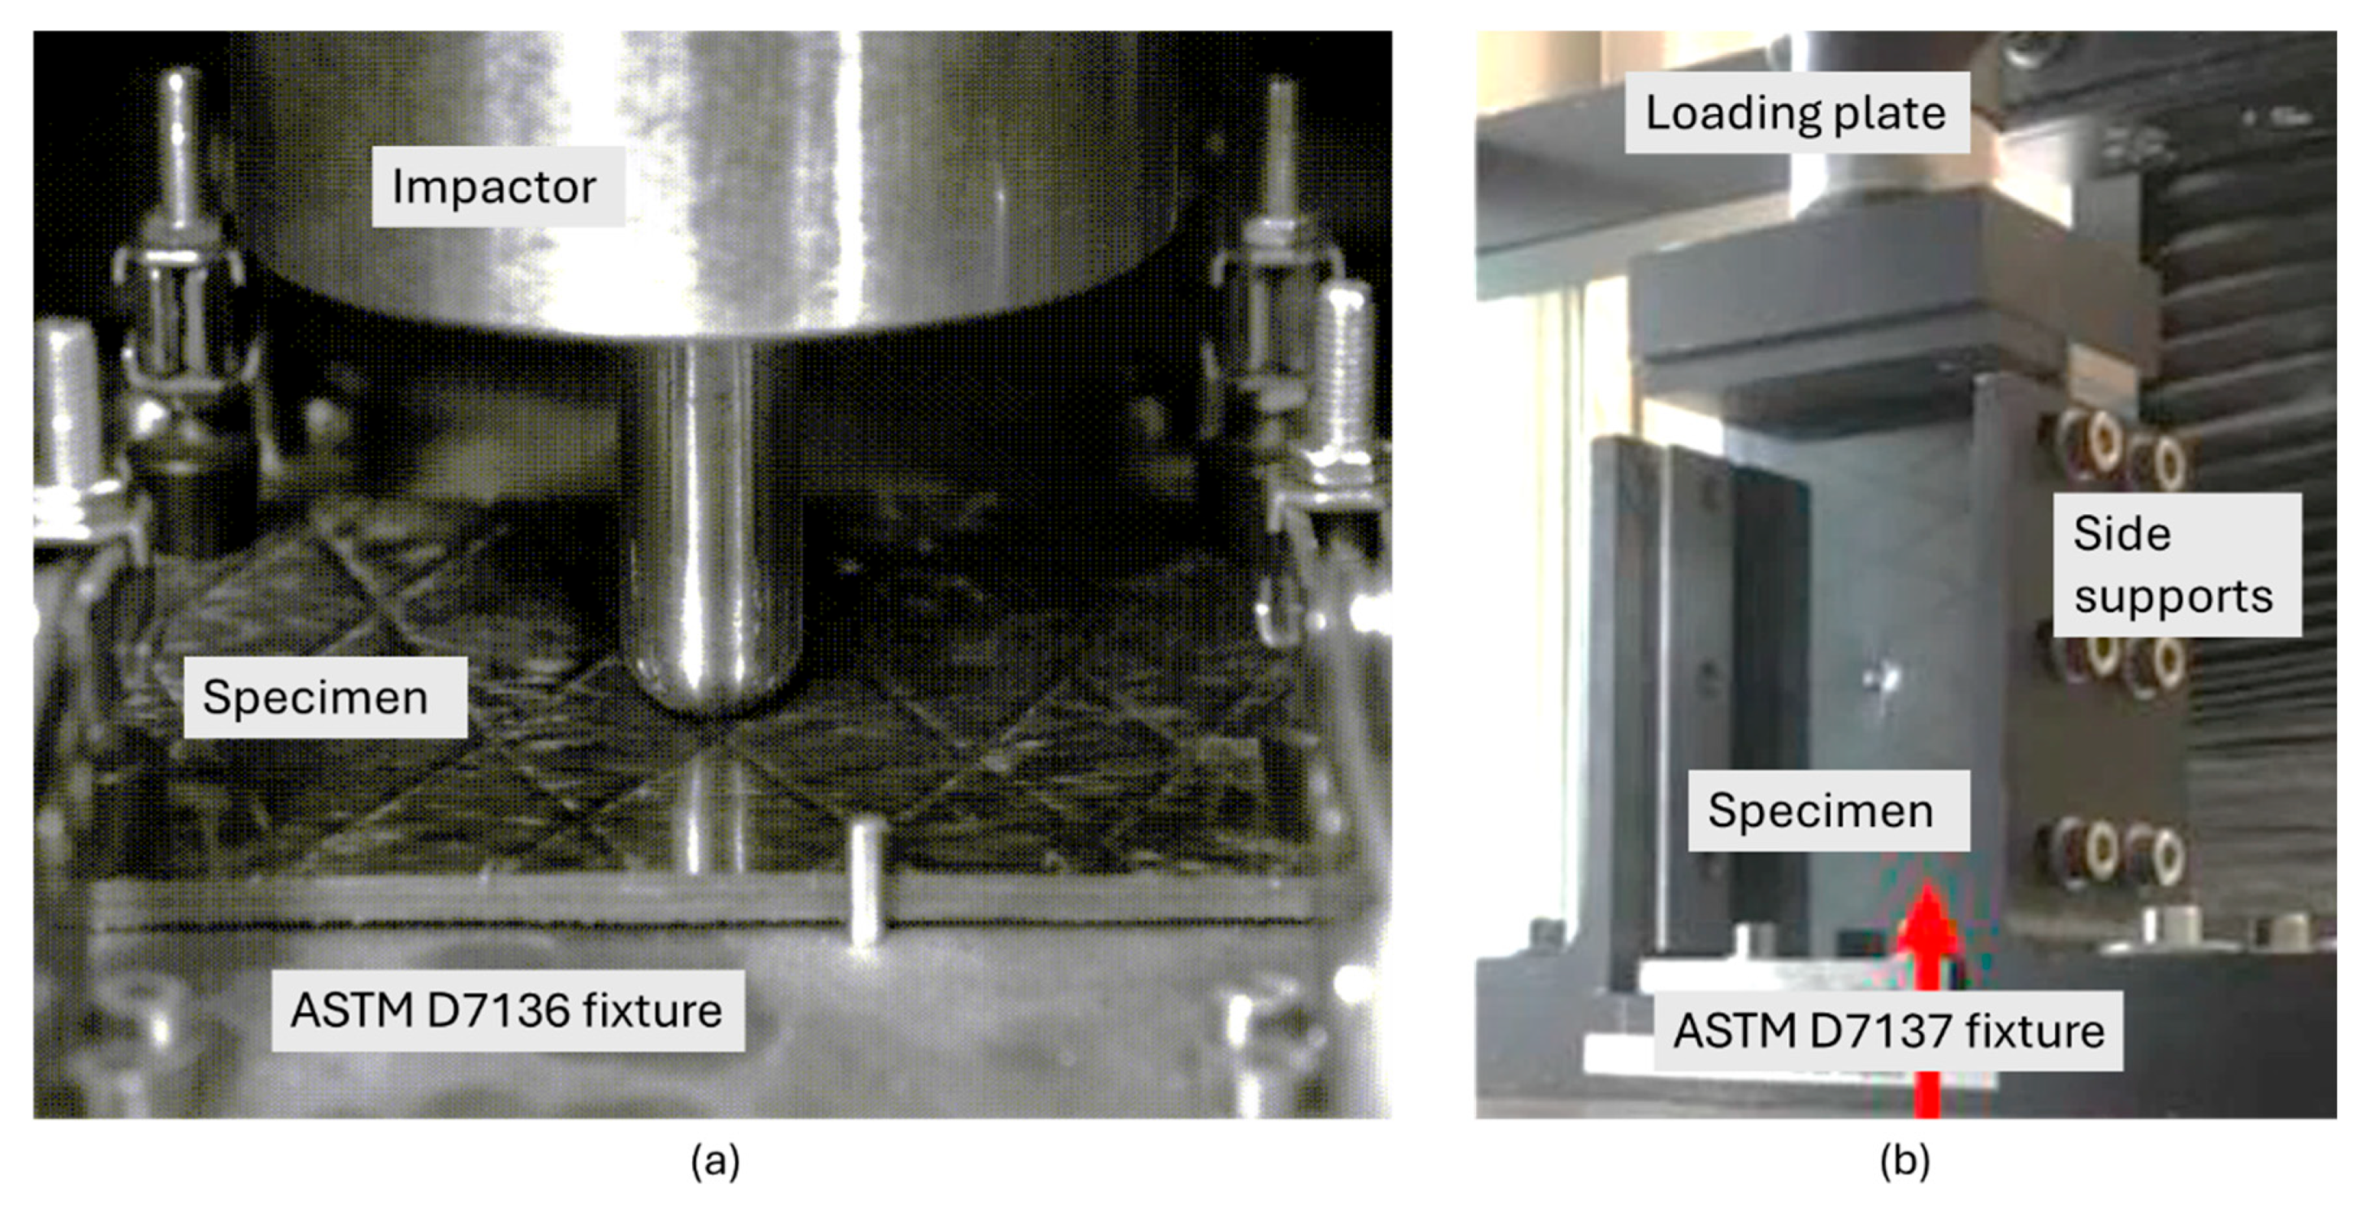
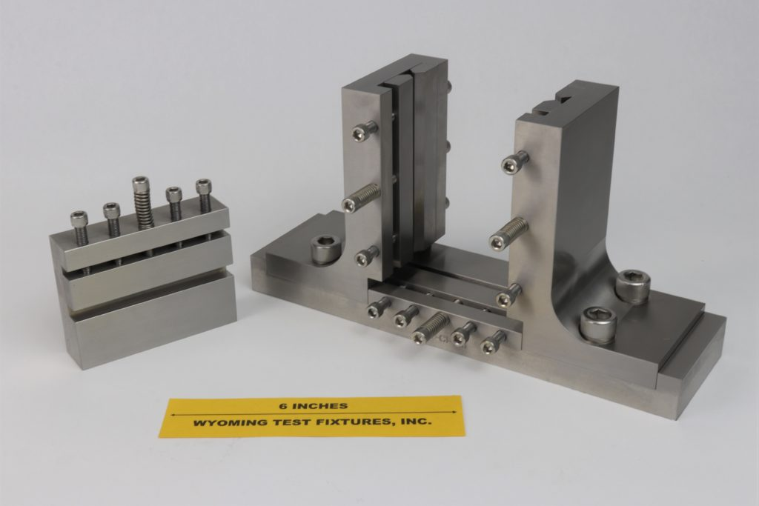
Impact and Compression After Impact
Low velocity impact/ BVID- typical to occur in service like tool drops.
The CAI test simulates real-world damage scenarios that could occur in service.
The goal is to evaluate how much compressive load a composite laminate can carry after sustaining such damage
Two stages
Impact stage
Compression stage

Slide 5
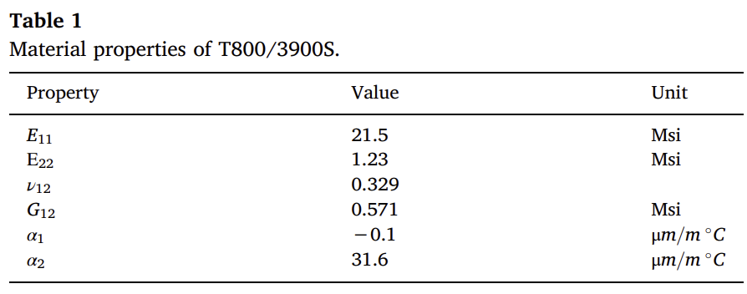








Mechanics Problem
A flat, rectangle panel
6 in x 4 in
Simply supported on lateral edges
Clamped at x=0,a
Load applied from x=a
Material Properties
Toray T800/3900S
Each lamina will have thickness of 0.0075 in
$$y,w$$
$$ss$$
$$N_{x}$$
$$b$$
$$ss$$
$x,$u
$$z,w$$
$$a$$

Slide 6
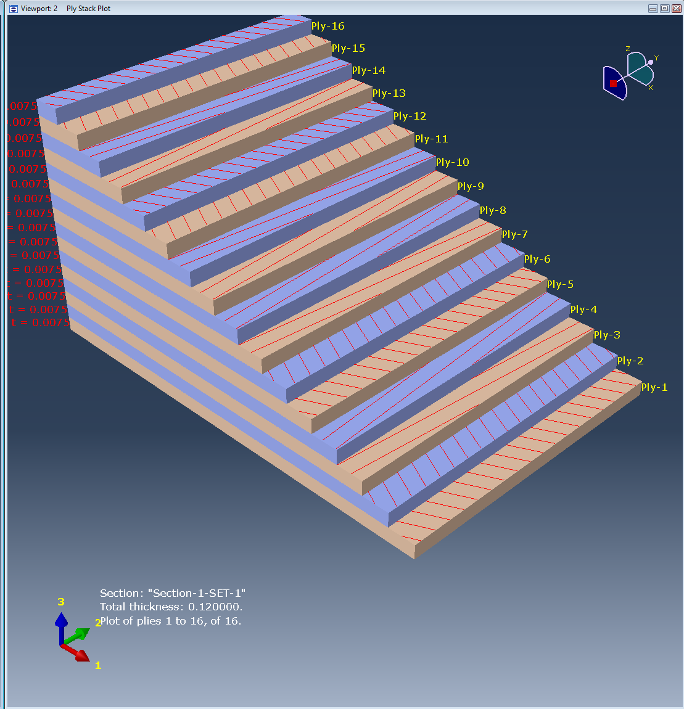


$DD$and $D\overline{D}$ Orientations
Total of 16 plies
3 different cases
Case 1 : ${[±θ_{1}/{±θ}_{2}]}_{4}$
Case 2 : ${[{±θ}_{1}/{±θ}_{2}{/∓θ}_{1}/{∓θ}_{2}]}_{2}$
Case 3 : $[{{(±θ}_{1}/{±θ}_{2})}_{2}/$ ${{(∓θ}_{1}/{∓θ}_{2})}_{2}]$

Slide 7
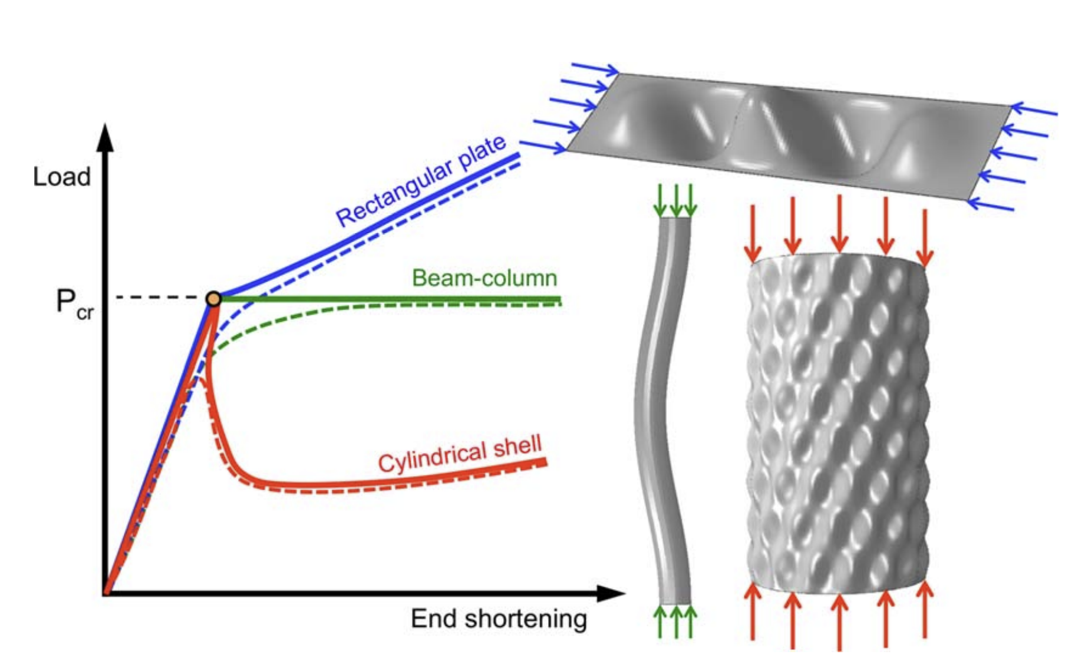
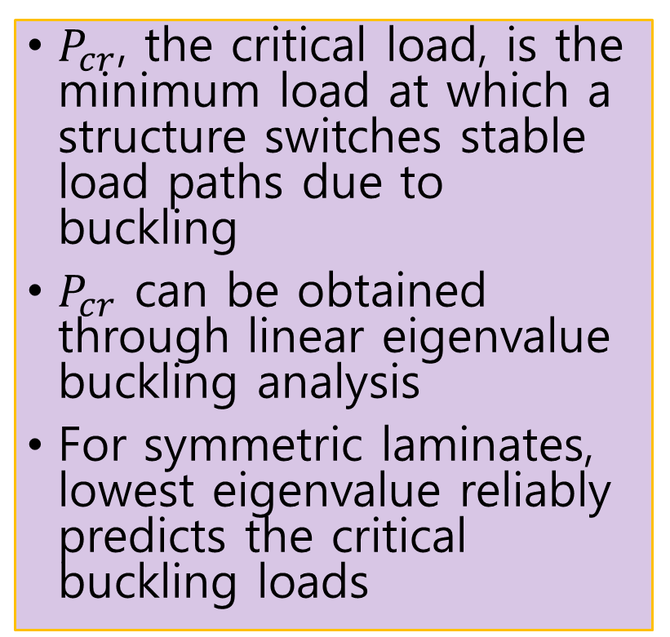
Buckling vs. Transition Loads
$P_{cr}$, the critical load, is the minimum load at which a structure switches stable load paths due to buckling
$P_{cr}$ can be obtained through linear eigenvalue buckling analysis
For symmetric laminates, lowest eigenvalue reliably predicts the critical buckling loads
Load vs end-shortening
Solid line
Ideal (perfect) structure
Theoretical equilibrium path is symmetric
Dashed line
Real (imperfect) structure
Realistic response with small initial imperfections or load eccentricity

Slide 8
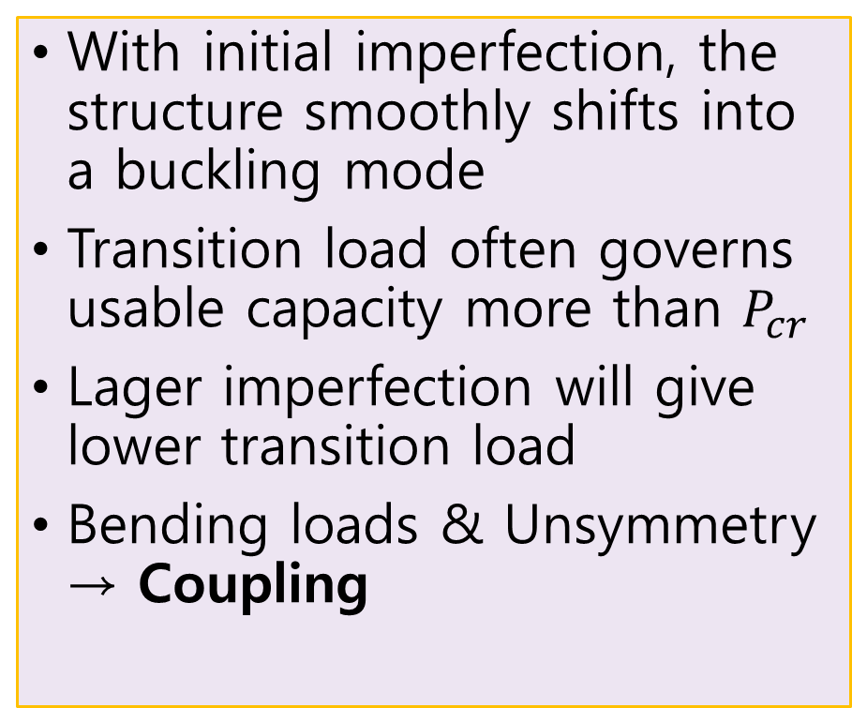
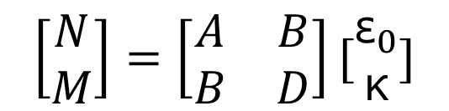
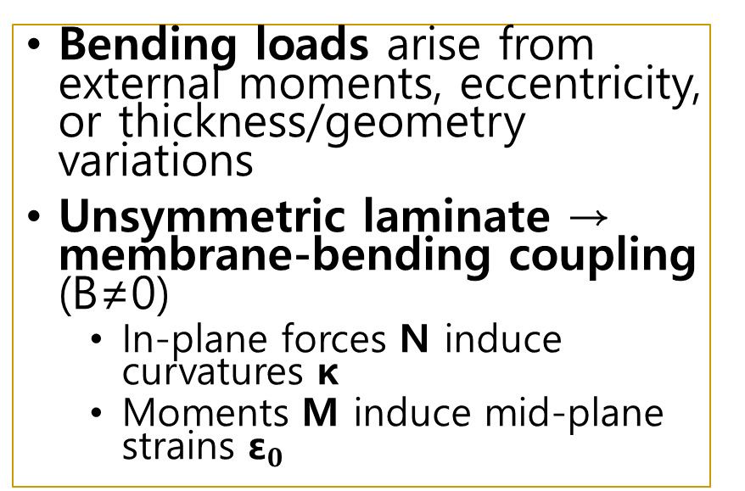
Transition Loads
With initial imperfection, the structure smoothly shifts into a buckling mode
Transition load often governs usable capacity more than $P_{cr}$
Lager imperfection will give lower transition load
Bending loads & Unsymmetry → Coupling
Bending loads arise from external moments, eccentricity, or thickness/geometry variations
Unsymmetric laminate → membrane-bending coupling (B≠0)
In-plane forces N induce curvatures κ
Moments M induce mid-plane strains ${\text{ε}}_{0}$
$$\left[\begin{matrix}N \\ M\end{matrix}\right]=\left[\begin{matrix}A & B \\ B & D\end{matrix}\right][\begin{matrix}{\text{ε}}_{0} \\ \text{κ}\end{matrix}]$$

Slide 9
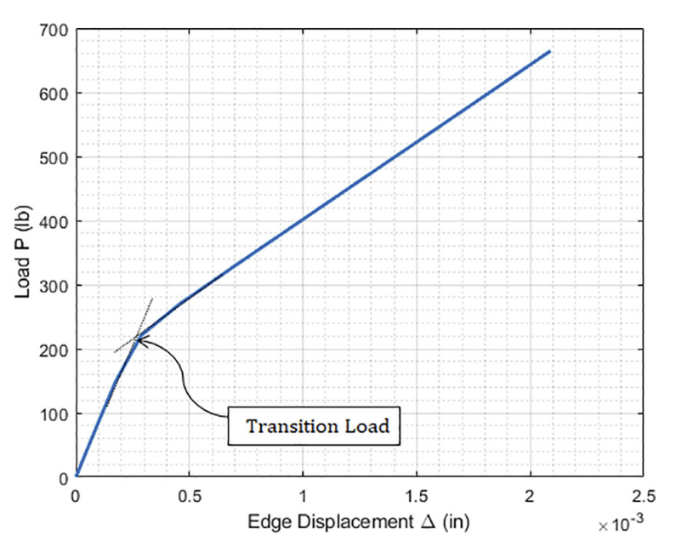
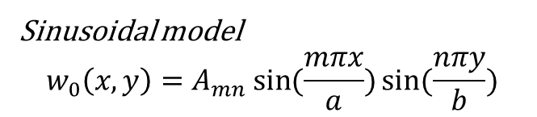
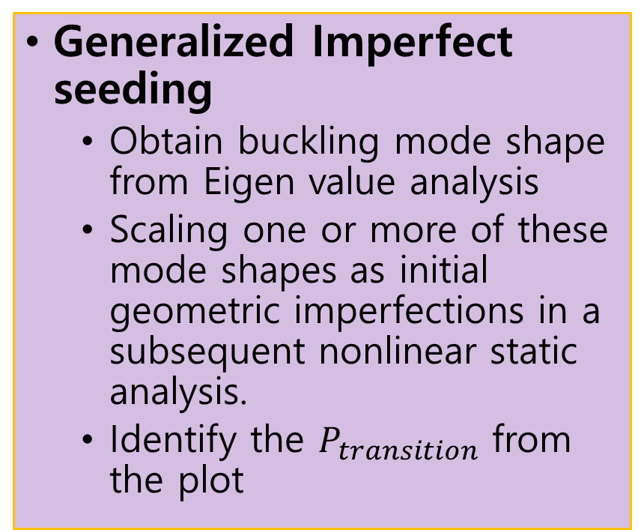
Imperfection seeding
What if some layups are not symmetric?
If it is non-symmetric, we cannot use eigenvalue.
It overestimates the critical load
Miss the actual buckling mode
B matrix in stiffness matrix is not zero
Generalized Imperfect seeding
Obtain buckling mode shape from Eigen value analysis
Scaling one or more of these mode shapes as initial geometric imperfections in a subsequent nonlinear static analysis.
Identify the $P_{transition}$ from the plot
Sinusoidal model
$$w_{0}\left(x,y\right)=A_{mn}\sin{(\frac{mπx}{a})}\sin{(\frac{nπy}{b})}$$

Slide 10
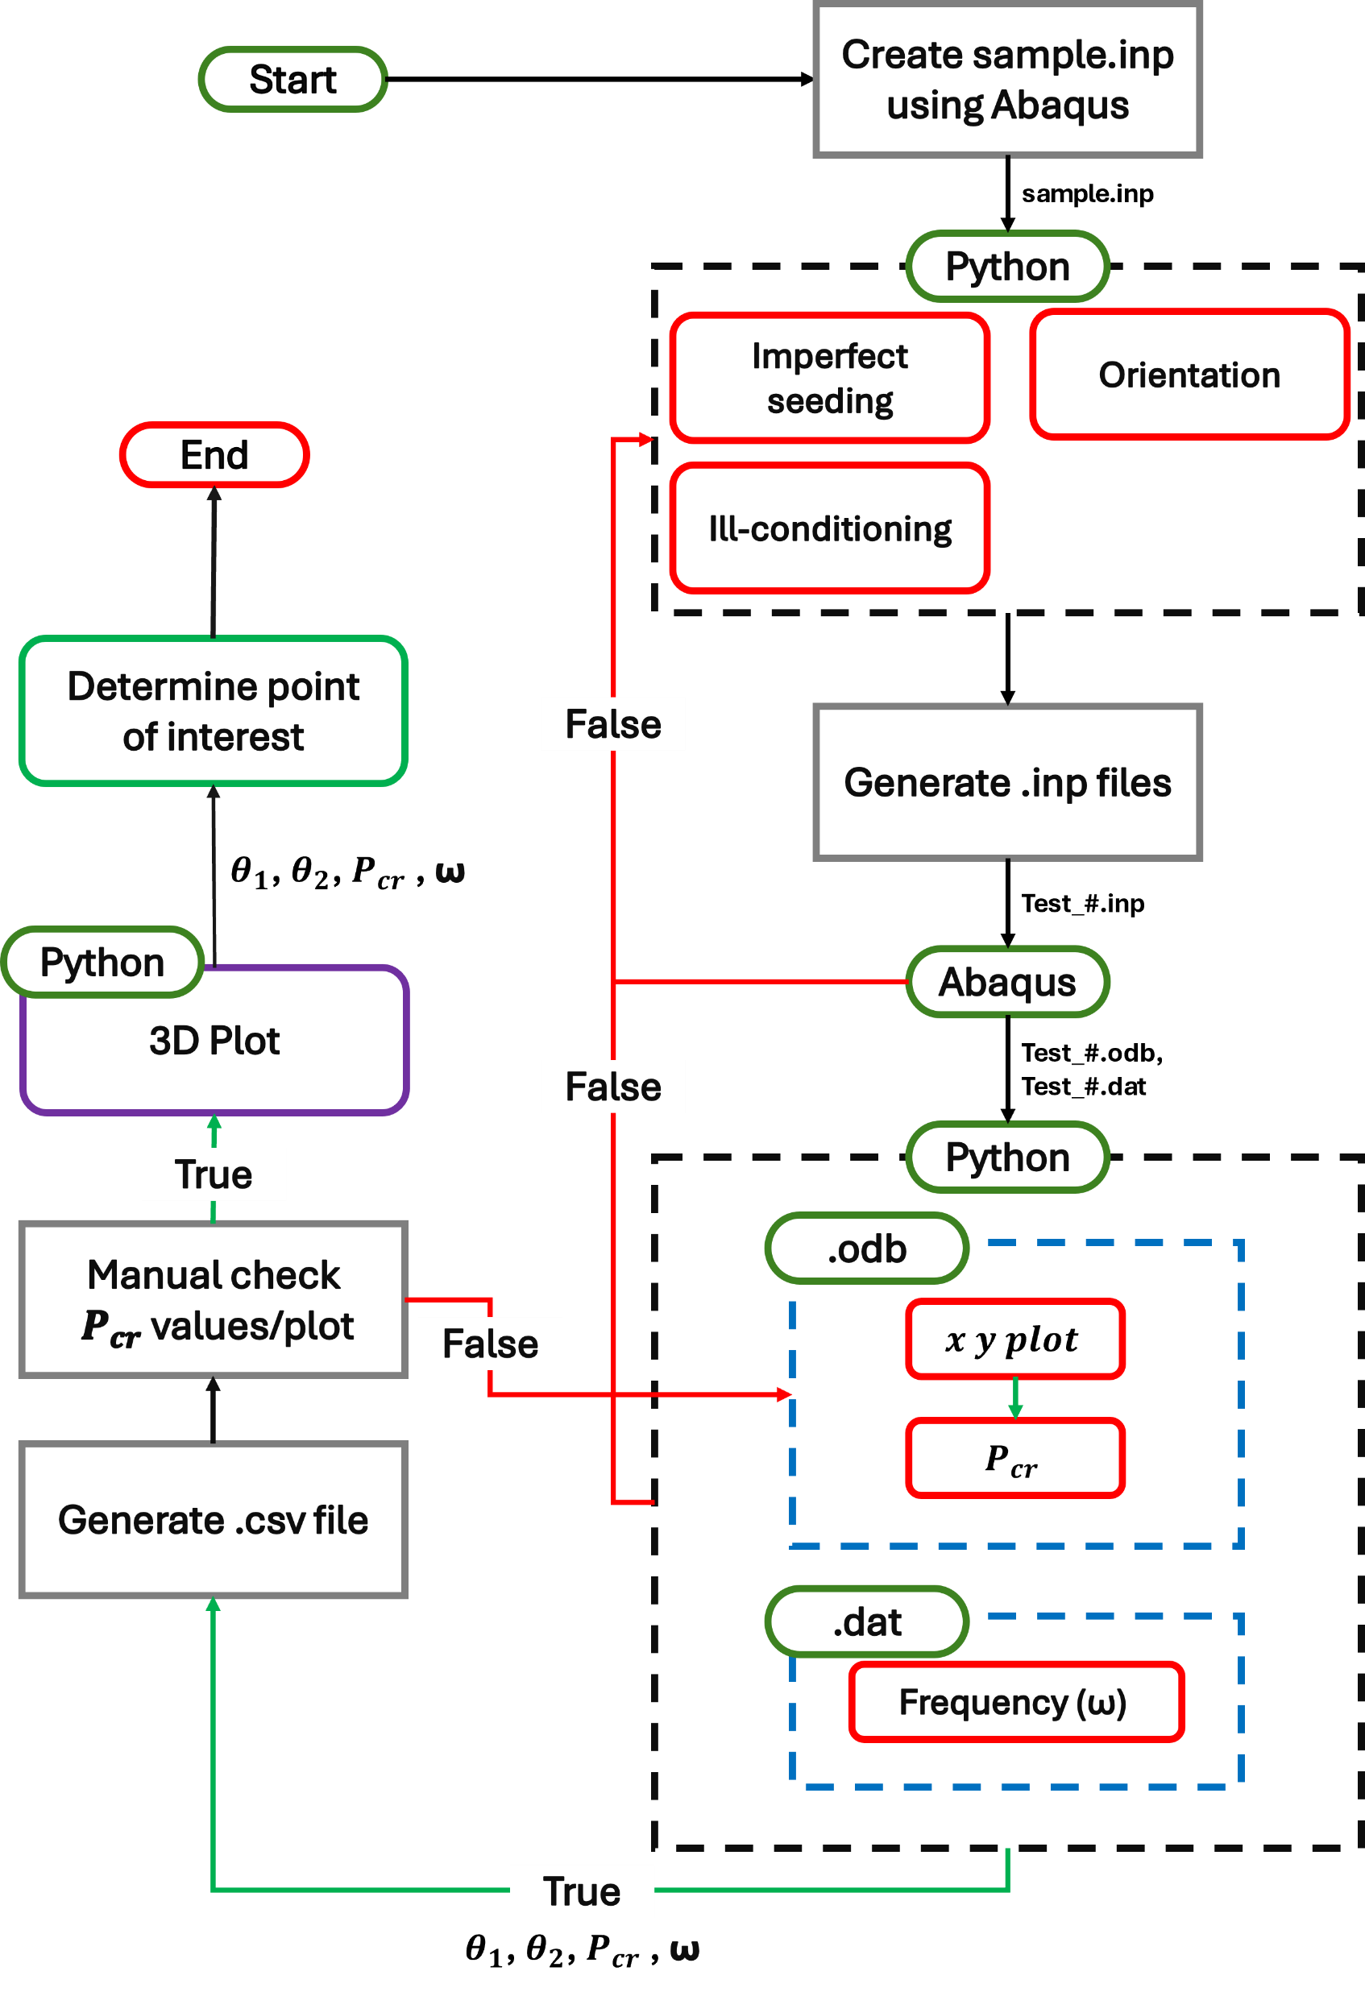

Optimization workflow
Stage 0 : Create sample input file
B.C.s
Material Properties
Stage 1 : Python Pre-Process
Imperfection seeding
Orientation
Stage 2 : .inp Generation & Abaqus Run
Stage 3 : .dat & .odb
$P_{tr}$
ω
Stage 4 : Post-Processing & QC
Check if $P_{tr}$ is correct by looking at the xy plot
Stage 5 : Output & Data Management
Generate .csv file to save data

Slide 11
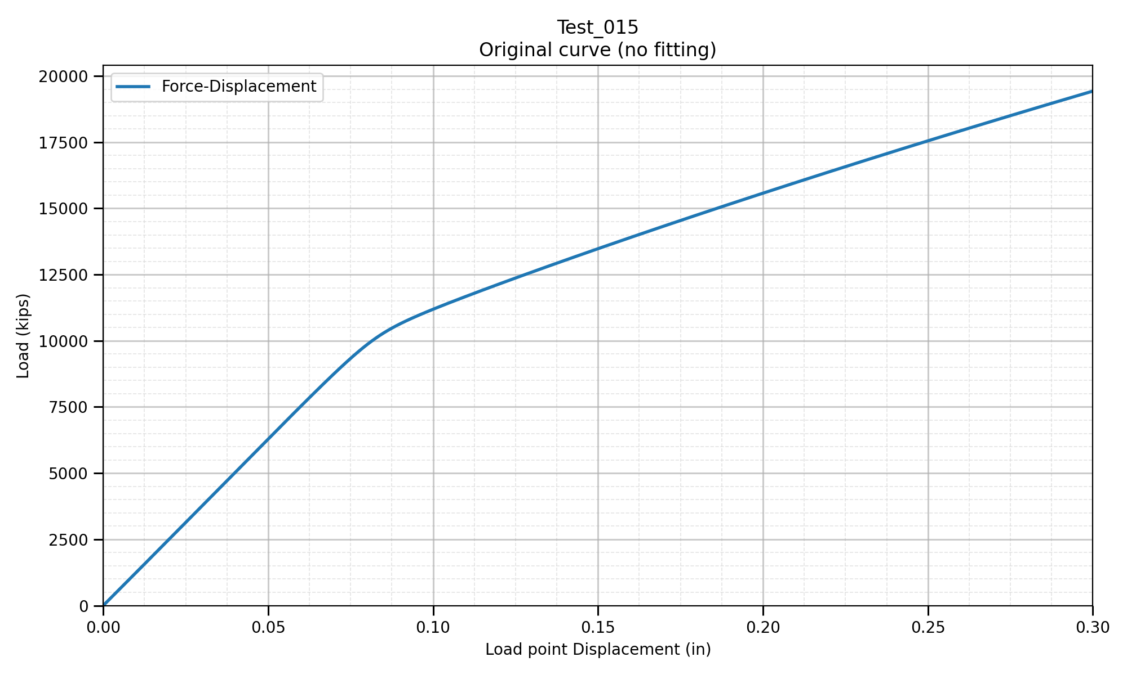

Type 1: Imperfection perfect
We have perfect bilinear curve
Easy to tell plot and where transition load is located
= $P_{tr}$

Slide 12
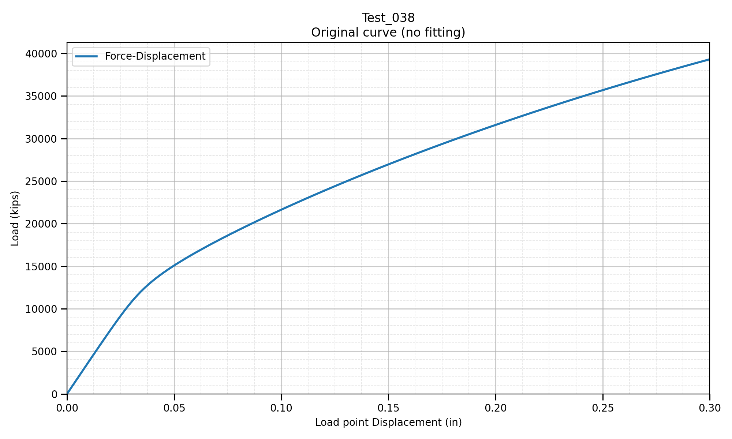

Type 2: Imperfection imperfect-1
We have somewhat bilinear curve
The 2nd part of the curve tends to “curve”
= $P_{tr1}$

Slide 13
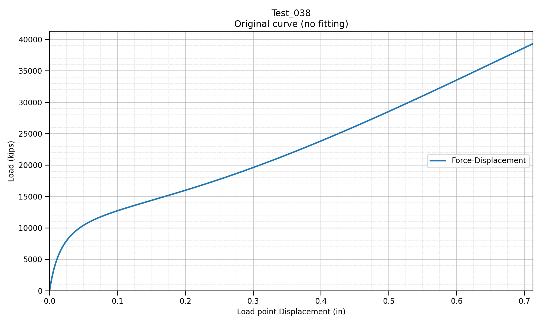
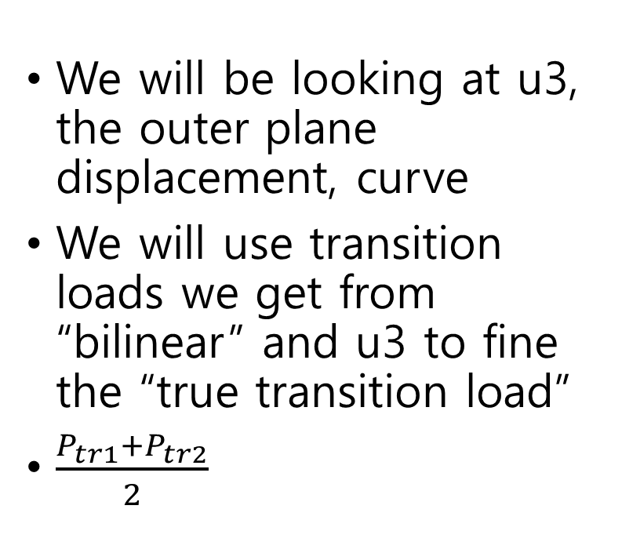

Type 2: Imperfection imperfect-1
We will be looking at u3, the outer plane displacement, curve
We will use transition loads we get from “bilinear” and u3 to fine the “true transition load”
$\frac{P_{tr1}+P_{tr2}}{2}$
= $P_{tr2}$

Slide 14
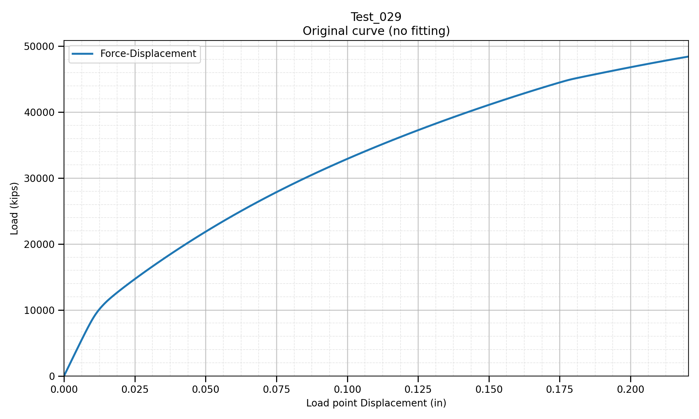
Type 3: Imperfection imperfect-2
We have “bilinear curve” where we cannot use due to 2nd half of the curve has to much curve/slope
= $P_{tr}$

Slide 15
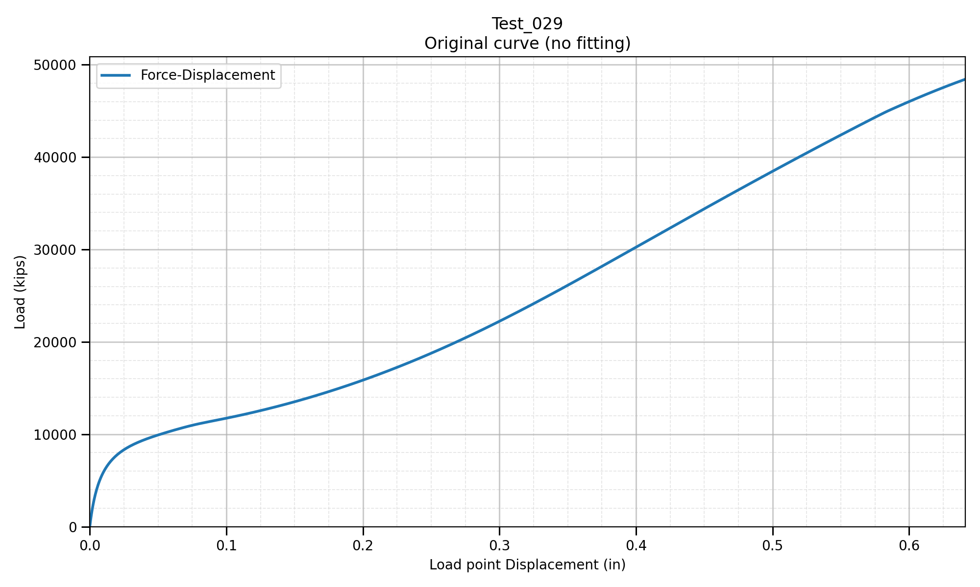
Type 3: Imperfection imperfect-2
We will be looking at u3, the outer plane displacement, curve
We will only use transition loads we get from u3 and say this is our transition load
= $P_{tr}$

Slide 16
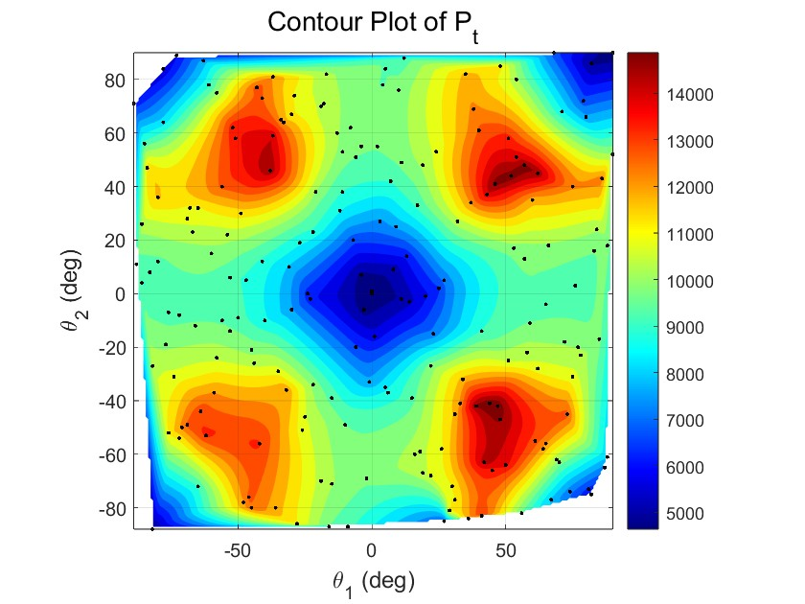
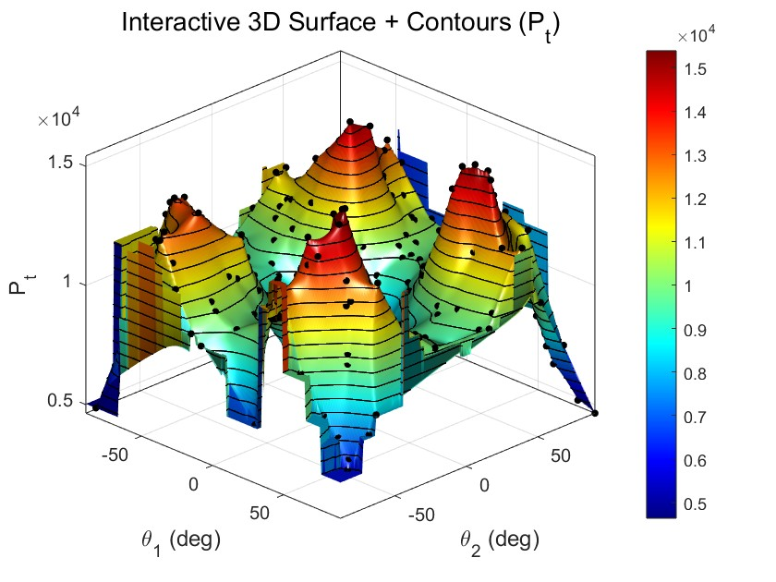
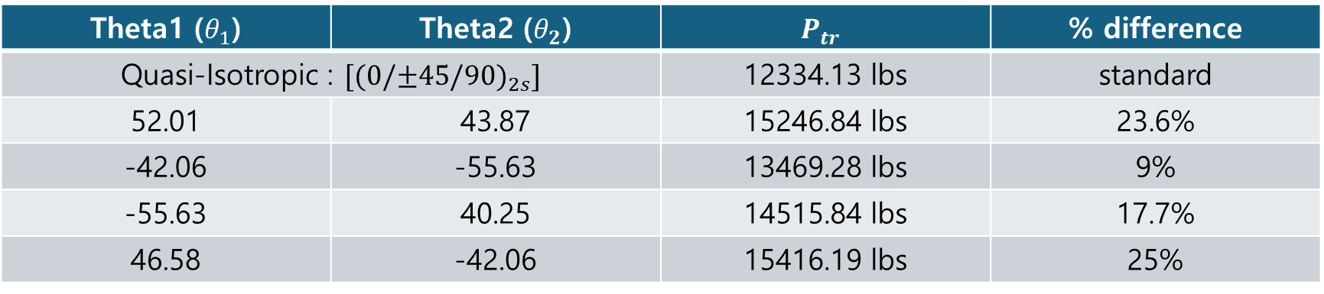

Case 1: ${[±θ_{1}/{±θ}_{2}]}_{4} − Evaluating Peaks$
Theta1 ($θ_{1}$) | Theta2 ($θ_{2}$) | $$P_{tr}$$ | % difference
Quasi-Isotropic : $[{(0/±45/90)}_{2s}]$ |  | 12334.13 lbs | standard
52.01 | 43.87 | 15246.84 lbs | 23.6%
-42.06 | -55.63 | 13469.28 lbs | 9%
-55.63 | 40.25 | 14515.84 lbs | 17.7%
46.58 | -42.06 | 15416.19 lbs | 25%
Type 1 | Type 2 | Type 3
58 | 124 | 18

Slide 17
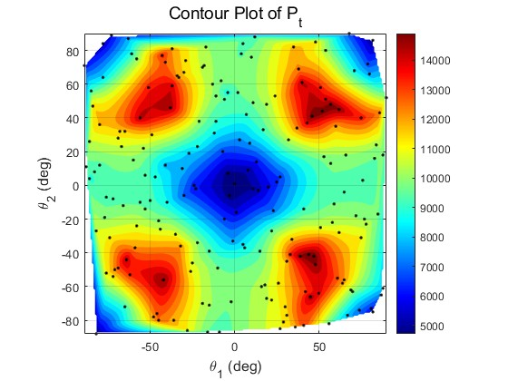
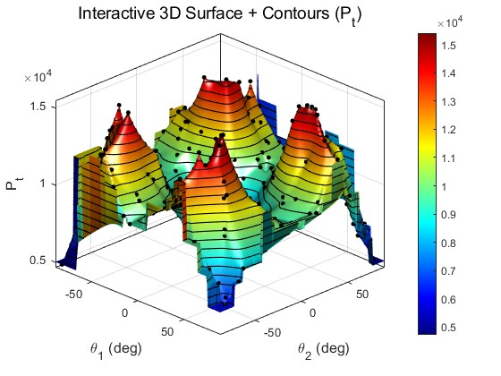
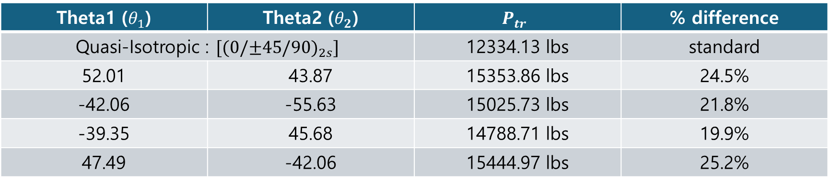

Case 2:${ [{±θ}_{1}/{±θ}_{2}{/∓θ}_{1}/{∓θ}_{2}]}_{2} − Evaluating Peaks$
Theta1 ($θ_{1}$) | Theta2 ($θ_{2}$) | $$P_{tr}$$ | % difference
Quasi-Isotropic : $[{(0/±45/90)}_{2s}]$ |  | 12334.13 lbs | standard
52.01 | 43.87 | 15353.86 lbs | 24.5%
-42.06 | -55.63 | 15025.73 lbs | 21.8%
-39.35 | 45.68 | 14788.71 lbs | 19.9%
47.49 | -42.06 | 15444.97 lbs | 25.2%
Type 1 | Type 2 | Type 3
61 | 114 | 25

Slide 18
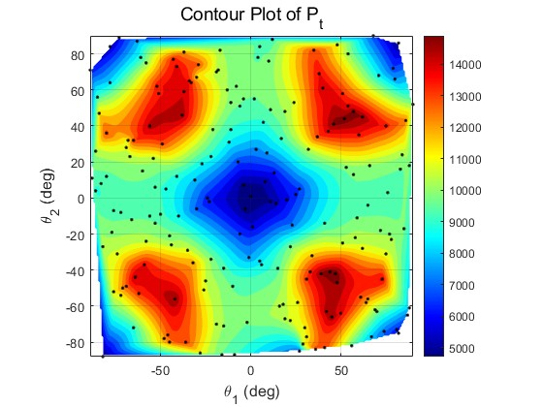
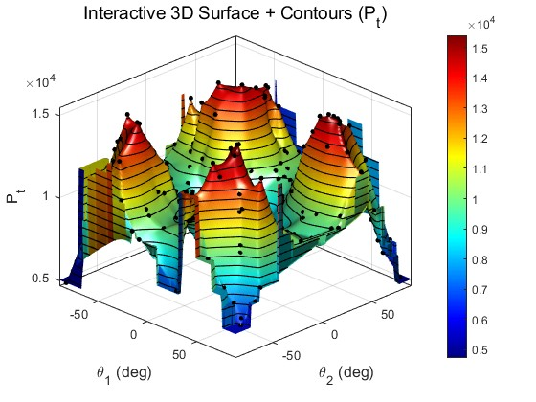


Case 3:$[{{(±θ}_{1}/{±θ}_{2})}_{2}/ {{(∓θ}_{1}/{∓θ}_{2})}_{2}]− Evaluating Peaks$
Theta1 ($θ_{1}$) | Theta2 ($θ_{2}$) | $$P_{tr}$$ | % difference
Quasi-Isotropic : $[{(0/±45/90)}_{2s}]$ |  | 12334.13 lbs | standard
52.01 | 43.87 | 15266.21 lbs | 23.8%
-42.06 | -55.63 | 14921.66 lbs | 21%
-39.35 | -45.68 | 14615.84 lbs | 18.5%
46.58 | -42.06 | 15428.14 lbs | 25.1%
Type 1 | Type 2 | Type 3
82 | 98 | 20

Slide 19
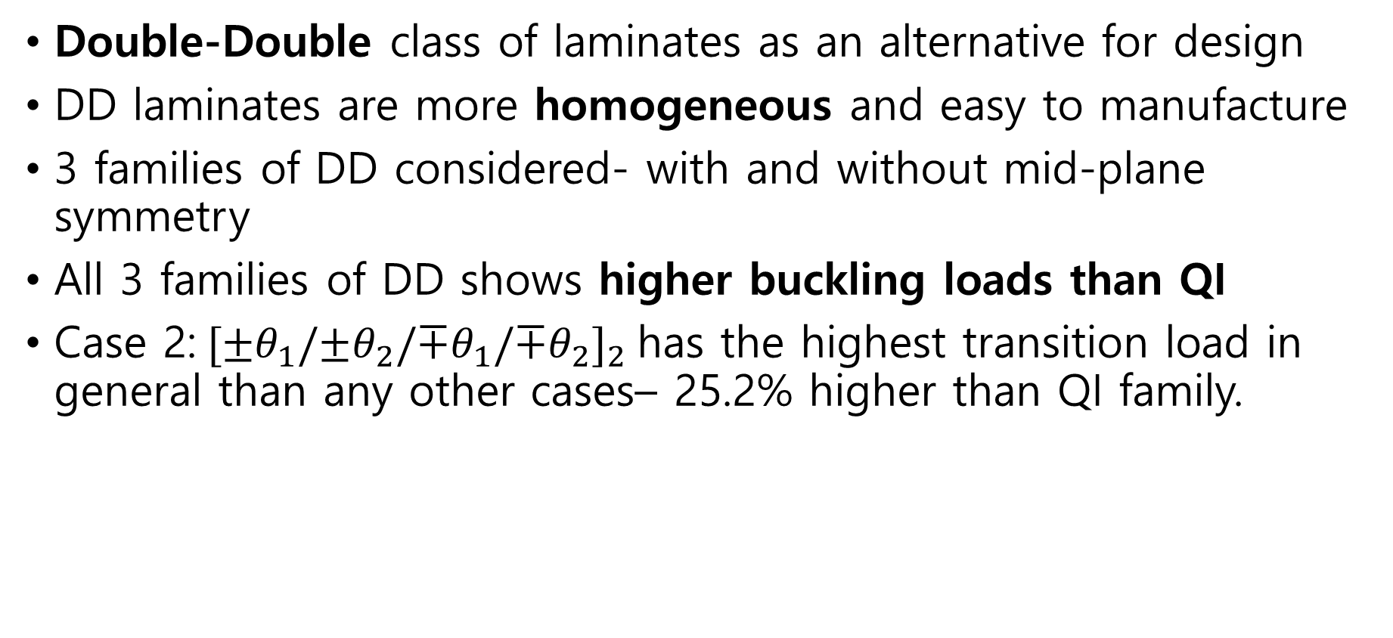
Conclusions
Double-Double class of laminates as an alternative for design
DD laminates are more homogeneous and easy to manufacture
3 families of DD considered- with and without mid-plane symmetry
All 3 families of DD shows higher buckling loads than QI
Case 2:${ [{±θ}_{1}/{±θ}_{2}{/∓θ}_{1}/{∓θ}_{2}]}_{2}$has the highest transition load in general than any other cases– 25.2% higher than QI family.

Slide 20
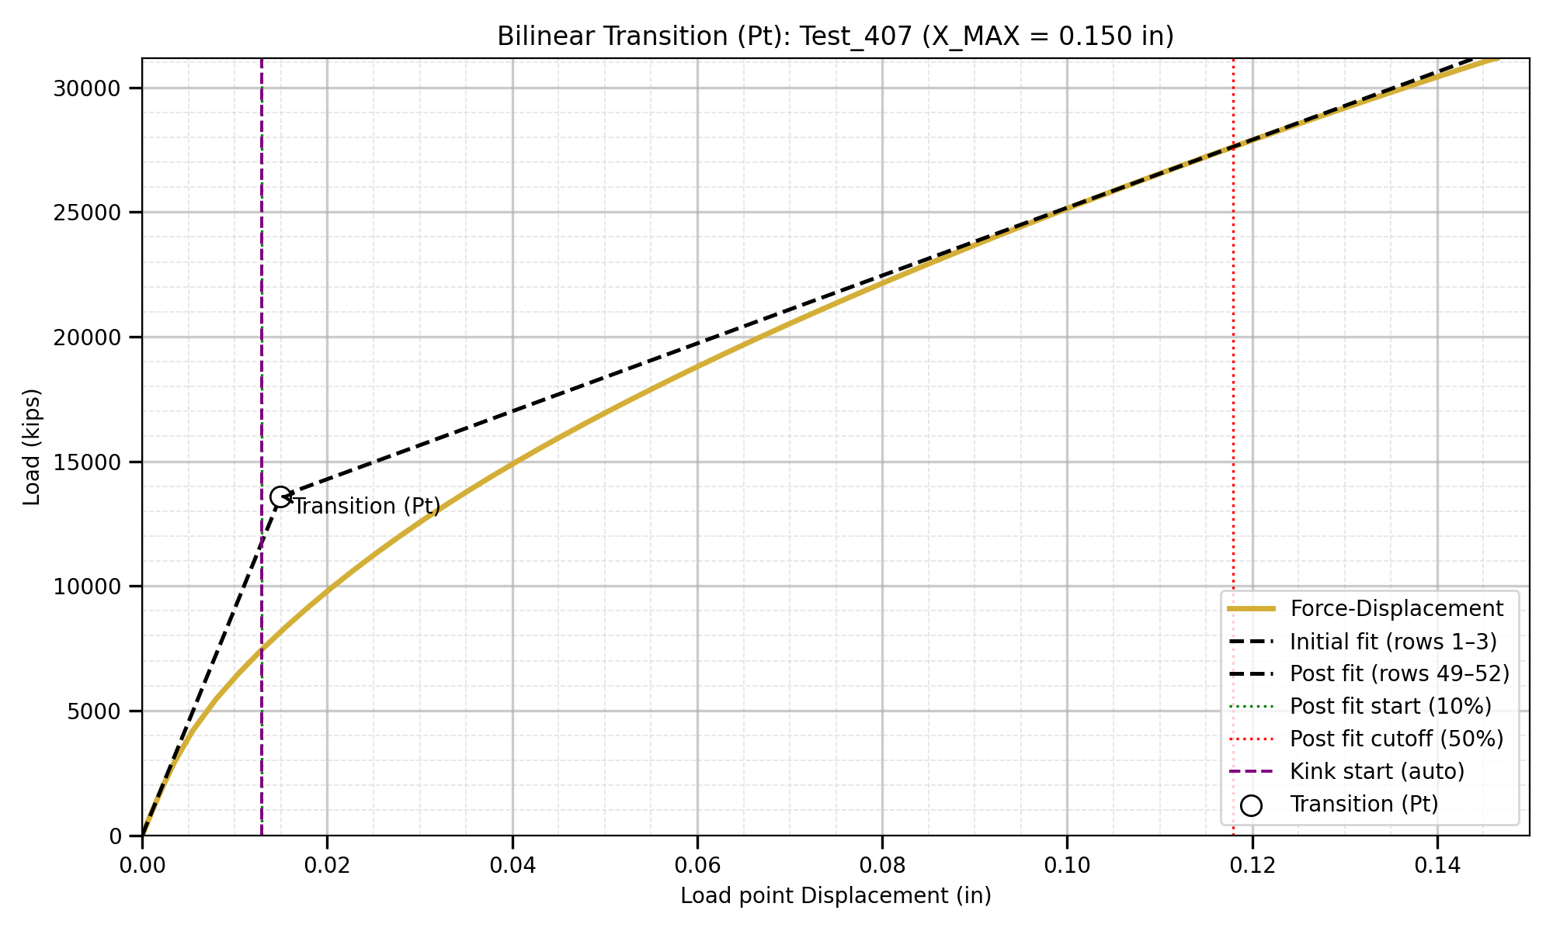
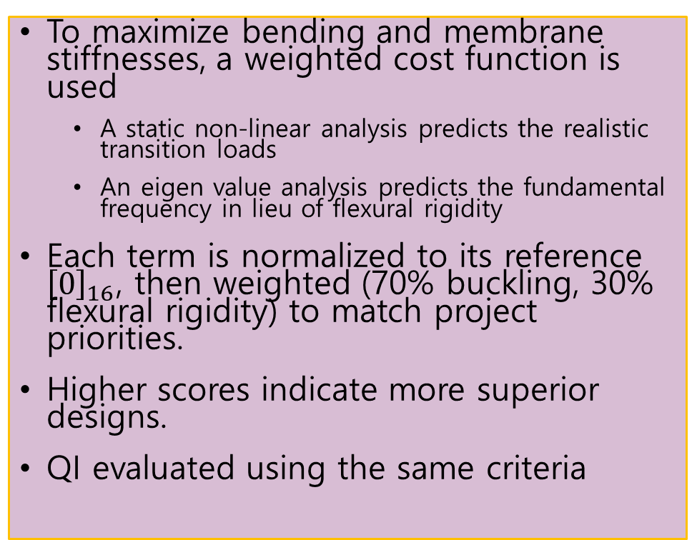
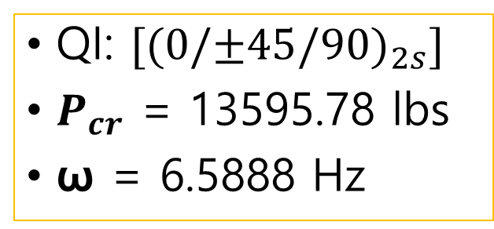
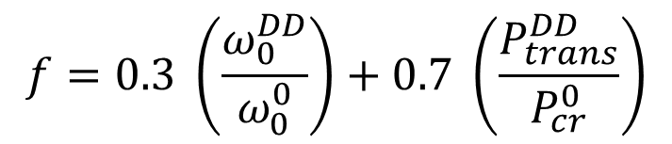
Cost function evaluation
$$f=0.3 \left(\frac{ω_{0}^{DD}}{ω_{0}^{0}}\right)+0.7 \left(\frac{P_{trans}^{DD}}{P_{cr}^{0}}\right)$$
To maximize bending and membrane stiffnesses, a weighted cost function is used
A static non-linear analysis predicts the realistic transition loads
An eigen value analysis predicts the fundamental frequency in lieu of flexural rigidity
Each term is normalized to its reference ${\left[0\right]}_{16}$, then weighted (70% buckling, 30% flexural rigidity) to match project priorities.
Higher scores indicate more superior designs.
QI evaluated using the same criteria
QI: $[{(0/±45/90)}_{2s}]$
$P_{cr}$ = 13595.78 lbs
ω = 6.5888 Hz

Slide 21

Thank you!!
Questions??

