Slide 1
Comp 512 - project
Daniel pham, harry simmonds, justin domingue

Slide 2
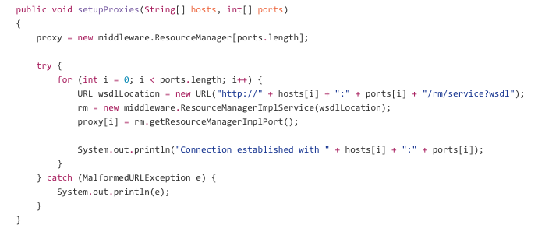

Part I – Distribute the system
Distribute the systems with a global middleware layer
Client interface doesn’t change
Flight, car and rooms handled by different resource managers
Reserve itinerary

Slide 3
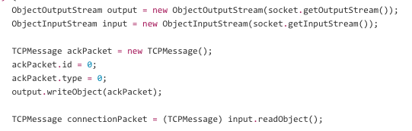
Part I – use tcp
Use TCP instead of Web-services
All communication based on sockets
Middleware and RMs can handle requests concurrently

Slide 4
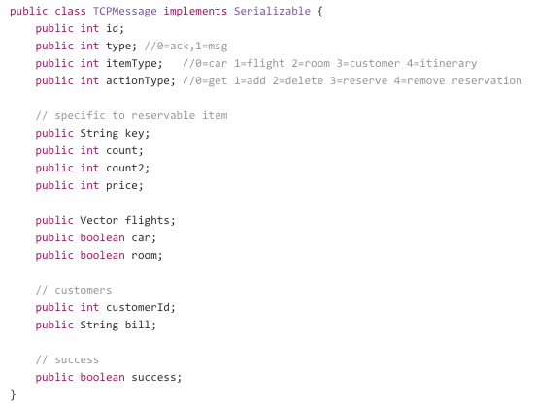
Part I – use tcp

Slide 5
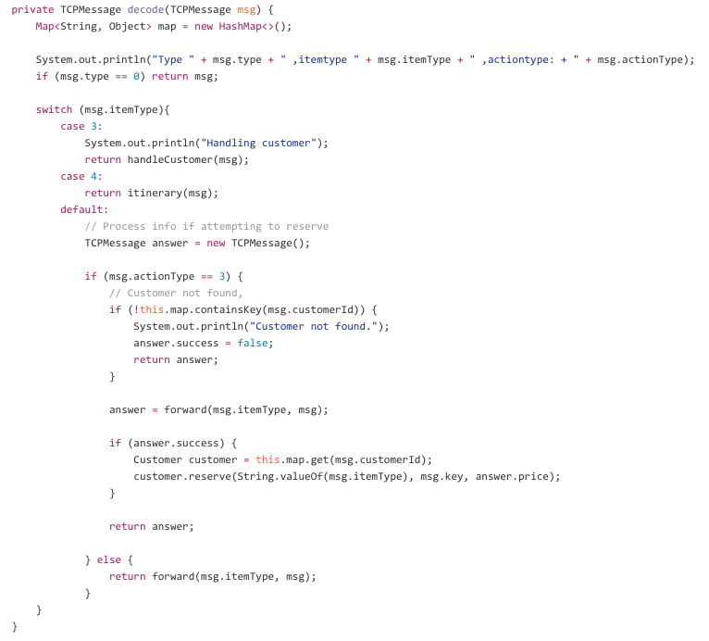
Part I – use tcp

Slide 6
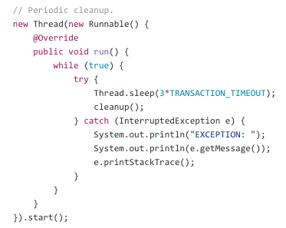
Part II – Concurrency control
Added the concept of transactions to the distributed system
Centralized transaction manager residing in the middleware
Time-to-live (TTL) to handle client crashes
Two approaches for updates
Update-in-place: any request is executed immediately by the RM
Deferred-update: any request is buffered until commit time

Slide 7
Architecture - client
WebService Method Calls
Maintained basic client framework
WSClient
WebServices Methods
abort(..)
commit(..)
Start(..)
Client
Middleware
@WebService(endpointInterface = "middleware.ws.MiddleWare")

Slide 8
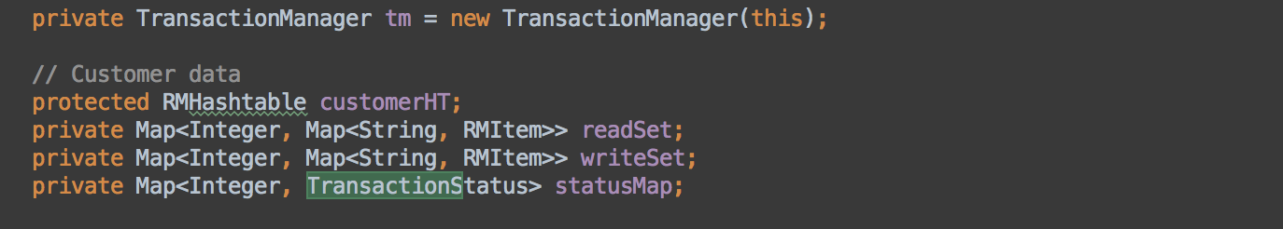
Architecture - middleware
Customer Data
LockManager
Incoming client requests
Associates
Aggregates
queryFlight(..)
addRoom(..)
deleteCar(..)
Middleware
3
ResourceManager
Start(..)
Commit(..)
Abort(..)
@WebService(endpointInterface = "server.ws.ResourceManager")
addRooms(…)
addFlight(..)
removeFlight(..)
reserveItenarary(..)
Associates
Transaction Manager

Slide 9
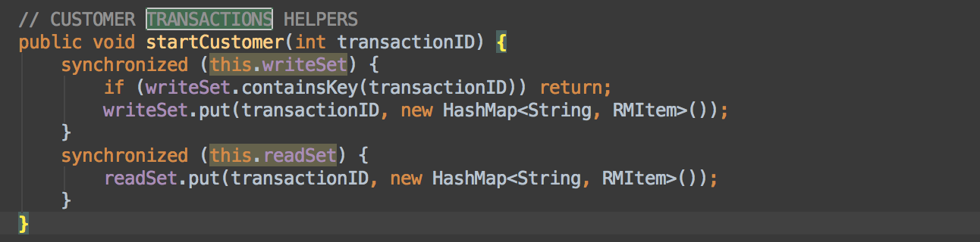
Architecture – customer data
RHMHashMap
synchronized
Middleware
CustomerData
deleteCust(..)
addCust(..)
custReservation(..)
Aggregates
Customers

Slide 10
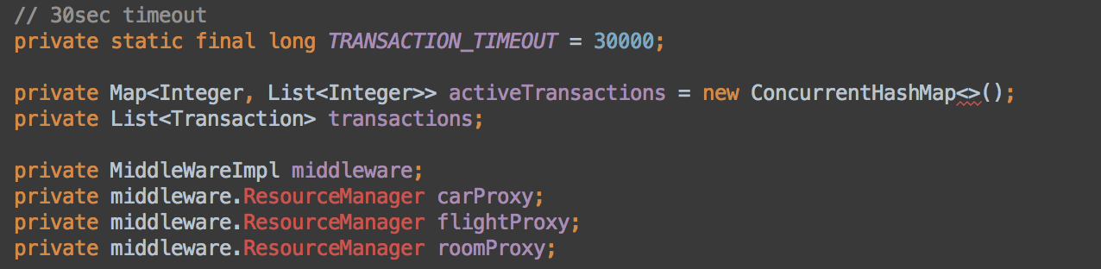
Architecture – transaction manager
NOTE: through middleware instance
start(..)
commit(..)
abort(..)
synchronized
TransactionManager
Middleware
RM
start(..)
commit(..)
abort(..)
addOperation(..)
isActive(..)
3
@WebService(endpointInterface = "server.ws.ResourceManager")
Aggregates
Operations

Slide 11
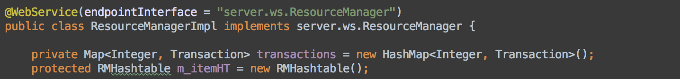
Architecture – resource manager
synchronized
Middleware
ResourceManager
@WebService(endpointInterface = "server.ws.ResourceManager")
queryFlight(..)
addRoom(..)
deleteCar(..)
start(..)
abort(..)
commit(..)
Transactions

Slide 12
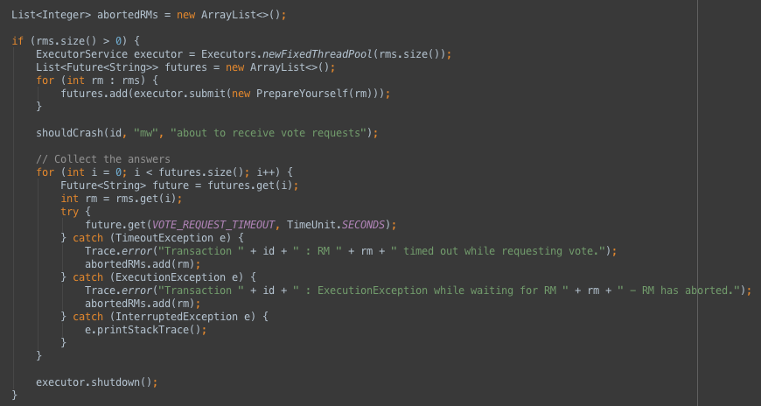
Two-phase commit – Vote requests

Slide 13
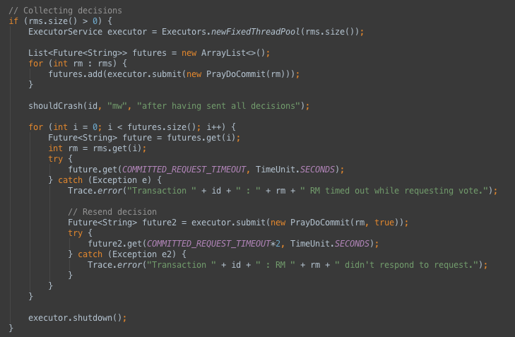
Two-phase commit – Send decisions

Slide 14
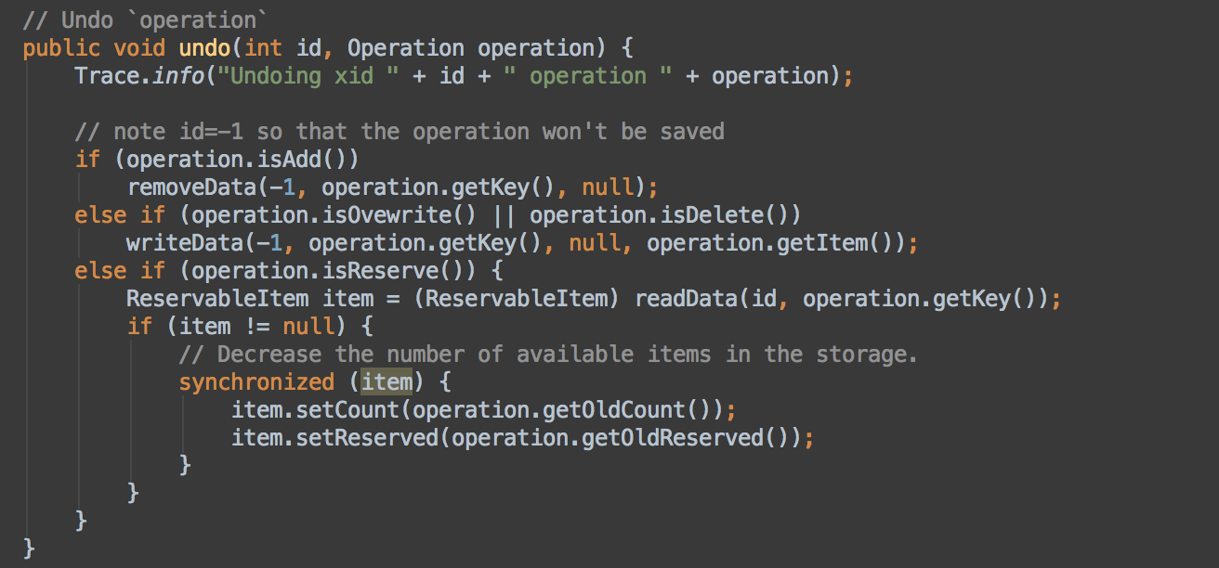
Commit/start/abort
Client -> Middleware -> Transaction Manager -> ResourceManager
COMMIT: Goes through to RM if transaction(id) exists and removes id from transaction list within RM
START: Adds new transaction to RM
ABORT: Will ‘undo’ actions within TM & also re-establish DB state in RM

Slide 15
Commit/start/abort
Client -> Middleware -> Transaction Manager -> ResourceManager
COMMIT: Goes through to RM if transaction(id) exists and removes id from transaction list within RM
START: Adds new transaction to RM
ABORT: Will ‘undo’ actions within TM & also re-establish DB state in RM

Slide 16
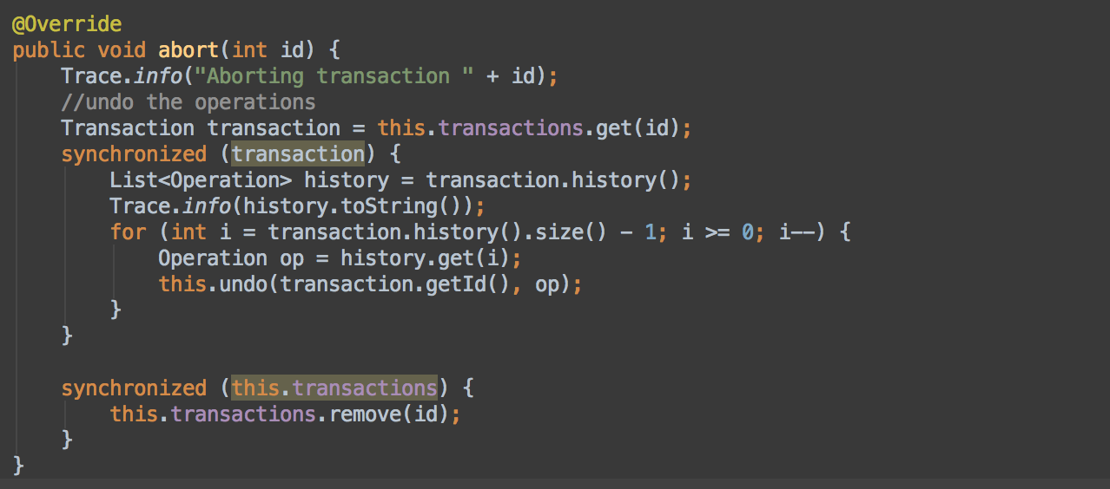
Update-in-place
Any request is executed immediately by the resource manager
Any modifying operation in the resource manager will be saved in an Operation object and added to List<Operations>
Any abort the RM will iterate List<Operations> and undo from recent to oldest

Slide 17
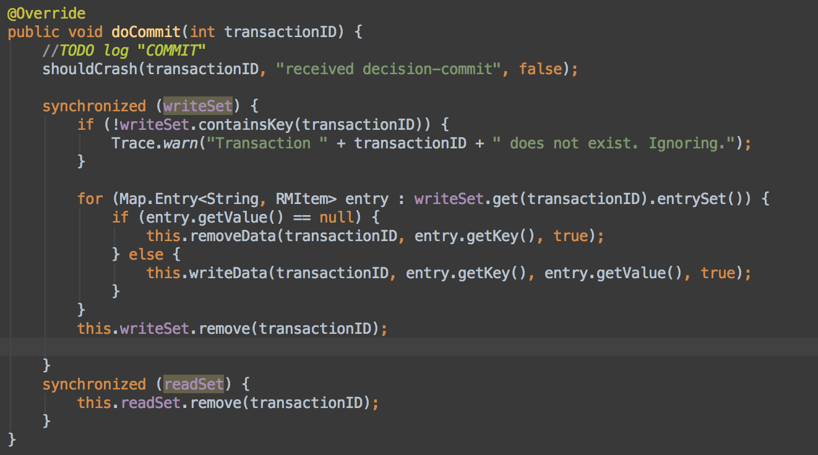
Deferred-update
Any request is buffered until commit time : List<ActiveTransactions>
On commit of some transaction X, RM goes over Operations within X, and performs all write operations from oldest – newest.
Concurrency: lockManager will secure data for each item

Slide 18
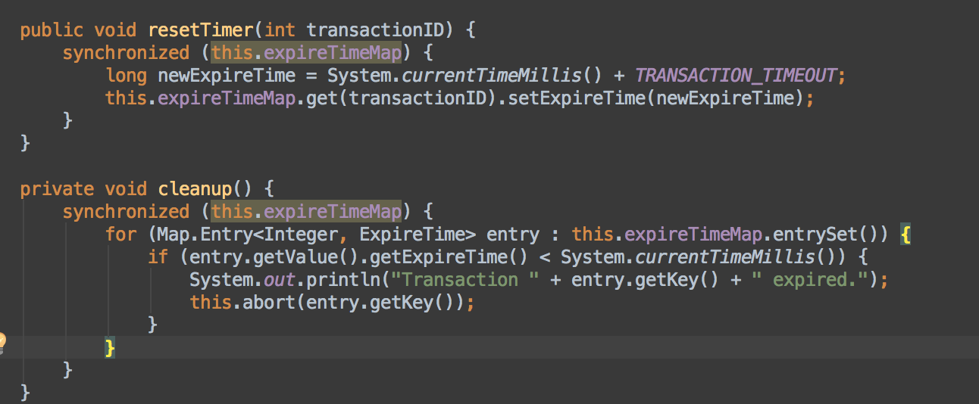
Time to live (TTL)
Maintain table of transactions with associated expireTime in TransactionManager
New Transaction : set time & reset timer for every new operation
Clean Up: in a thread, traverse through table and abort all expired time (expireTime < currentTime)

Slide 19
Data storage
MIDDLEWARE: Stores customer data & information
TRANSACTION MANAGER: Stores transaction information and TTL
RESOURCE MANAGER: Flights, cars, rooms and reservations

Slide 20
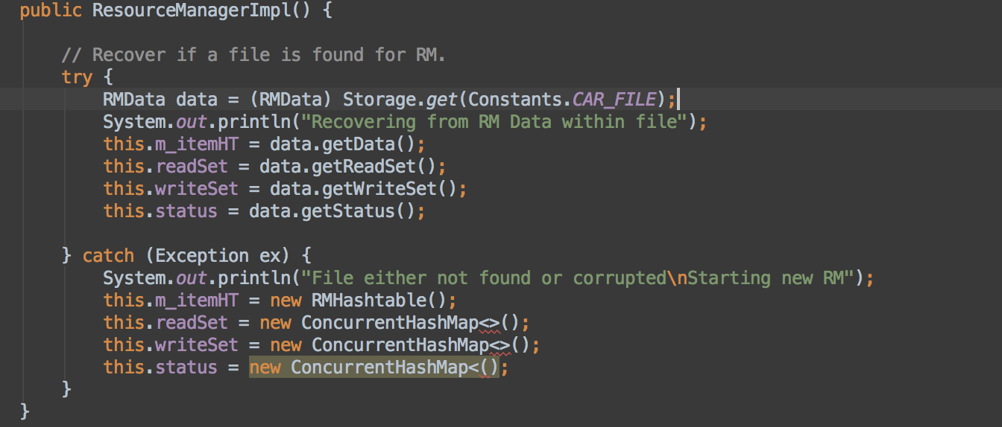
Data recovery – MW & RM
Save at strategic points in time to backup files (Within Storage class)
Upon startup of server (MW or RM) check for existing backup file

Slide 21
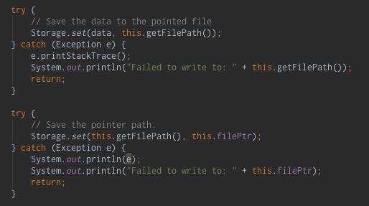
shadowing
Every RM has 2 versions of it’s files and a pointer file to determine current master.
On save:
Try to save to the file not pointed to.
Once the file was written, we update the pointer file.

Slide 22
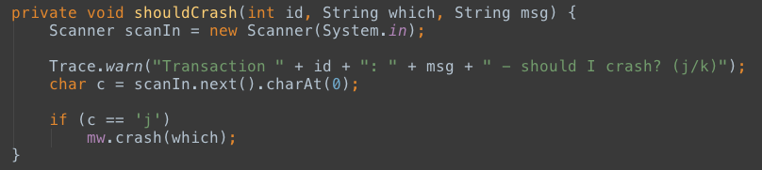
SITE FAILURES SIMULATION
Failure simulated by requesting user input at various strategic places in the code
Middleware
E.g. Before sending vote request, after deciding but before sending decision, after having sent all decisions
Resource manager
E.g. after receiving vote request but before sending answer, after sending answer, after receiving decision but before applying it

Slide 23
Site failures
In the middleware
Before vote request: recover, send abort to all
After vote request
w/o decision: recover, abort to all
w/ decision: recover, send decision to all who needs it
After sending decision,
Some have executed: recover send decision to all
All have executed it: recover, do nothing
At the resource managers
Before vote request: recover, abort
After vote request: recover, wait for decision from middleware
After applying decision: recover, do nothing
Notes:
Vote request: TransactionAbortedException if transaction cannot abort (read set different from committed or transaction has already been aborted)

Slide 24
Handling Site failures
Two ways of catching site failures: exceptions and failures
In the middleware
Waiting for vote requests: TransactionAbortedException, InvalidTransactionException, timeout – abort transaction
Decision sending: timeout (→ try resend) – abort transaction
In the resource managers
Waiting for vote request: abort after timeout
Waiting for decision: wait in uncertain state
Has aborted, receives vote request: ignores it
Notes:
Vote request: TransactionAbortedException if transaction cannot abort (read set different from committed or transaction has already been aborted)

Slide 25
Performance analysis - description

Slide 26
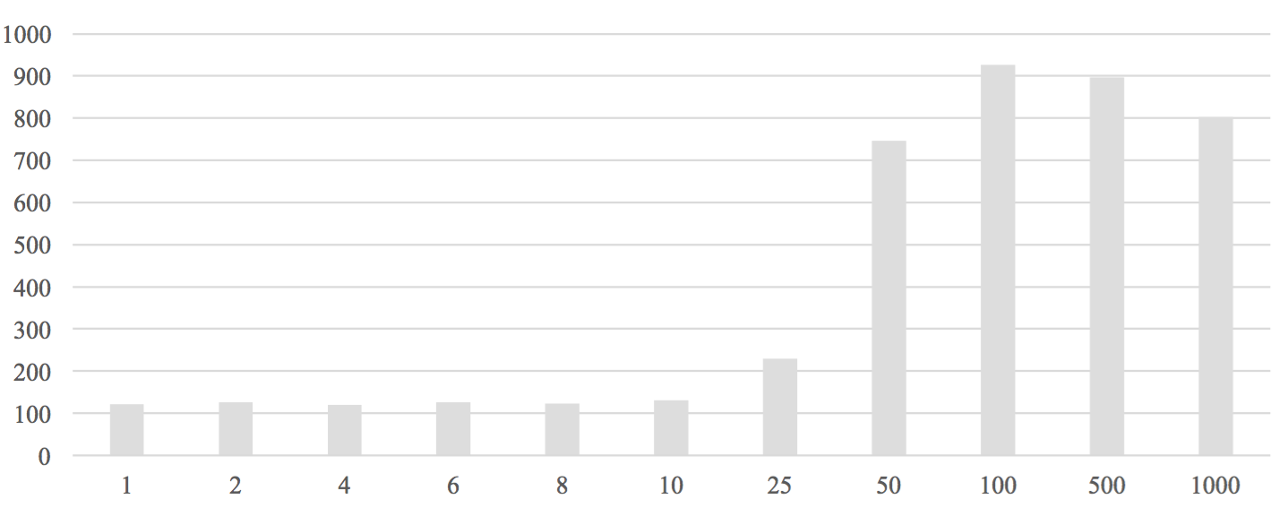
Response Time by Number of Transactions per Second

Slide 27
demo

