Slide 1
Comp 512 - project
Daniel pham, harry simmonds, justin domingue

Slide 2
Architecture - client
WebService Method Calls
Maintained basic client framework
WSClient
WebServices Methods
abort(..)
commit(..)
Start(..)
Client
Middleware
@WebService(endpointInterface = "middleware.ws.MiddleWare")

Slide 3
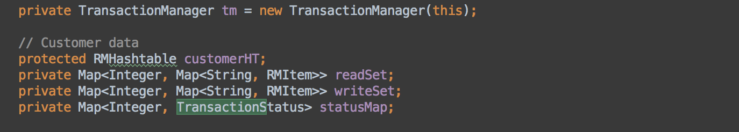
Architecture - middleware
Customer Data
LockManager
Incoming client requests
Associates
Aggregates
queryFlight(..)
addRoom(..)
deleteCar(..)
Middleware
3
ResourceManager
Start(..)
Commit(..)
Abort(..)
@WebService(endpointInterface = "server.ws.ResourceManager")
addRooms(…)
addFlight(..)
removeFlight(..)
reserveItenarary(..)
Associates
Transaction Manager

Slide 4
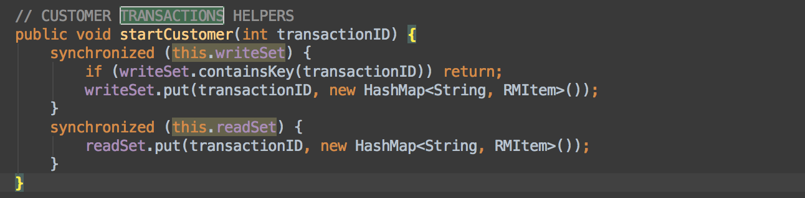
Architecture – customer data
RHMHashMap
synchronized
Middleware
CustomerData
deleteCust(..)
addCust(..)
custReservation(..)
Aggregates
Customers

Slide 5
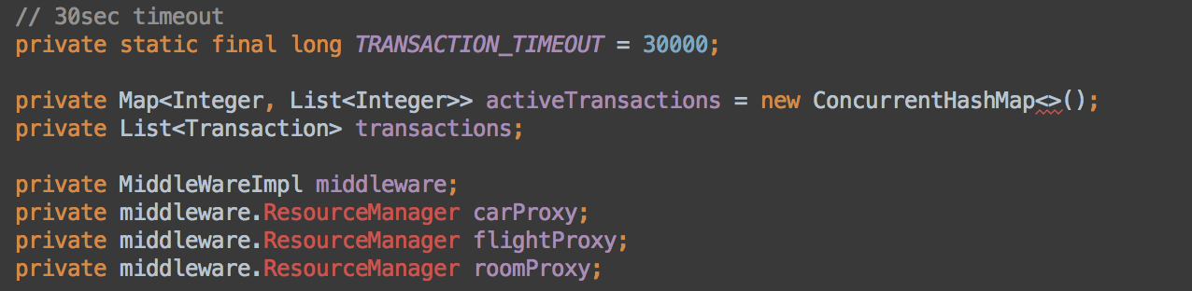
Architecture – transaction manager
NOTE: through middleware instance
start(..)
commit(..)
abort(..)
synchronized
TransactionManager
Middleware
RM
start(..)
commit(..)
abort(..)
addOperation(..)
isActive(..)
3
@WebService(endpointInterface = "server.ws.ResourceManager")
Aggregates
Operations

Slide 6

Architecture – resource manager
synchronized
Middleware
ResourceManager
@WebService(endpointInterface = "server.ws.ResourceManager")
queryFlight(..)
addRoom(..)
deleteCar(..)
start(..)
abort(..)
commit(..)
Transactions

Slide 7
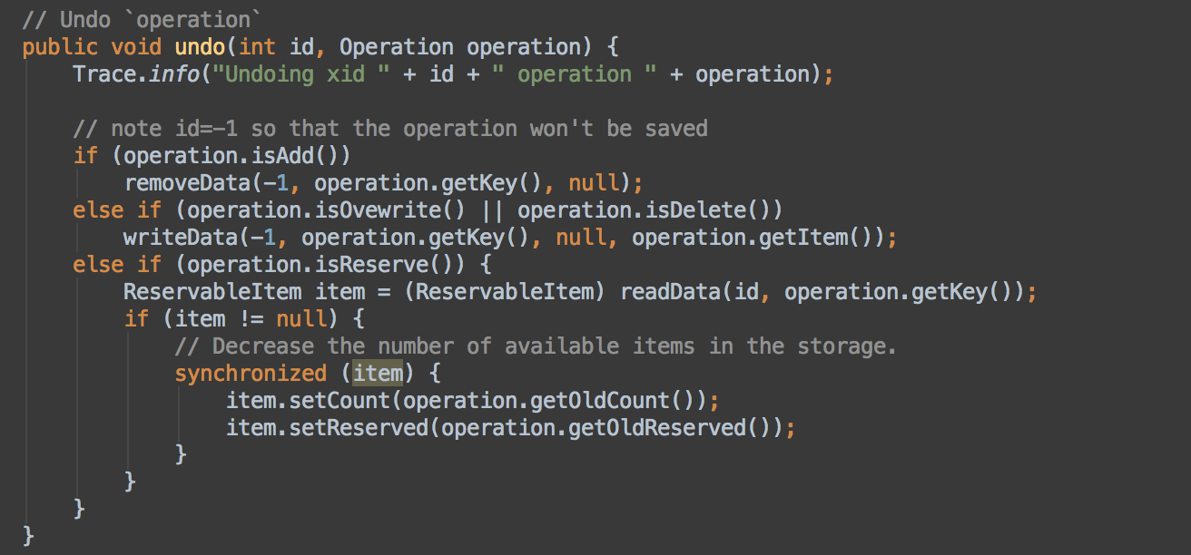
Commit/start/abort
Client -> Middleware -> Transaction Manager -> ResourceManager
COMMIT: Goes through to RM if transaction(id) exists and removes id from transaction list within RM
START: Adds new transaction to RM
ABORT: Will ‘undo’ actions within TM & also re-establish DB state in RM

Slide 8
Update-in-place

Slide 9
Deferred-update

Slide 10
Time to live (TTL)

Slide 11
shadowing

Slide 12
Data storage

Slide 13
Data recovery

Slide 14
Site failures

Slide 15
Performance analysis - description

Slide 16
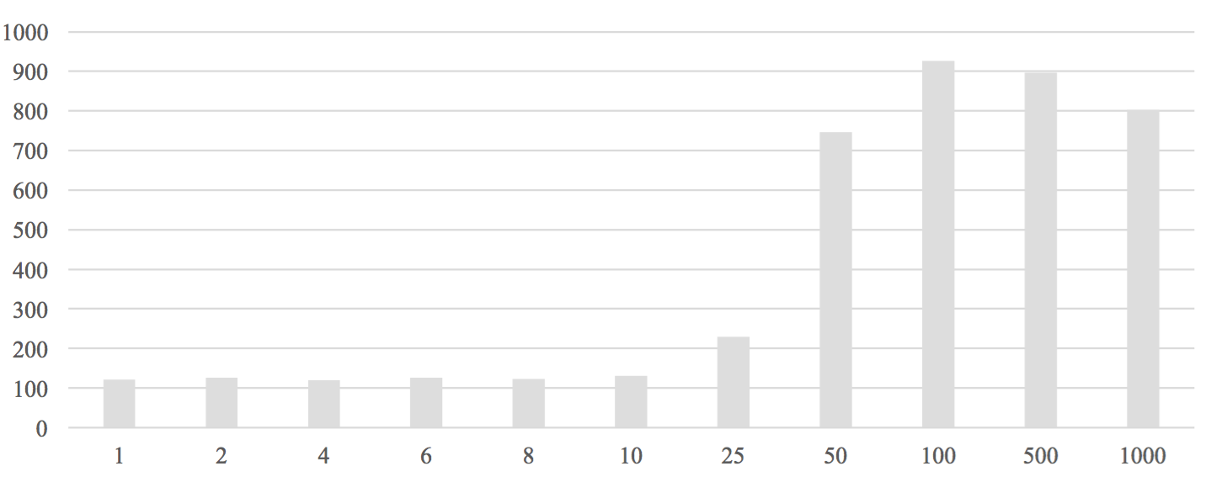
Response Time by Number of Transactions per Second

Slide 17
demo

