Slide 1
Comp 512 - project
Daniel pham, harry simmonds, justin domingue

Slide 2
Architecture - client
WebService Method Calls
Maintained basic client framework
WSClient
WebServices Methods
abort(..)
commit(..)
Start(..)
Client
Middleware
@WebService(endpointInterface = "middleware.ws.MiddleWare")

Slide 3
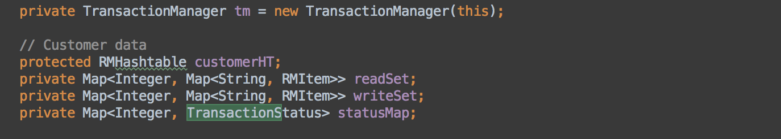
Architecture - middleware
Customer Data
LockManager
Incoming client requests
Associates
Aggregates
queryFlight(..)
addRoom(..)
deleteCar(..)
Middleware
3
ResourceManager
Start(..)
Commit(..)
Abort(..)
@WebService(endpointInterface = "server.ws.ResourceManager")
addRooms(…)
addFlight(..)
removeFlight(..)
reserveItenarary(..)
Associates
Transaction Manager

Slide 4
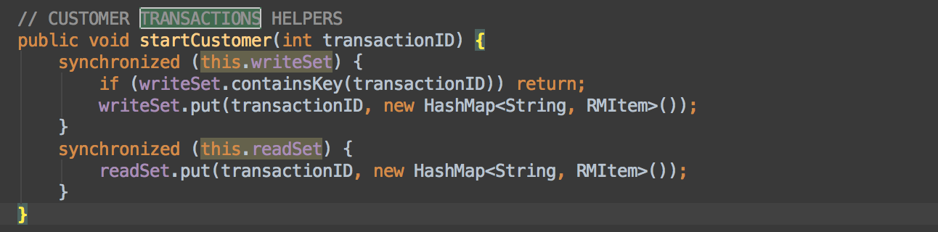
Architecture – customer data
RHMHashMap
synchronized
Middleware
CustomerData
deleteCust(..)
addCust(..)
custReservation(..)
Aggregates
Customers

Slide 5
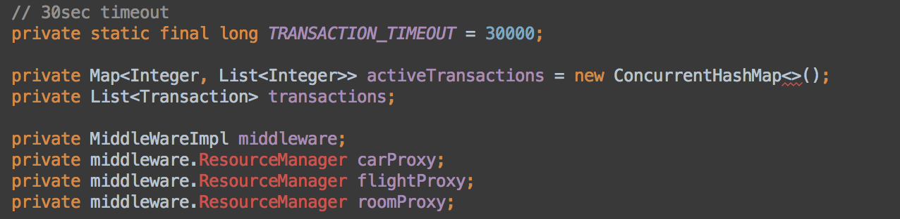
Architecture – transaction manager
NOTE: through middleware instance
start(..)
commit(..)
abort(..)
synchronized
TransactionManager
Middleware
RM
start(..)
commit(..)
abort(..)
addOperation(..)
isActive(..)
3
@WebService(endpointInterface = "server.ws.ResourceManager")
Aggregates
Operations

Slide 6
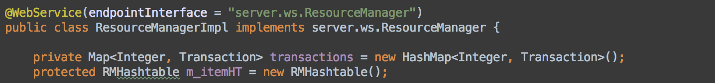
Architecture – resource manager
synchronized
Middleware
ResourceManager
@WebService(endpointInterface = "server.ws.ResourceManager")
queryFlight(..)
addRoom(..)
deleteCar(..)
start(..)
abort(..)
commit(..)
Transactions

Slide 7
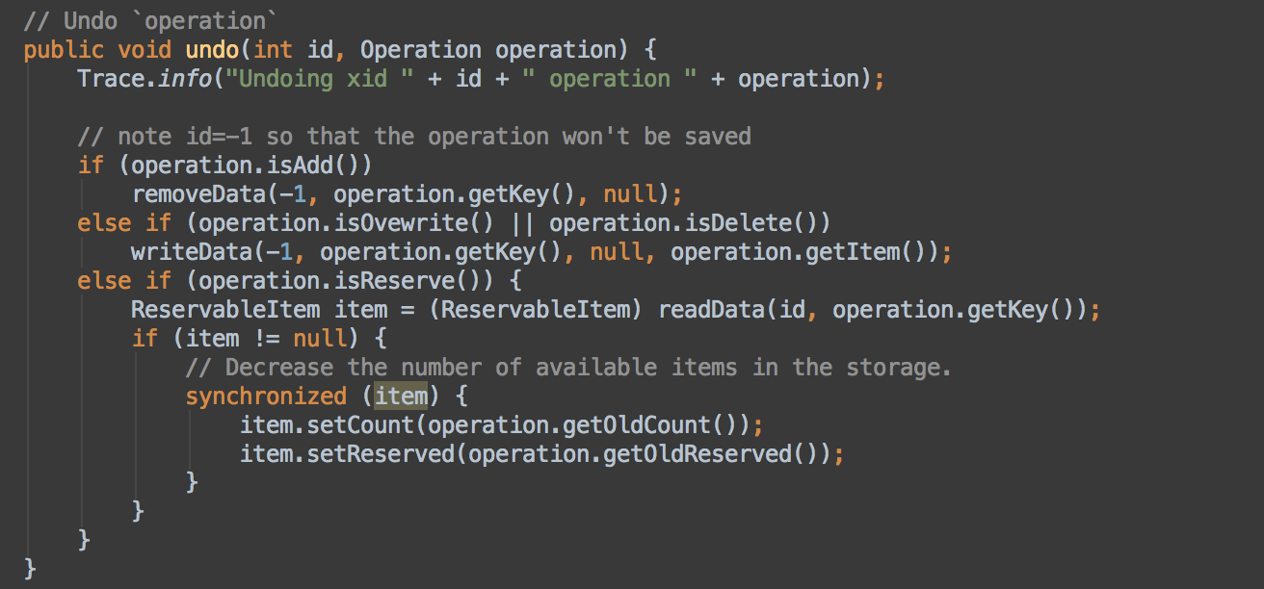
Commit/start/abort
Client -> Middleware -> Transaction Manager -> ResourceManager
COMMIT: Goes through to RM if transaction(id) exists and removes id from transaction list within RM
START: Adds new transaction to RM
ABORT: Will ‘undo’ actions within TM & also re-establish DB state in RM

Slide 8
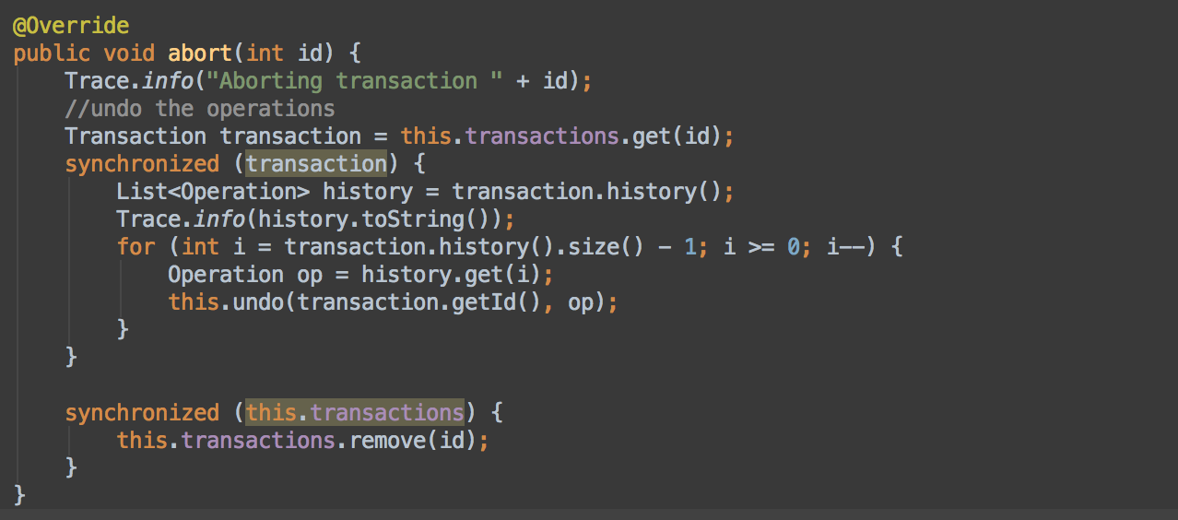
Update-in-place
Any request is executed immediately by the resource manager
Any modifying operation in the resource manager will be saved in an Operation object and added to List<Operations>
Any abort the RM will iterate List<Operations> and undo from recent to oldest

Slide 9
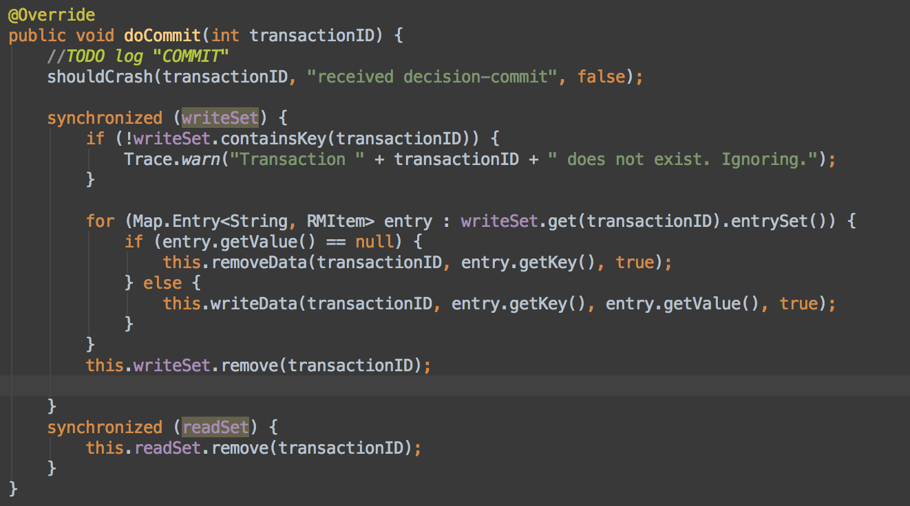
Deferred-update
Any request is buffered until commit time : List<ActiveTransactions>
On commit of some transaction X, RM goes over Operations within X, and performs all write operations from oldest – newest.
Concurrency: lockManager will secure data for each item

Slide 10
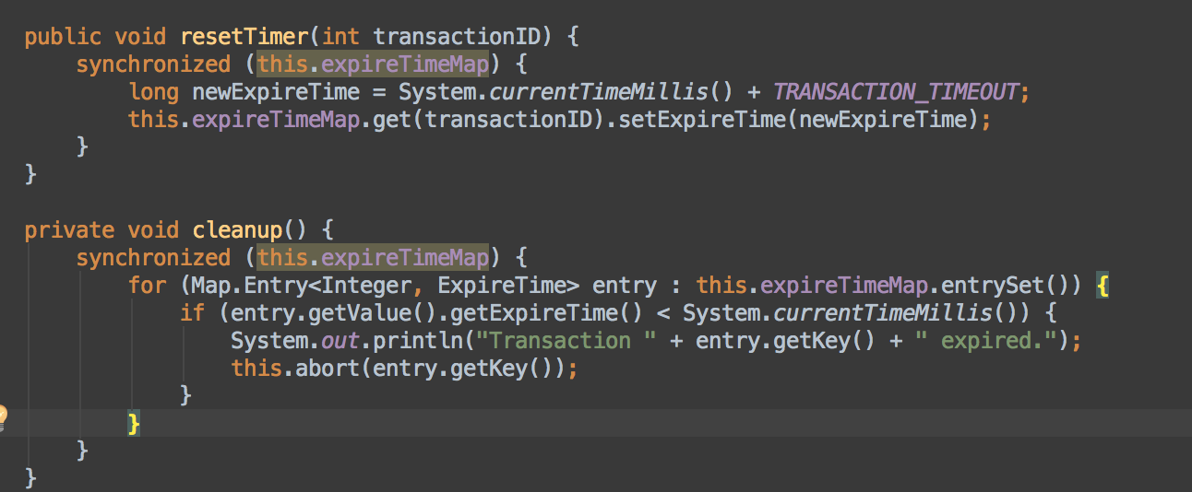
Time to live (TTL)
Maintain table of transactions with associated expireTime in TransactionManager
New Transaction : set time & reset timer for every new operation
Clean Up: traverse through table and abort all expired time (expireTime < currentTime)

Slide 11
Data storage
MIDDLEWARE: Stores customer data & information
TRANSACTION MANAGER: Stores transaction information and TTL
RESOURCE MANAGER: Reservations, flights, cars…etc

Slide 12
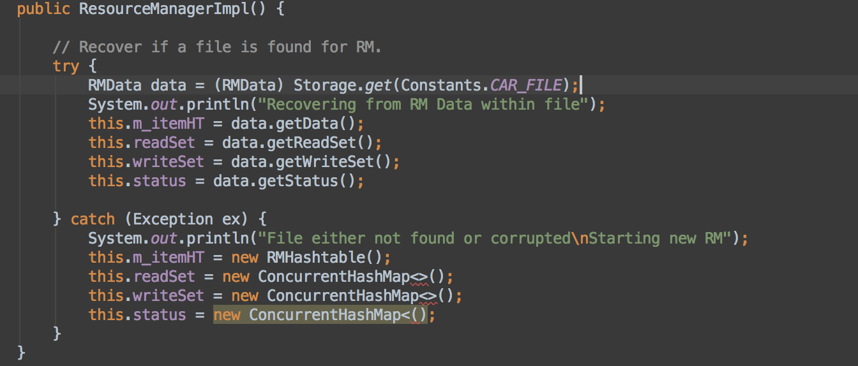
Data recovery – MW & RM
Save periodically to backup files (Within Storage class)
Upon startup of server (MW or RM) check for existing backup file

Slide 13
shadowing

Slide 14
Site failures

Slide 15
Performance analysis - description

Slide 16
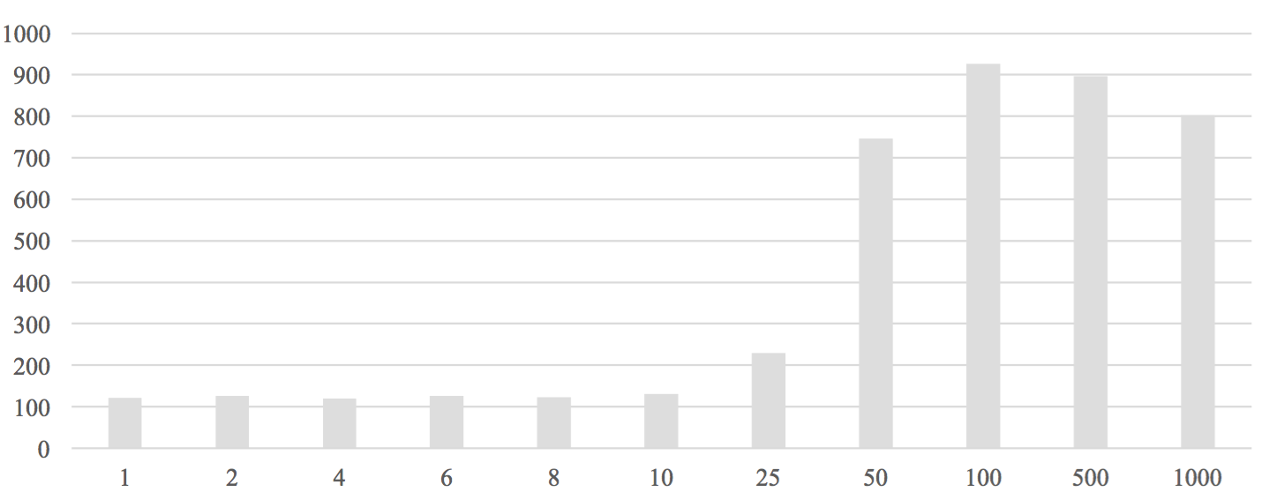
Response Time by Number of Transactions per Second

Slide 17
demo

