Slide 1
Matemática Computacional
#tecnologia
Matemática Aplicada à Computação; Matemática; Fundamentos de Computação; Modelagem Computacional

Slide 2
Table of contents
01
02
03
04
Problem-solving strategies
Mathematical modeling
Critical thinking skills and mathematical reasoning
Analyzing and interpreting mathematical models
Mathematics in everyday life
Mathematics and technology
Identifying mathematical concepts in real-world scenarios
Integration of technology tools in mathematical exploration

Slide 3
Introduction
In high school and middle school math lessons, students delve into various engaging topics. They explore problem-solving strategies, honing critical thinking and logical reasoning skills. Additionally, at that age, math lessons focus on the practical application of mathematics, revealing its role in everyday life
From mathematical modeling to the integration of technology tools, these lessons empower students to appreciate the versatility and relevance of mathematics across diverse contexts. Through this comprehensive approach, students not only master mathematical concepts but also develop essential skills for navigating the complexities of the modern world

Slide 4
01
Problem-solving strategies
Apply problem-solving strategies in various contexts

Slide 5
Analytical thinking
Break down
complex problems
Systematic and
logical approach
Cultivate the ability to break down complex problems into several manageable parts
A systematical and logical approach to mathematical problems is the foundation for many disciplines

Slide 6
Patterns, precision and problem-solving

Slide 7
Conclusions
Summarize key concepts
Recap the main mathematical concepts covered during the lesson
Real-world applications
Emphasize the practical relevance of the concepts and skills of the lesson
Preview next steps
Provide a glimpse into the upcoming lessons for continuity of learning

Slide 8
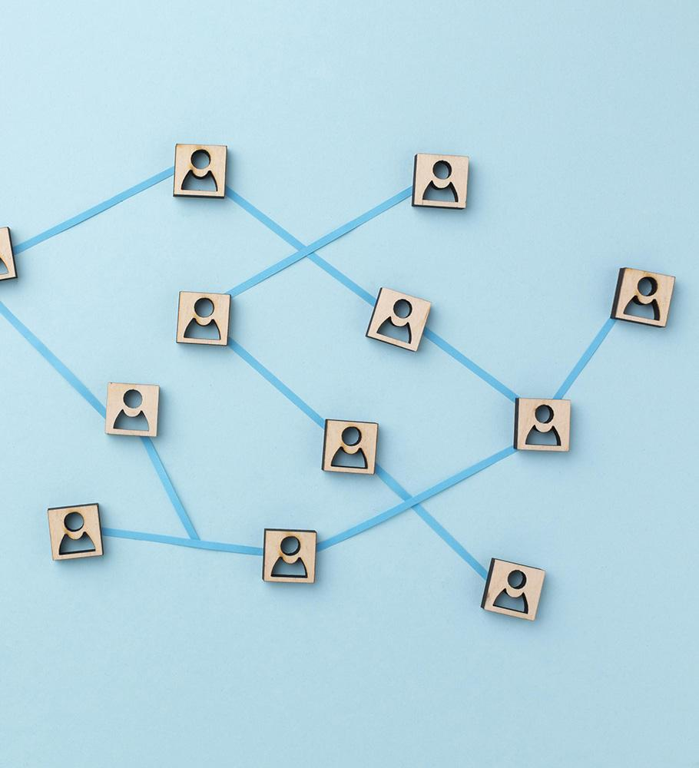
Mathematical investigation
Students will have to delve into a specific mathematical concept or problem, explore it in-depth, and present their findings
Choose a number sequence: Ask each student to select a number sequence that interests them
Investigate the pattern: Instruct them to explore the pattern within their chosen number sequence
Apply mathematical concepts: They should apply relevant mathematical concepts to their investigation
Solve problems: They have to create and solve problems related to their chosen sequence
Create a portfolio: Instead of a traditional essay, ask them to compile their findings into a portfolio and present it

Slide 9
Thanks!
Do you have any questions?
daniel.h.paiva@ulife.com.br

