Slide 1
A study of machine learning approaches to cross-language code clone detection
Daniel Perez M2
Chiba Shigeru Lab

Slide 2
Clone detection
Python function
Detect duplicated code in programs
Single language: programs in same language
Cross language: programs in different languages
Motivation for cross-language
Refactoring large systems
Sub-systems often use multiple languages
Code duplication may occur across sub-systems
def add(a, b):
return a + b
Java function
int add(int a, int b) {
return a + b;
}

Slide 3
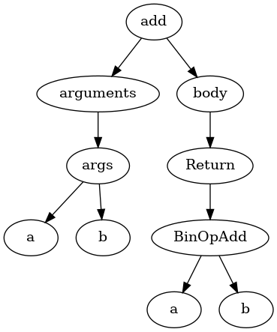
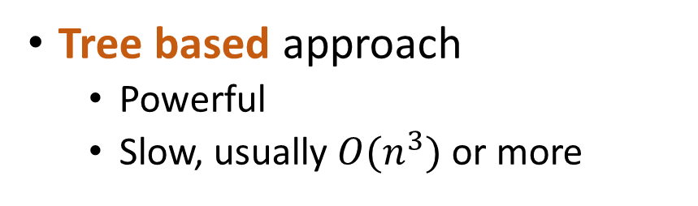
Current approaches to clone detection
Token based approach
Simple
Fast
Can lack expressiveness
Tree based approach
Powerful
Slow, usually $O(n^{3})$ or more
["def", "add", "(", "a", "b", ")", ":", "\n", "\t", "return", "a", "+", "b"]
Current approaches are designed for clone detection in single language

Slide 4
Case study: SourcererCC
Overview
Current state-of-the-art clone detection tool
Uses token based approach
Create reverse index of tokens
Match tokens in the code fragment with the index
Performs well for copy-paste induced code clones
Limits for cross-language code clones
Cross-language code clones usually share fewer tokens
Would at least need some kind of cross-language mapping

Slide 5
Difficulty of cross-language clone detection
Factorial in Java
Factorial in Python
public int factorial(int n) {
int result = 1;
for (int i = 2; i <= n; i++) {
result *= i;
}
return result;
}
def fact(n):
res = 1
for i in range(2, n + 1):
res *= i
return res

Slide 6
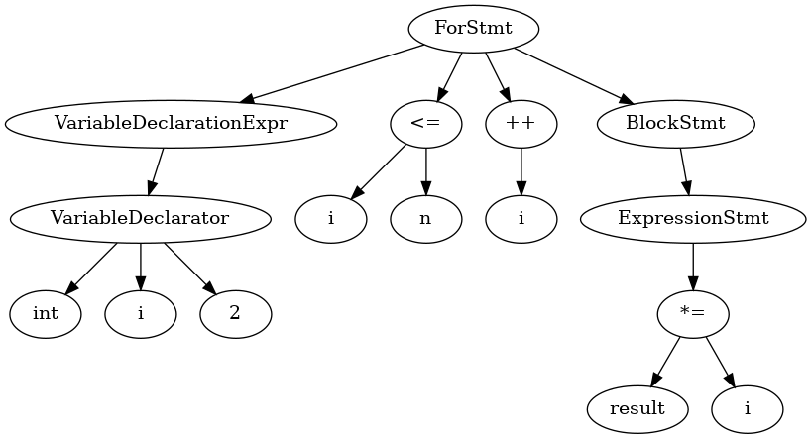
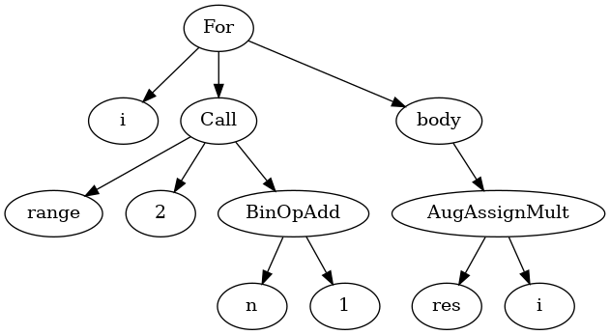
Difficulty of cross-language clone detection
Java factorial loop AST
Python factorial loop AST

Slide 7
Our proposal
General idea
Learn AST structure representation
Use learned representation for cross-language clone detection
Overview
Find a token-level vector representation
Use end-to-end supervised machine learning to learn AST representation

Slide 8
System overview
System currently supports Java and Python
Java AST
vector of indexes
token
embedding
LSTM
MLP
Clone prediction
Python AST
vector of indexes
token
embedding
LSTM
AST encoding
https://github.com/tuvistavie/suplearn-clone-detection

Slide 9
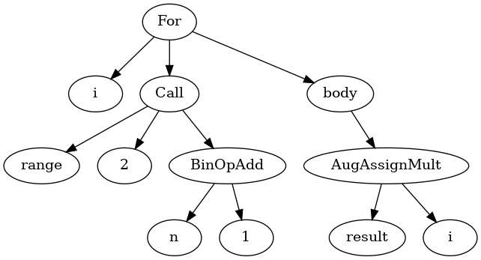
Token embeddings generation
We propose tree-based skipgram
Generate a vocabulary
For each “target” node, generate “context” nodes
Feed (target, context) as input, output of a single layer MLP
Use hidden layer as embeddings
For, i, Call, range, 2, BinOpAdd, n, 1, body, AugAssignMult, result
https://github.com/tuvistavie/bigcode-tools

Slide 10
AST encoding
Feed AST to recurrent neural network
Generate tokens sequence from AST using depth-first search
Map each token to its vector representation
Feed the sequence to an LSTM
Prefix depth-first traversal gave us the best results
Notes:
行き掛け順深さ優先探索

Slide 11
Token embeddings generation experiment
Dataset
Java: all Apache projects
~400k files
Apache2 license
Python: popular projects on GitHub
~150k files
Non-viral license (MIT, BSD, Apache)
Hyper parameters
Use identifiers or not
Ancestors window size: 1, 2, 3
Children window size: 0, 1, 2, 3
Include siblings or not
ML related parameters

Slide 12
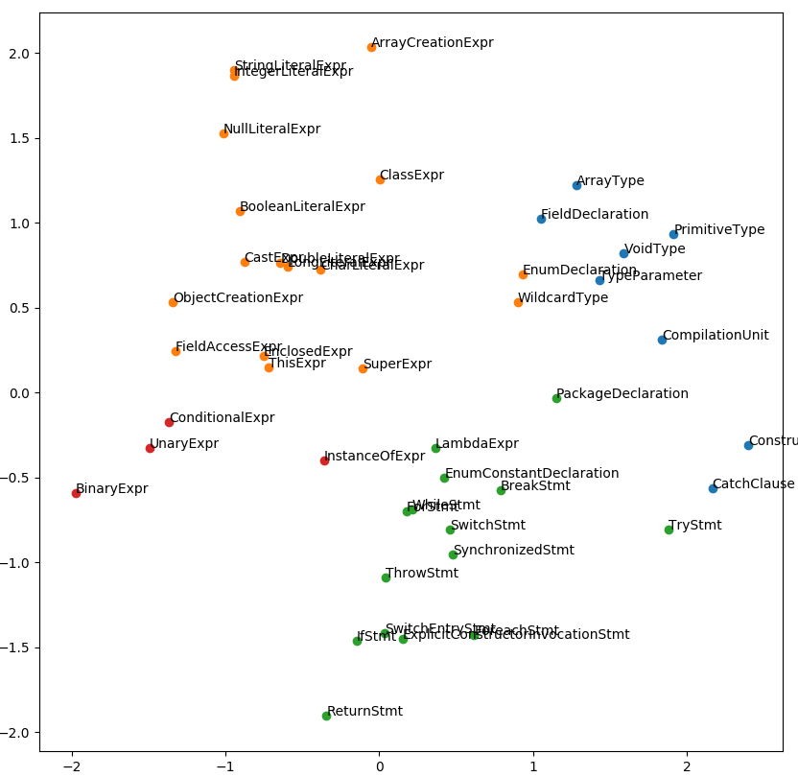
Java token embeddings results
Semantic somewhat preserved
Statement, expressions, declarations clustered more or less correctly
e.g. Token closest from ForStmt is WhileStmt
Hyperparameters results
Two level of ancestors works well
One level of children is enough
Siblings add too much noise

Slide 13
Clone detection experiment goals
Evaluate the effectiveness of trained embeddings
Tune our model and evaluate its capacity to learn clones
Compare our model performance with other clone detection tools

Slide 14
Dataset creation for clone detection
Dataset must have following properties
Python and Java implementation
Implement same functionality/program
Competitive programming is a good candidate
Scraped AtCoder¹ website
Measure | Value
Problems count | 576
Files count | 44,620
Avg. Files/problem | 77

Slide 15
Clone detection experiment results
Training and test with 20% of clones in samples
Java-Python clone detection
 | F1 | Precision | Recall
Pretrained embeddings | 0.66 | 0.55 | 0.83
Untrained embeddings | 0.61 | 0.49 | 0.82
No identifiers | 0.51 | 0.40 | 0.71
Cross-language is harder than single-language detection
Pre-trained embeddings help improving the model
Removing identifiers loses information
Java-Java clone detection
 | F1 | Precision | Recall
Pretrained embeddings | 0.77 | 0.67 | 0.92
Untrained embeddings | 0.73 | 0.65 | 0.85
No identifiers | 0.69 | 0.56 | 0.90

Slide 16
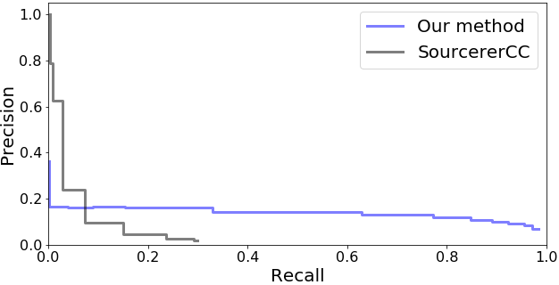
Comparison with SourcererCC
Java code clone experiments using our test set, about 1000 files Our method currently only takes pairs of code: 1000² samples for this experiment
Precision/recall curve
 | F1 | Precision | Recall
Our method | 0.21 | 0.12 | 0.85
SourcererCC | 0.05 | 0.63 | 0.03

Slide 17
Related work
Hui-HuiWei & al, Supervised Deep Features for Software Functional Clone Detection by Exploiting Lexical and Syntactical Information in Source Code, IJCAI’17
Single-language clone detection
Supervised learning approach
Tree-LSTM like model
Generates hash-code from AST
Kraft & al, Cross-Language Clone Detection, SEKE’2008
Uses common intermediate representation between languages
Detects clones between VB.NET and C#

Slide 18
Future work
Make better use of the AST structure
Try other models for encoding AST (e.g. Gated Graph Sequence NN)
Improve the system to be able to run in linear time
Add trainable hash layer to the model
Index hashed vectors using a reversed-index

Slide 19
Summary
Proposed a method to learn AST structure
Method and hyperparameters set to generate token level embeddings
End-to-end supervised learning model
Applied our idea to detect cross-language code clones
Cross-language code clone detection dataset
Trained model on code clone dataset
Source code available at
https://github.com/tuvistavie/bigcode-tools
https://github.com/tuvistavie/suplearn-clone-detection

Slide 20
Supporting slides follow

Slide 21
What is clone detection?
Detecting duplicated code in programs
Base technology for many applications
Intra-project: find duplicates in a single project
Find refactoring opportunities
Quality evaluation metrics
Inter-project: find duplicate from other projects
Copyright violation
Code search
Detect malicious software

Slide 22
Program representations
Source program
Token Representation
AST Representation
def add(a, b):
return a + b
["def", "add", "(", "a", "b", ")", ":", "\n", "\t", "return", "a", "+", "b"]

Slide 23
Type of clones
4 types of code clone
Type I: changes in spacing and comments
Type II: changes in identifier and literals
Type III: syntactically similar with changes in statements
Type IV: syntactically dissimilar with same functionality

Slide 24
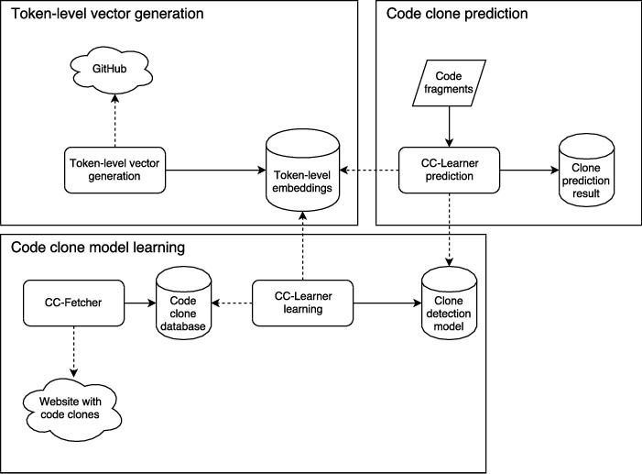
System overview

Slide 25
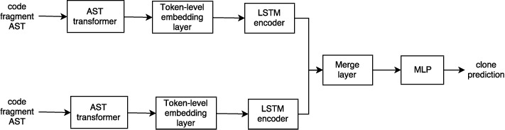
Model overview

Slide 26
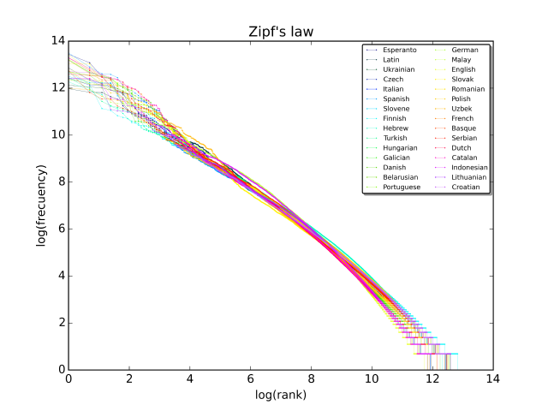
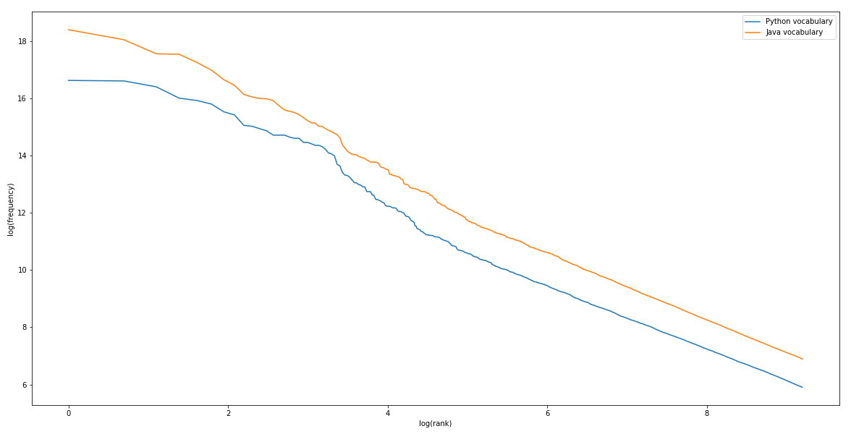
Zipf’s law
Frequency of any word is inversely proportional to its rank
Programming language frequency/rank log graph (not normalized)
Natural languages frequency/rank log graph
Source: https://en.wikipedia.org/wiki/Zipf’s_law

Slide 27
Model with hash layer
Java AST
vector of indexes
token
embedding
LSTM
Hash
Distance
Clone prediction
Python AST
vector of indexes
token
embedding
LSTM
Hash

Slide 28
Source code normalization
Remove identifiers
Remove custom types
public int add(Custom a, int b) {
return a.doSomething(b);
}
public int METHOD(TYPE VAR, int VAR) {
return VAR.METHOD(VAR);
}

Slide 29
Clone false-positive example
Code fragment 1
Code fragment 2
import java.util.Scanner;
public class Main{
public static void main(String[] args) {
Scanner sc = new Scanner(System.in);
int n = sc.nextInt();
int ans = Integer.MAX_VALUE;
for (int i = 1; i <= n; i++) {
int j = n / i;
ans = Math.min(
ans, Math.abs(i - j) + n - i * j); }
System.out.println(ans);
}
}
import java.util.*;
class Main {
public static void main(String[] args){
Scanner read = new Scanner(System.in);
int x = Integer.parseInt(read.nextLine());
int c = 0;
int sum = 0;
while (sum < x) {
c++;
sum += c;
}
System.out.println(c);
}
}

Slide 30
Embeddings hyperparameters
Parameter | Value
Ancestors windows size | 2
Descendants window size | 1
Siblings | False
Embeddings size | 100
Vocabulary size | 10000

Slide 31
Clone detection hyperparameters
Parameter | Value
Vocabulary size | 10000
Embeddings dimension | 100
LSTM | Stacked bidirectional ー {100, 50}
Multilayer perceptron | 1 layer, 64 units
Optimizer | Adam

Slide 32
Deckard, Jiang & al., ICSE’07
Tree-based clone detection
Rule-based vector generation for AST
Cluster vectors using LSH
Support multiple languages
Designed for single-language clone detection
Assume clones ASTs have similar structure

Slide 33
SourcererCC, Sajnani & al., ICSE’16
Token-based clone detection
Uses reversed-index to index tokens
Optimized for large-scale
Fast
Low memory
Assumes clones have large number of tokens in common
Works best for clones introduced by copy-paste

